Slide 1
Using data for investigations
VVOJ 2013
Jennifer LaFleur, Center for Investigative Reporting

Slide 2
Why data?
It takes you beyond the anecdote
It’s easier than counting sheets of paper

Slide 3
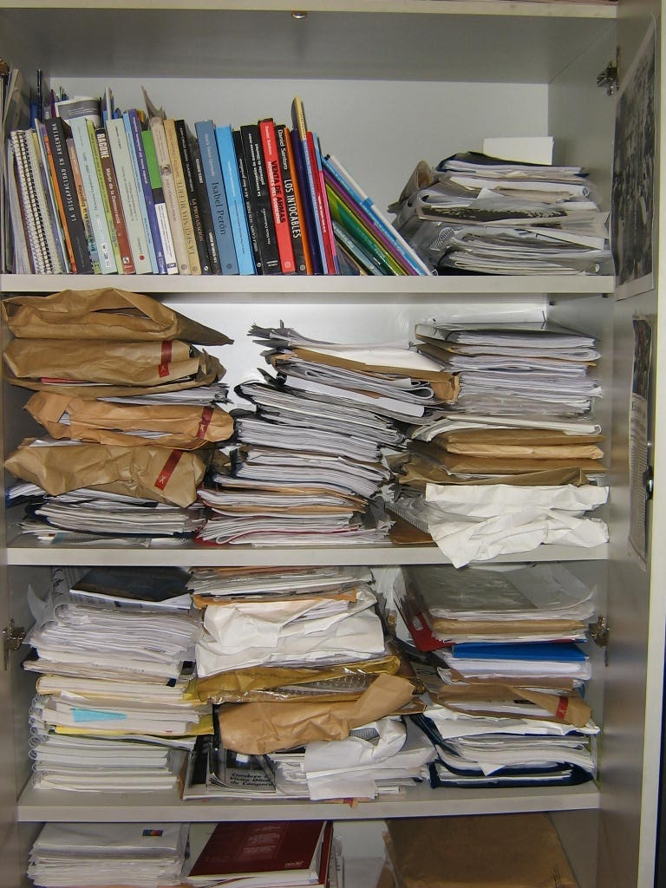

Slide 4
Why data?
Contrasts are in the data

Slide 5
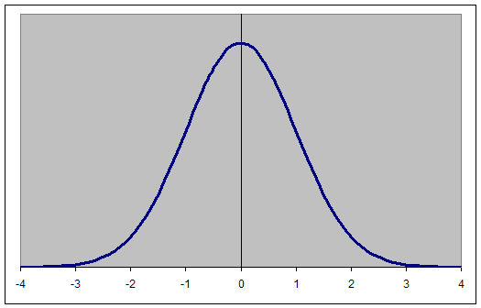
Caution: This slide contains extreme nerdiness

Slide 7
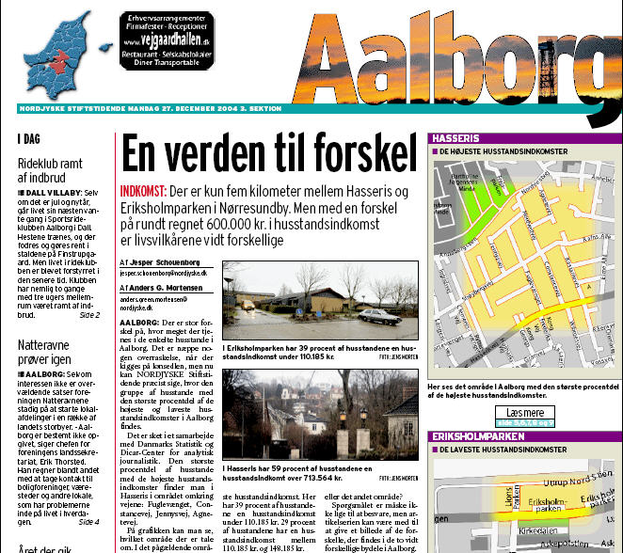

Slide 8
Why Computer-Assisted Reporting?
Contrasts are in the data
Your most powerful figures are in the data

Slide 9
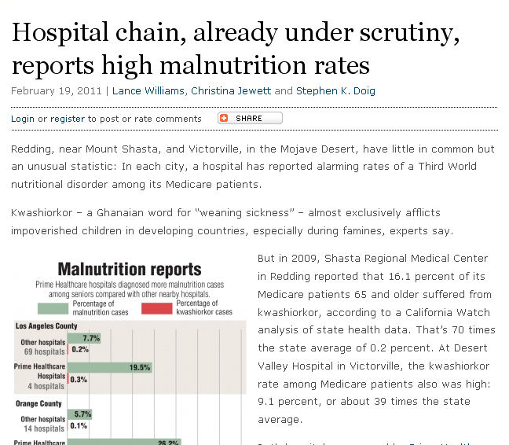
Source: California Health Dept. data, Medicare billing data
Findings: Some hospitals had “alarming rates of a Third World nutritional disorder among its Medicare patients.”

Slide 10
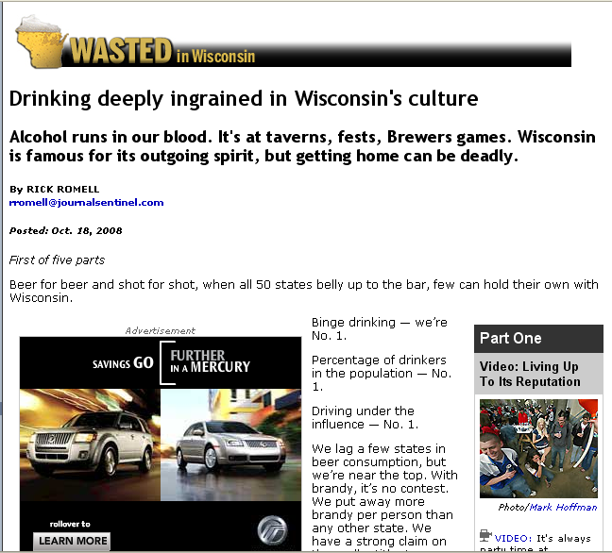

Slide 11
Why data?
Contrasts are in the data
Your most powerful figures are in the data
You can make connections you might not be able to make otherwise

Slide 12
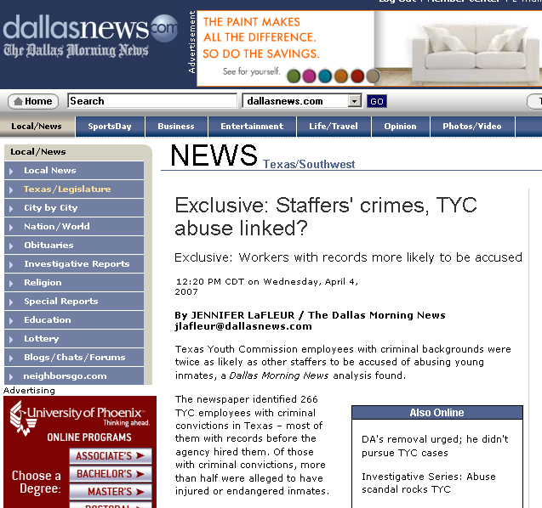
Data: Youth prison workers, criminal convictions and grievance data
Findings: Employees with criminal backgrounds were more likely to be accused of abusing inmates.

Slide 13
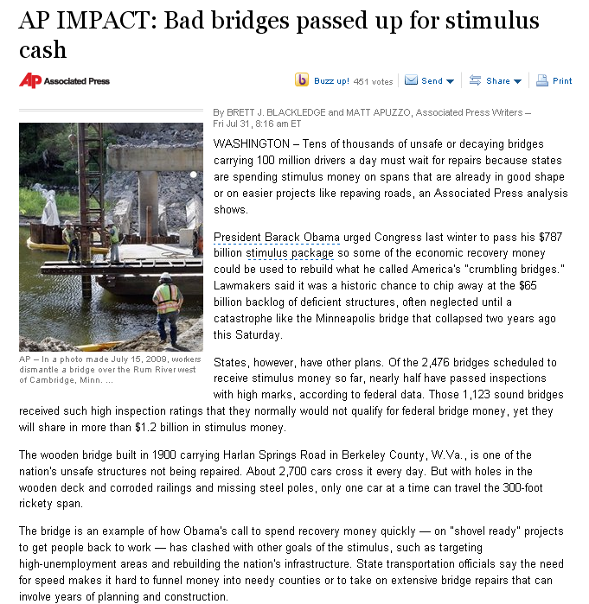
Data: Federal bridge inspections and stimulus funding.
Findings: Some of the nation’s worst bridges did not get stimulus funds.

Slide 14
Why data?
Contrasts are in the data
Your most powerful figures are in the data
You can make connections you might not be able to make otherwise
You can test assumptions

Slide 15
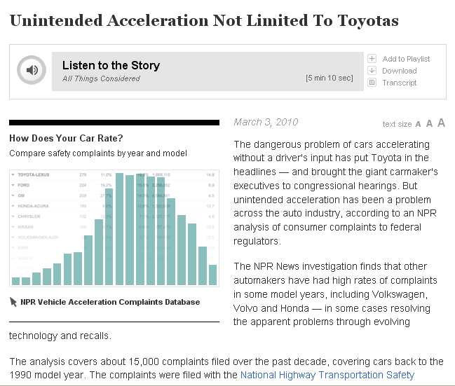
Source: NHTSA complaint data
Findings: “…unintended acceleration has been a problem across the auto industry.”

Slide 16
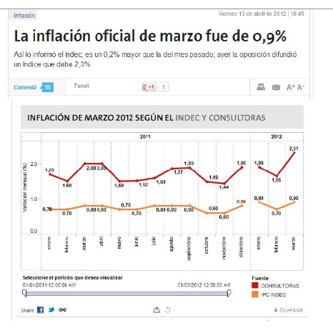

Slide 17
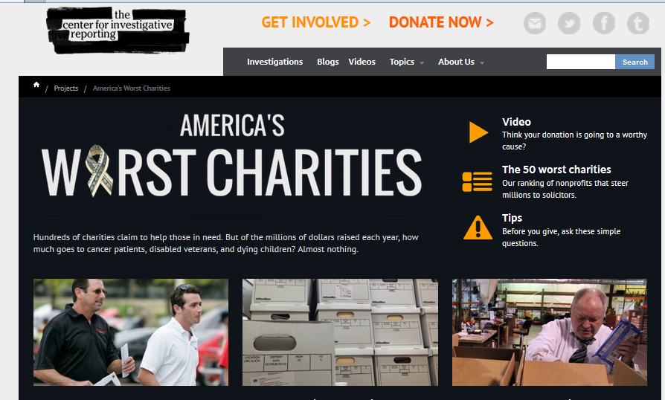

Slide 18
Collecting the data

Slide 19
Where’s the data?
If something is inspected
Licensed
Enforced or
Purchased
…There probably is a database

Slide 20
Where’s the data?
If there is a report
Or a form
There probably is a database

Slide 21
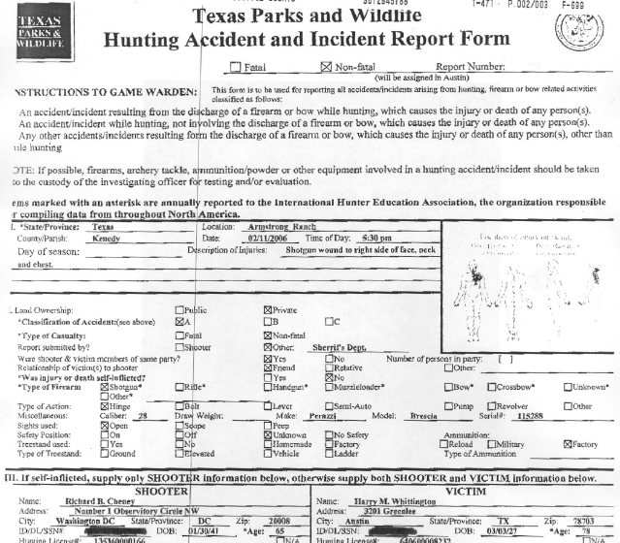
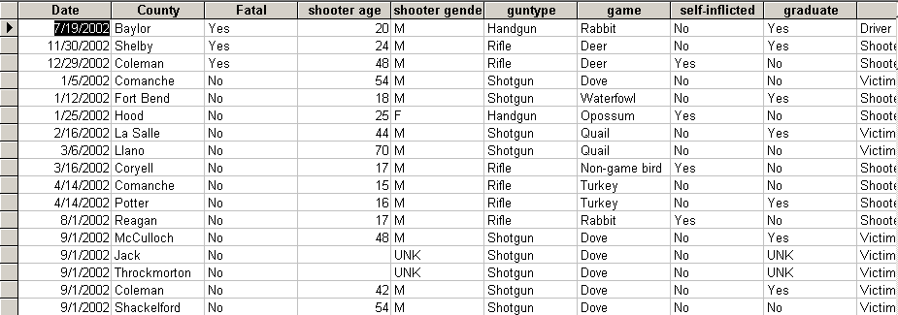

Slide 22
Where’s the data?
Sometimes data is readily available online for download

Slide 23
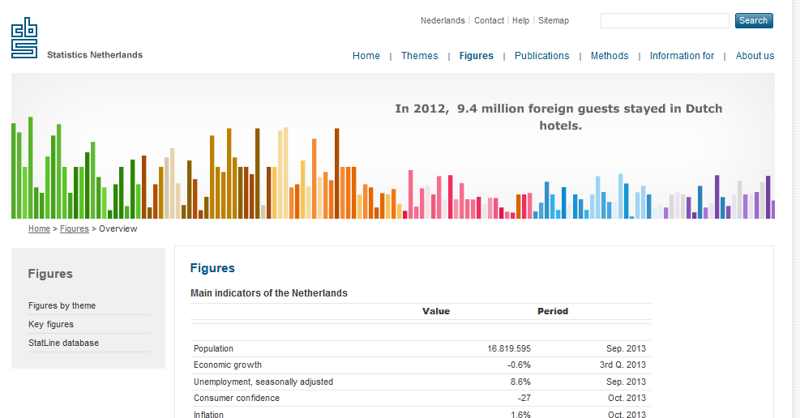

Slide 24
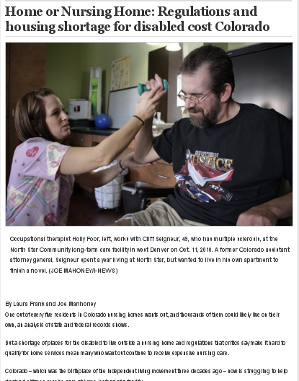
Source: Medicaid nursing home survey data and finance data, housing data
Findings: “…a shortage of places for the disabled to live outside a nursing home and regulations that critics say make it hard to qualify for home services mean many who want out continue to receive expensive nursing care.”

Slide 25
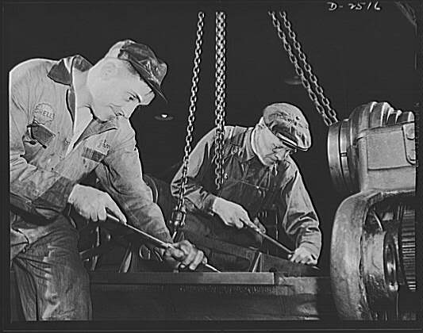
Where’s the data?
Sometimes you have to scrape it.
That usually involves programs that automate searching tasks on Web sites.

Slide 26
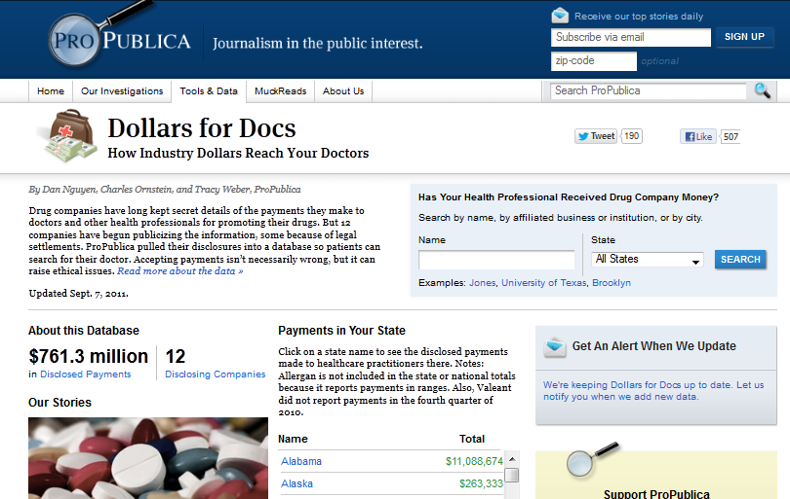

Slide 27
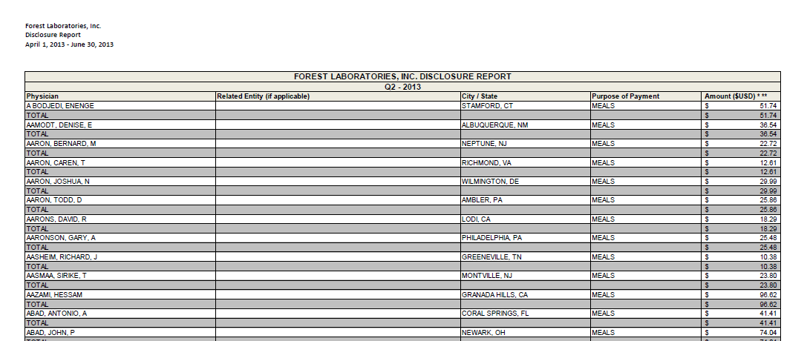
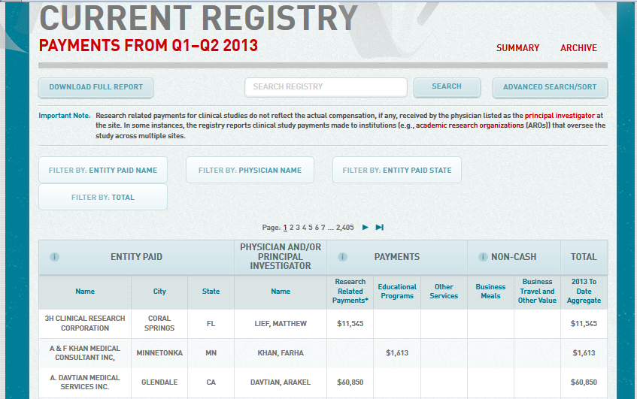

Slide 28
Where’s the data?
More often you need to go to an agency to get the data
This can be tricky if an agency doesn’t want to release it. (Stay tuned for more on that…)

Slide 29
Source: School district credit card purchases
Findings: District card holders made questionable purchases with their cards.

Slide 30
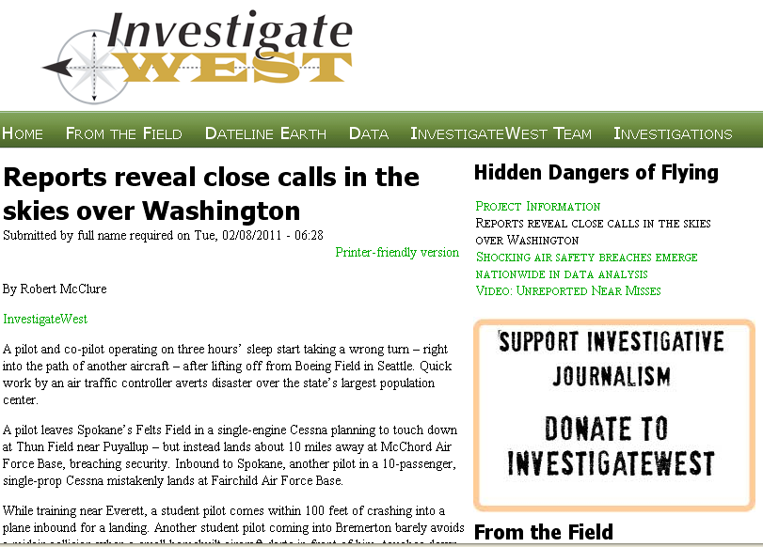

Slide 31
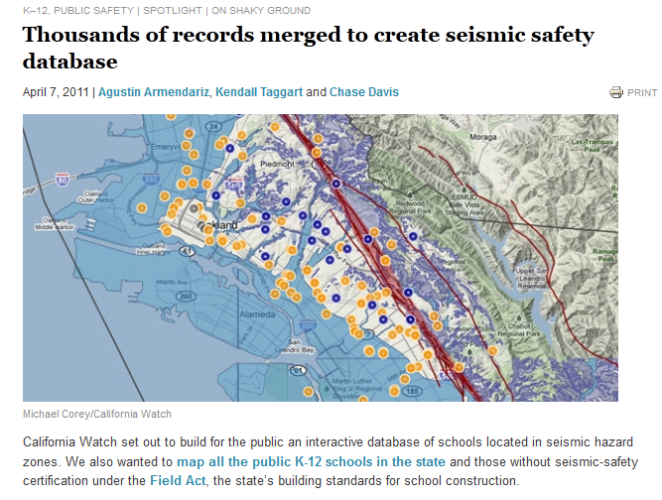

Slide 32
Sometimes, there is no data.
But it’s okay because there are techniques for sampling and building a database.
(more about that tomorrow)

Slide 33
Where’s the data?
Sometimes data enhances a story
But most of the time it’s the base that a story is built on
Stories don’t end at the data – we must find people to tell the stories

Slide 34
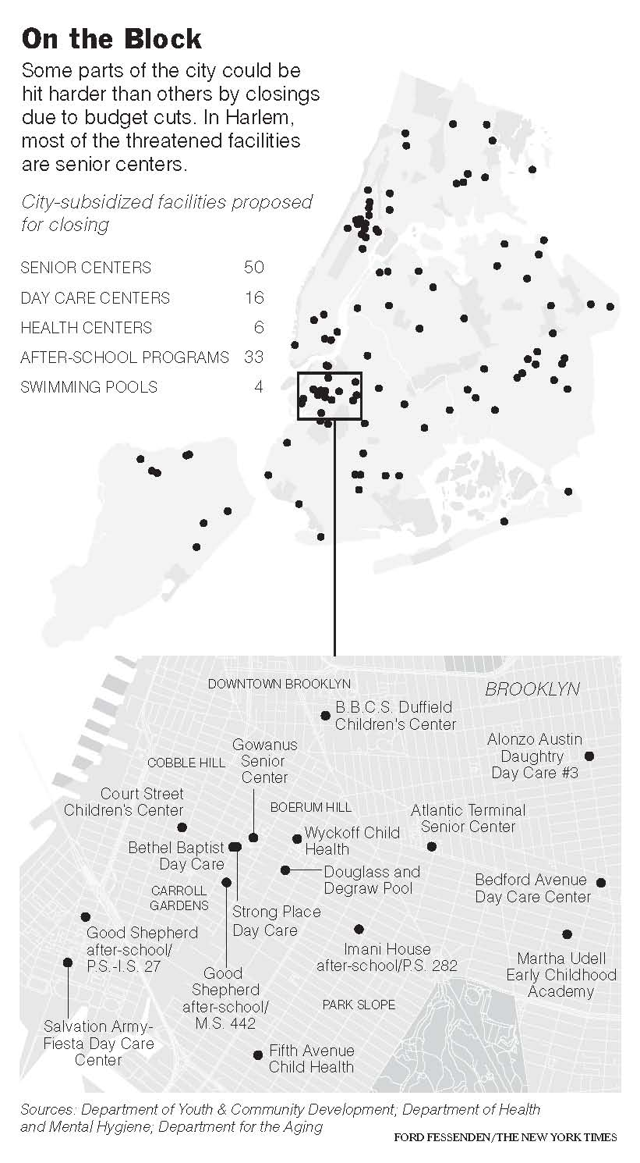
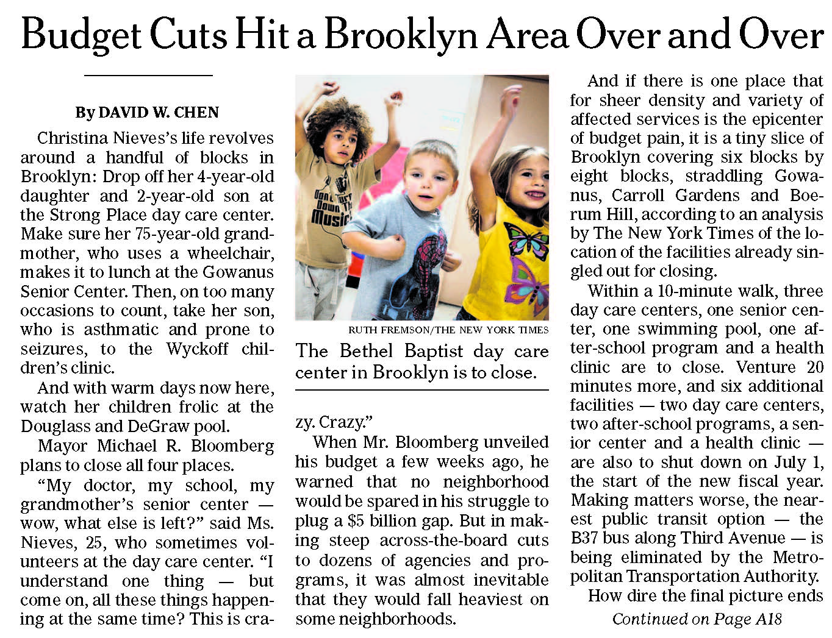
Source: City Budget
Findings: Some neighborhoods suffer more than others as mayor cuts budgets

Slide 35
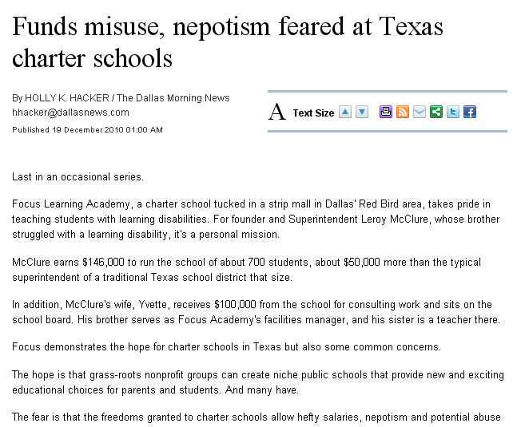
Source: Salary data and other charter school records
Findings: Reporters Found nepotism in charter schools and administrators earning six-figure salaries to run schools with only a few hundred or a couple of thousand students

Slide 36
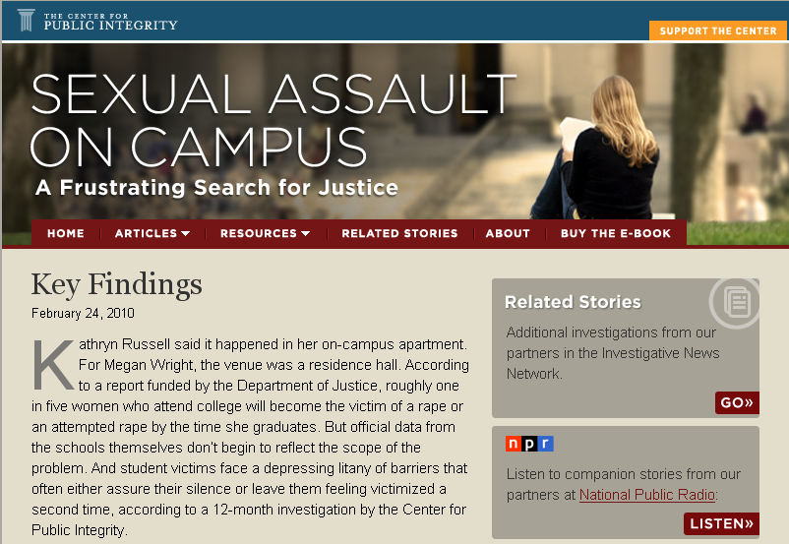
Source: Dept. of Ed data and surveys of campus crisis clinics
Findings: Many campuses had lax enforcement and reporting loop holes mean problems go unchecked.

Slide 37
Where’s the data?
The tools
Spreadsheets
Databases
Mapping
Statistics

Slide 38
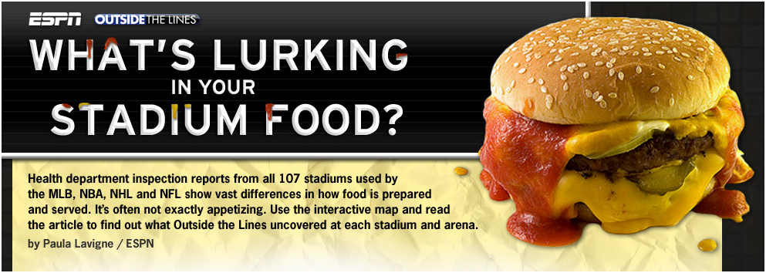
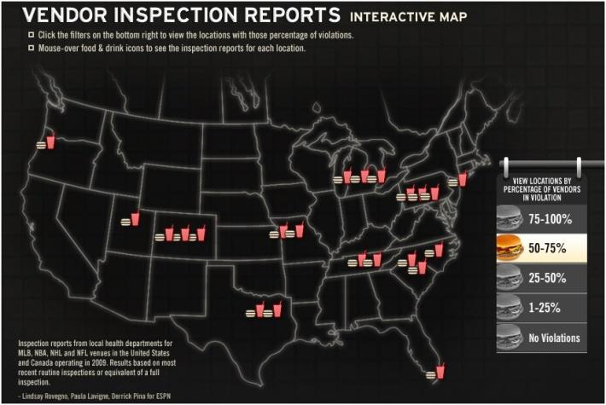
SOURCE: Local health department inspection reports
FINDINGS: At 28% of the venues, more than half of the concession stands or restaurants had been cited for at least one "critical" or "major" health violation.

Slide 39
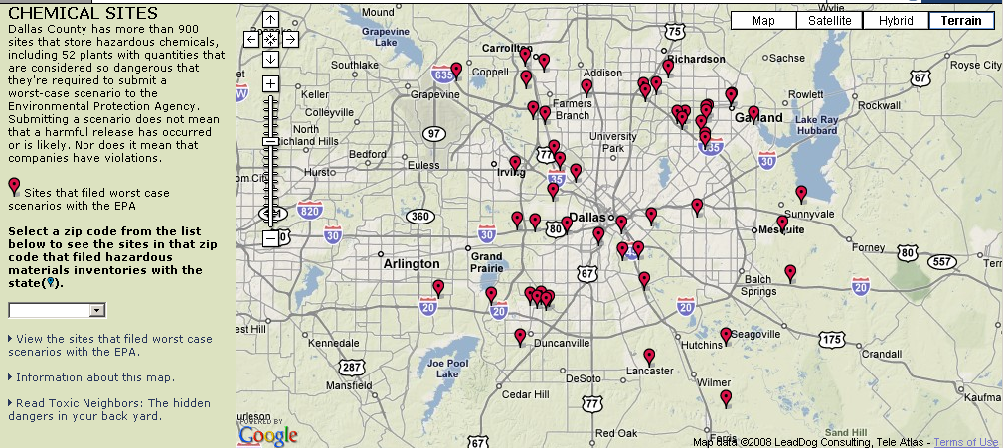
Source: EPA and state data on hazardous chemical locations
Findings: Dallas County has 900+ sites that store hazardous chemicals

Slide 40
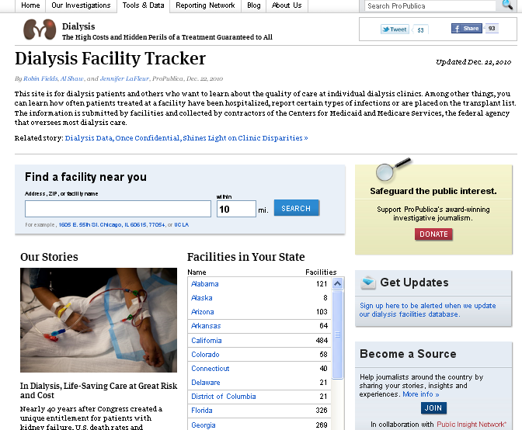
Source: Medicaid outcomes data for dialysis facilities
Findings: A CMS online tool did not tell the whole story about facilities. In some counties the gap in measures, such as survival rate were vast.

Slide 41
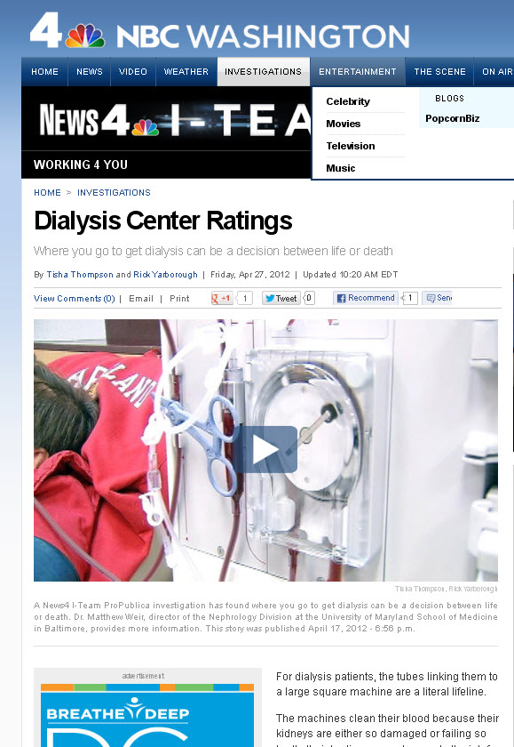

Slide 42
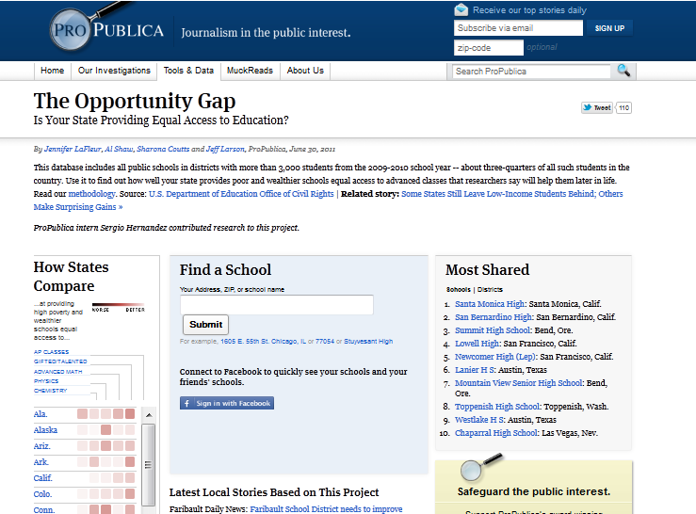
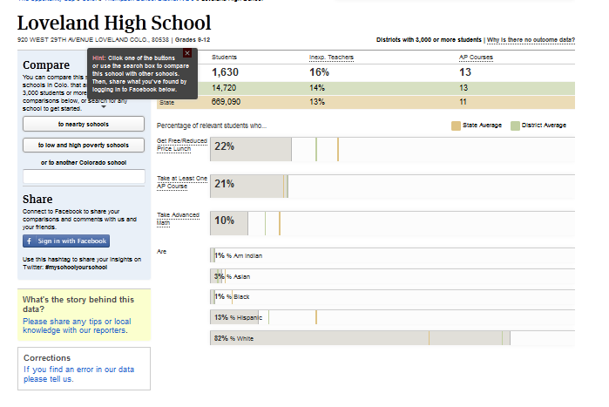

Slide 43
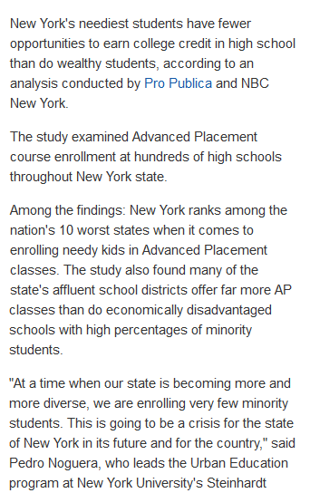

Slide 45
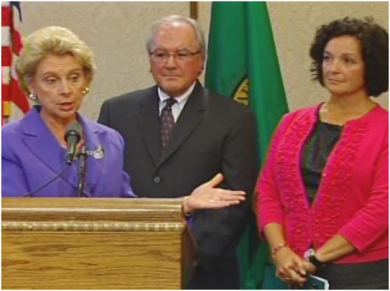
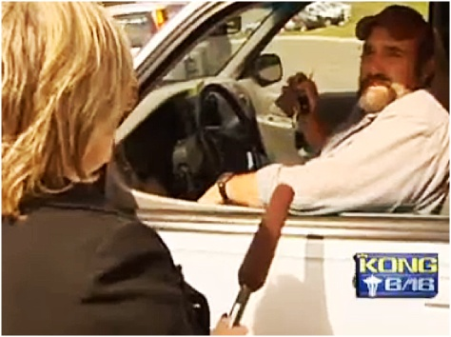
KING-TV Seattle
DATA: Payroll records, time sheets and other data and documents from Washington State Ferries.
FINDINGS: The rolling investigation uncovered serious problems within the country's largest ferry system - the Washington State Ferries. State employees ignored millions of taxpayer dollars in questionable spending. There was practically no internal review or accountability.

Slide 46
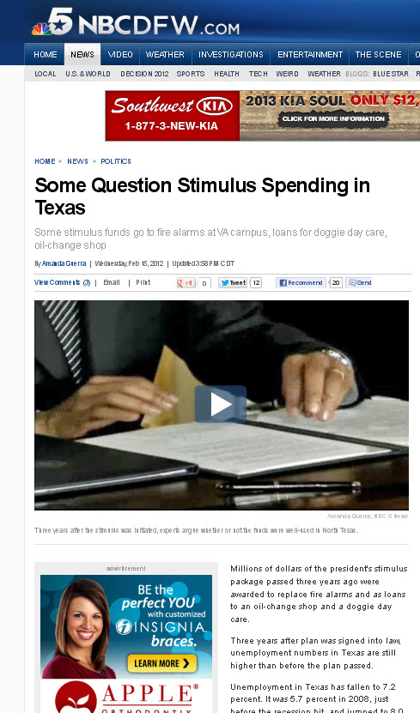

Slide 47
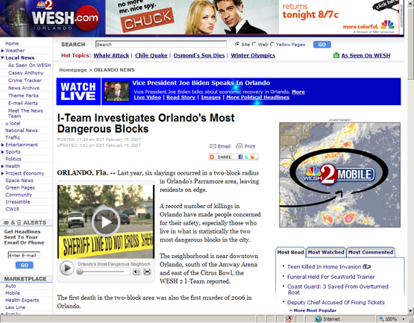

Slide 48
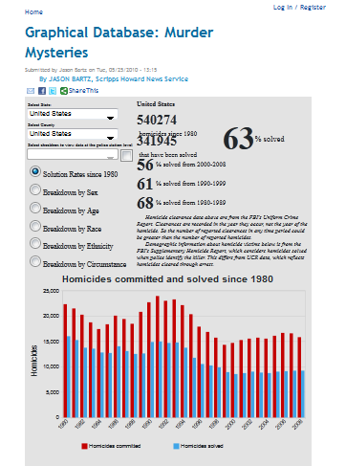
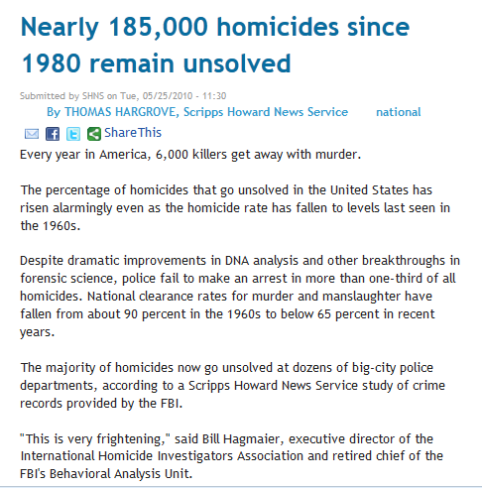

Slide 49
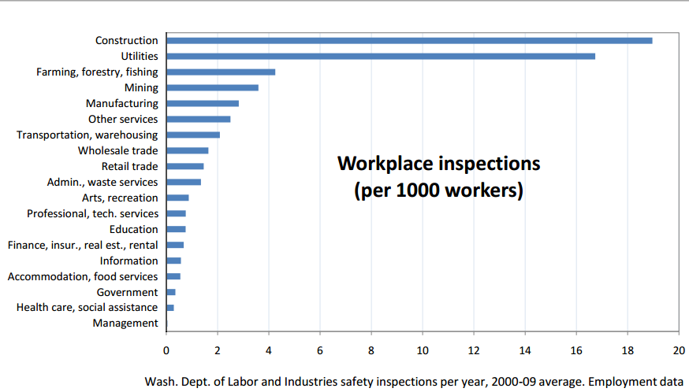
DATA: workplace safety inspections
FINDINGS: Workers in many dangerous industries get a small fraction of the attention from inspectors that construction workers do.
Two of Washington's
most injury–prone
industries get
Almost no attention
from workplace
safety
inspectors:
Nursing homes and
Hospitals

Slide 50
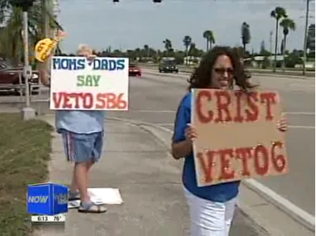
SOURCE: voter rolls, school staff list
FINDINGS: teachers living in Lee County, Florida didn't turn out as expected for the Lee County Supervisor of Election. 48% of staff vs. 53% voter turnout

Slide 51
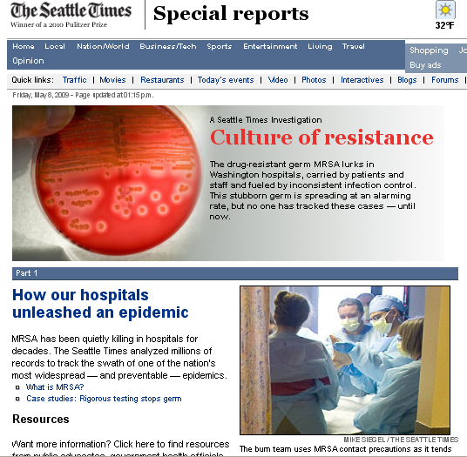
Source: Washington Health Department data
Findings: “MRSA has been quietly killing in hospitals for decades.” But no one had tracked it until this story.

Slide 52
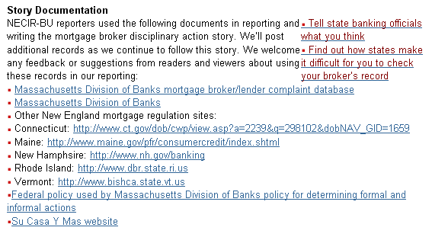

Slide 54
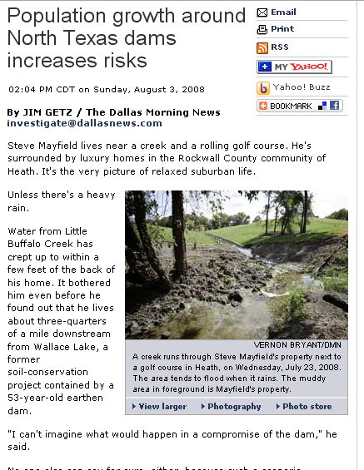
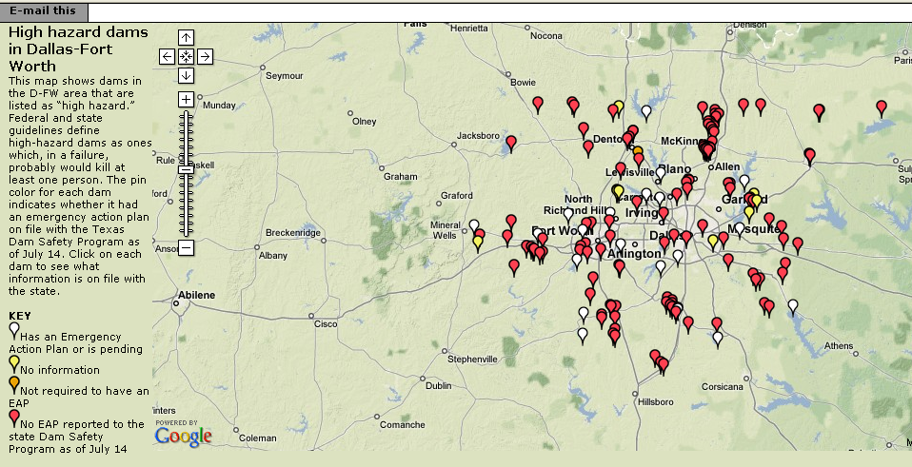
Source: Dam inspection data from Texas and federal government
Findings: Dam records had not been updated to account for population growth

Slide 55
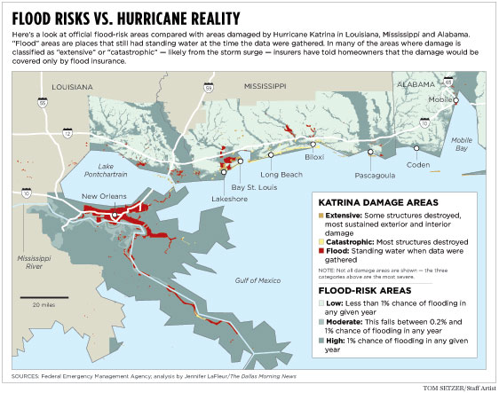

Slide 56
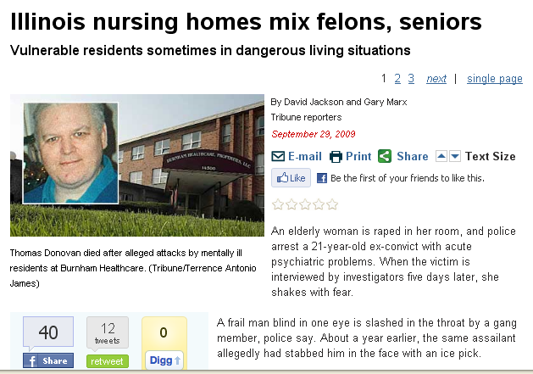
Source: Illinois health data, police data
Findings: Dangerous systemic failed to protect elderly patients in Illinois nursing homes that also house mentally ill younger residents, including murderers, sex offenders, and armed robbers.

Slide 57
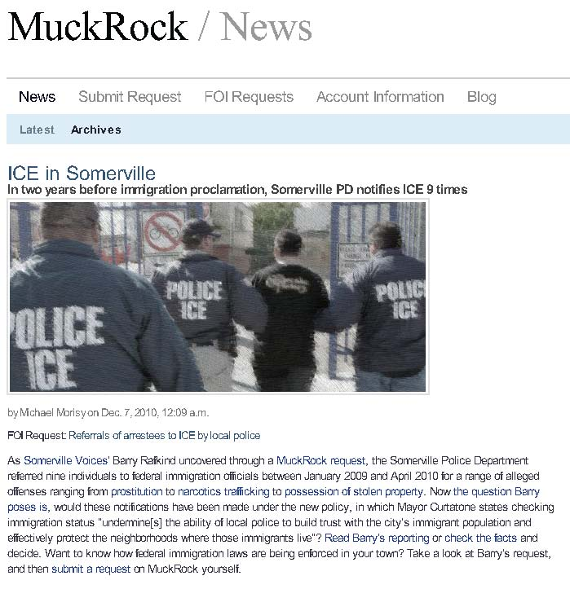
Source: ICE referrals
Findings: Somerville police referred nine individuals to federal immigration officials between January 2009 and April 2010 for offenses ranging from prostitution to narcotics trafficking to possession of stolen property.

Slide 58
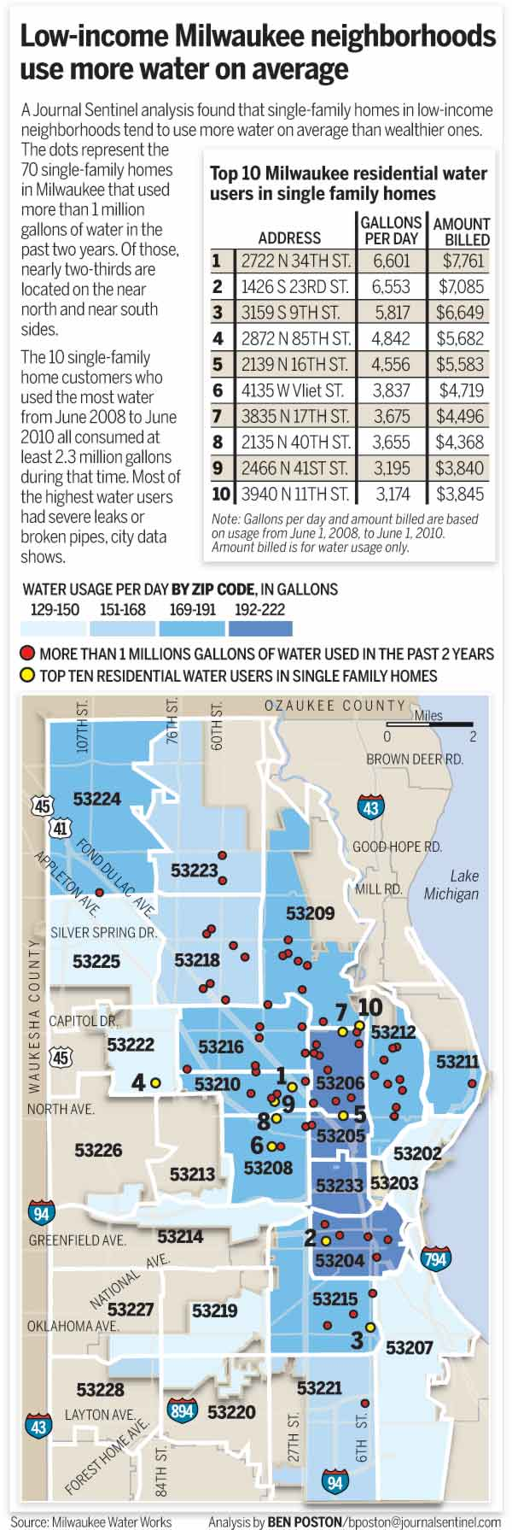
Disparities in water usage
“Water use highest in poor areas of the city”
Mapping and statistical analysis

Slide 59
Source: Federal jobs data
Findings: When Tories took power, the percentage of females began to drop.

Slide 60
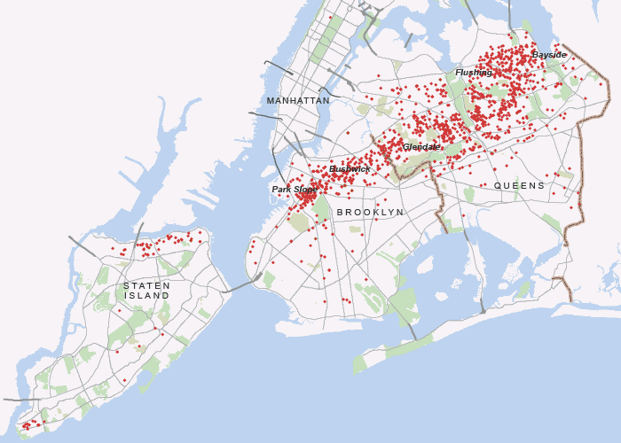
Source: 311 calls for downed trees
Findings: After a tornado swept across New York City, 311 calls for downed trees helps trace its path

Slide 62
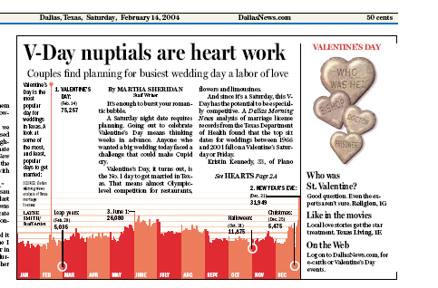

Slide 64
Just another way of saying no
Huge costs
Delay tactics
“Oh you silly little journalist”
Sending you the wrong thing
“Your request was unclear”

Slide 65
Our database is on a mainframe and it’s very complicated, Missy

Slide 66
That uses proprietary software.

Slide 67
We don’t keep that on computer

Slide 68
That information is protected by law

Slide 74
Jennifer LaFleur
jlafleur@cironline.org
@j_la28
www.cironline.org

