Slide 1
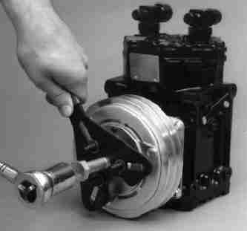
Ratchet up your investigation with statistics
David Donald, The Center for Public Integrity
Jennifer LaFleur, CIR

Slide 2
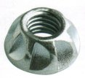
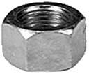
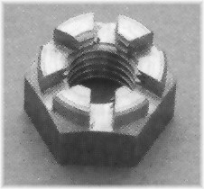
These may all be nuts

Slide 3
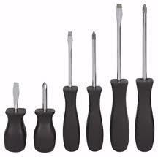
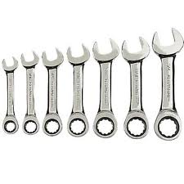
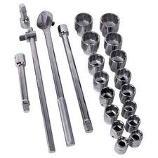
But they do different things and need different tools

Slide 4
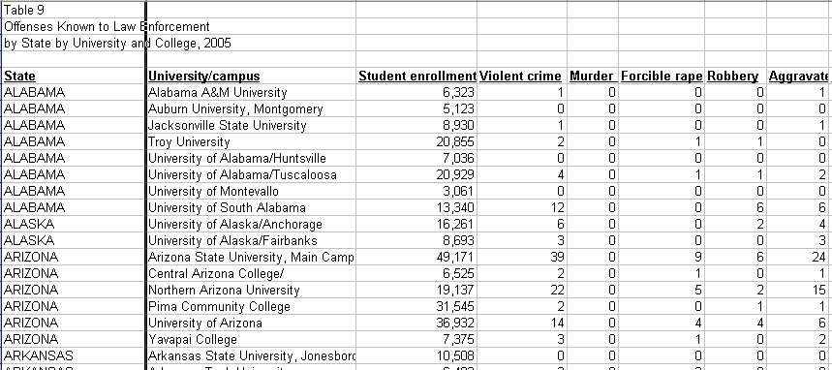
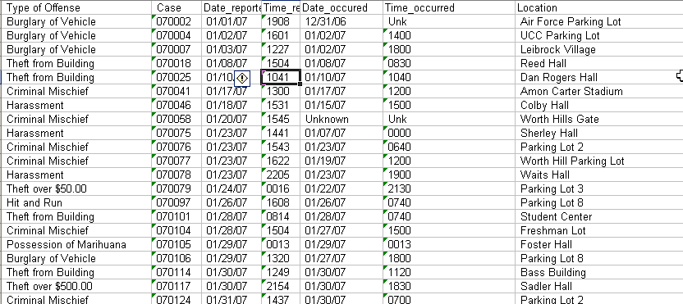
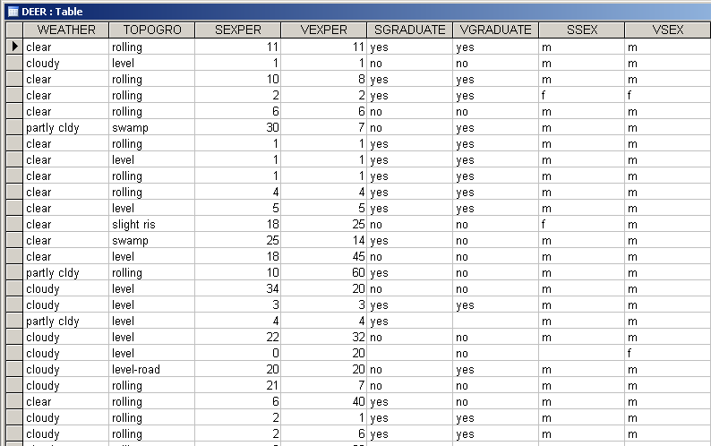
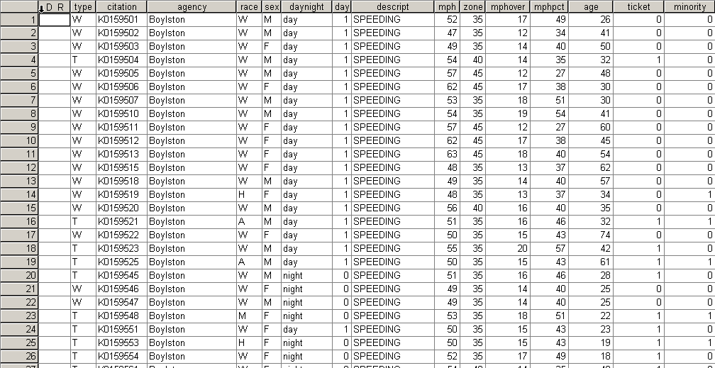
These may all be data

Slide 5
But they too require the right tool

Slide 6
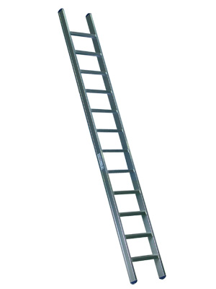
First step: Understand your data
Categorical data
Dichotomous: yes/no, 1/0

Slide 8
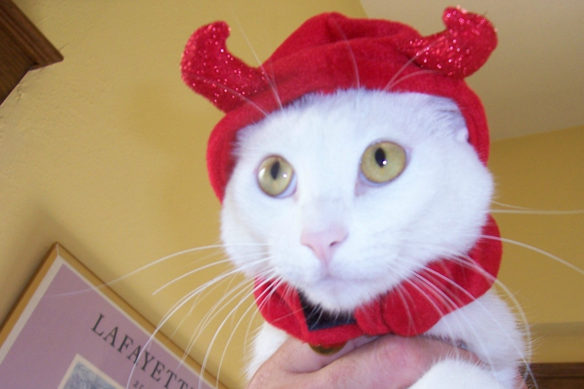
On
Off
←UP
DOWN→

Slide 9
Next step: Know what you can do with it
Frequencies

Slide 10
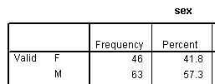
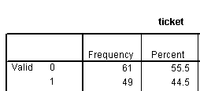

Slide 11
Categorical →Dichotomous
Frequencies
Cross-tabs

Slide 12
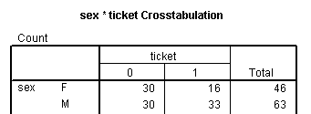

Slide 13
Stepping up the data ladder
Categorical data
Dichotomous: yes/no, 1/0
Multiple categories

Slide 16
Categorical → Multi-categorical
Frequencies

Slide 17
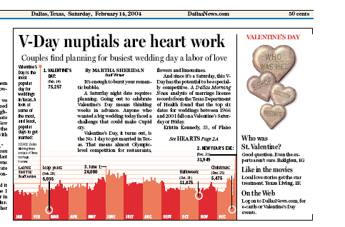

Slide 18
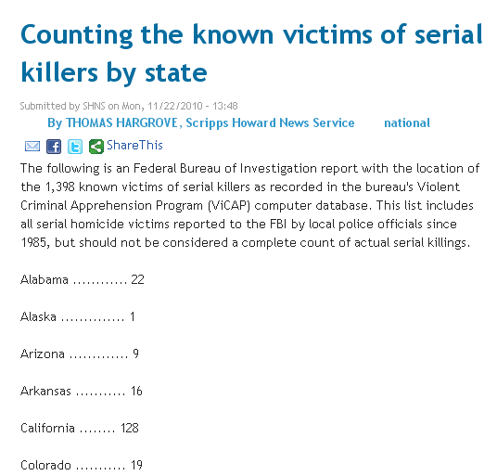

Slide 19
Categorical → Multi-categorical
Frequencies
Cross-tabs

Slide 20
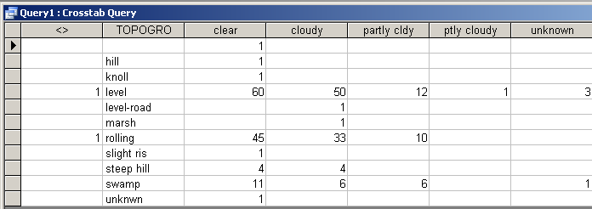

Slide 21
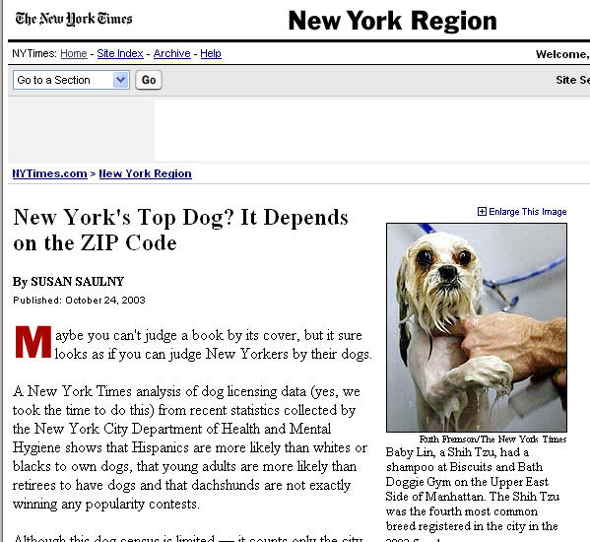
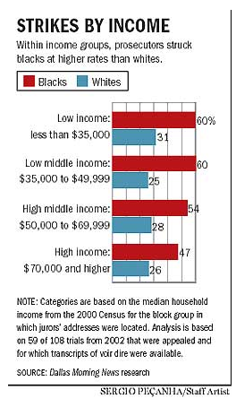

Slide 22
Stepping up the data ladder
Continuous data
Categorical data
Dichotomous: yes/no, 1/0
Multiple categories

Slide 24
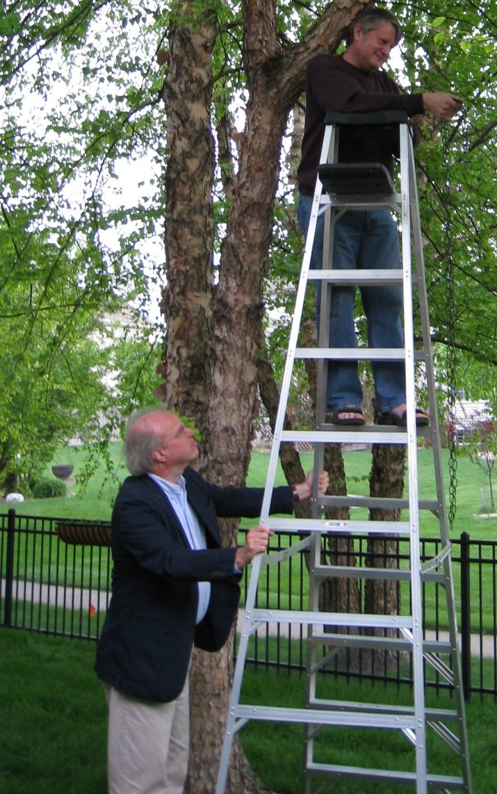
Working with continuous data
Continuous data
Mean
Median
Range
Rank

Slide 25
MPH
Mean: 54.63
Median: 54.09

Slide 26
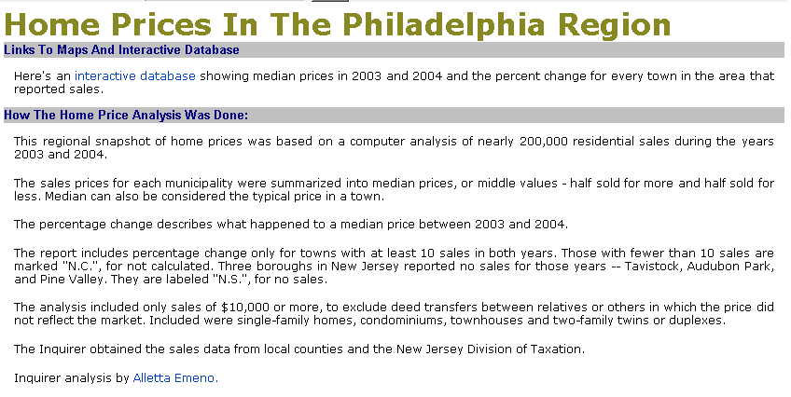

Slide 27
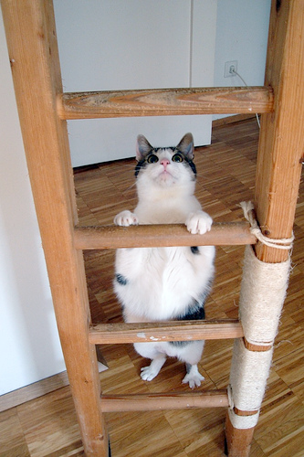
But wait! There’s more
More with continuous data
N-tiles
Rates
Correlation
Regression

Slide 28
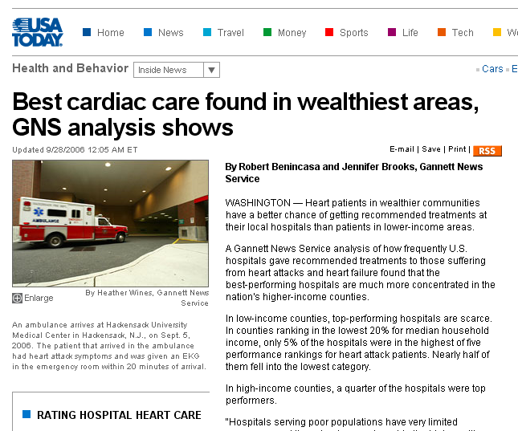
Correlation

Slide 29
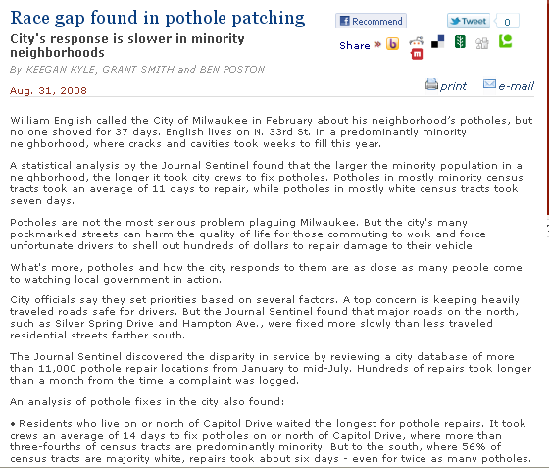

Slide 30
Distribution

Slide 31
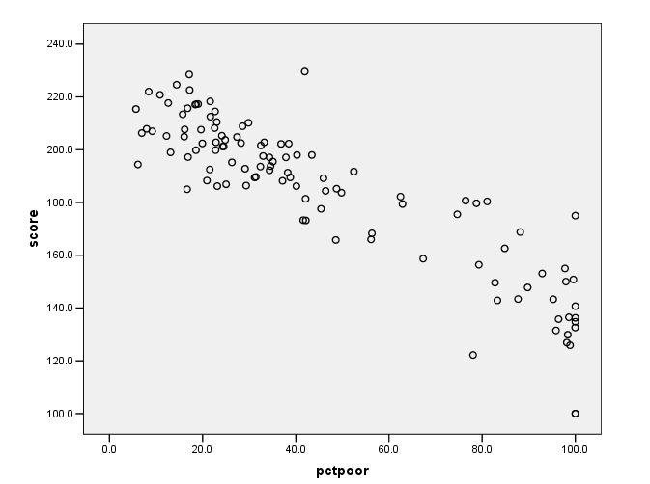
Regression

Slide 32
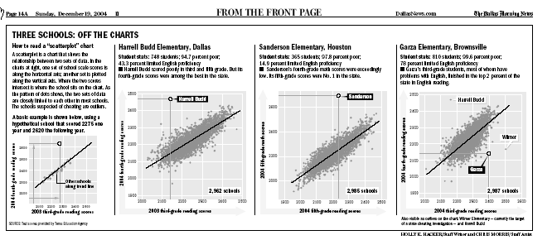
Regression

Slide 33
Regression
When you run a regression, you get a result called an R-square. That will help you see how much the independent variable predicts the dependent variable.
Model Summary
Model
R
R Square
Adjusted R Square
Std. Error of the Estimate
1
.911(a)
.830
.829
10.8330
83 percent of the variation in test scores is explained by change in poverty

Slide 34
Regression
Then use that information to “adjust” the data or to see if entities are doing better or worse than they should.

Slide 35
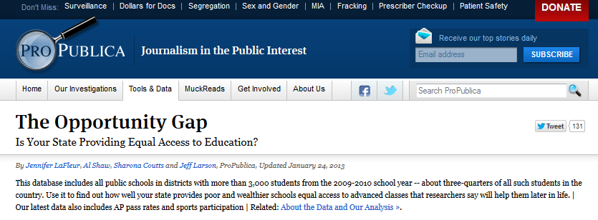
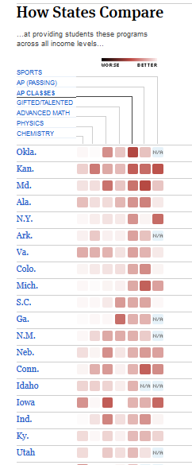

Slide 36
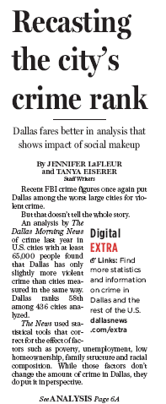
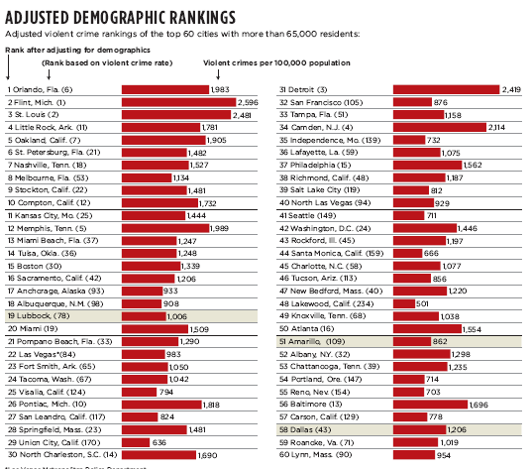

Slide 37
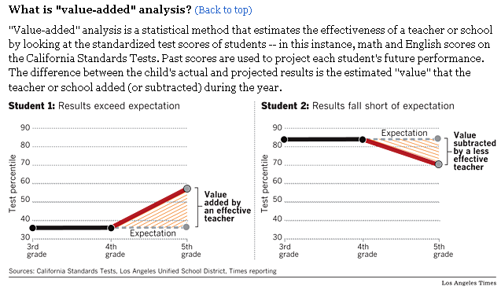

Slide 38
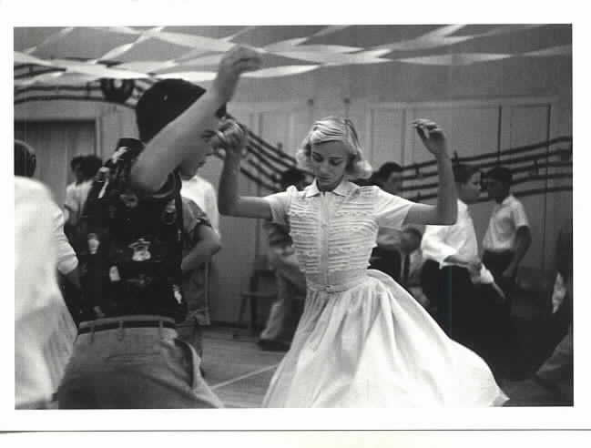
Mixing it up
Categorical and continuous
T-tests or nonparametric tests can be used to compare two groups

Slide 39
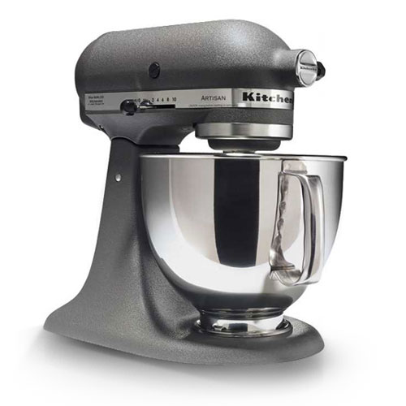
Mixing it up
Categorical and continuous
ANOVA – analysis of variance
Good for comparing more than 2 groups
Is variation across groups greater than within groups

Slide 40
Mixing it up
Categorical and continuous
AND your outcome variables is dichotomous
Logistic regression

Slide 41
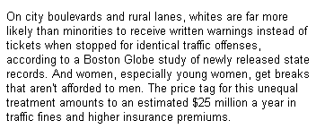

Slide 43
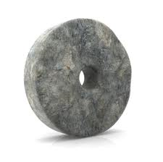
Don’t reinvent the wheel Know the tools (or find them)

Slide 44
Index
A measurement of movement used to simplify or compare a set of numbers

Slide 47
Indexes
FBI Crime index: total of seven crimes
Diversity Index: probability that two people pulled out of a given area would be of the same race
Herfindahl-Hirshman Index: measures competition in a market
Gini Coefficient: measures income disparity

Slide 48
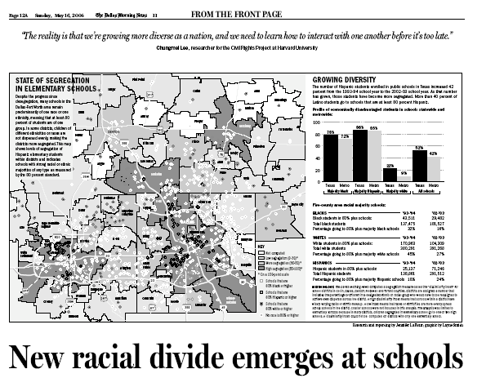

Slide 49
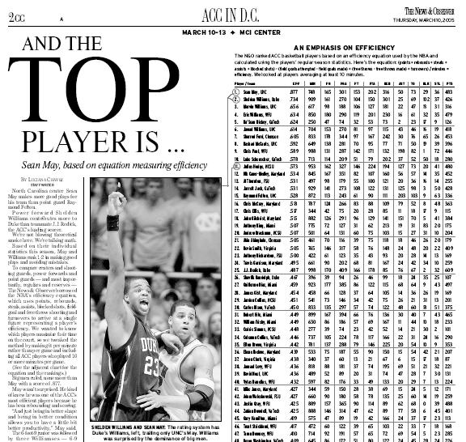

Slide 50
How to build your own index
Make sure what your index is valid. Here’s an example:
No index measures people’s attitudes toward pro-development versus pro-environment. And it’s hard to ask people up front, which are you?
One way is in a survey to ask a bunch of questions on a scale, such as whether more material consumption makes happier people. You ask on a scale of 1-5 if you agree or disagree with the statement.

Slide 51
Your own index
Say you ask questions along this line. Then you can see if they correlate.
You want some correlation but not too much. a Pearson “r” between .2 and .5
Run a test called Chronbach’s Alpha to examine affect each question has on the others. You want the score to be above .7 at least, .8 is better.
If you find that to be met, then you can average the scores on the seven questions (or however many correlate) and come up with one score that measures your difficult concept.

Slide 52
Your own index
Using a panel of questions and a statistical test known as Cronbach’s Alpha, David Donald, then with the Savannah Morning News , showed that those who are most pro-development were lower income people, those who had been left out of the American Dream. Material success apparently allows you to become more pro-environment.

Slide 53
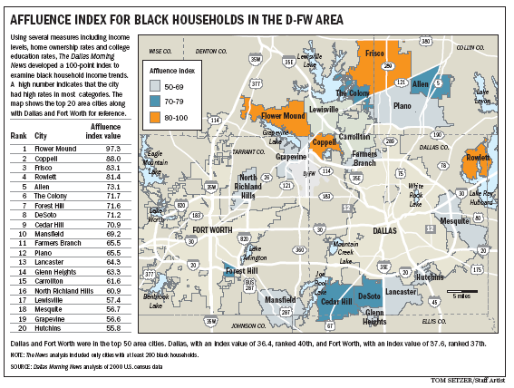

Slide 54
Knowing all of these tools can get confusing

Slide 55
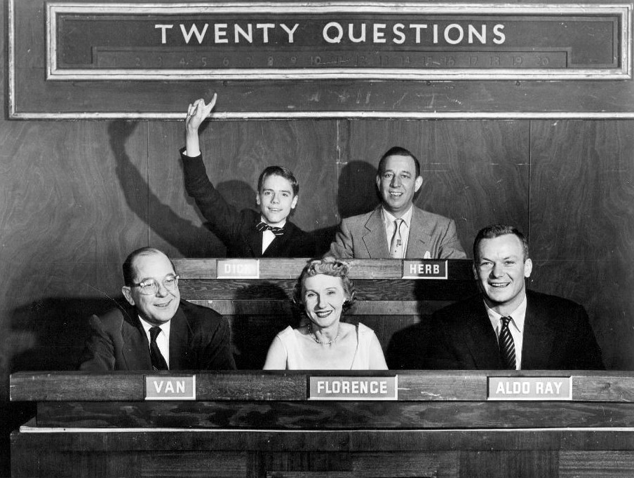
So when you’re not sure which tool to use, ask someone.

Slide 56
Dos and Don’ts
Put your findings in terms readers can understand
Explain your methodology
Put complicated numbers in graphics
Duplicate your results
Duplicate your results

Slide 57
Dos and Don’ts
Watch your wording:
A farm city of 122,000 known as the "Salad Bowl of the World," Salinas had become a cornucopia of gang violence. The number of gangs more than tripled since 1990. In 1994, the per-capita murder rate in Salinas, largely attributed to warring gangs, surpassed that of San Jose, at 38 and 24 respectively.

Slide 58
Dos and Don’ts
Bounce findings off experts/targets
Don’t say significant – when you don’t really now (but you can test for that)
Beware the spurious correlation
While your analysis may generate lots of Rs and Ps --- you may want to go back to descriptives in print.

Slide 59
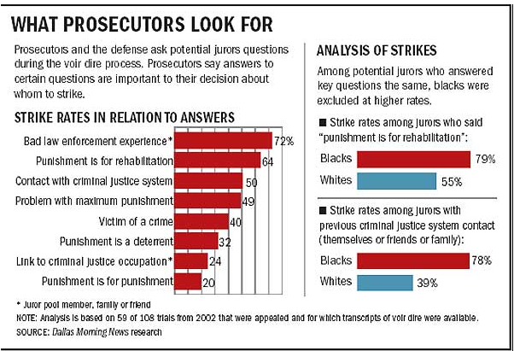

Slide 60
Questions?

