Slide 1
What to do when you can’t get all the data
VVOJ 2013
Jennifer LaFleur, CIR

Slide 2
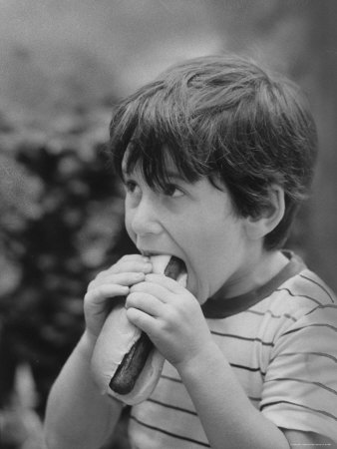
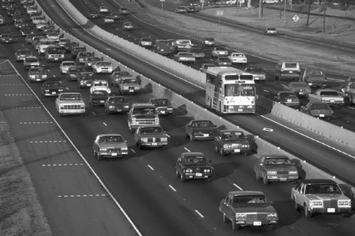
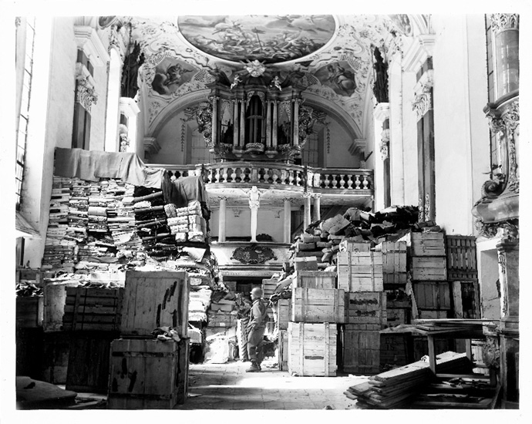
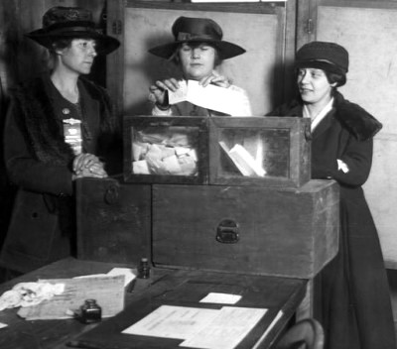
Sometimes data is not in rows and columns

Slide 3
But there are ways to gather data…
Sampling
Building from documents
Physical surveys
Testing
Questionnaires, polls and surveys

Slide 4
Sampling Considerations
What’s the universe?
How will you draw the sample?
How will you get the items, docs or data?
How far will you want to break it down?
What sort of accuracy do you need?

Slide 5
Sampling Considerations
Random sample – Ever item has an equal chance of being included.
Rand() function in Excel, then sort
SPSS and other statistics programs will pull a random sample

Slide 6
Sampling Considerations
Random sample – Ever item has an equal chance of being included.
Rand() function in Excel, then sort
SPSS and other statistics programs will pull a random sample

Slide 7
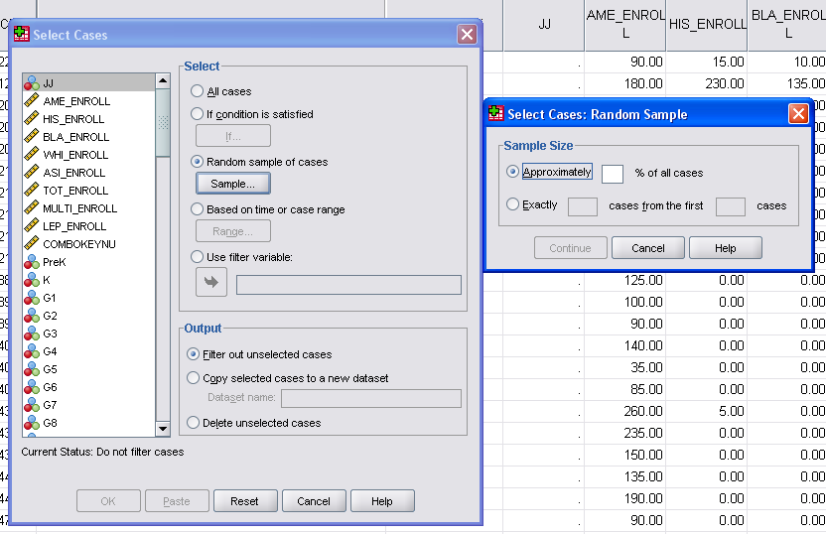

Slide 8
Sampling Considerations
Systematic sample – Pulling every Nth record.
Stratified sample – pulling your sample based on another underlying number – such as population.
Rather than pouring all the records for four counties in a pot and pulling randomly – you pull a random sample from each county.
Oversampling – pulling more of a particular group in order to do further research with that group

Slide 9
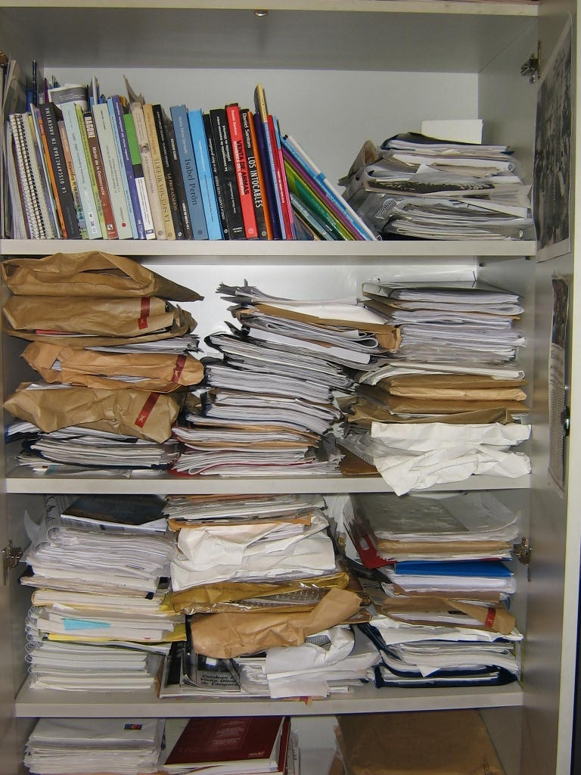
It might even help in these situations

Slide 10
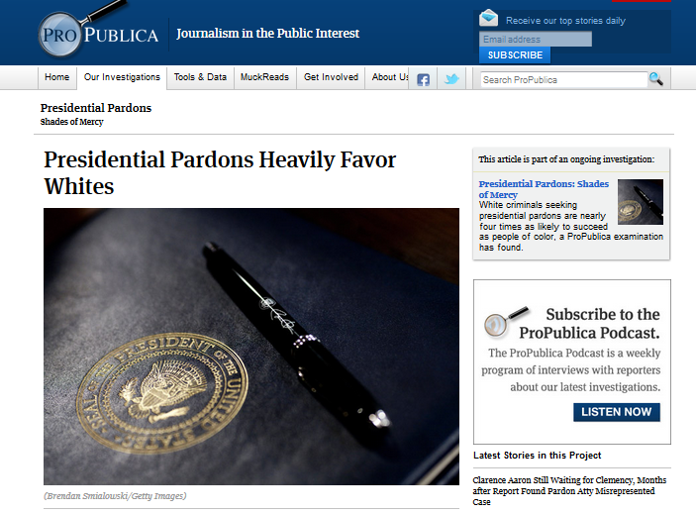
White criminals seeking presidential pardons were nearly four times as likely to succeed as minorities.

Slide 11
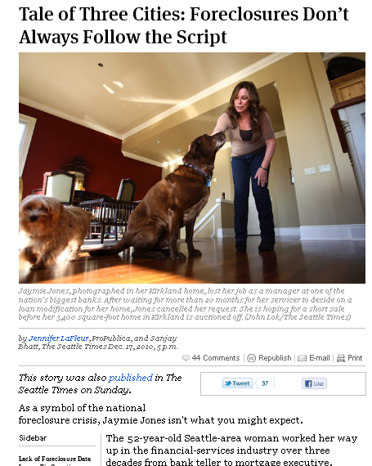
ProPublica and The Seattle Times wanted to study foreclosure patterns in three U.S. cities, but much of the information we needed was scattered in various paper and electronic files. So we pulled a random sample of foreclosure filings from each city.

Slide 12
The Dallas Morning News used a random sample of non-capital murder cases to build a database based on hard-copy juror questionnaires and coding of voir dire transcripts.

Slide 13
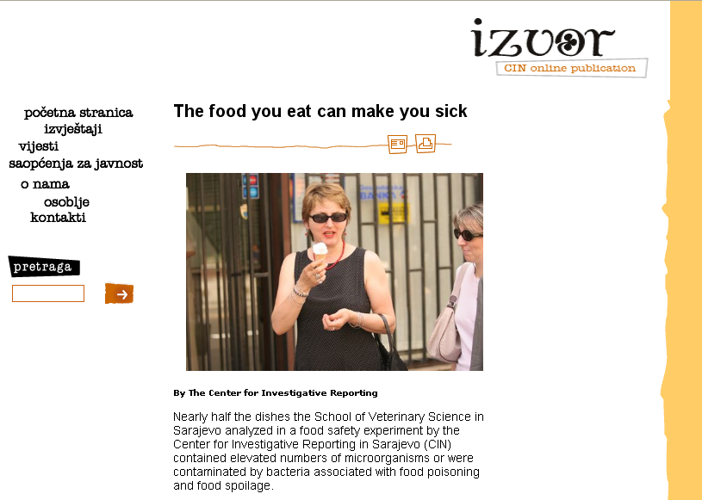
To examine food safety, the Center for Investigative Reporting in Bosnia sampled food – literally and had it tested in labs.

Slide 14
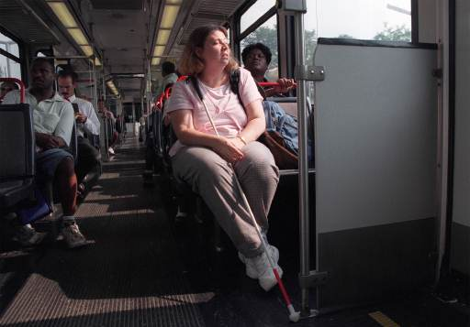
To study whether bus drivers in St. Louis were complying with the ADA, reporters rode a sample of bus routes. The stories prompted a federal investigation into the transit system.

Slide 15
To provide a look into who we’re driving with during a typical commute, Dallas Morning News reporters drove the major routes and recorded the trucks on the road.

Slide 16
Other examples
Counting vehicles in HOV lanes from official count points
Build a database of murders from news articles
Physically checking work sites, bridges, dams and just about anything else

Slide 17
What are NOT scientific surveys
Web polls
Radio or TV call-in polls
Man or woman on the street
American Idol

Slide 18
Beyond the basics
Check with experts
Research others’ methodologies
We did a study to audit accessibility – so we worked with a company who did that to help us develop a survey to use on a sample of facilities.
Oh, and make sure actual data really doesn’t exist

Slide 19
SHOULD HAVE USED SAMPLING? Dozens of St. Louis voters are being wrongly accused of casting ballots from fraudulent addresses in last year's Nov. 7 election.

Slide 20
Other uses of sampling
To test a theory before diving into a massive records hunt
To double-check your analysis – you should get roughly the same results from a sample of your data

Slide 21
Sensor journalism
Using tests or sensors to gather data

Slide 22
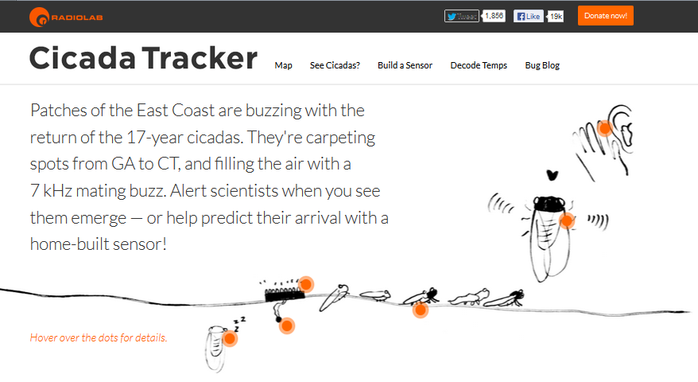

Slide 23
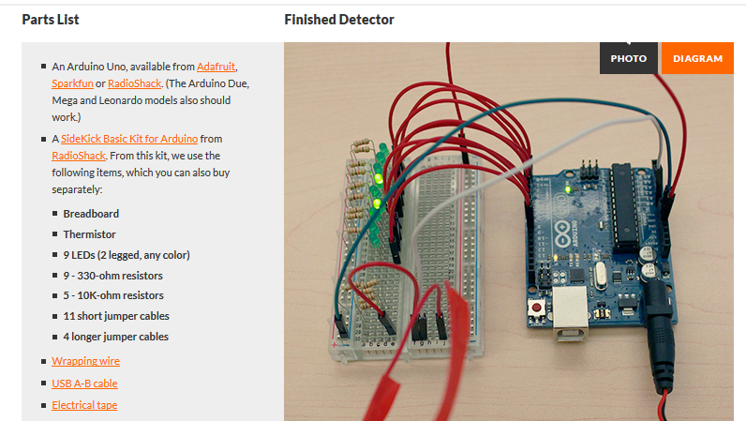

Slide 24
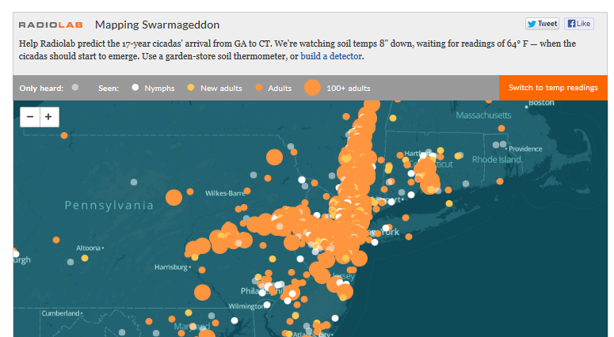

Slide 25
Find the right methodology
Read research reports
Find an existing model
Find an expert
Duplicate or do spot checks
Keep detailed notes so you can explain what you did
If you’re doing a survey or poll – test run it on a few folk before full launch

Slide 26
Dealing with documents
Data entry
Data entry firms --- but use verification if you can afford it
Intern entry – definitely double enter
Mechanical Turk – Amazon service for small – task data gathering

Slide 27
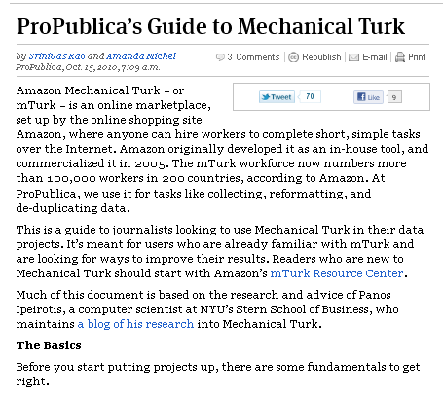
(http://www.propublica.org/article/propublicas-guide-to-mechanical-turk)

Slide 28
Dealing with documents
Scanning and scraping
Need to have good quality documents – be cautious of documents with lots of tiny numbers
Do physical spot checks of your results
Check totals, counts

Slide 29
Sweden
From
Helena Bengtsson, SVT
Worlds oldest FOIA law from 1766
Doesn’t support electronic format
What does that mean?
There could be a database that is a public record – but the authorities can choose to disclose it as docs

Slide 30
What to do?
Scan and OCR documents
Create your own panel
Crowd sourcing
Surveys

Slide 31
Who gets childcare allowance?
5000 kr ($700) a month to stay home
Children 1-3 years old
Could also be used for nanny and/or grandparents to stay with kids
Apply with local municipalities

Slide 32
Building our own panel
TV-show about education
Created a teachers panel – 900 teachers

Slide 33
900 teachers to represent all teachers in Sweden
Asked for participants on TV and web
Matched that group against known statistics about teachers
Parameters: Sex, Age, Geography, Grade and Public/Private school
Checked the group with a question we knew the answer to

Slide 34
Drug control at counties and cities
Surveyed 355 counties and districts – all replied

Slide 35
Other examples
1800 vicars about same sex marriges
Unions about on-going negotiations
21 regions about…
Female representation in publicly owned companies
Public contributions to political parties
290 counties about…
Night time care for old people that still live at home
Will you raise the tax next year?
Alcohol licences for restaurants
Public contributions to local organizations

Slide 36
The candidates
Public information about all 54 673:
Age
Place of residence
Declared income from two years back
Company interest – member of the board
Selfowned company

Slide 37
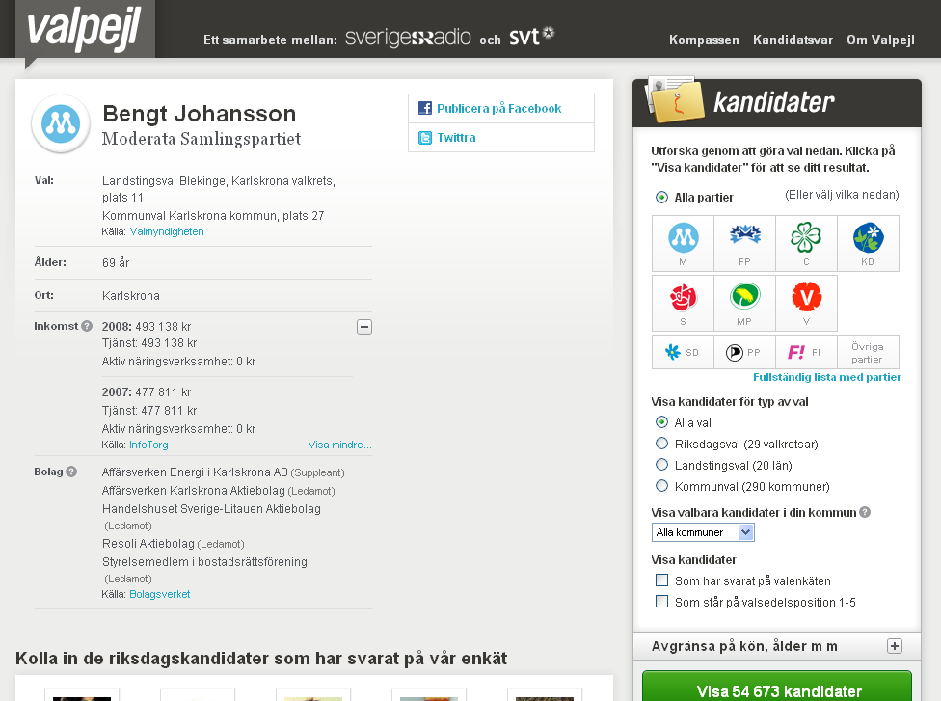

Slide 38
Bulletproofing your project
Bounce your methodology off experts
Disclose all details of your methodology
Never draw conclusions about a whole group unless you got all or almost all to answer –Helena B.

