Slide 1
What to do when you can’t get all the data
NICAR 2012, St. Louis
Helena Bengtsson, SVT
Jennifer LaFleur, ProPublica

Slide 2
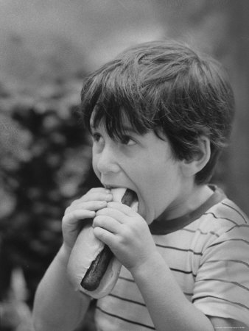
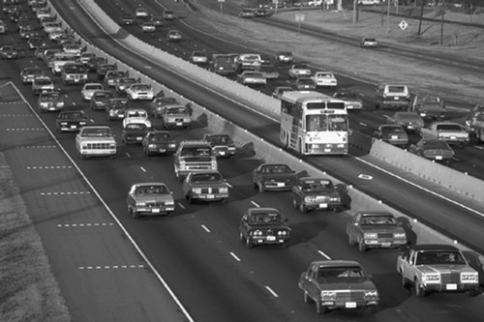
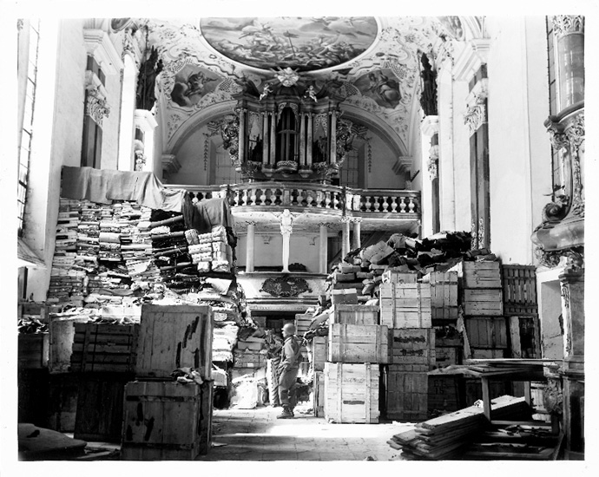
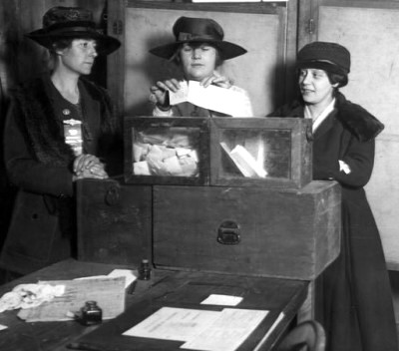
Sometimes data is not in rows and columns

Slide 3
But there are ways to gather data…
Sampling
Building from documents
Physical surveys
Testing
Questionnaires, polls and surveys

Slide 4
Sampling Considerations
What’s the universe?
How will you draw the sample?
How will you get the items, docs or data?
How far will you want to break it down?
What sort of accuracy do you need?

Slide 5
Sampling Considerations
Random sample – Ever item has an equal chance of being included.
Rand() function in Excel, then sort
SPSS and other statistics programs will pull a random sample

Slide 6
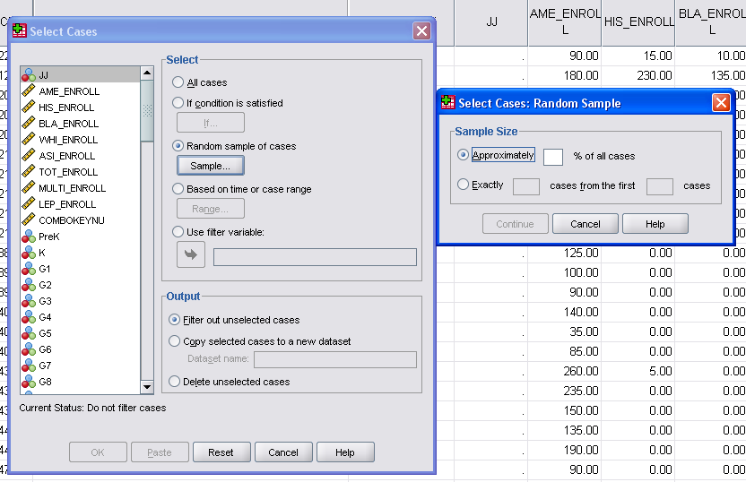

Slide 7
Sampling Considerations
Systematic sample – Pulling every Nth record.
Stratified sample – pulling your sample based on another underlying number – such as population.
Rather than pouring all the records for four counties in a pot and pulling randomly – you pull a random sample from each county.
Oversampling – pulling more of a particular group in order to do further research with that group

Slide 8
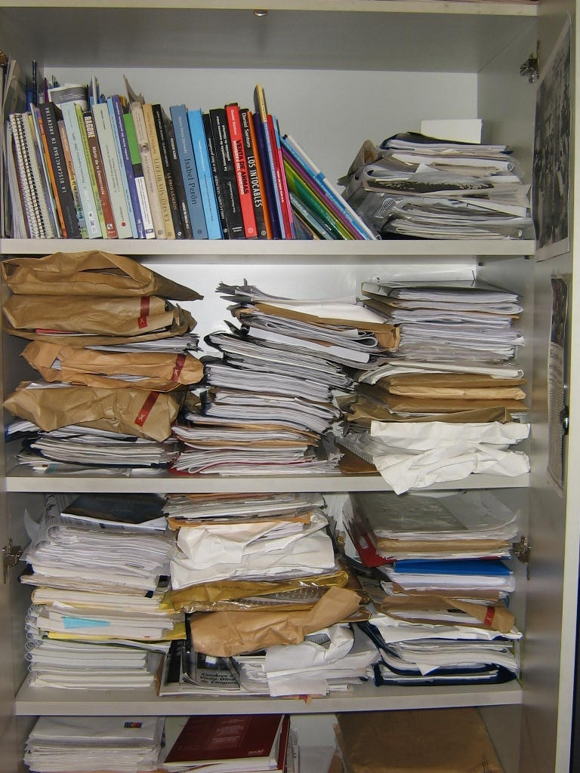
It might even help in these situations

Slide 9
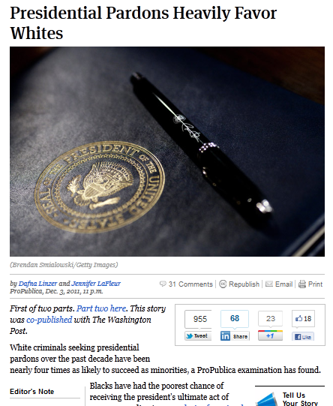
We built a database of 500 people who had been granted or denied pardons during the Bush administration
We started with a list of nearly 2,000 people. From that, we pulled a random sample. Then spent months researching the individuals.
We found that even after controlling for other factors, whites were more likely to get a pardon.

Slide 10
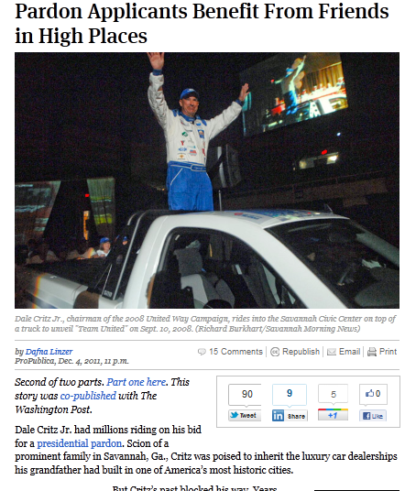
In response to a FOIA request, we received correspondence from members of Congress to the Office of the Pardon Attorney. From that, we built a database of characteristics form the letters to see if applicants benefitted from the correspondence.
We found that those with letters, tho’ fewer than the total sample, were more likely to be pardoned.

Slide 11
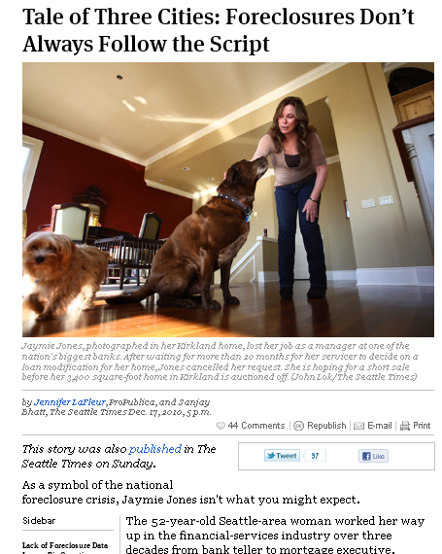
ProPublica and The Seattle Times wanted to study foreclosure patterns in three U.S. cities, but much of the information we needed was scattered in various paper and electronic files. So we pulled a random sample of foreclosure filings from each city.

Slide 12
The Dallas Morning News used a random sample of non-capital murder cases to build a database based on hard-copy juror questionnaires and coding of voir dire transcripts.

Slide 13
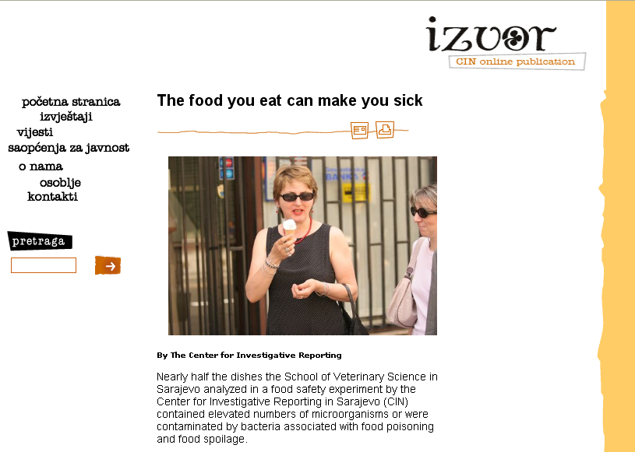
To examine food safety, the Center for Investigative Reporting in Bosnia sampled food – literally and had it tested in labs.

Slide 14
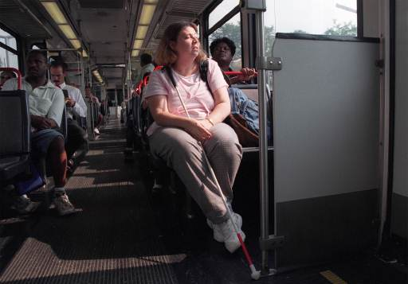
To study whether bus drivers in St. Louis were complying with the ADA, reporters rode a sample of bus routes. The stories prompted a federal investigation into the transit system.

Slide 15
To provide a look into who we’re driving with during a typical commute, Dallas Morning News reporters drove the major routes and recorded the trucks on the road.

Slide 16
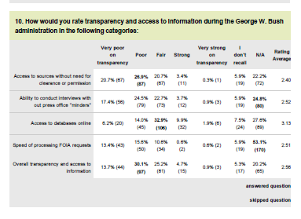
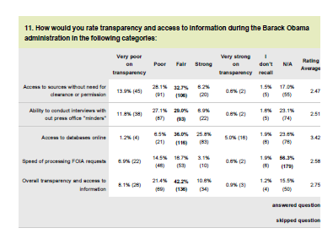
For a project on open government, ProPublica and CJR used Surveymonkey.com

Slide 17
Other examples
Counting vehicles in traffic lanes from official count points
Build a database of murders from news articles
Physically checking work sites, bridges, dams and just about anything else

Slide 18
What are NOT scientific surveys
Web polls
Radio or TV call-in polls
Man or woman on the street
American Idol

Slide 19
Beyond the basics
Check with experts
Research others’ methodologies
We did a study to audit accessibility – so we worked with a company who did that to help us develop a survey to use on a sample of facilities.
Oh, and make sure actual data really doesn’t exist

Slide 20
SHOULD HAVE USED SAMPLING? Dozens of St. Louis voters are being wrongly accused of casting ballots from fraudulent addresses in last year's Nov. 7 election.

Slide 21
Other uses of sampling
To test a theory before diving into a massive records hunt
To double-check your analysis – you should get roughly the same results from a sample of your data

Slide 22
Find the right methodology
Read research reports
Find an existing model
Find an expert
Duplicate or do spot checks
Keep detailed notes so you can explain what you did
If you’re doing a survey or poll – test run it on a few folk before full launch

Slide 23
Dealing with documents
Data entry
Data entry firms --- but use verification if you can afford it
Intern entry – definitely double enter
Mechanical Turk – Amazon service for small – task data gathering – if you have a U.S. office or collaborator

Slide 24
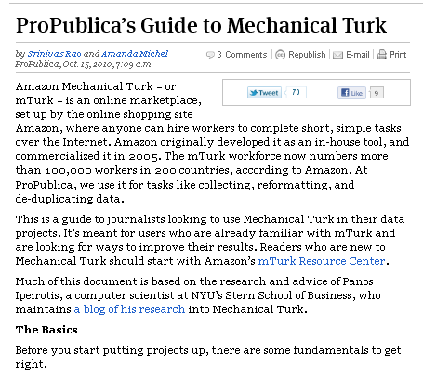
(http://www.propublica.org/article/propublicas-guide-to-mechanical-turk)

Slide 25
Dealing with documents
Scanning and scraping
Need to have good quality documents – be cautious of documents with lots of tiny numbers
Do physical spot checks of your results
Check totals, counts

Slide 26
Sweden
Worlds oldest FOIA law from 1766
Doesn’t support electronic format
What does that mean?
There could be a database that is a public record – but the authorities can choose to disclose it as docs

Slide 27
What to do?
Scan and OCR documents
Create your own panel
Crowd sourcing
Surveys
Building an application to present and gather data

Slide 28
Tracking Swedish Lobbying
No disclosure
Idea to get sign in sheets from the parliament
First – no problem – Excel
Later – just paper documents
Should I have stopped there?

Slide 29
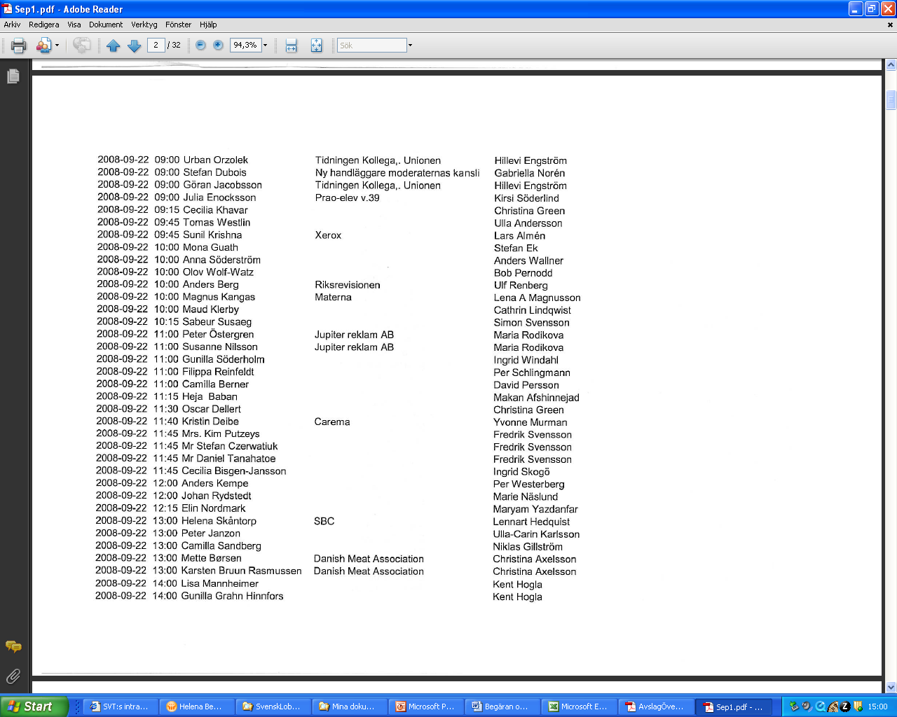

Slide 30
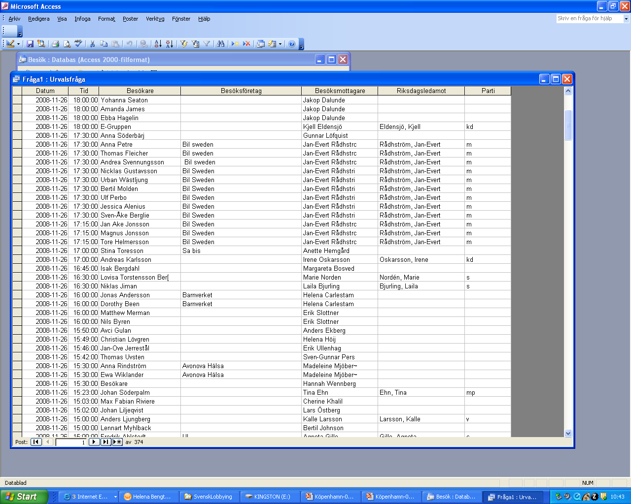

Slide 31
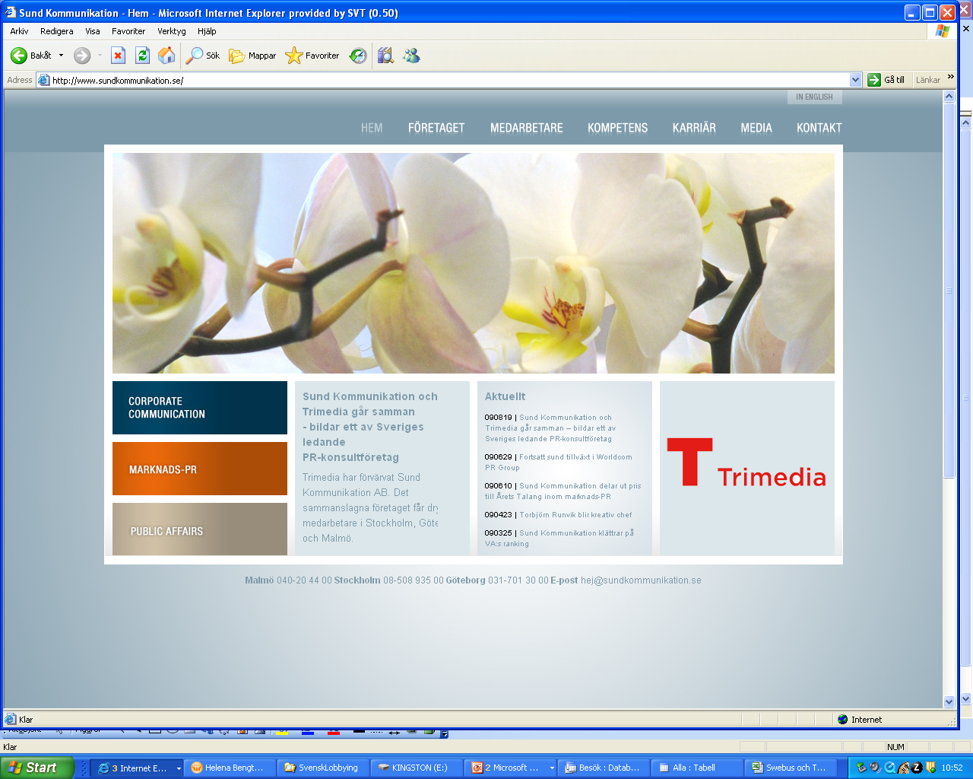

Slide 32
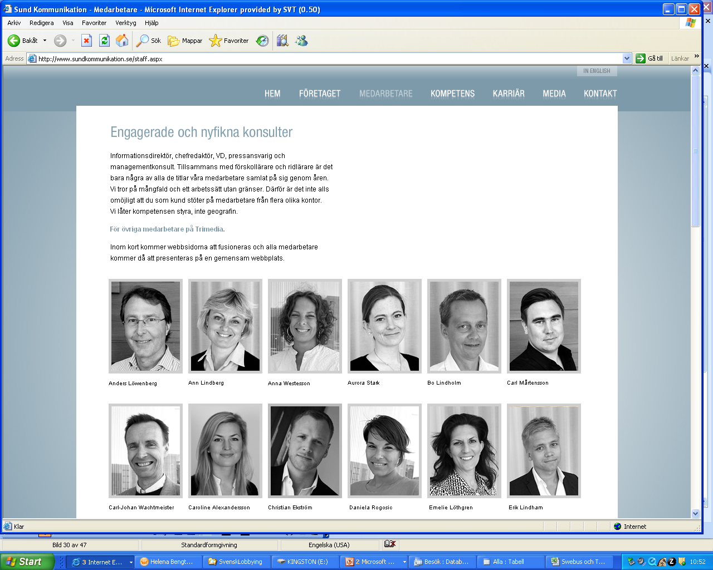

Slide 34
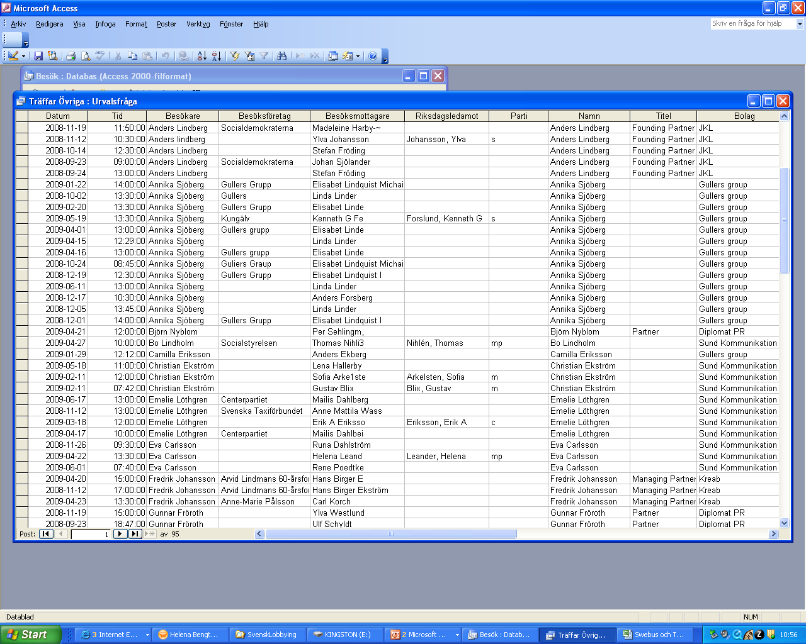

Slide 35
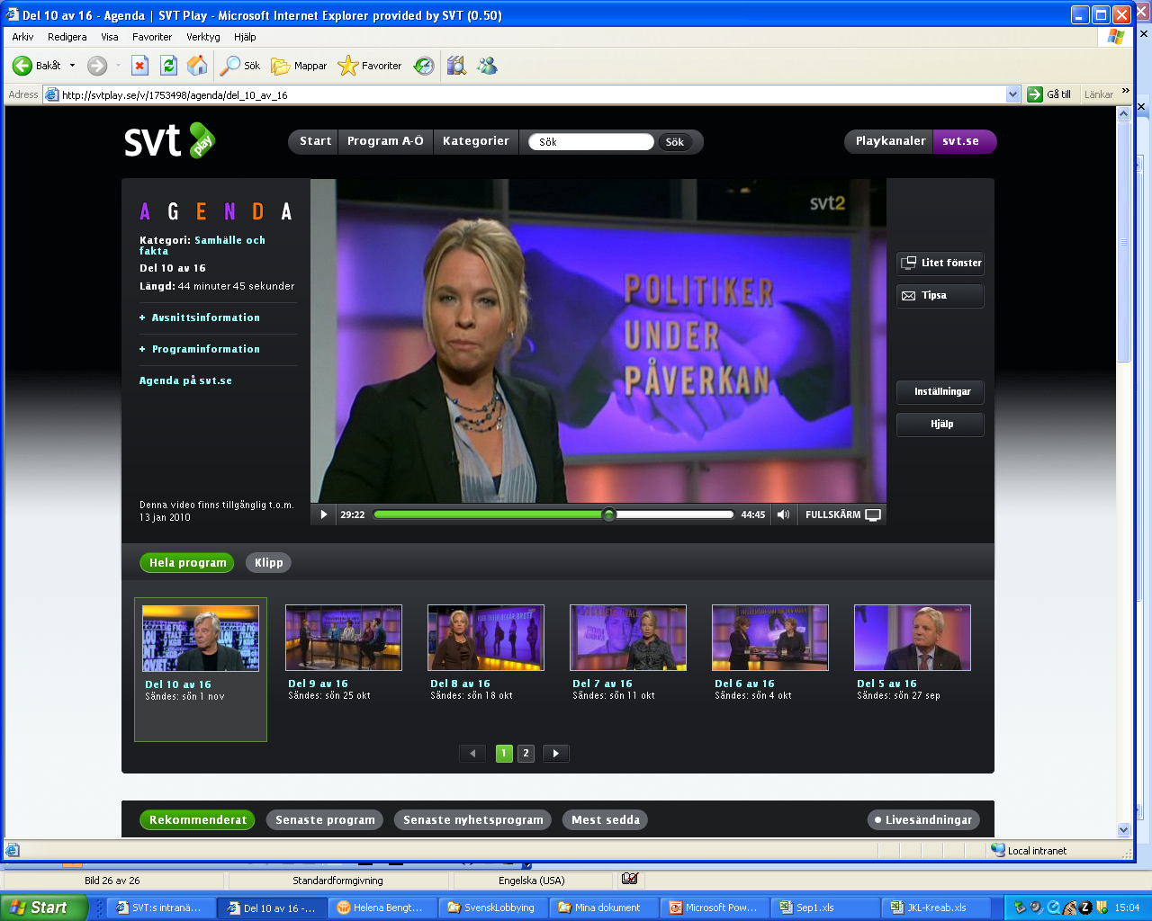

Slide 36
Documents – when not to continue
Quality is bad
Layout makes it hard to transfer
The story is too small for that effort
Hardest to do is to weigh my effort against the impact of the story

Slide 37
Building our own panel
TV-show about education
Created a teachers panel – 900 teachers

Slide 38
900 teachers to represent all teachers in Sweden
Asked for participants on TV and web
Matched that group against known statistics about teachers
Parameters: Sex, Age, Geography, Grade and Public/Private school
Checked the group with a question we knew the answer to

Slide 40
Crowd sourcing – Every Day Crime
Collaboration with TV-show: ”Crime of the week”
Asking the public to tell us what happened when they contacted the police
Building a database interface that allowed us to easily sort through entries – and divide them geographically
First night – over 800 tips. In total: about 2 500 tips, 25 news stories And one very embarrassed Chief of Police

Slide 52
Surveys – but no sampling
We survey ALL:
290 counties
1800 vicars
5500 candidates (more on this later…)
Use FOIA as part of the survey makes them answer

Slide 53
Drug control at counties and cities
Surveyed 355 counties and districts – all replied

Slide 54
Comments – very important
Respondant can explain – we get stories

Slide 55
Other examples
1800 vicars about same sex marriges
Unions about on-going negotiations
21 regions about…
Female representation in publicly owned companies
Public contributions to political parties
290 counties about…
Night time care for old people that still live at home
Will you raise the tax next year?
Alcohol licences for restaurants
Public contributions to local organizations

Slide 56
What to think about for surveys
Fact box – what did we do – and how
How many did we send the survey to and how many answered?
Never draw conclusions about a whole group unless you got all or almost all to answer
Again – be sure to tell your audience HOW you did something – and if you do that you get away with a lot of things

Slide 57
www.valpejl.se
val = election
pejl = 1) to examine, to check out
2) to measure depth (sonar)
3) be in control

Slide 58
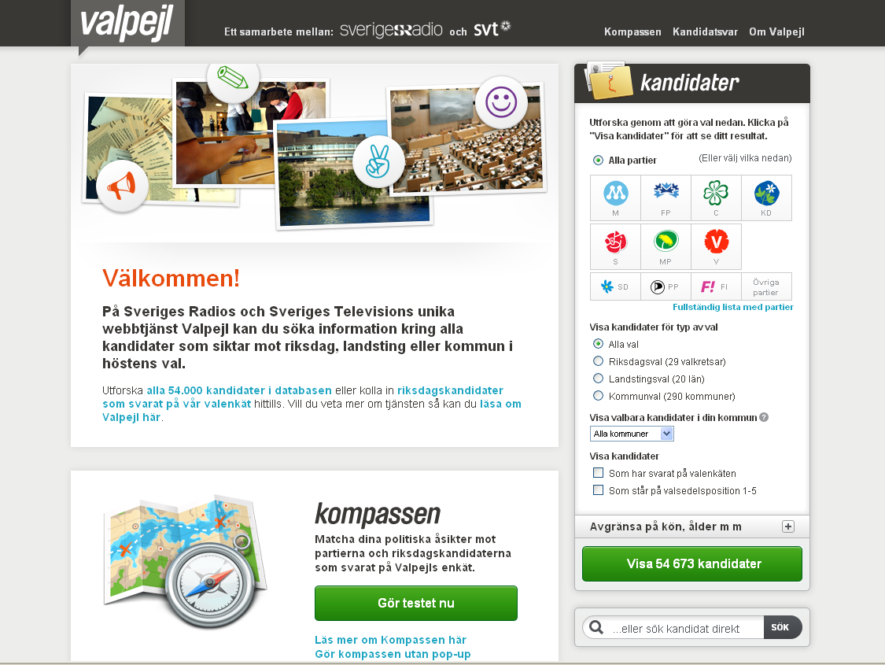

Slide 59
Background
Parliamentary system – 4% and you’re in
Seven parties in the national parliament
Another three that might qualify
Another 200 or so for the local, regional and national parliament
In all 54 673 candidates
5 627 candidates for the national election

Slide 60
The compass
A compass for voters to help them find a party that suits their opinion
Answer 50 questions in 10 areas
Possible to mark questions with extra weight
Answers gives a percentage of how well your opinion matches the different parties in the national parliament

Slide 61
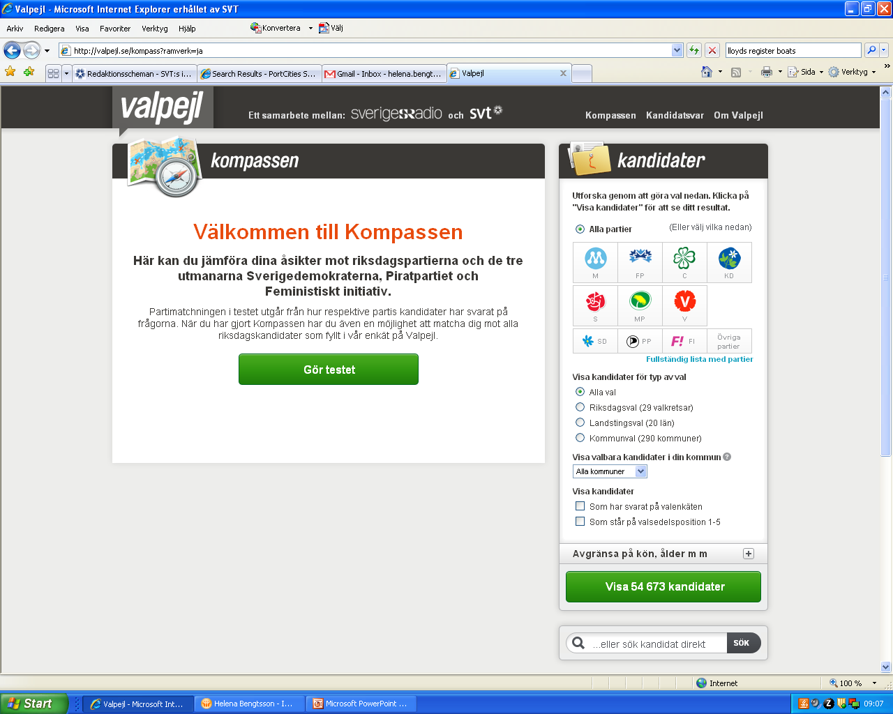

Slide 62
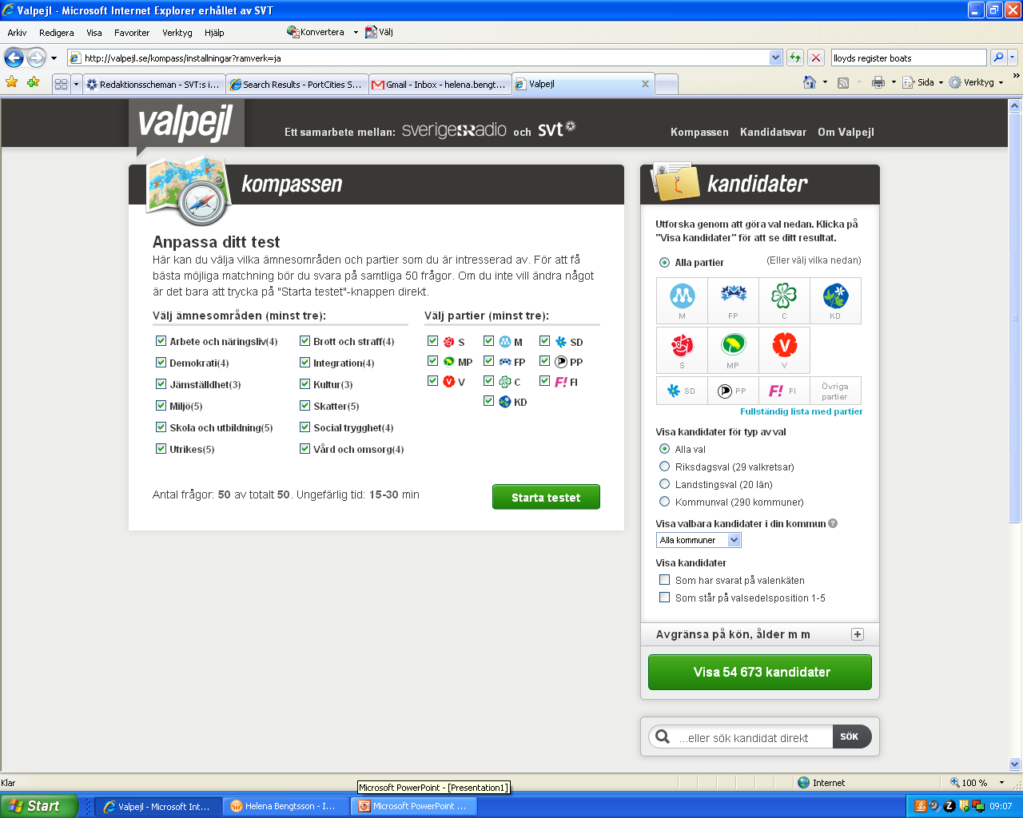

Slide 63
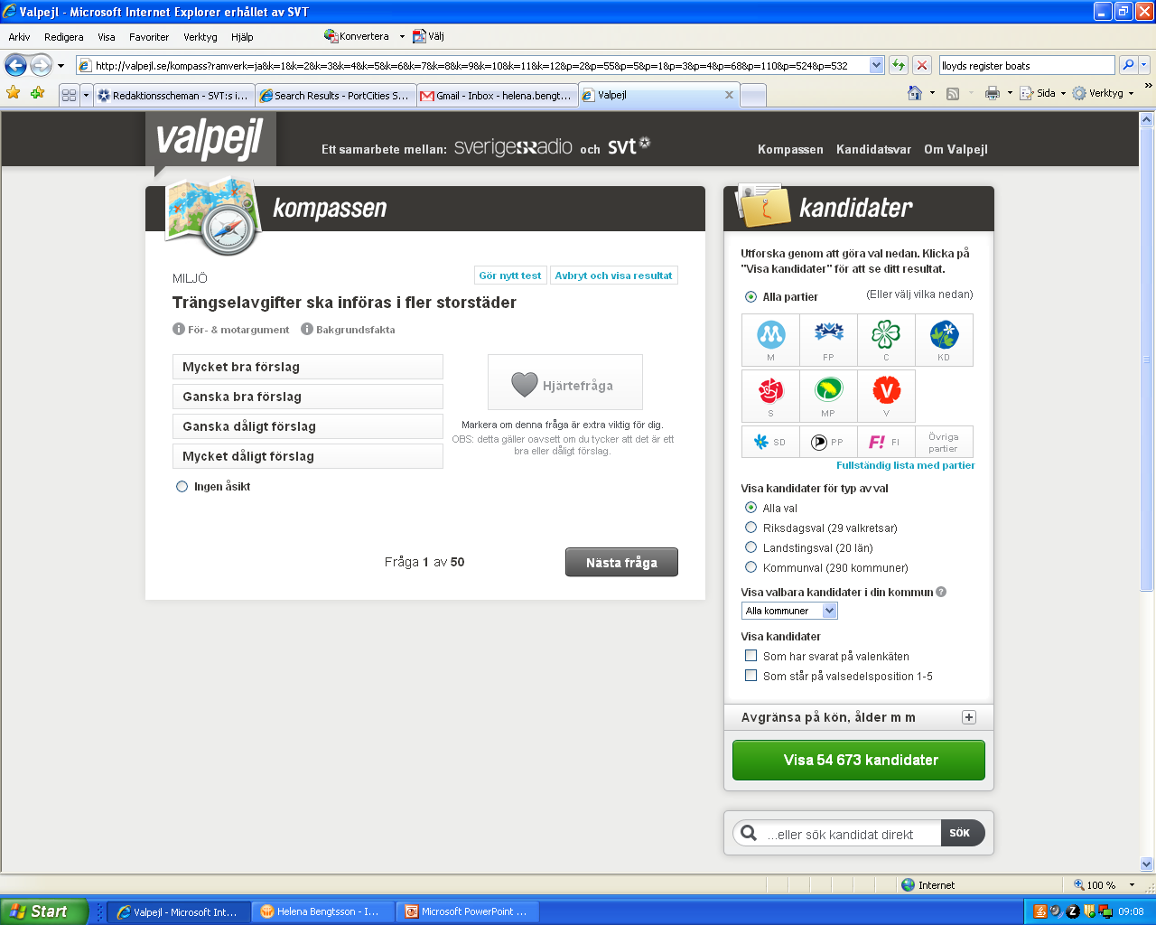

Slide 64
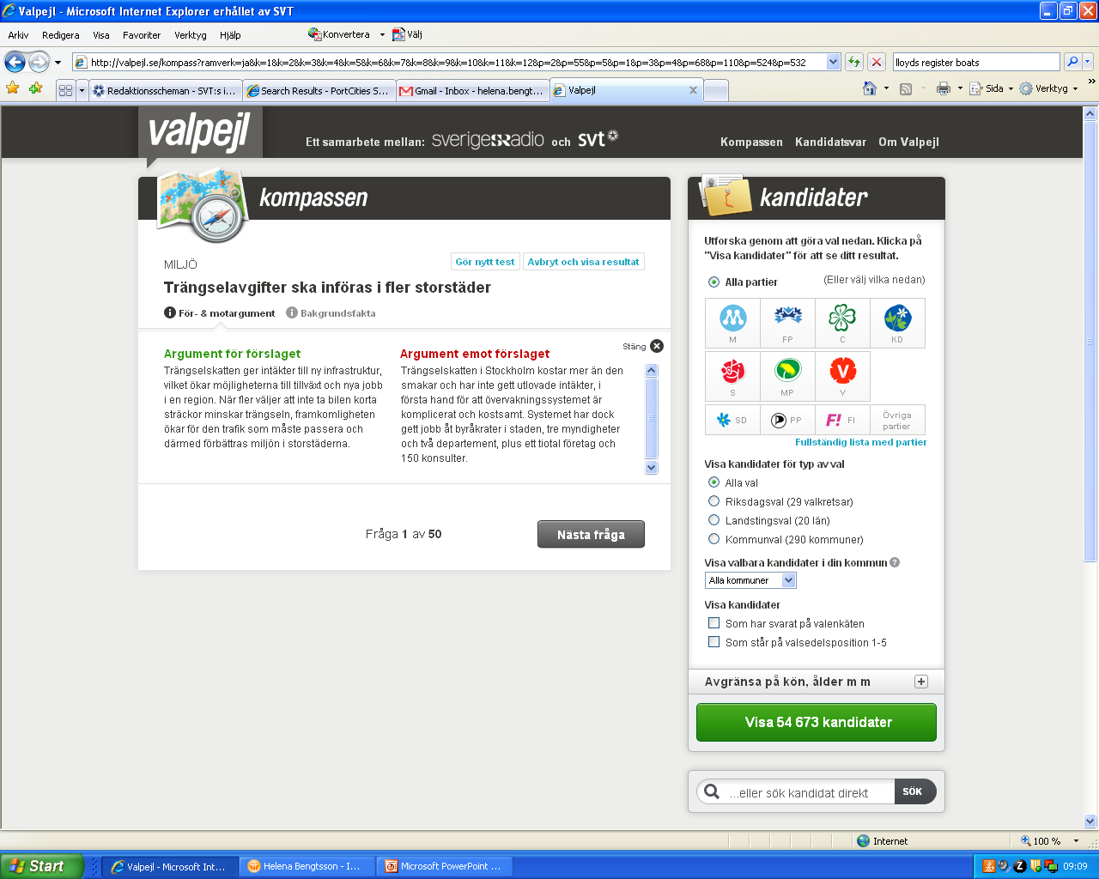

Slide 65
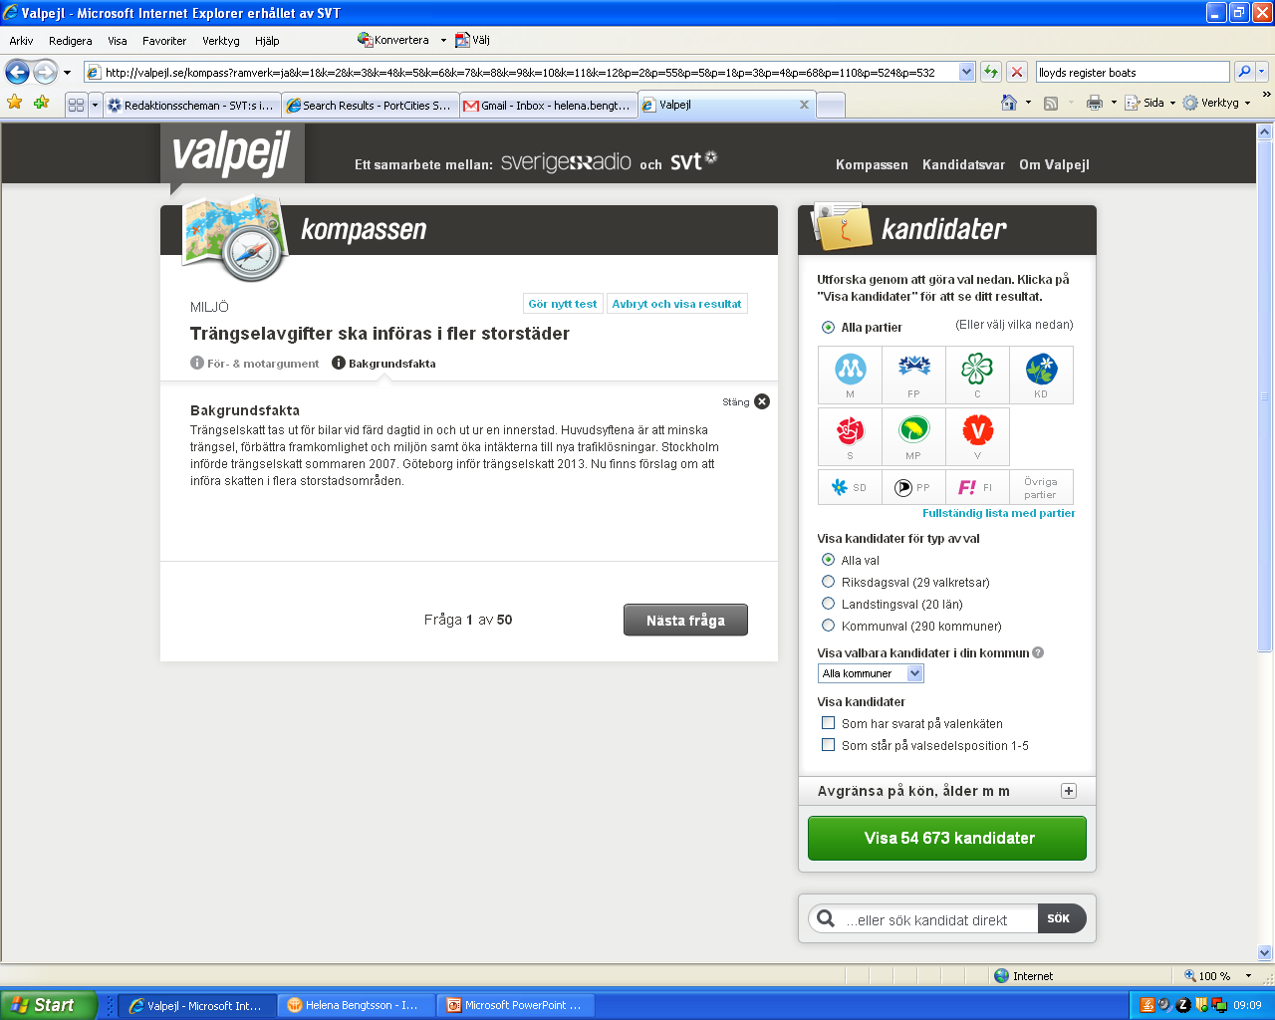

Slide 66
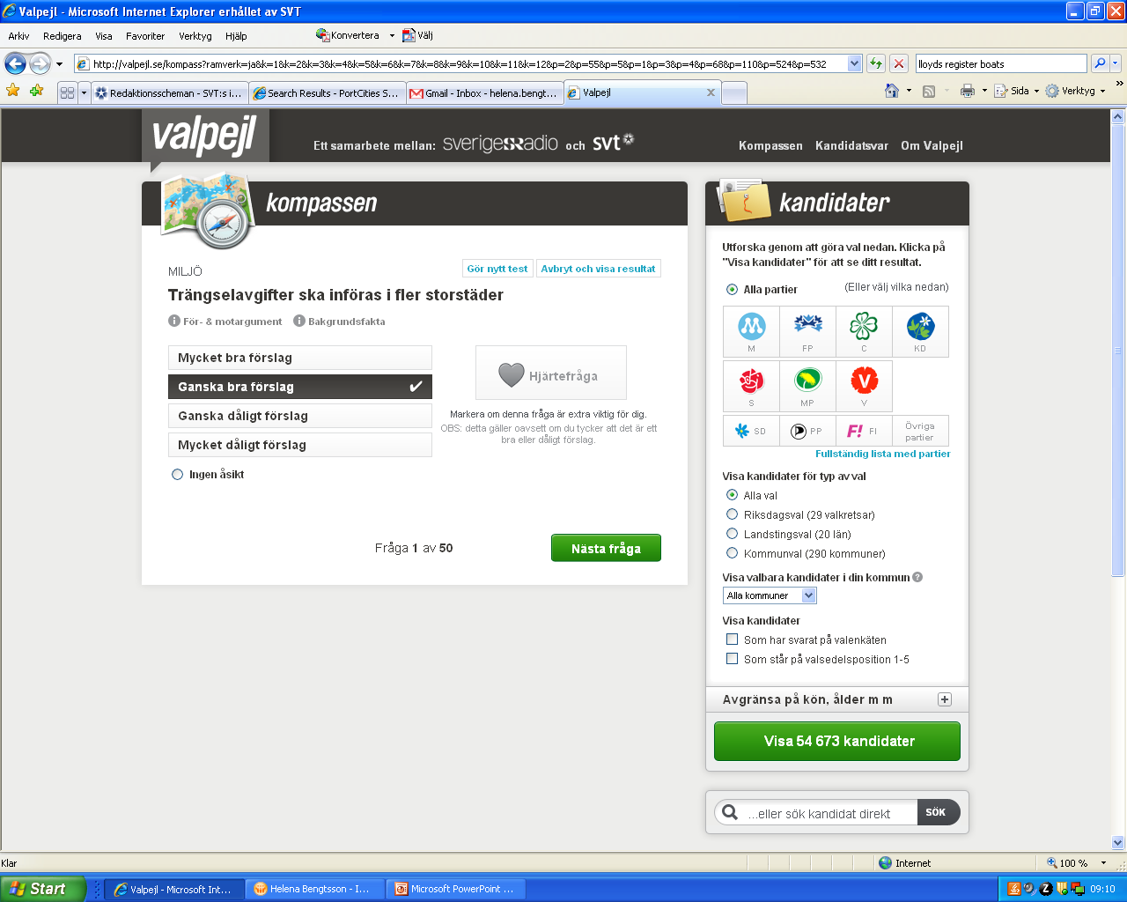

Slide 67
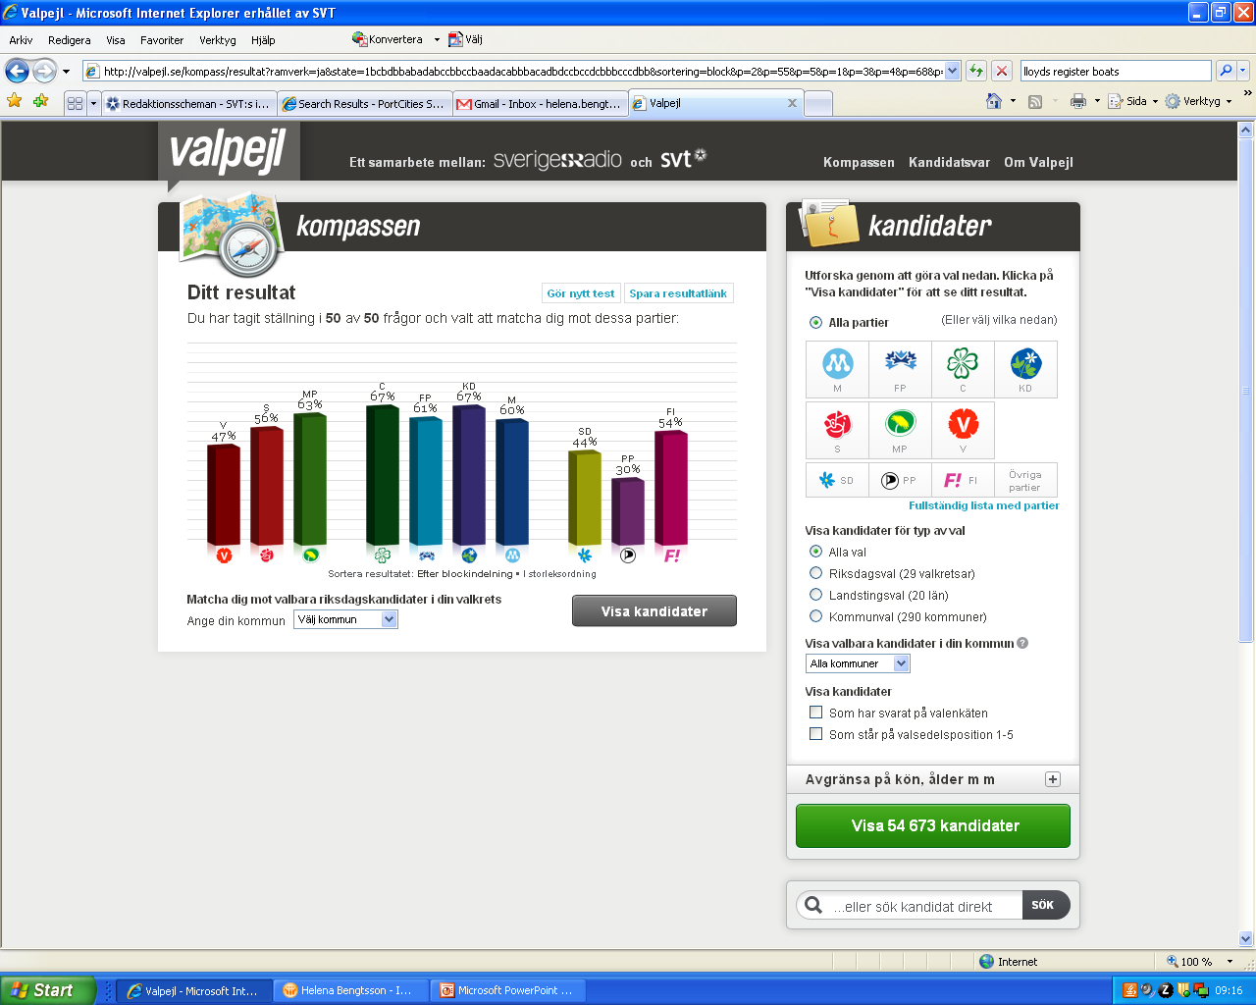

Slide 68
The candidates
Public information about all 54 673:
Age
Place of residence
Declared income from two years back
Company interest – member of the board
Selfowned company

Slide 69
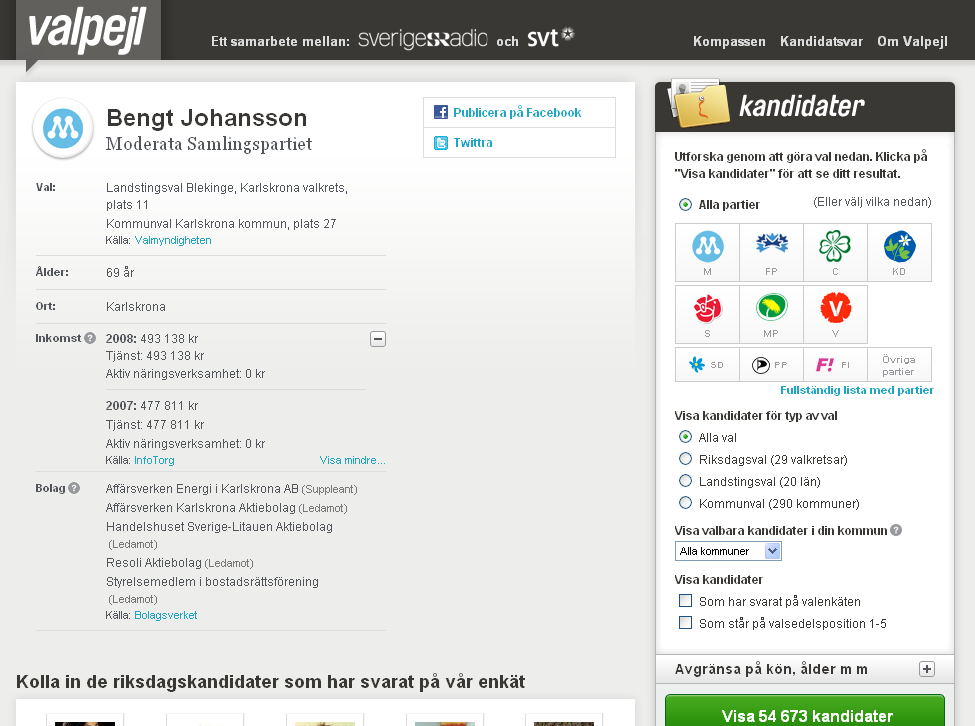

Slide 70
The survey
For all 5 627 candidates for the national parliament:
Contact all local party organizations
Gather e-mail addresses for all candidates
Use a web based survey tool and send each candidate a two part survey
AND: Ask them for a photo

Slide 71
The survey
Part 1: The Compass questions
Obligatory (but ”no opinion” was allowed)
Possible to comment each question
Part 2: Personal and political questions
Have you ever changed your mind?
Which party other than your own would you be a member of?
What’s your favorite food, music, book?

Slide 72
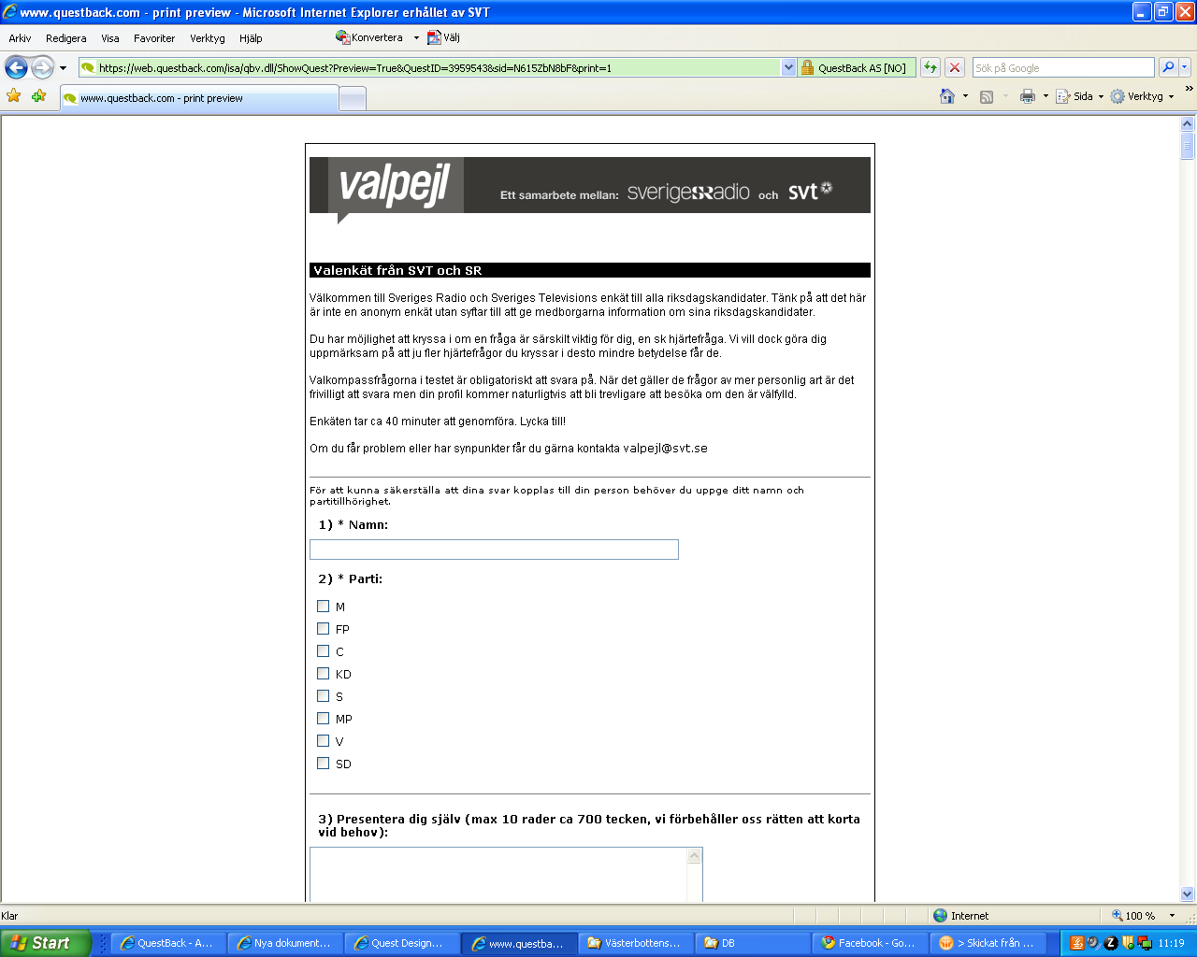

Slide 73
www.valpejl.se
Compass
Answered by the candidate
AND the voter
Match Candidate with voter

Slide 74
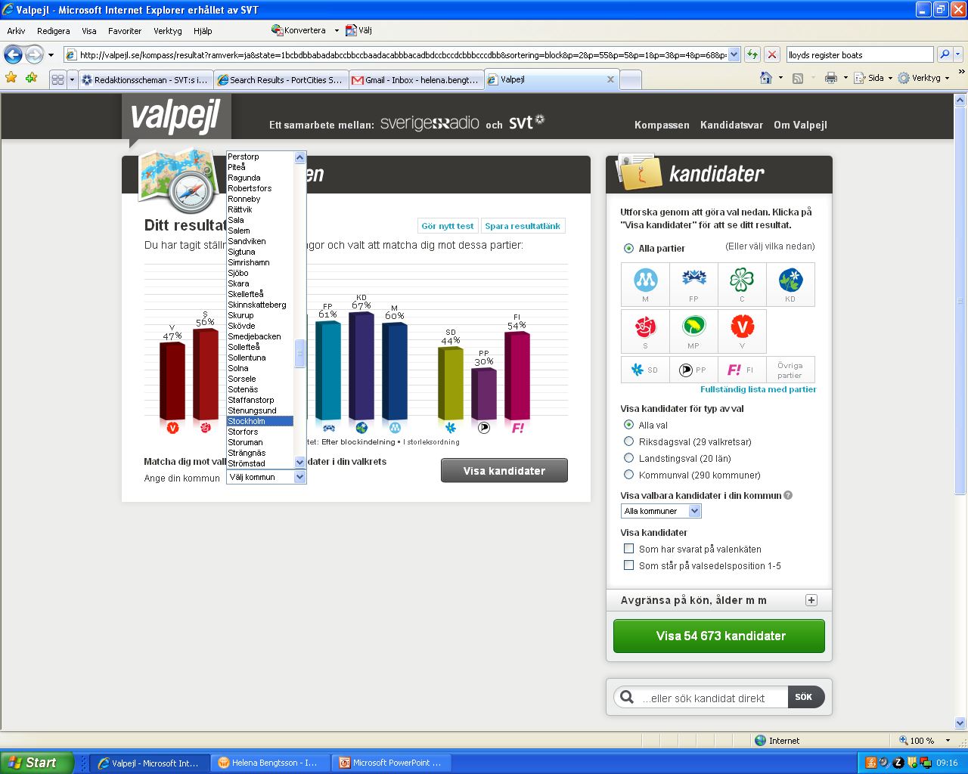

Slide 75
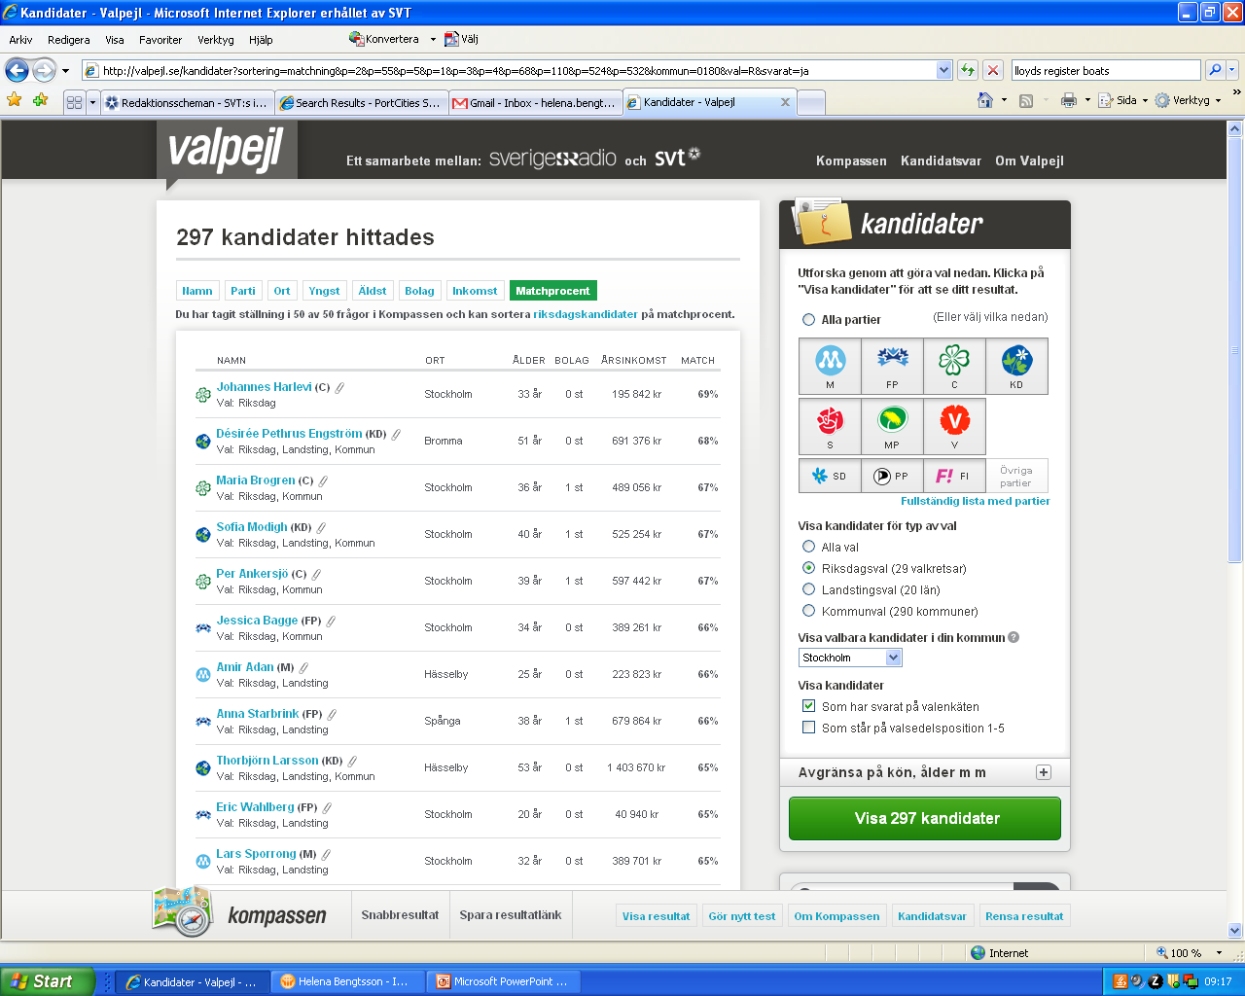

Slide 76
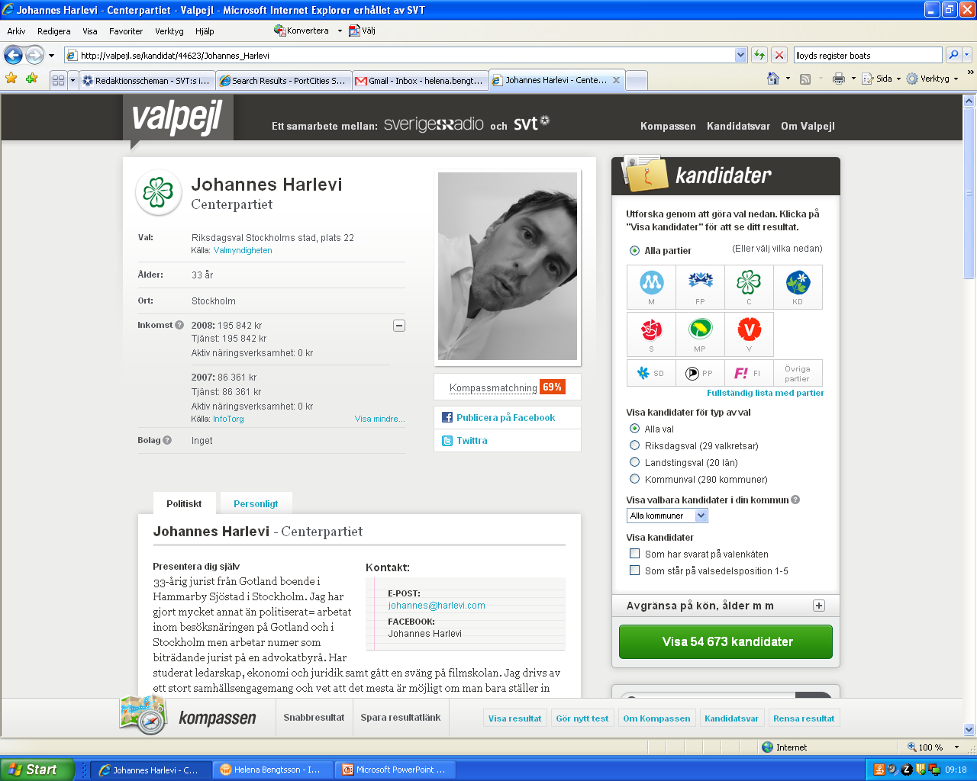

Slide 77
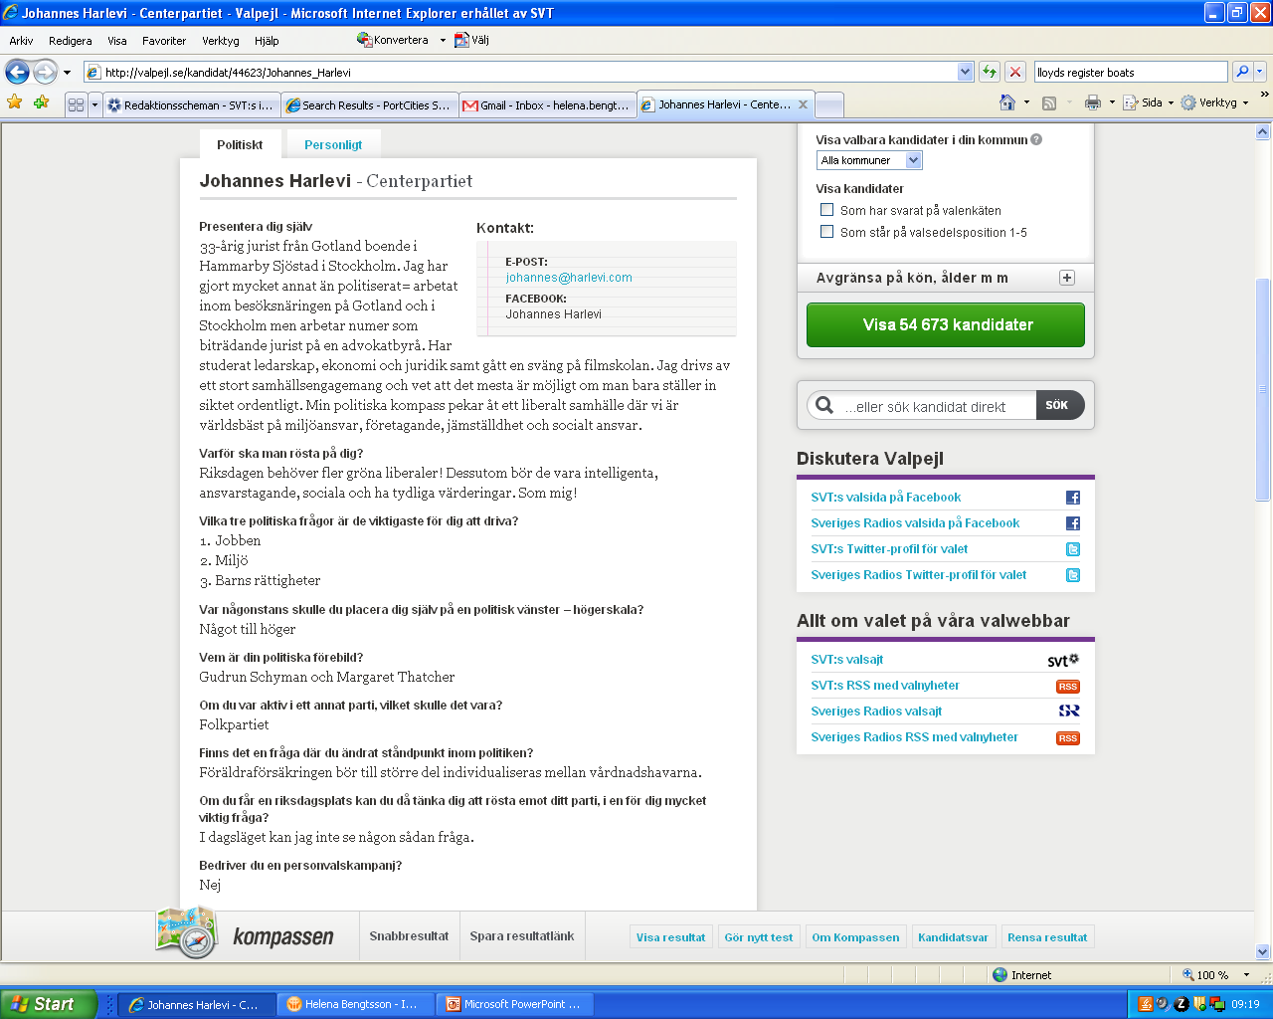

Slide 78
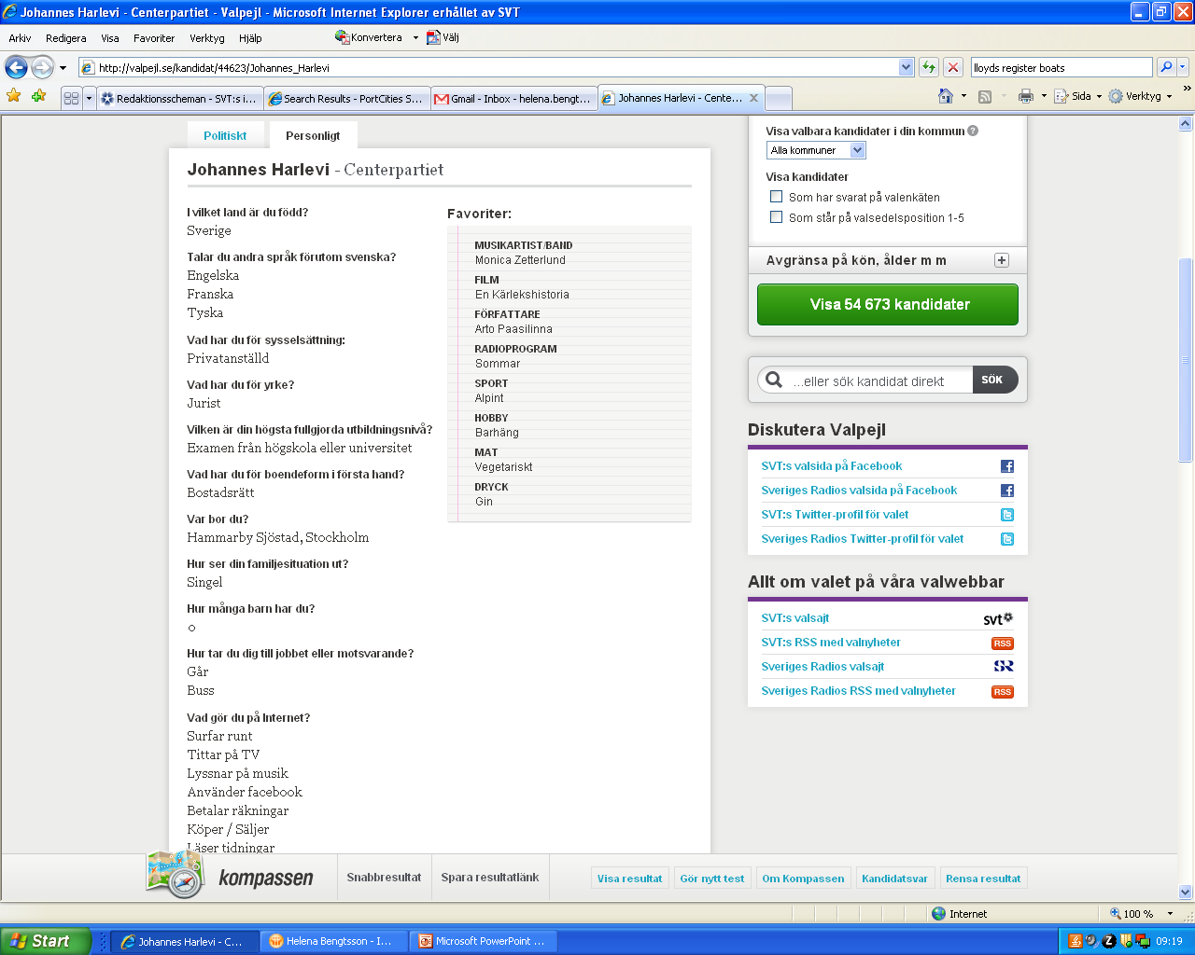

Slide 79
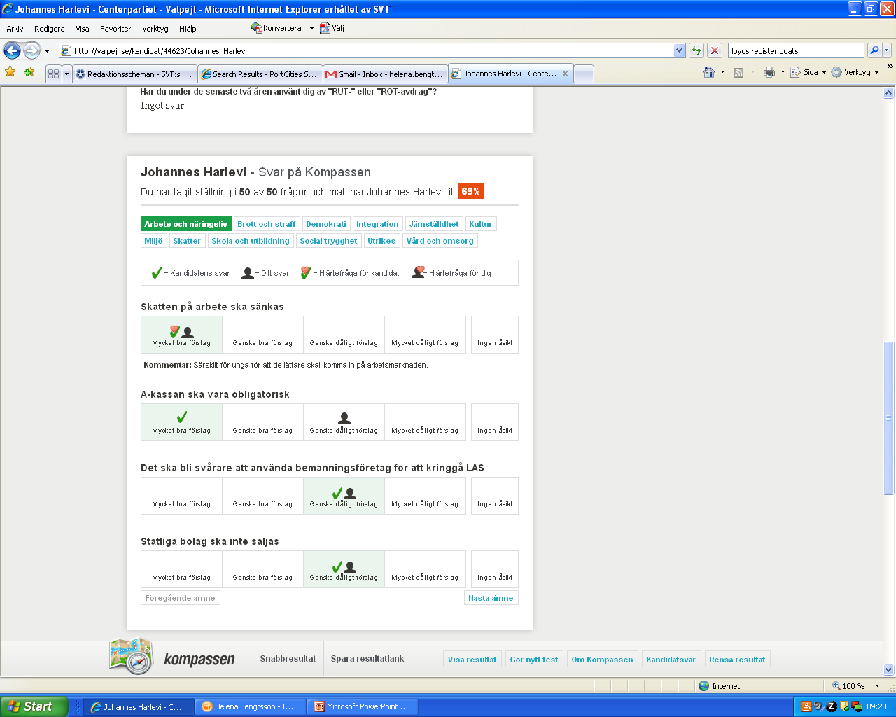

Slide 80
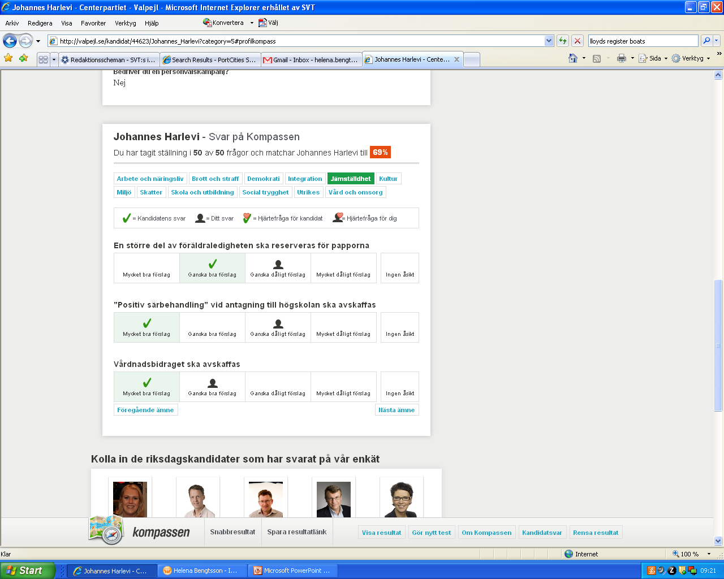

Slide 81
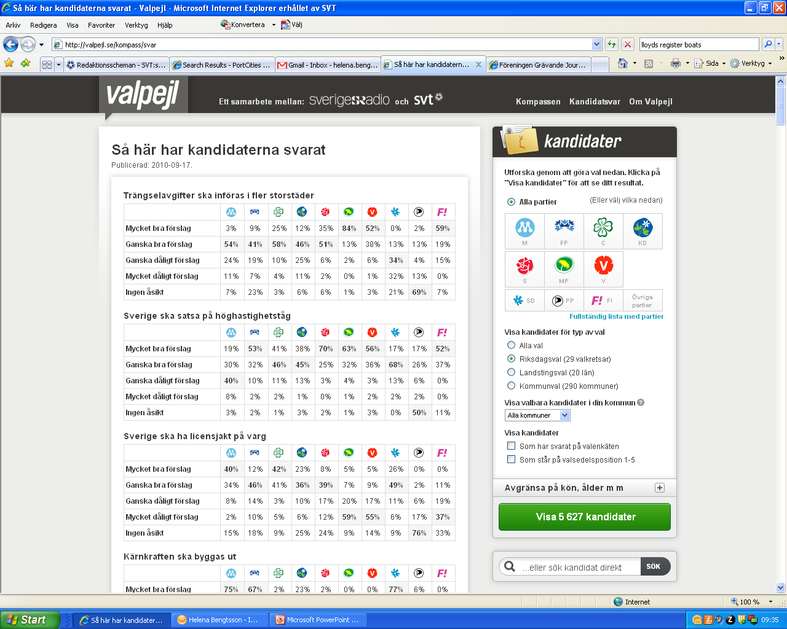

Slide 83
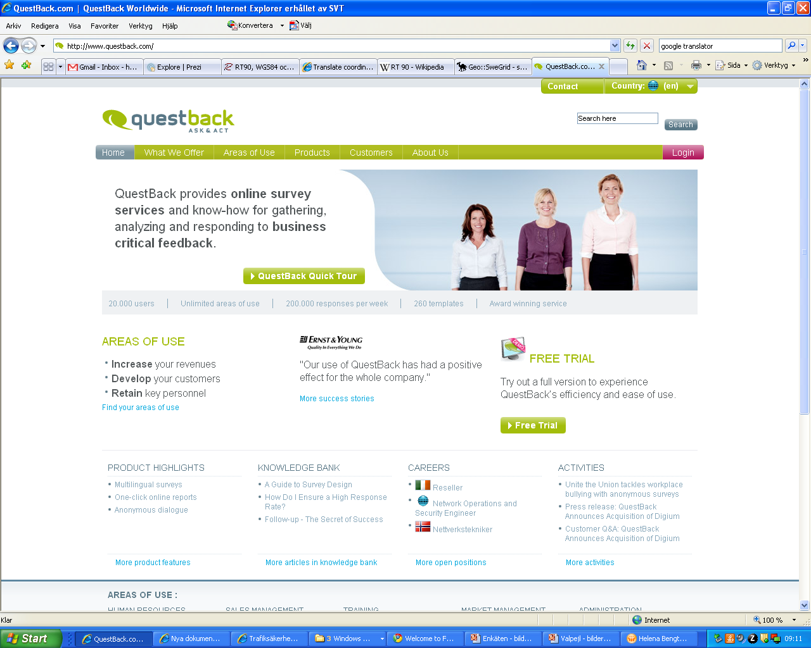

Slide 84
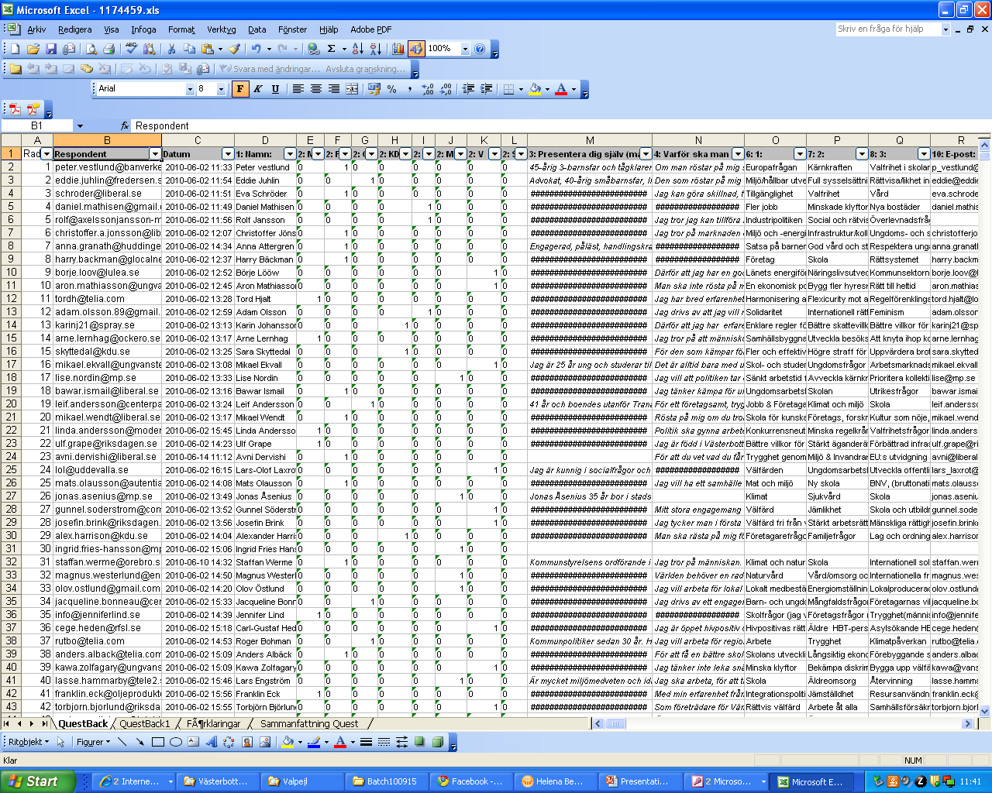

Slide 85
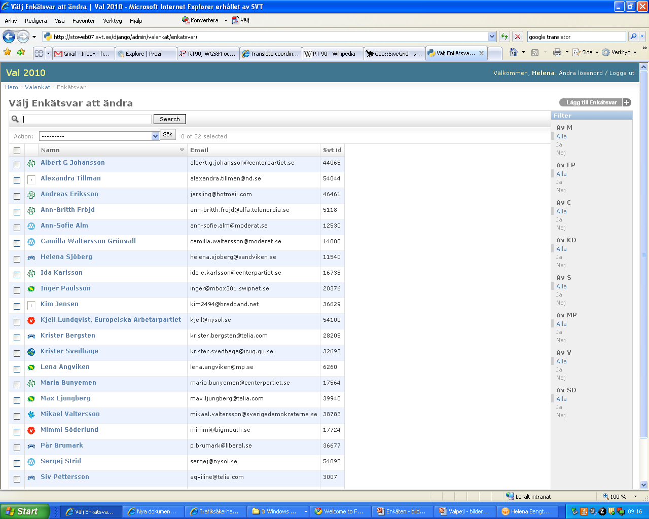

Slide 86
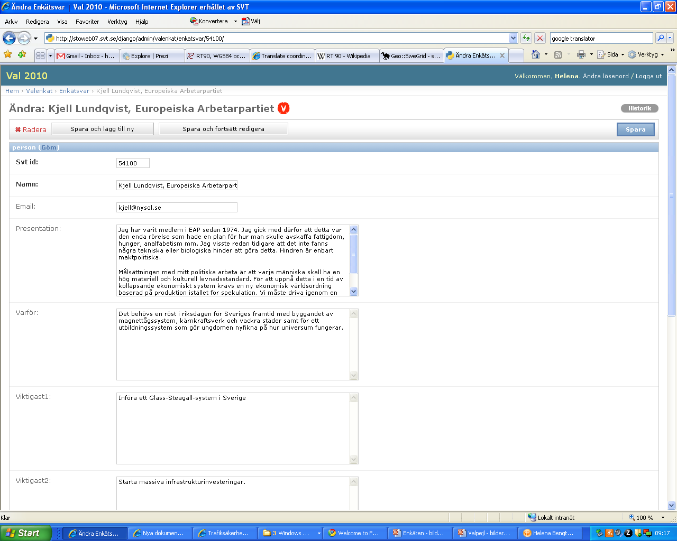

Slide 87
Now what?
Now
Updated the site with 14 144 elected officials
Add new income
Add changed company info
Next time
A survey tool that connects to the database and enables changes by the candidate
If possible – extend the survey and matching to regional and local level

Slide 88
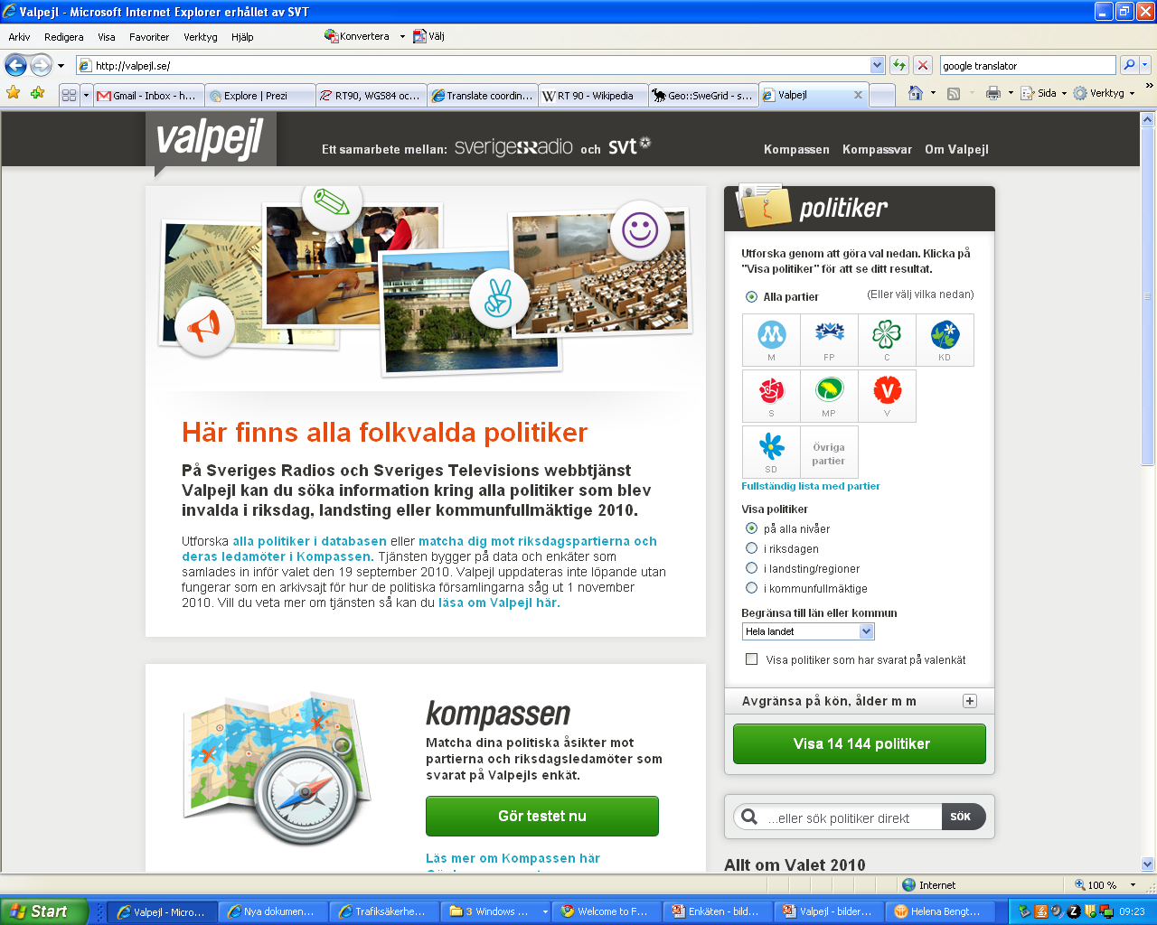

Slide 89
Get a copy of this presentation at www.jenster.com/nicar2012
helena.bengtsson@svt.se
jennifer.lafleur@propublica.org

