Slide 1
Examining Prescribing Patterns
Charles Ornstein, ProPublica
Jennifer LaFleur, CIR

Slide 2
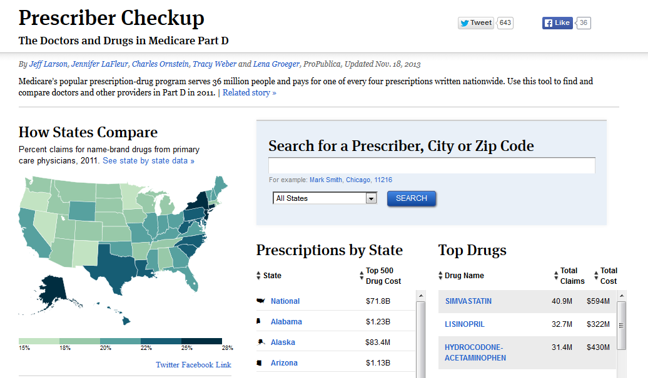

Slide 3
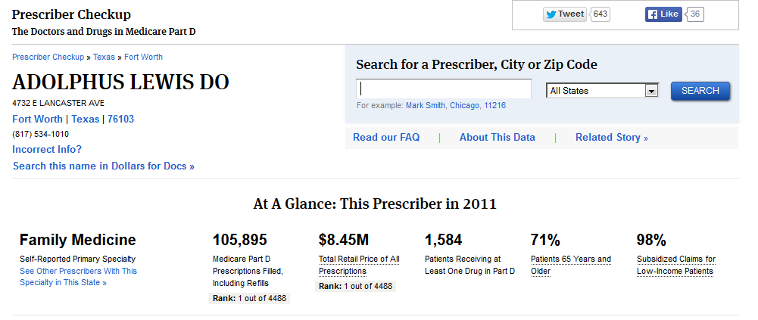

Slide 4
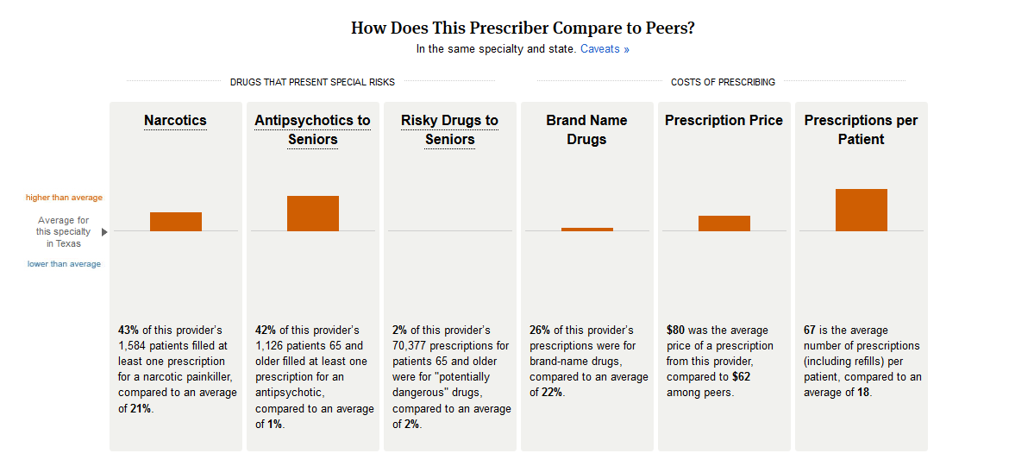

Slide 5
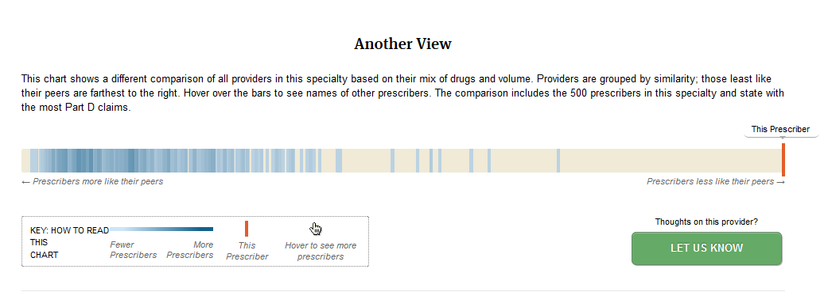

Slide 6
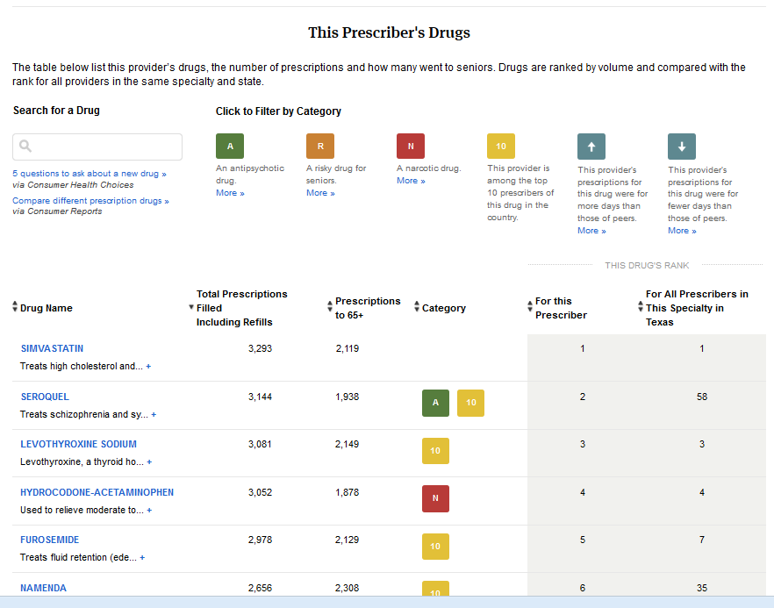

Slide 7
Medicare prescribing data
Pharmaceutical companies purchase data from middlemen, who purchase the data from pharmacies.
The middlemen would not sell it to ProPublica at any price.
We requested the data from Medicare because its Part D program pays for one of every four prescriptions dispensed annually in the U.S.

Slide 8
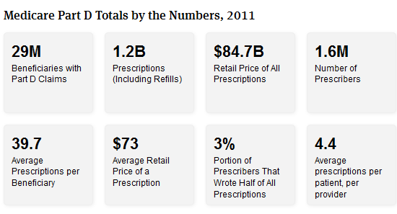
Medicare Part D is vast
http://www.propublica.org/checkup

Slide 9
The FOIA process
Found list of available information on ResDAC website (resdac.org)
Worked with CMS officials early and often to craft request
Met with more than a dozen CMS officials to discuss request

Slide 10
The FOIA process
Differentiated our request from WSJ/CPI 2010 requests
Willing to accept aggregate data
Willing to give up very small cases

Slide 11
Medicare prescribing data
Prescribing data by provider ID from 2007 to 2010 (and later 2011)
For each prescriber and drug:
the total number of claims
the retail cost of the drug (by brand and NDC)
the days of supply
the number of units (i.e. pills or ounces)
Prescribing data for people 65+

Slide 12
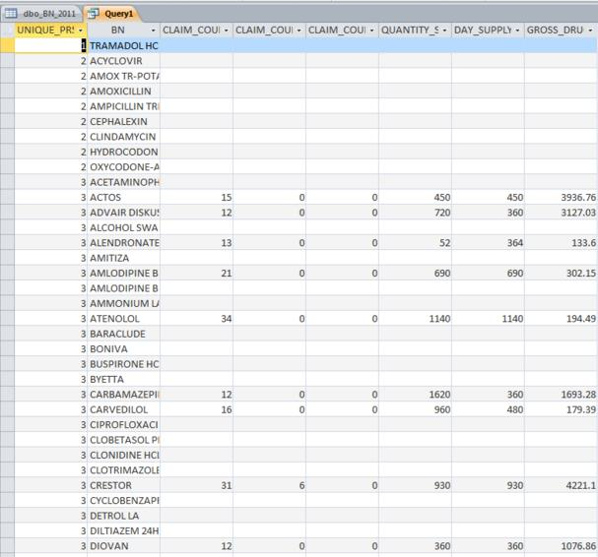

Slide 13
Medicare prescribing data
CMS also did additional data runs that we could not do because of redactions
Top 500 drugs prescribed nationally and in each state

Slide 14
Medicare prescribing data
We got the data in SAS files, which we read into SPSS and stored on SQL server.
CMS included unique IDs for prescribers and provided a separate table linking IDs to identifiers such as NPI or DEA.
Reporters could access via Access, SPSS or other programs via ODBC.

Slide 15
Beyond the Part D data
CMS NPI registration data (on CMS site) to identify doctors
DEA registered prescribers (from National Technical Information Service) to identify doctors that did not have NPI #s
Data from First Databank to help us categorize data into types of drugs
(Ex: Lipitor = antihyperlipidemic)

Slide 16
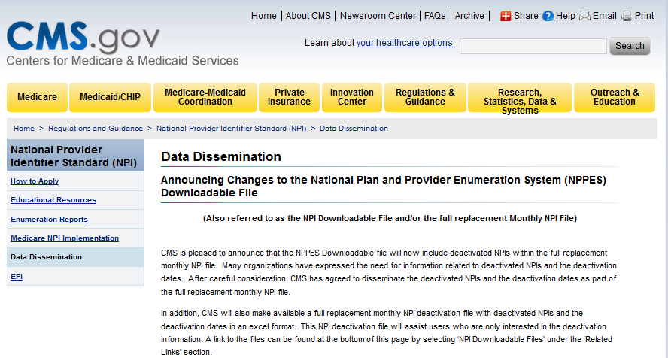
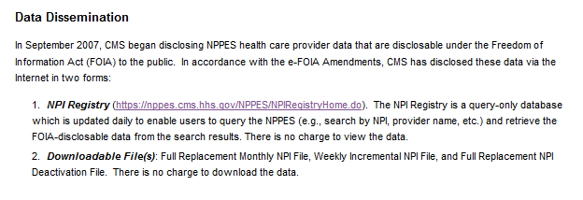
Beyond the Part D data

Slide 17
Beyond the Part D data
CMS NPI registration data (on CMS site)
DEA registered prescribers (from National Technical Information Service)

Slide 18
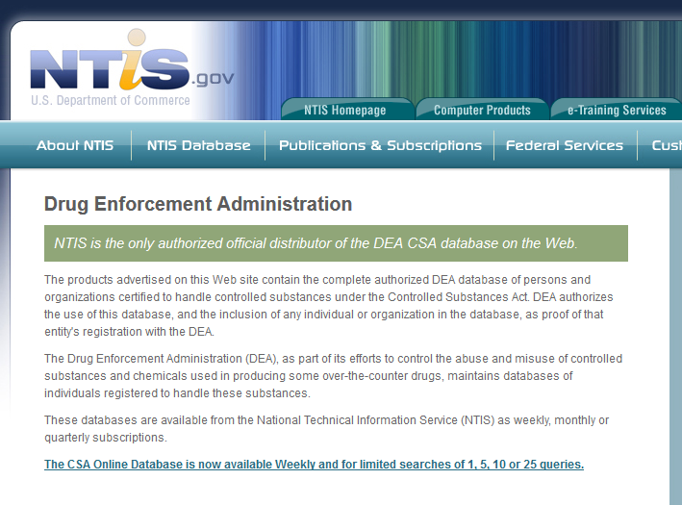
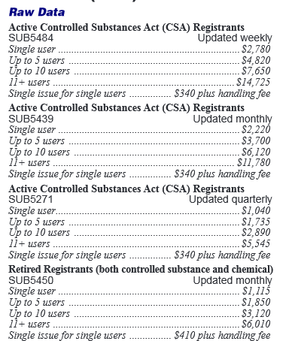
Beyond the Part D data

Slide 19
Beyond the Part D data
CMS NPI registration data (on CMS site)
DEA registered prescribers (from National Technical Information Service)
Data from First Databank to help us categorize data into types of drugs
(Ex: Lipitor = antihyperlipidemic)

Slide 20
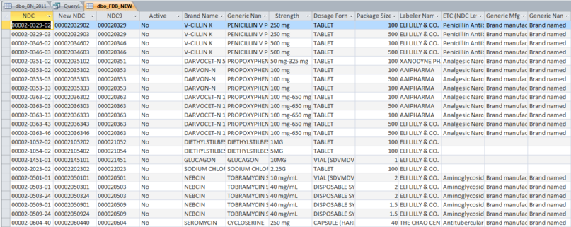
Beyond the Part D data

Slide 21
Beyond the Part D data
Data from American Geriatric Society on drugs dangerous to seniors (Beers)

Slide 22
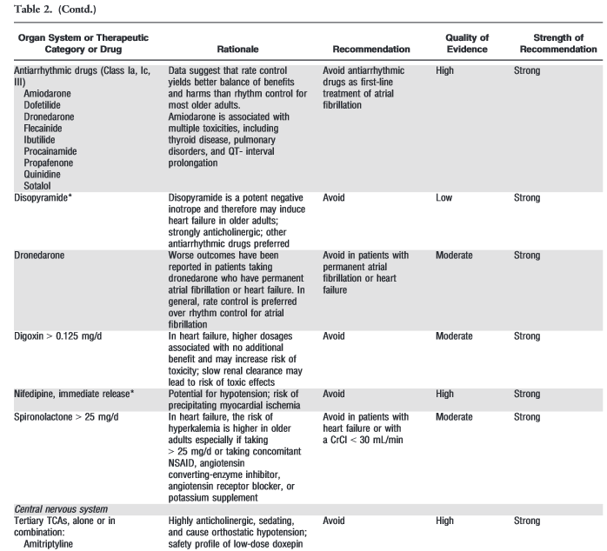

Slide 23
Beyond the Part D data
Data from American Geriatric Society on drugs dangerous to seniors (Beers)
Scraped drug information sites for top 500

Slide 24
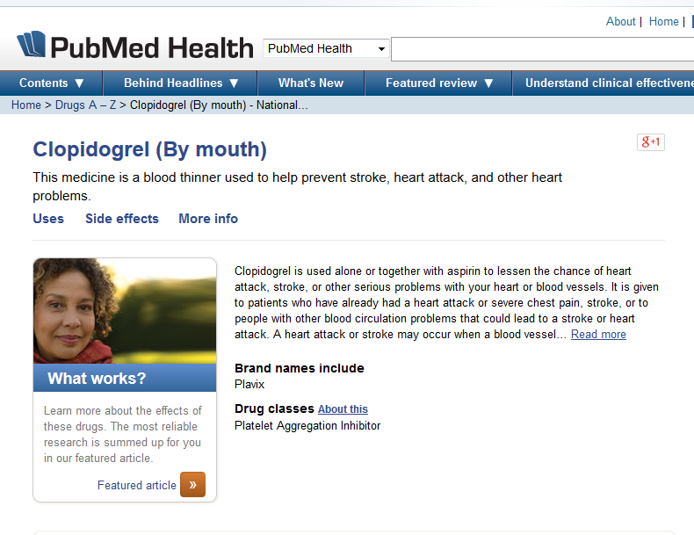

Slide 25
Beyond the Part D data
Data from American Geriatric Society on drugs dangerous to seniors (Beers)
Scraped drug information sites for top 500
Data from ProPublica’s Dollars for Doctors project to look at physicians who got money from drug companies

Slide 26
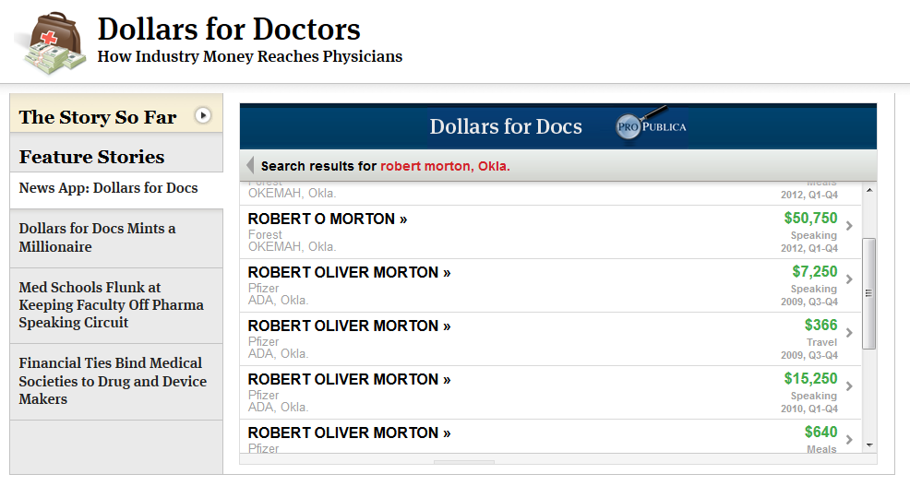

Slide 27
Medicare prescribing data
Talked to many experts about how to best examine the data and develop methodologies.
Within categories, did crosstabs to look for doctors who did not follow pattern
Those who prescribed at rates more or fewer than 2 standard deviation from others in category

Slide 28
Medicare prescribing data
Talked to those who prescribed high amounts or in unusual ways
Bounced findings off experts

Slide 29
What we found
Medicare’s failure to keep watch over Part D had enabled:
Inappropriate and risky prescribing
Billions of dollars in waste
Fraud to flourish
We also found clear signs that doctors who had relationships with pharmaceutical companies prescribed more name-brand drugs

Slide 30
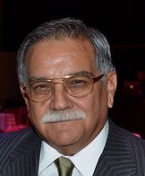
What we found
In his worn Miami office, psychiatrist Enrique Casuso said he has no choice but to give antipsychotics to many of his elderly patients.
Drugs keep them safe and ease their anxiety, Casuso said: "You have to submerge them in medication to avoid a catastrophic event."
In 2010, Casuso prescribed more of these medicines to seniors in Medicare than any other physician in the country--50 percent more than the second-ranking doctor.

Slide 31
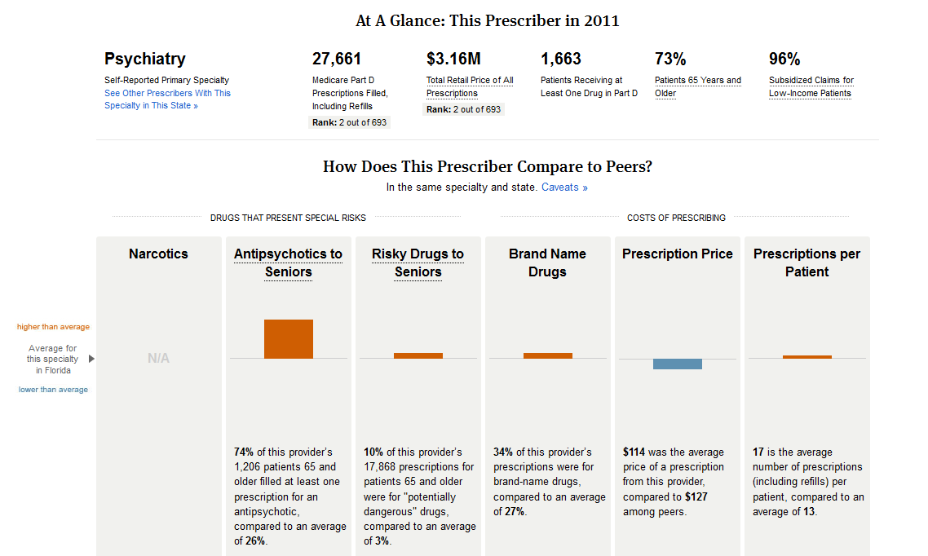

Slide 32
What we found
Dr. Hew Wah Quon is one of Medicare’s top prescribers. From a worn office in Los Angeles’ bustling Chinatown, he churned out $27 million worth of prescriptions from 2009 to 2011, data show.
He mostly prescribed name brands, such as AstraZeneca’s Crestor, for high cholesterol. Crestor costs more than $6 a pill; the leading generic costs as little as 20 cents.
If Quon had prescribed the way other internists do in California, choosing drugs so that his average cost was similar to theirs, he alone could have saved Medicare $5 million in 2011, ProPublica’s analysis shows.

Slide 34
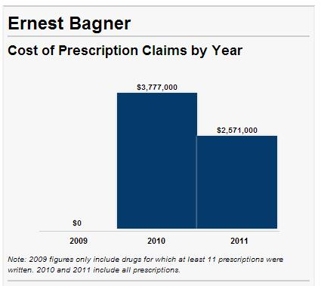
What we found

Slide 35
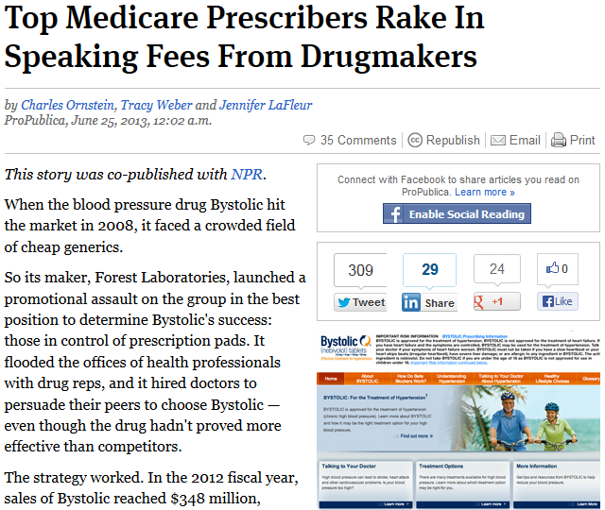
Marrying the databases

Slide 36
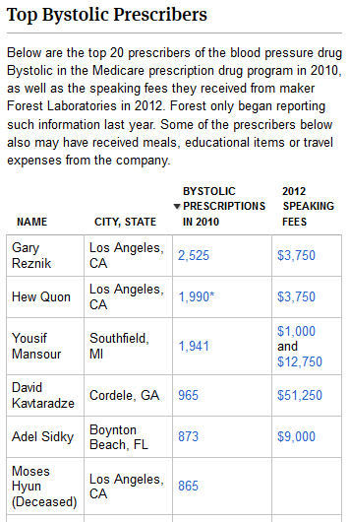
The beta blocker Bystolic

Slide 37
Medicare prescribing data
In some cases, prescriptions from other physicians within a clinic or practice were attributed to one physician.
In some cases, pharmacies entered the wrong NPI number.
In some cases, prescriptions were attributed to “dummy” prescribers.

Slide 38
Other prescribing data
State Medicaid prescription data
Veteran’s Administration

Slide 39
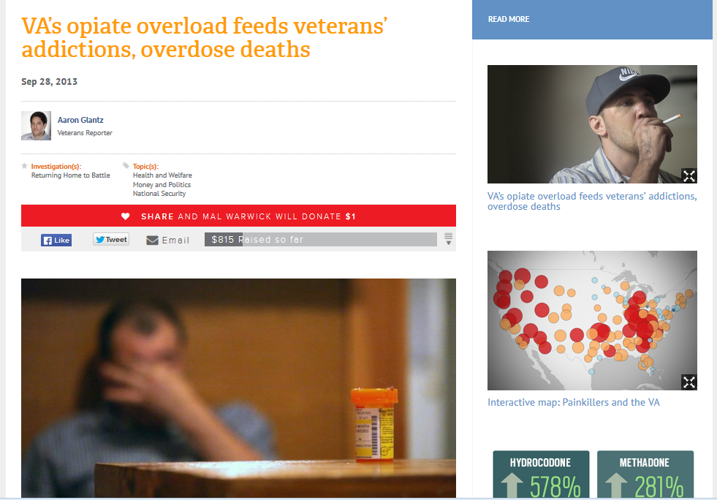

Slide 40
What’s new in 2014
CMS will release new data on:
Prescribing in Part D for 2012
Physician payments in Medicare Part B
Pharmaceutical and medical device company payments to doctors

Slide 41
Looking your local prescribers
Using ProPublica’s Prescriber Checkup

Slide 42
Questions?
charles.ornstein@propublica.org
jlafleur@cironline.org
Get a copy of this presentation at www.jenster.com/2014 or at cornstein.tumblr.com

