Slide 1
Tracking non-profit money
(and some stuff about money and schools)
Education Reporting Fellowships
Columbia University
Jennifer LaFleur, ProPublica

Slide 2
Non-profit funding of education
What can they do? What are the state laws on outside funding for public education?
Courtesy: http://www.edweek.org/media/eperc_finance_0410.pdf

Slide 3
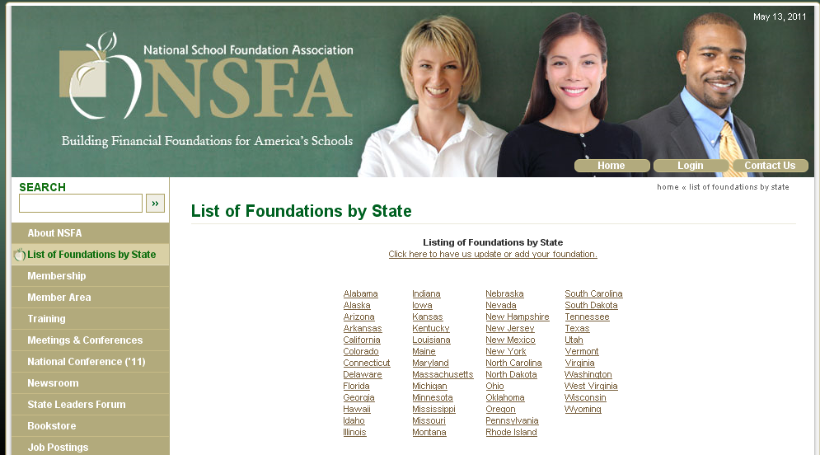
Non-profit funding of education
Who are they?

Slide 4
Non-profit funding of education
What are they doing?

Slide 5
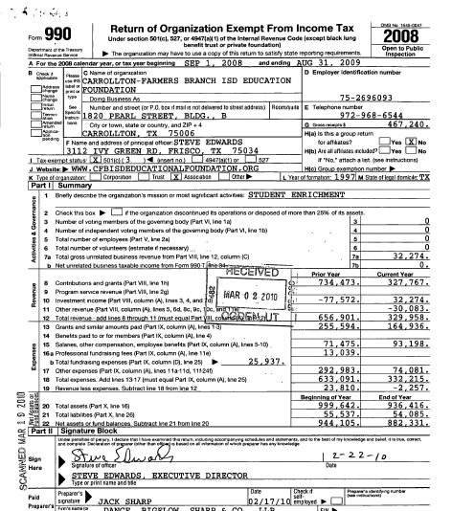
Non-profit funding of education
What are they doing?
(Besides trick roping)
Get the 990 form

Slide 6
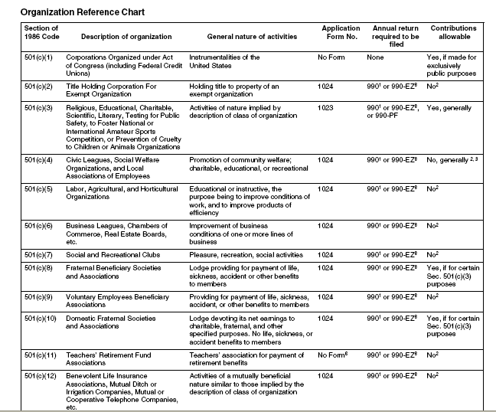
http://www.irs.gov/pub/irs-pdf/p557.pdf

Slide 7
Getting the 990 or other financial information
Guidestar – www.guidestar.org --- You need to register, but can get the past three years’ 990s for free. Beyond that you need to pay
Foundation Center - foundationcenter.org has more years of 990s available for free– but not every non-profit is available.
Your state secretary or state or whichever agency oversees corporations – will give you basic information
IRS – You can request them from the IRS
The organization itself is required to provide them – in some states, non-profits have to provide more information about their books.

Slide 8
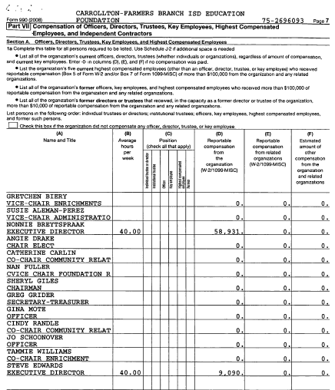
Non-profit funding of education
Who are they?

Slide 9
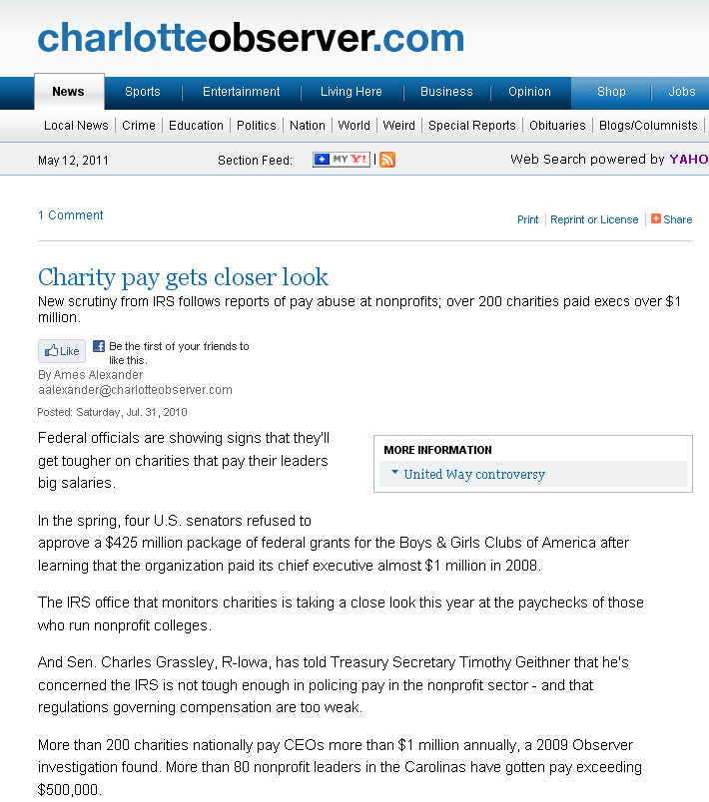
Source: Non-profit financial data
Findings: Hundreds of charities pay their top managers big bucks

Slide 10
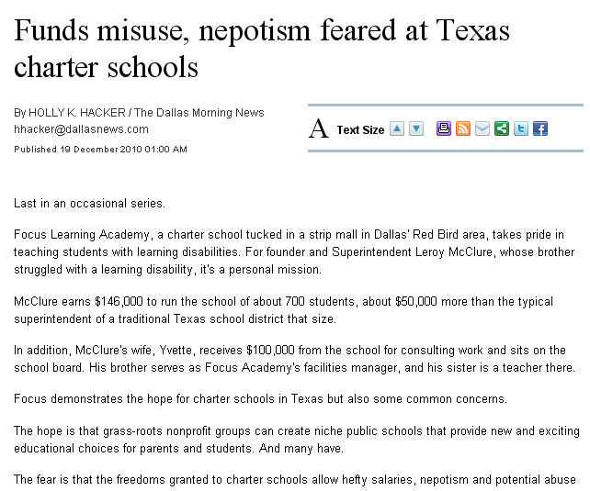
Source: Salary data and other charter school records
Findings: Reporters Found nepotism in charter schools and administrators earning six-figure salaries to run schools with only a few hundred or a couple of thousand students

Slide 11
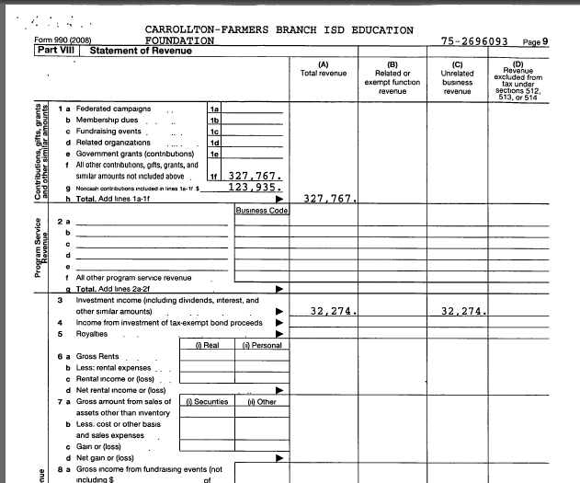
Non-profit funding of education
Where is the
money from?

Slide 12
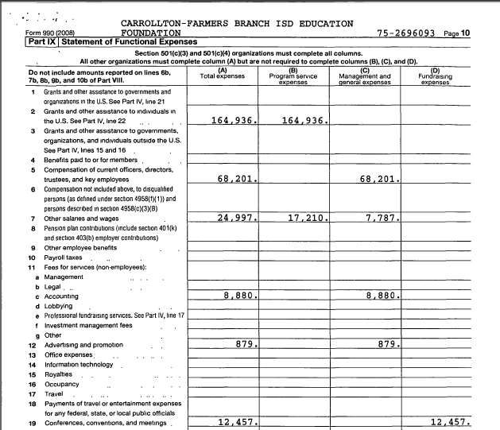
Non-profit funding of education
Where is the
money going?

Slide 13
Analyzing 990s
What percentage of the money is going to operations versus administration?
Look at changes over time – big increases or decreases? This may require typing the figures into your spreadsheet program.
If a non-profit gave money to a school or district, the school or district should have a record of receiving the same amount.

Slide 14
Other documents and data
Consolidated financial statements/annual reports – compare to 990
Independent or government audits – the IRS audits only 1 percent of all non-profits, so there may be errors on 990 forms
If they get federal money, SINGLE AUDIT
Federal grants and loans: usaspending.gov

Slide 15
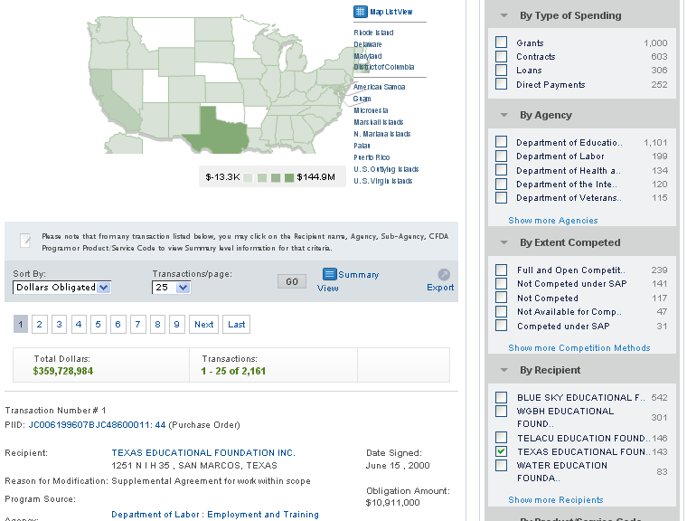
www.usaspending.gov

Slide 16
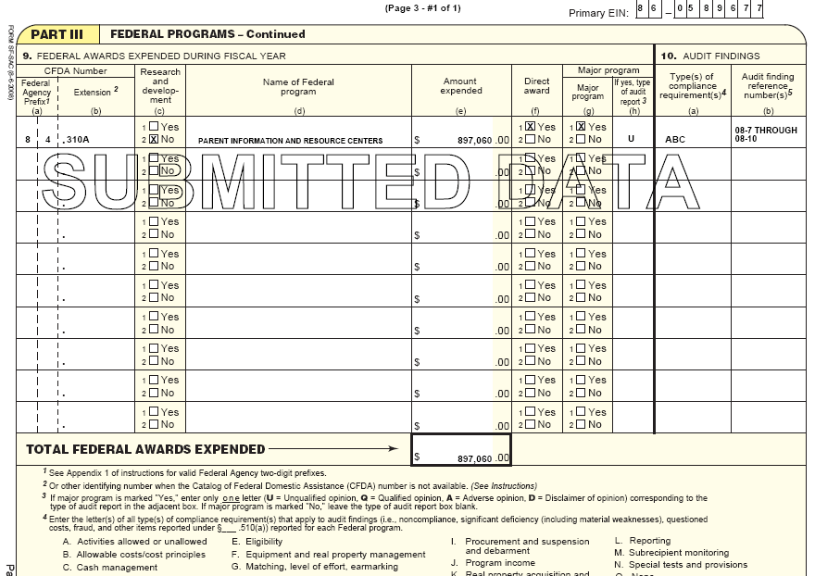
Federal Audit Clearinghouse: http://harvester.census.gov/sac/

Slide 17
Look at connections
Between donors and who else they give to
Between board members and what other boards they are on
Between recipients of funds

Slide 18
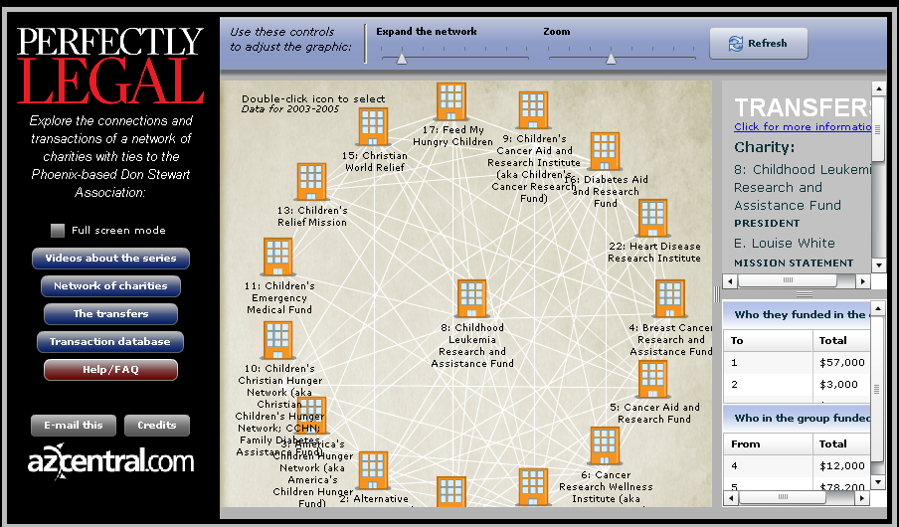
http://www.azcentral.com/flash/news/charities/index.html

Slide 19
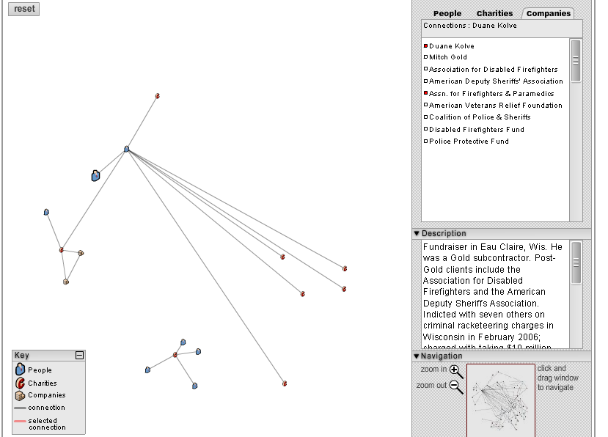
www.ocregister.com/multimedia/gold/

Slide 20
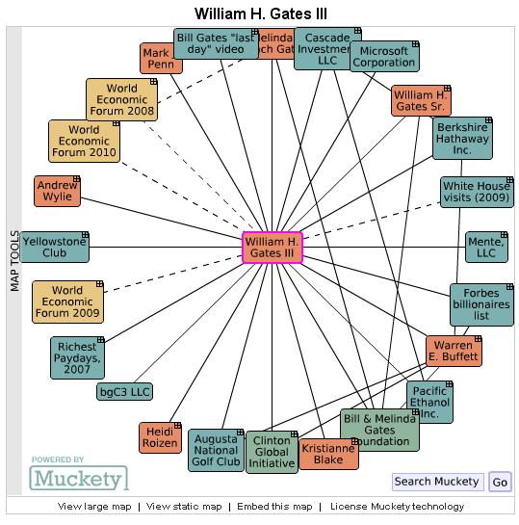
Muckety map of Bill Gates

Slide 21
Other connections
Who is on the foundation boards?
What influence might they have?
What are their other connections?
Are they making campaign contributions to state legislators or members of Congress?

Slide 22
Is it making a difference?
Are schools seeing the benefit of the programs?
Test scores, truancy, graduation rates

Slide 23
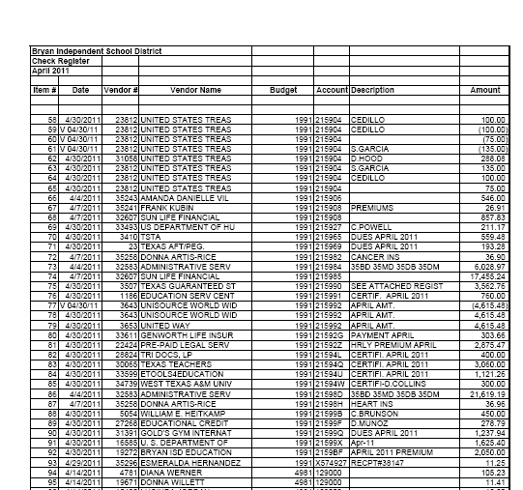
More data to track on the school/district side
Check registers
Contractors/Vendors
Sources of revenue
Personnel

Slide 24
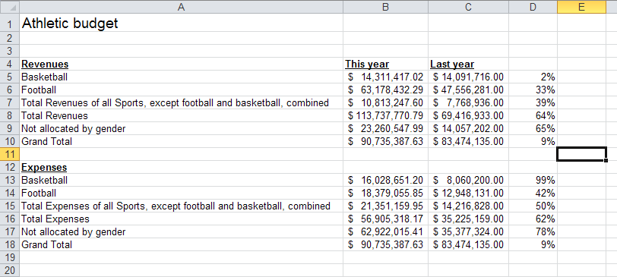
Changes in the budget

Slide 25
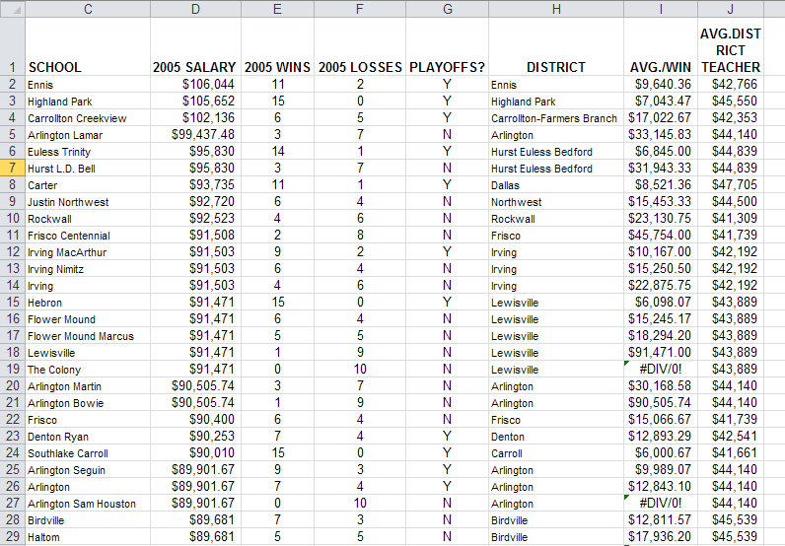
Salaries

Slide 26
In a time of budget woes – examining finances is key
Is there misspending?
Double-dipping
Special bonuses – car allowances
Are they doing with the money what they said they would?

Slide 27
Source: School district credit card purchases
Findings: District card holders made questionable purchases with their cards.

Slide 28
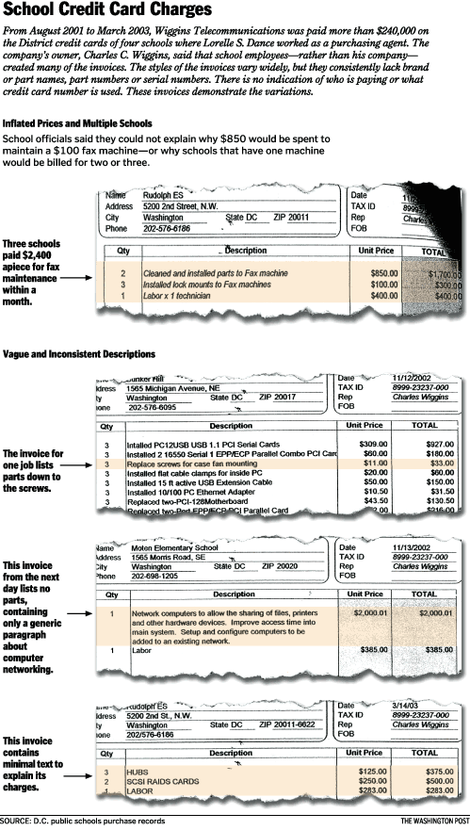

Slide 29
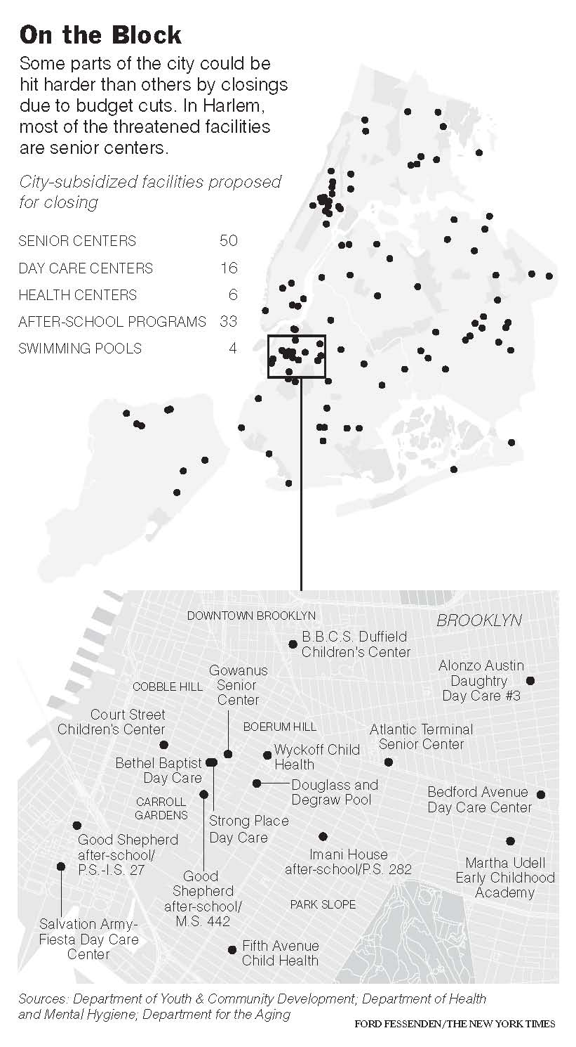
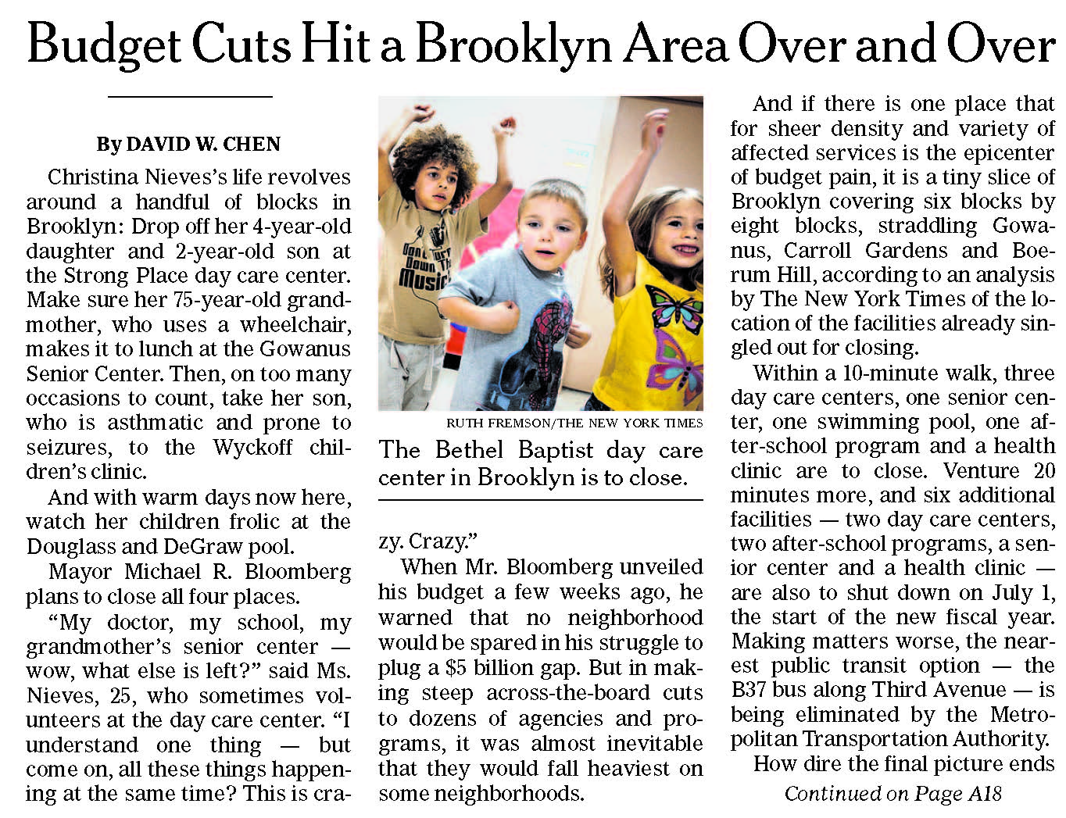
Source: City Budget
Findings: Some neighborhoods suffer more than others as mayor cuts budgets

Slide 30
Source: Voting and teacher data
Findings: “…they gave this promise to school board members: Support us or we'll remember you on election day.
But election day came, and the vast majority of teachers didn't show up.”

Slide 31
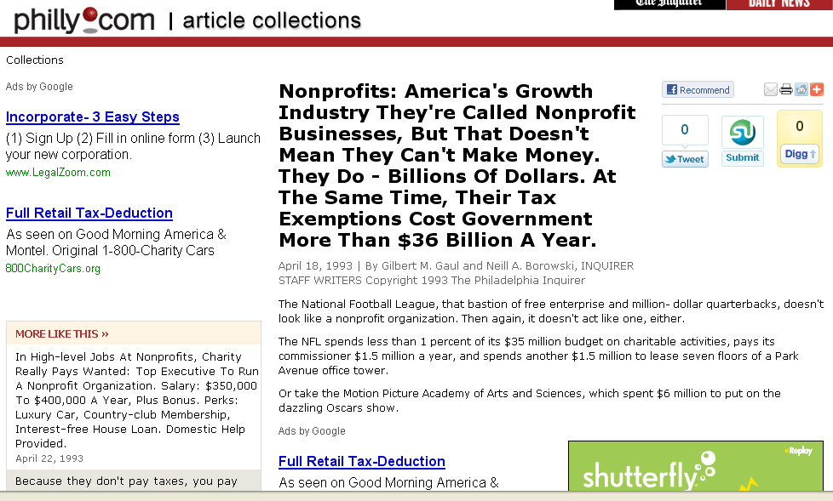
http://articles.philly.com/1993-04-18/news/25983746_1_organizations-nonprofits-account-nonprofit-hospitals

Slide 32
Other resources
www.ire.org – tip sheets, extraextra, story database
www.rcfp.org – information on public records by state – and help with public records requests
www.npccny.org/Form_990/990.htm -- Nonprofit Coordinating Committee of New York – Good info on understanding nonprofits
Reynolds Center – businessjournalism.org

