Slide 1
Let’s get maptastic

Slide 2
Mapping for stories
Jennifer LaFleur, CIR
Ronald Campbell, awesome
David Herzog, huge contributor

Slide 3
Some of these examples were provided by Jo Craven-McGinty of the New York Times. Thanks Jo!

Slide 4
Using maps in the newsroom
Navigation for Web data
Show summary data
Show locations
Help you check assumptions
Provide the basis for reporting

Slide 5
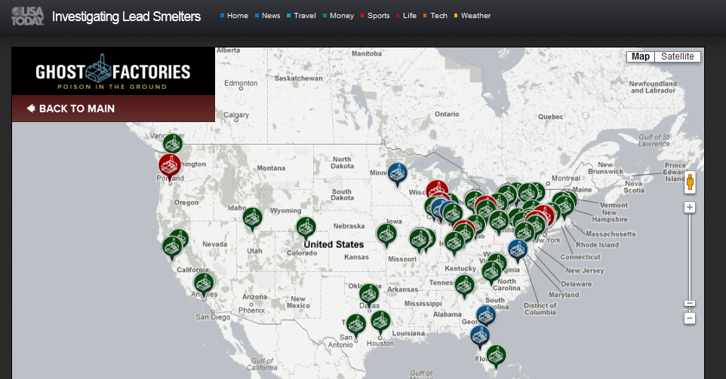

Slide 6
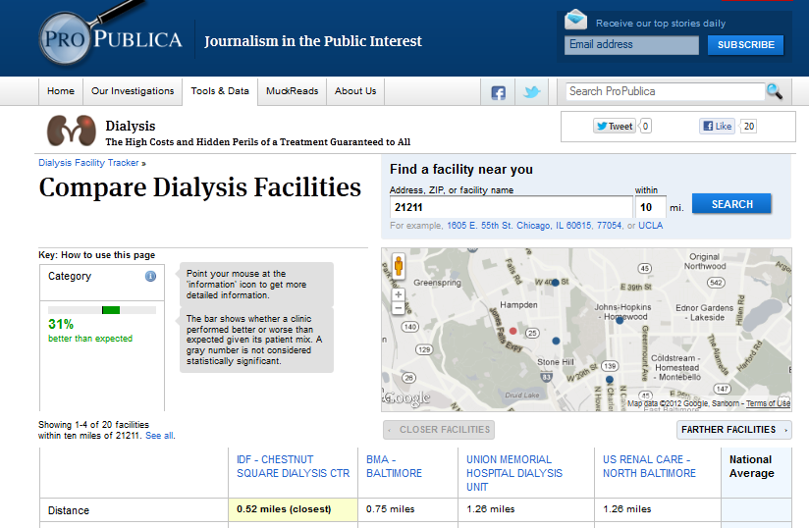

Slide 7
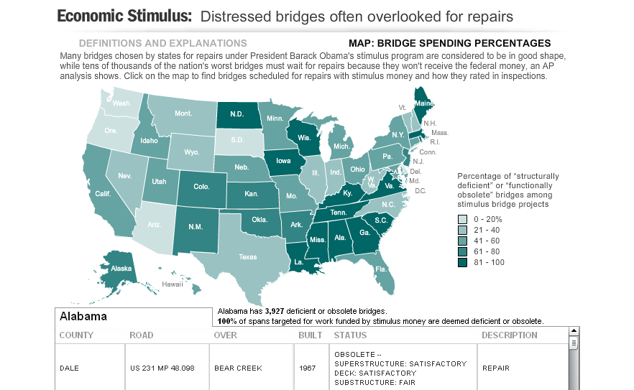
Associated Press: Bridge inspections v. stimulus spending

Slide 9
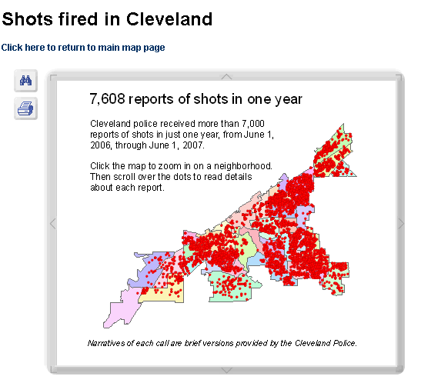

Slide 10
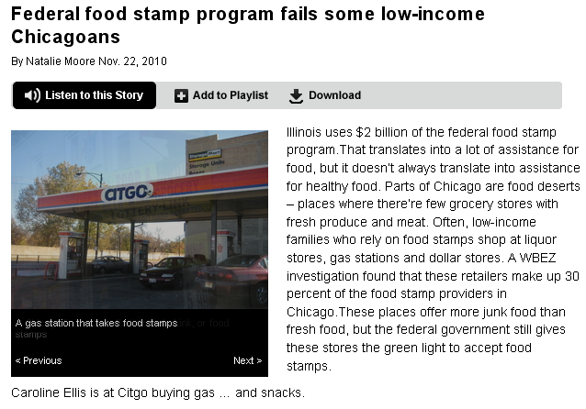
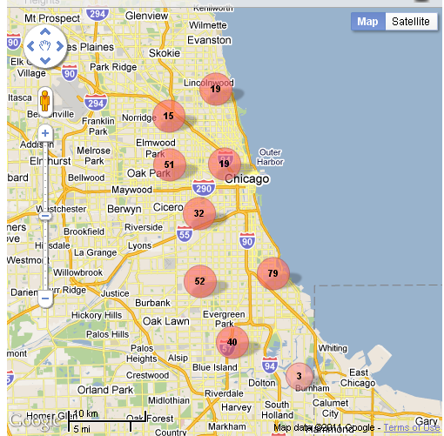
Source: Food stamp sales
Findings: Areas where people using food stamps have little or no access to full-service grocery stores…Liquor stores, gas stations and dollar stores make up 30 percent of food-stamp sales in Chicago

Slide 11
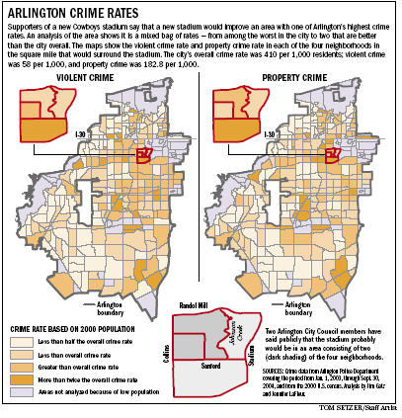
Test assumptions
Source: City of Arlington crime data
Findings: The site for the new stadium not as crime-ridden as officials say

Slide 12
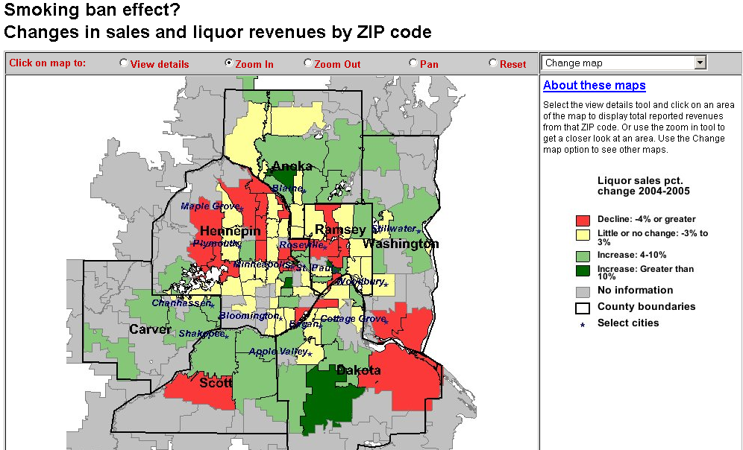
Test assumptions

Slide 13
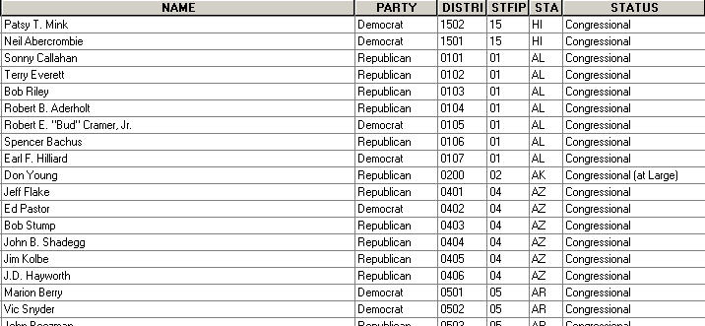
Every map for analysis has a database

Slide 14
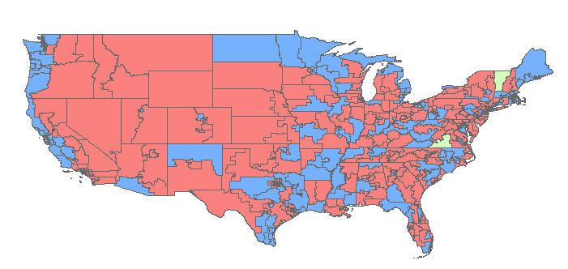
Connected to geography

Slide 15
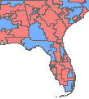
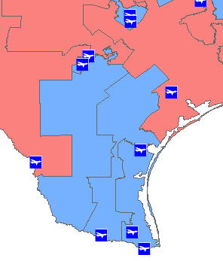
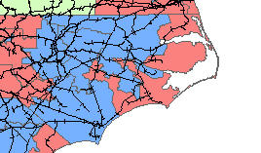
Connected to geography

Slide 16
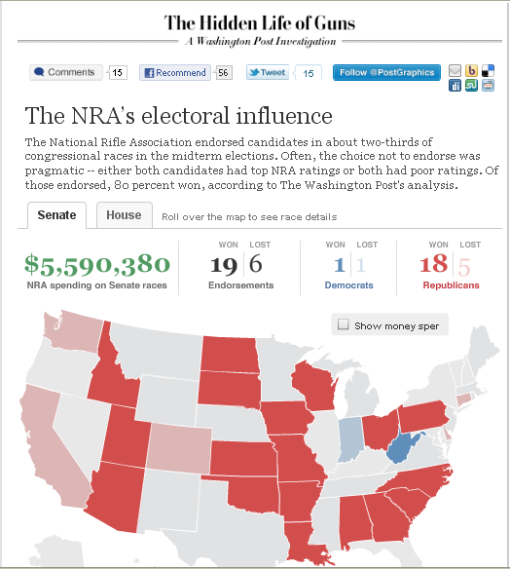
Source: Center for Responsive Politics, National Rifle Association, FEC filings.
Navigation and trends

Slide 17
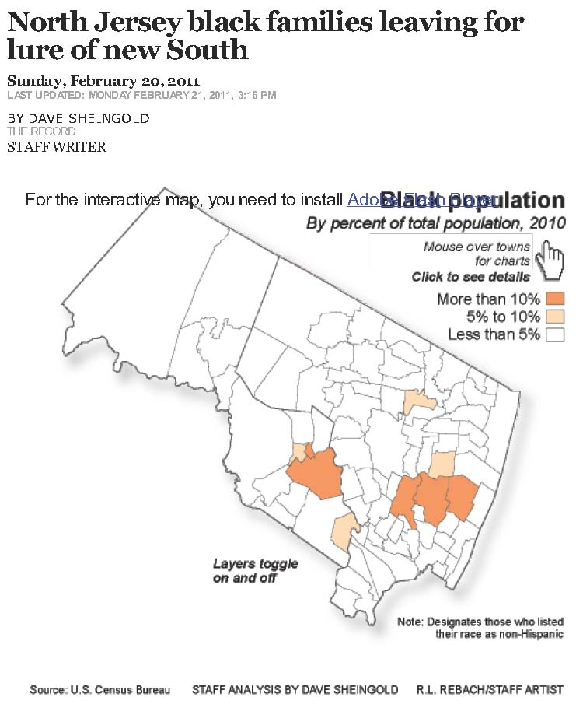
Source: Census Data
Findings: African-Americans are leaving black enclaves in the Northeast to move South to places that generations before them had fled.

Slide 18
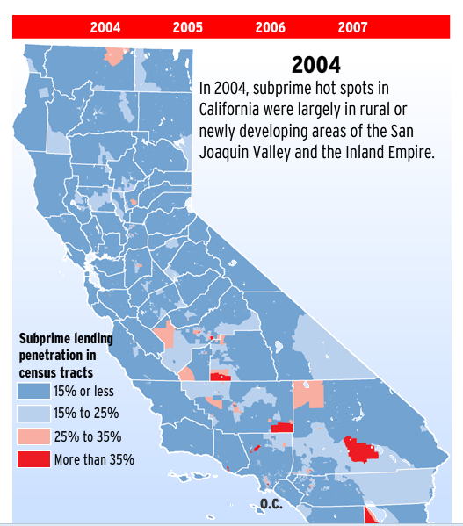

Slide 19
Combining data
Census data versus bank locations
Flood area versus building permits
Transit routes versus census data
Crime incidents versus police distribution
Stimulus funding and unemployment

Slide 20
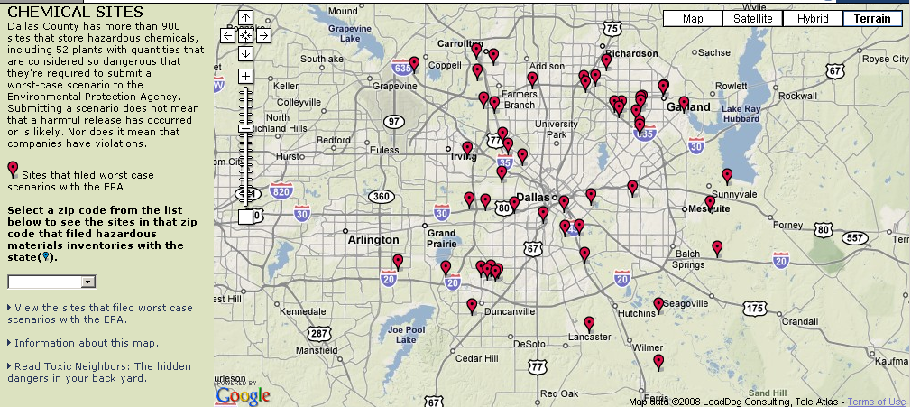
Source: EPA and state data on hazardous chemical locations
Findings: Dallas County has 900+ sites that store hazardous chemicals

Slide 21
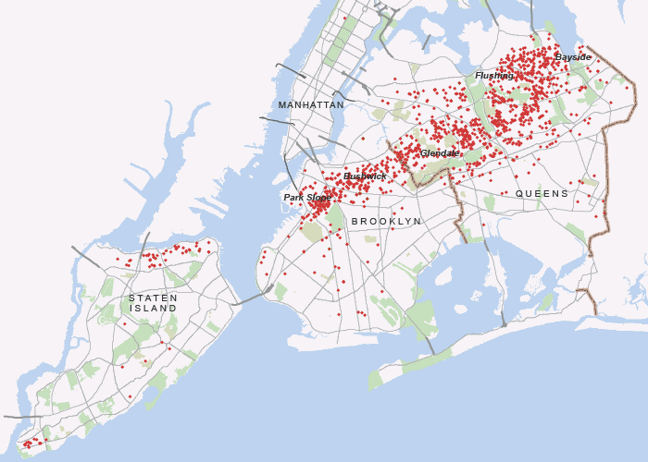
Source: 311 calls for downed trees
Findings: After a tornado swept across New York City, 311 calls for downed trees helps trace its path

Slide 22
Stories
Think about the stories you and others already doing - and how geography affects them.
Find the experts in other disciplines who are using mapping
Crime mapping
Demographers
Planners
Environmental scientists

Slide 23
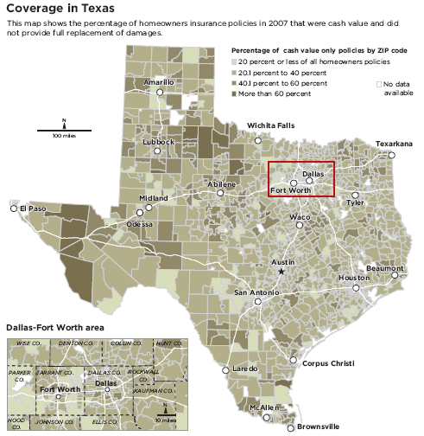
Source: Texas Department of Insurance
Findings: Cash only policies were in lower income ZIP codes.
5:09 PM

Slide 24
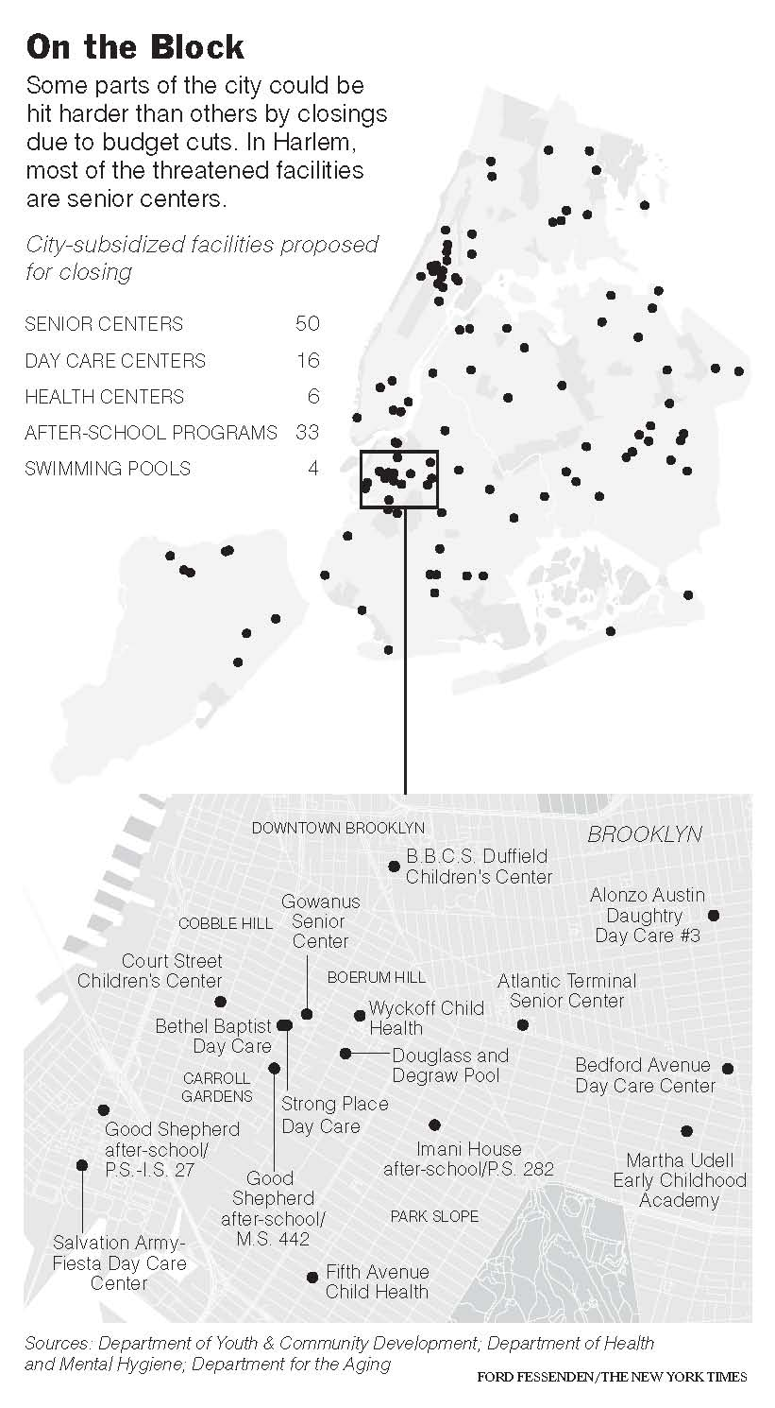
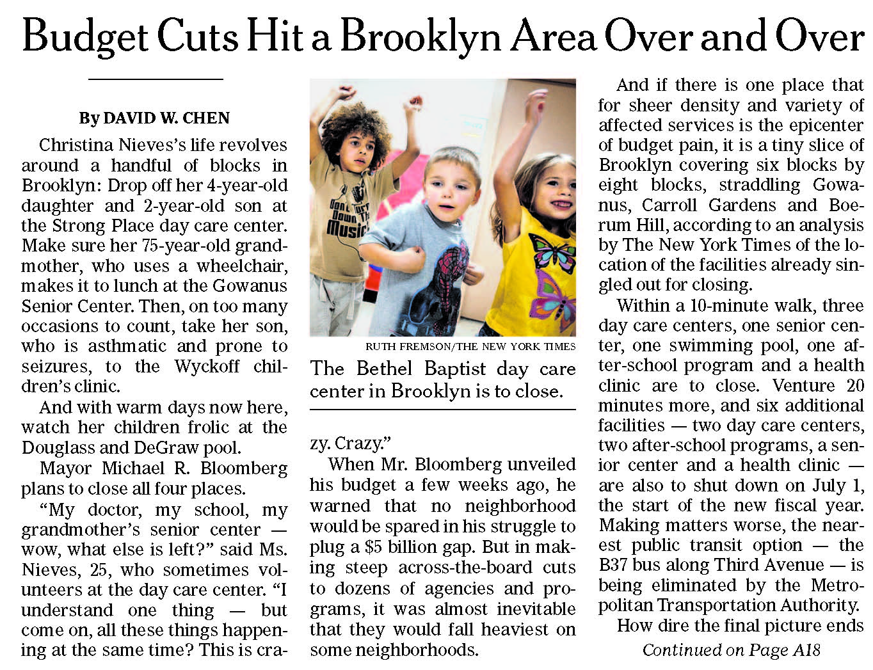
Source: City Budget
Findings: Some neighborhoods suffer more than others as mayor cuts budgets

Slide 25
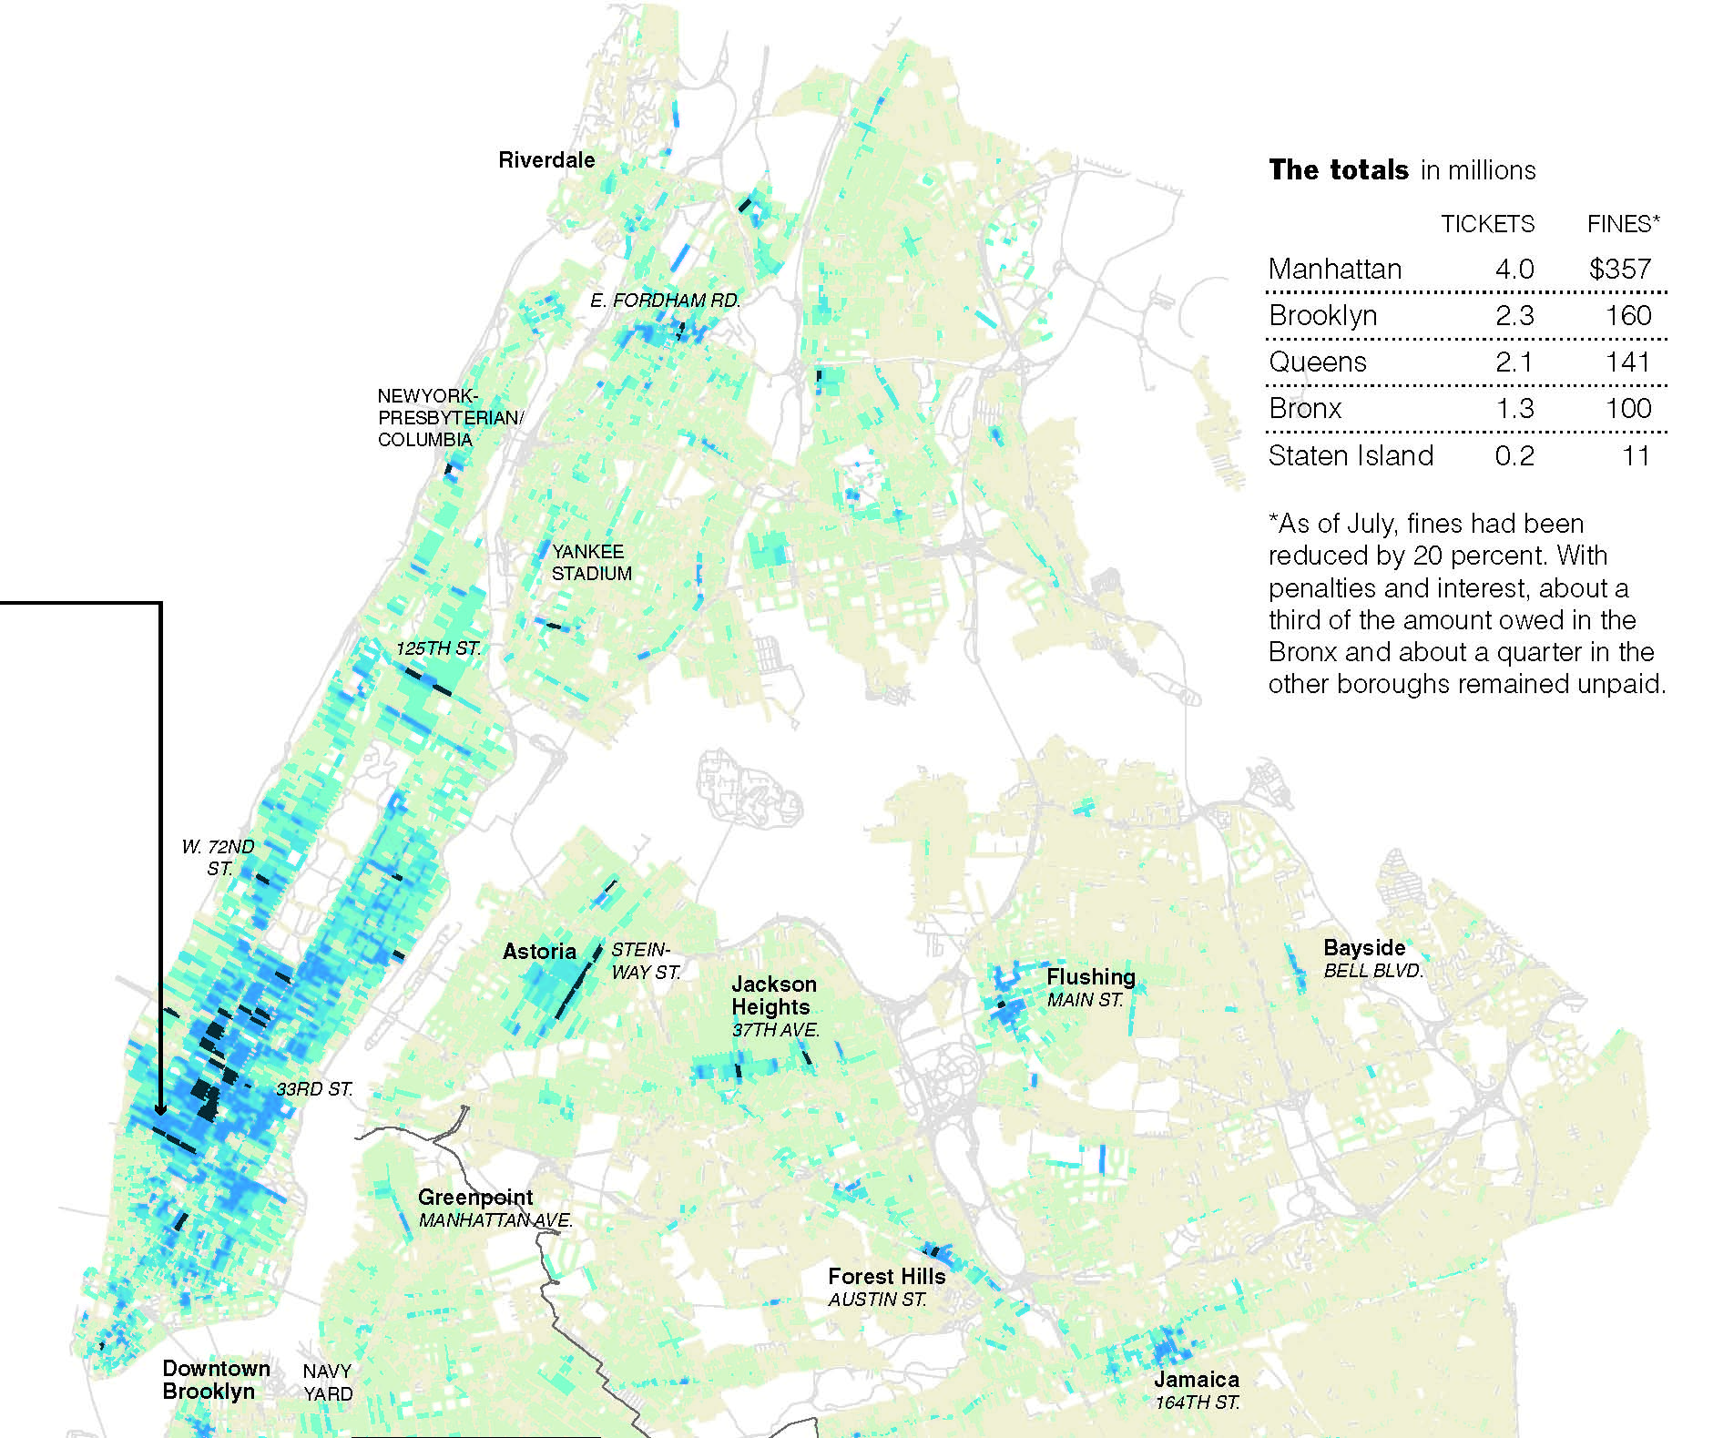
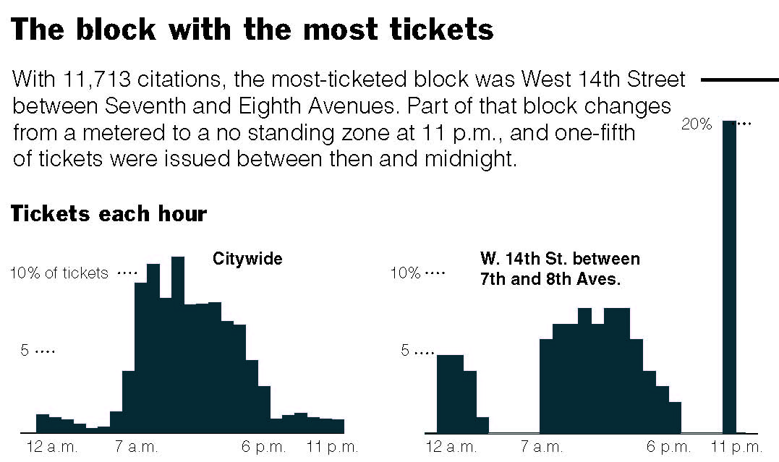
Source: Parking tickets
Findings: Ticket “dumping,” “disco” towing, day with most tickets, block with most tickets

Slide 26
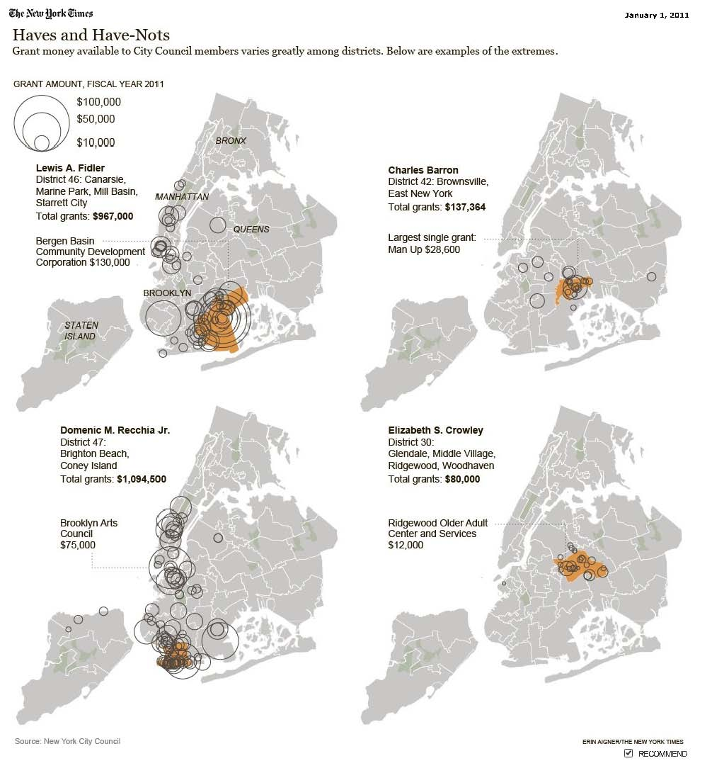
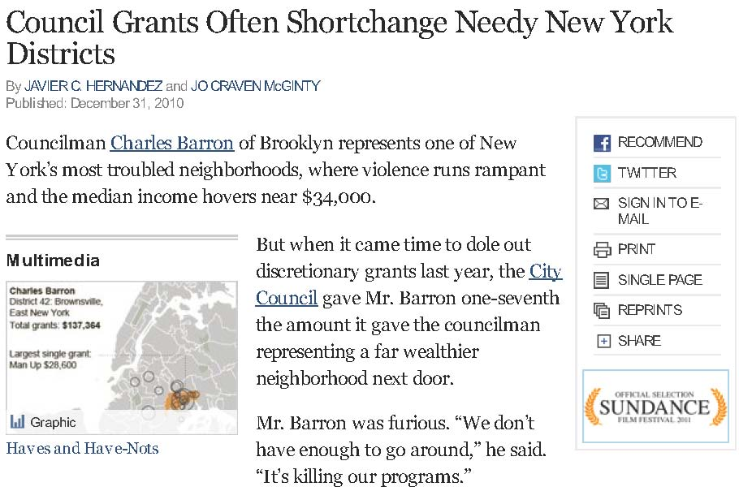
Source: City Council discretionary spending (earmarks)
Findings: Allies of the speaker seem to get more money to spend in their districts

Slide 27
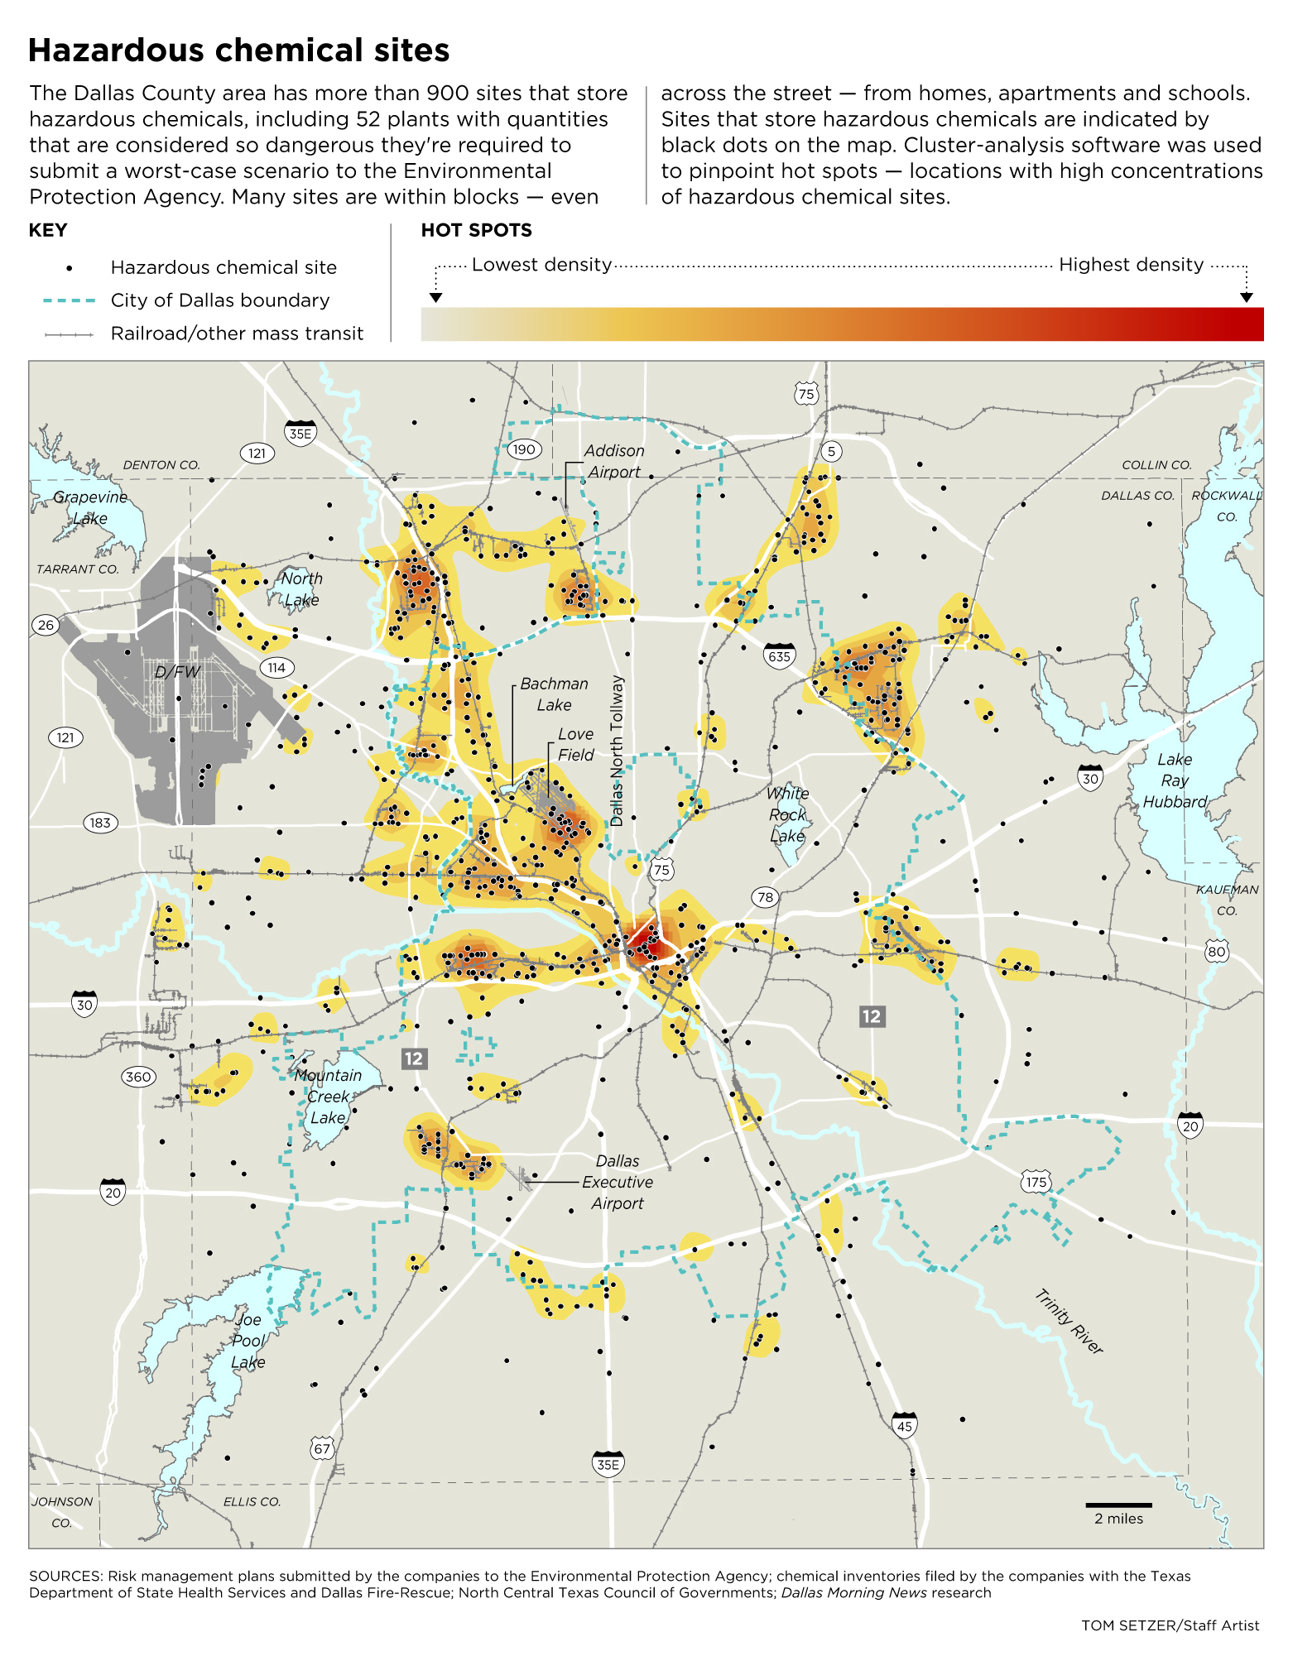
Find hot spots
(stay tuned for more info on that)

Slide 28
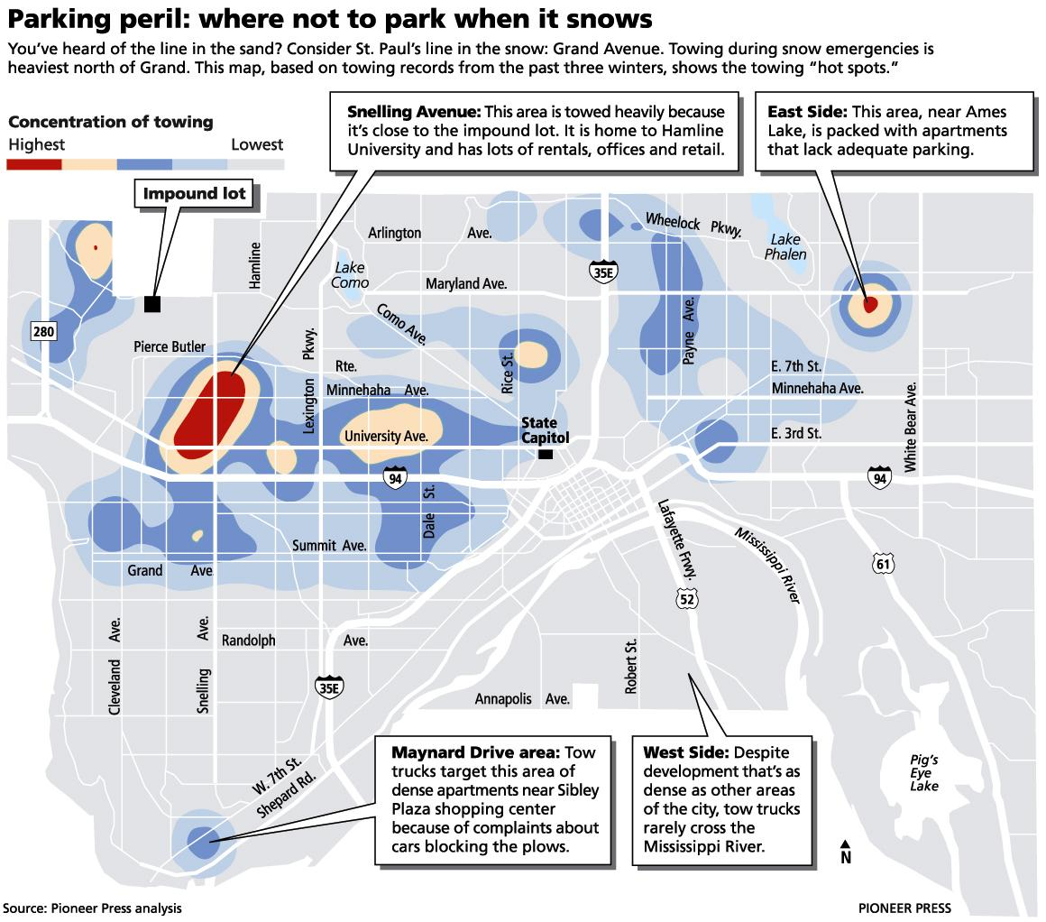

Slide 29
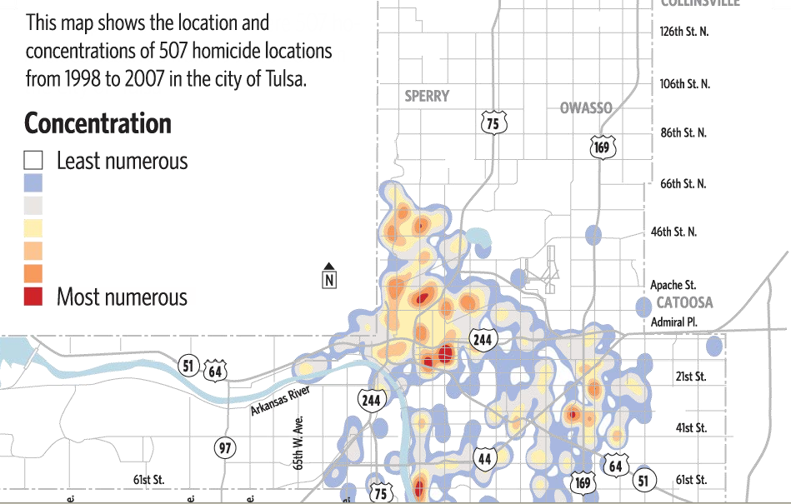

Slide 30
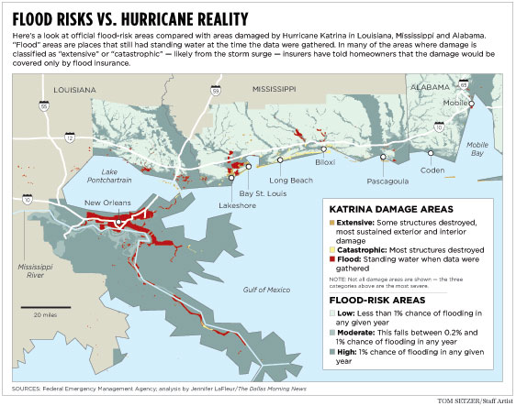
The power of layers

Slide 31
Cleveland Plain Dealer

Slide 32
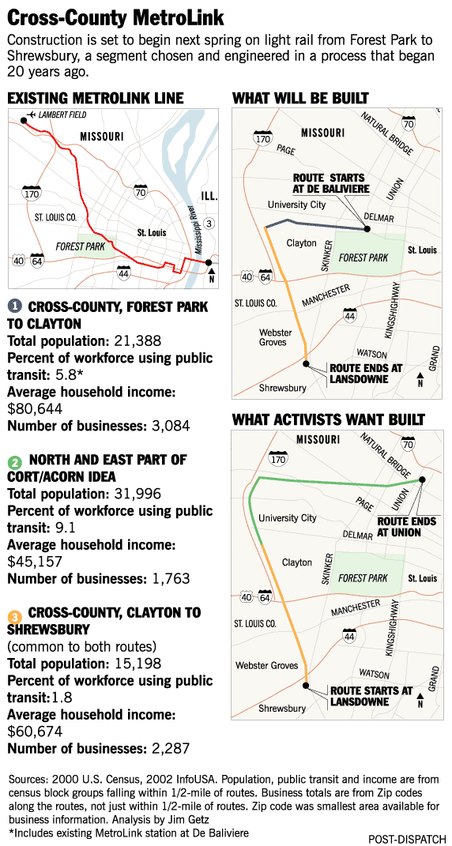

Slide 33
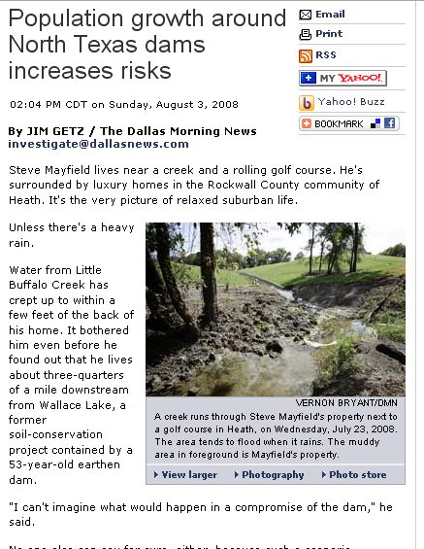
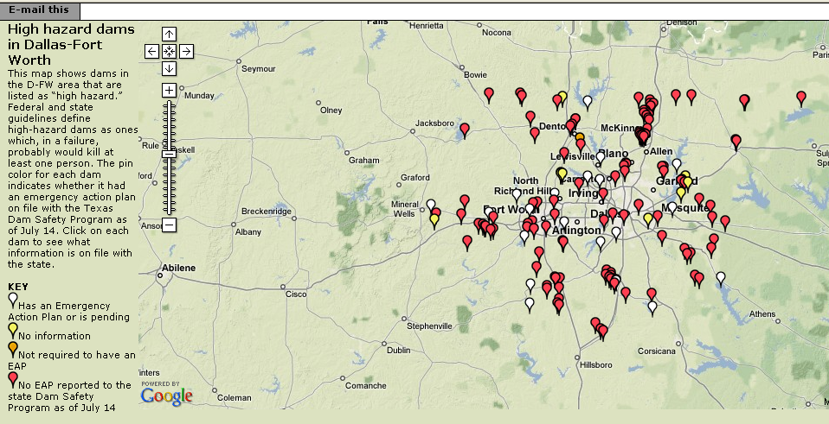
Source: Dam inspection data from Texas and federal government
Findings: Dam records had not been updated to account for population growth
5:09 PM

Slide 34
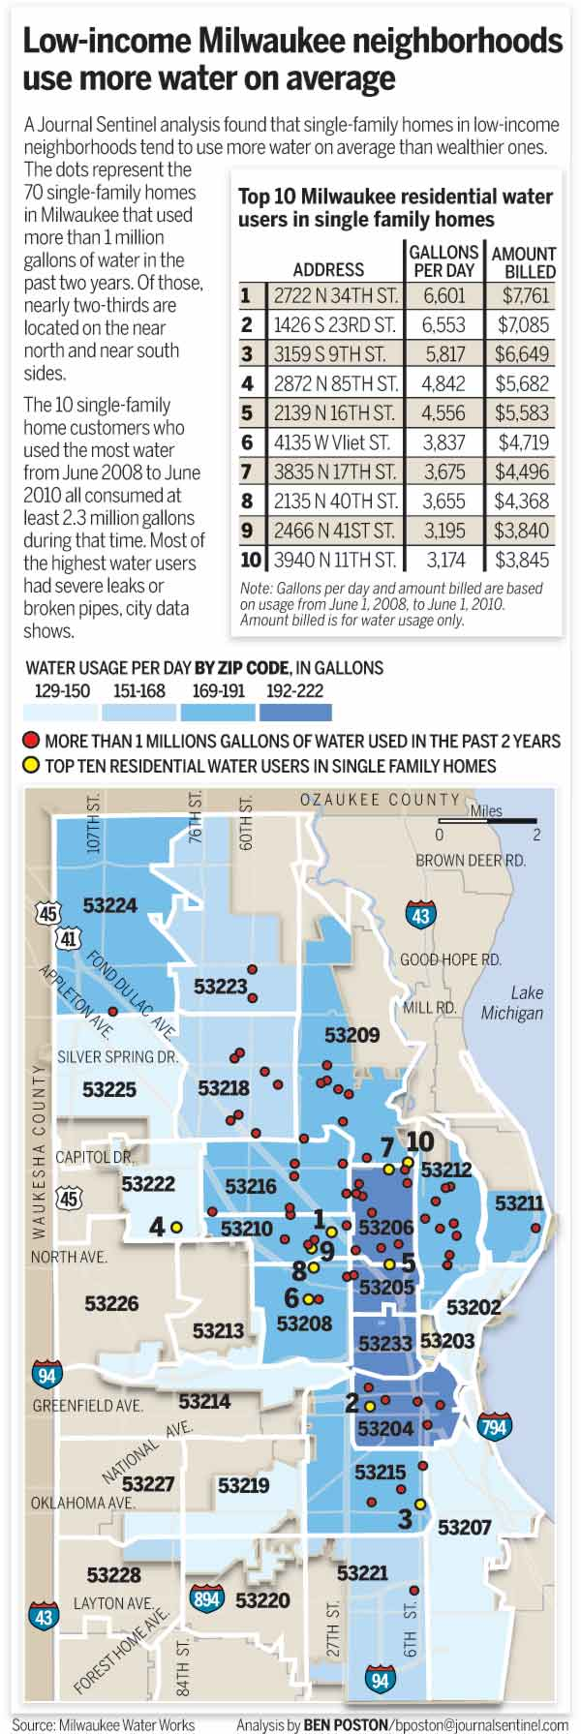
Disparities in water usage
“Water use highest in poor areas of the city”
Mapping and statistical analysis
5:09 PM

Slide 35
Maps to have on hand in your newsroom
Local roads
Precincts
Parcels
Police reporting areas
Census geography
School districts/schools

Slide 36
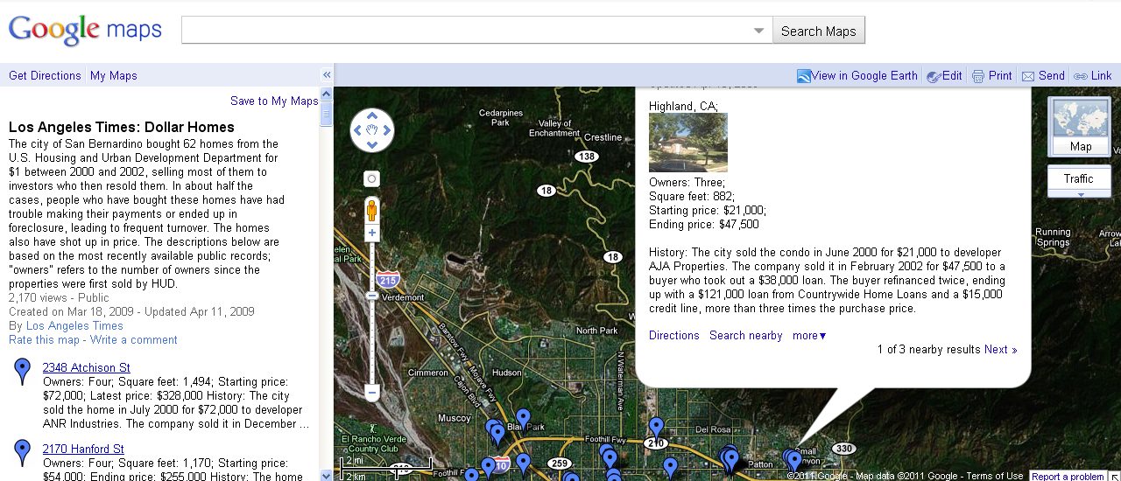
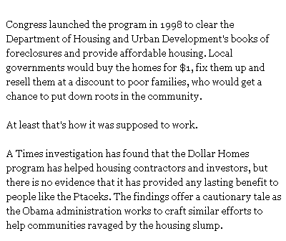

Slide 37
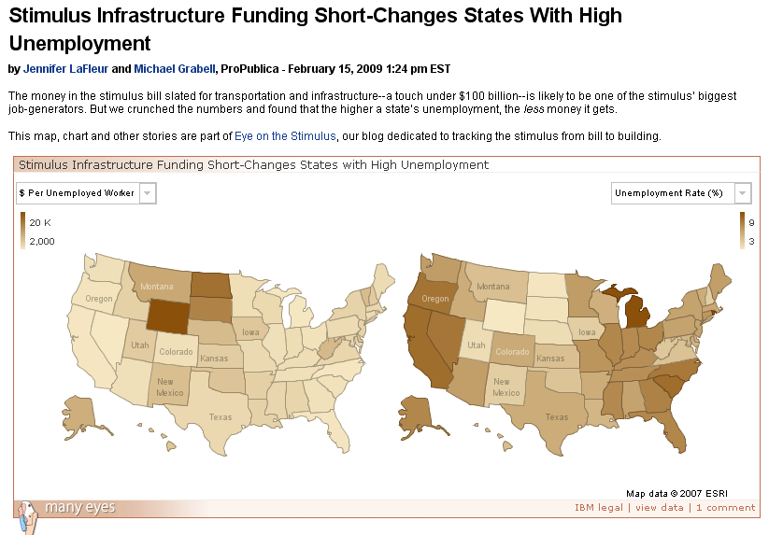

Slide 38
Access to GIS
Know how your state law treats GIS
Watch out for: privacy, privatization, cash cows, homeland security
Places to find data
Universities
GIS users group
State GIS clearinghouse
Local/state agencies

