Slide 1

Using FOIA for investigations
IRE Better Watchdog Workshop
St. Louis
Jennifer LaFleur, ProPublica

Slide 2
What does FOIA cover?
U.S. federal agency records
  Paper, electronic, tape recordings, data
  Sometimes (but not always) government contractor’s records
Does not cover
  Congress
  The Courts
  Answers to questions

Slide 3

The basics steps for
requesting records
Before filing a request: Ask for it
If they require a formal request, find out who it should go to and what you should ask for
Letter should describe what you’re asking for under FOIA
  State that they should reply within 20 business
  Request an itemized cost estimate
  Provide all possible contact information
  Note that you’re willing to negotiate

Slide 4
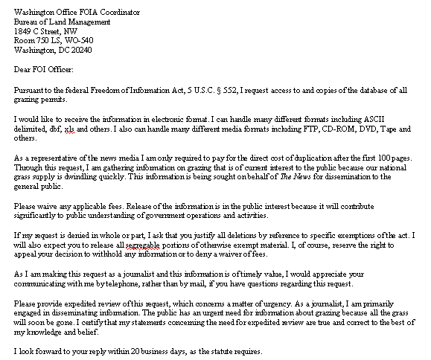

Slide 5
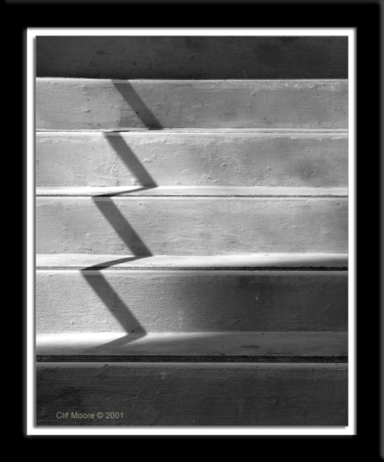
The basics steps to
requesting records
Do your homework – check the annual FOI reports for the agency
Delay can constitute denial. A requester may institute proceedings 5 days from the date of the request.
If you are denied records, file an appeal. Some agencies comply with appeals
Follow up on your requests

Slide 6
The nine exemptions to FOIA
  National Security
  Internal agency personnel rules
  Information exempt by other laws
  Trade secrets
  Internal agency memoranda
  Personal privacy
  Law enforcement investigations
  Federally regulated banks
  Oil and gas wells

Slide 7

Dos and Don’ts
Know what you’re asking for
Follow, follow, follow
Know the law
Know the appropriate cost guidelines
Be willing to negotiate
Address your request to the correct person

Slide 8
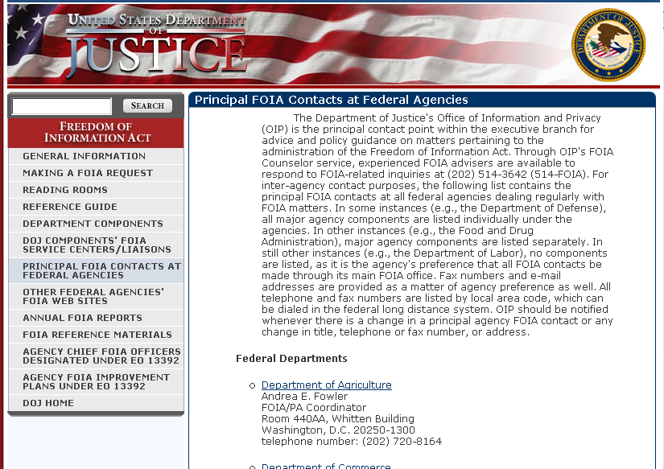

Slide 9
Planning, Negotiating
Who has the record?
Who do they share it with?
Has it been released before?
The law and possible exemptions?
What information is needed for the story?
How much time do you have?

Slide 10
Our computer system can’t do that.

Slide 11
We don’t have the authority to do that

Slide 12
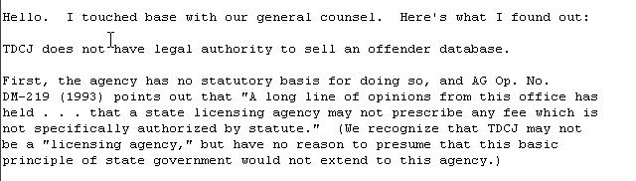

Slide 13
That will cost $25,000.

Slide 14
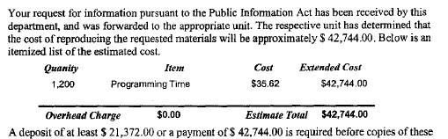

Slide 15
That uses proprietary software.

Slide 16
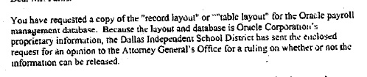

Slide 17
Our database is on a mainframe and it’s very complicated, Missy

Slide 18
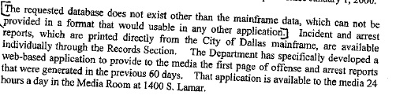

Slide 19
We don’t keep that information on computer

Slide 20
Resources:
Investigative Reporters and Editors – www.ire.org/foia
The Reporters Committee for Freedom of the Press: www.rcfp.org
Freedom of Information Center at the University of Missouri – http://foi.missouri.edu
Justice Department’s FOIA page (includes links to FOIA officials and annual reports) -- http://www.usdoj.gov/04foia/index.html

