Slide 1

The art of requesting and negotiating for data
NICAR 2012
David Hunn, St. Louis Post-Dispatch
Jennifer LaFleur, ProPublica

Slide 2

Where’s the data?
If something is inspected
Licensed
Enforced or
Purchased
….There probably is a database

Slide 3
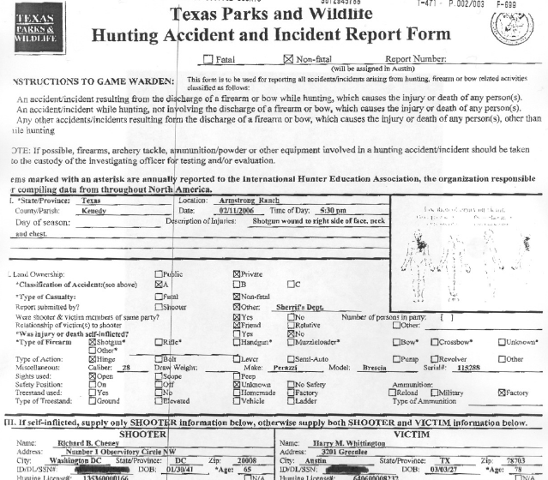
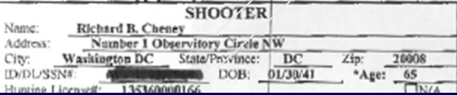

Slide 4
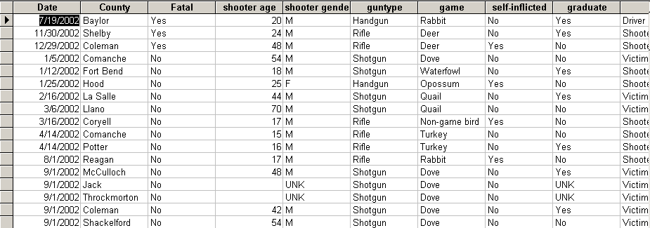

Slide 5

Be prepared
Do your homework – check the annual FOI reports for federal agencies – or AG rules for state agencies
Follow up on your requests
If you are denied records, file an appeal
Get copies of retention schedules - example

Slide 6
What does FOIA cover?
U.S. federal agency records
  Paper, electronic, tape recordings, data
  Sometimes (but not always) government contractor’s records
Does not cover
  Congress
  The Courts
  Answers to questions

Slide 7
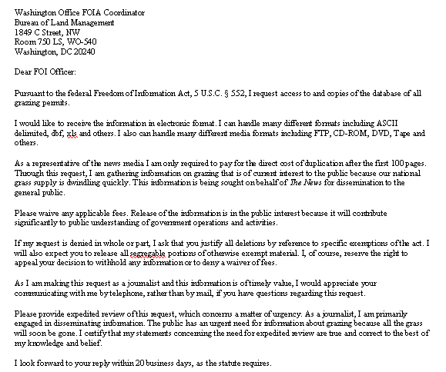

Slide 8

The nine exemptions to FOIA
  National Security
  Internal agency personnel rules
  Information exempt by other laws
  Trade secrets
  Internal agency memoranda
  Personal privacy
  Law enforcement investigations
  Federally regulated banks
  Oil and gas wells

Slide 9
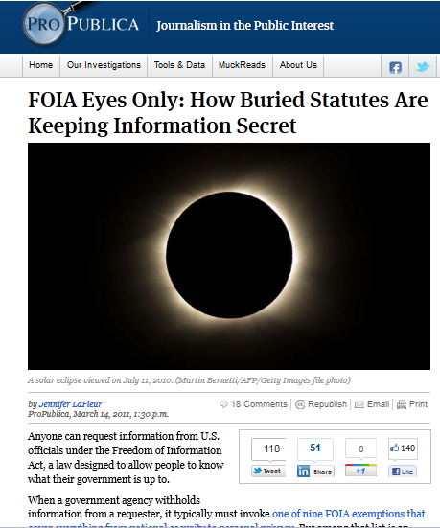
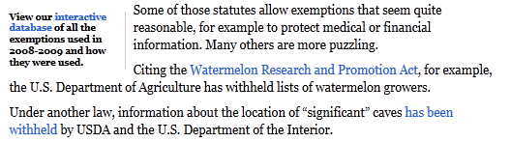

Slide 10

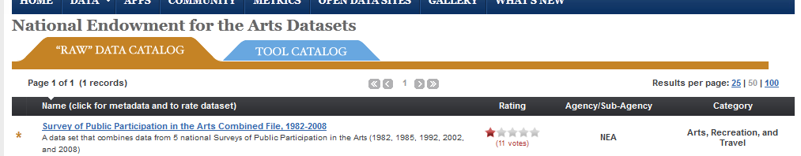
Don’t count on what you need being one of the “high-value” data sets
That doesn’t mean you can’t request via FOIA

Slide 11
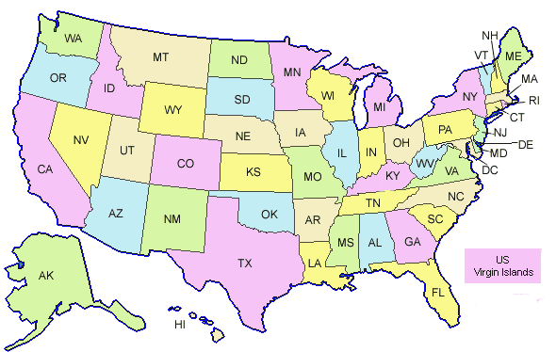
What do state laws cover?
State, city and county governments
Police departments
Sheriff’s departments
State and municipal courts
School districts
Charter schools
Quasi-governmental agencies

Slide 12
State records laws
Many are similar to FOIA – but differ as what organizations are covered, exemptions and procedures.
Some states have an administrative appeal process.
  TX – Required to go to AG
  MO – Rep must ask for ruling
  CA – Good luck

Slide 13

Some basic steps
Before filing a request: Ask for it
If they require a formal request, find out who it should go to and what you should ask for
Letter should describe what you’re asking for
    Note that you’re willing to negotiate
    Ask for a cost estimate

Slide 14
Getting electronic information
  Know the law. Know how your state treats (or doesn’t) the records you need.
  Know what information you want.
  Do your homework
  Know what the appropriate cost should be.
  Know who does the data entry.
  Get to know Leon
  When something may not clearly be public use your sourcing

Slide 15
A check list to help negotiate for data, of all kinds
(in a perfect world):

Slide 16
Figure out who physically holds the information.
Ask for a tour of the office and data (with the media spokesperson if necessary).
Sit down with the person who works with the data most.
Ask them to explain the data, in detail, including their own definitions of all the fields.
Ask them how long it would take them to create the data set for which you are asking.
Ask for a data "dictionary," training manual, program instructions, or literature that describes the data.

Slide 17
Bring a flash drive with you.
If that doesn't work, ask for the name of the official “custodian of records” for that particular dataset.
Request the "record layout," the list of all fields in the database.
Figure out which fields you want.
Read the law, and case law. Know what is clearly open, clearly closed, and up for debate.

Slide 18
Weigh legal consequences v. speed.
Write the request. Use a consistent form that includes issues of timeline, expense, and any fee waiver.
Send the request to the “custodian of records.”
Call the custodian and make sure he or she got it.
Follow up, nearly every day, until the data is ready.
If the data isn't ready on time, write a story.

Slide 19
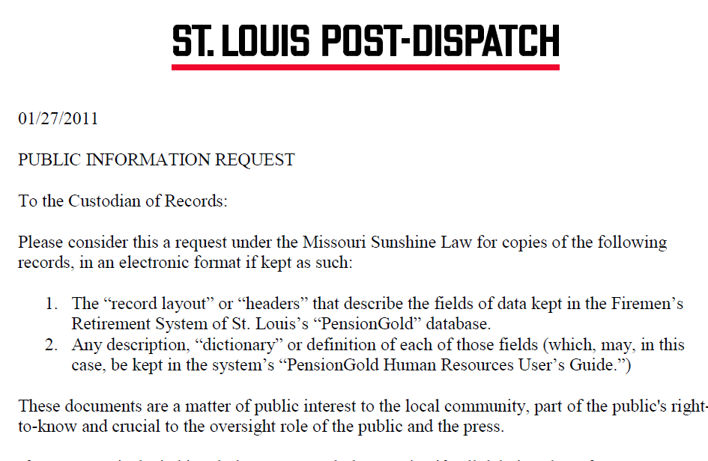

Slide 23
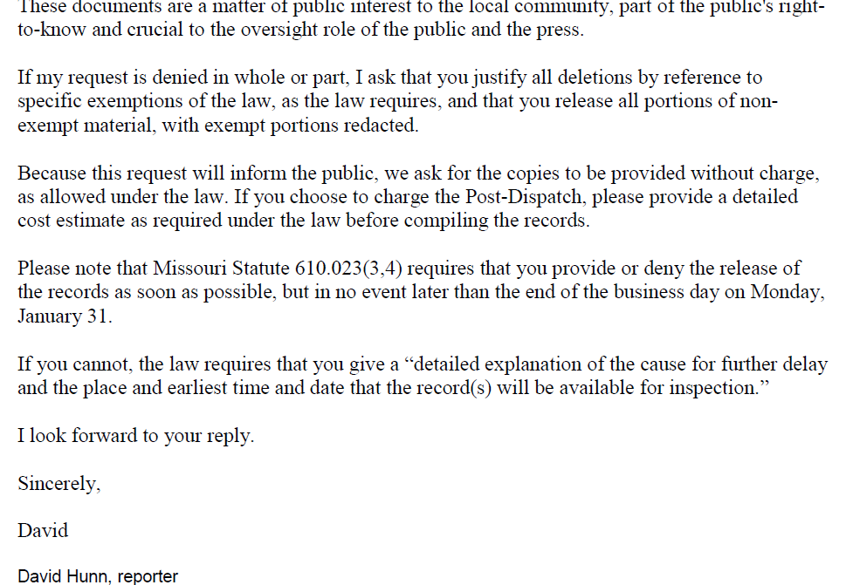

Slide 29
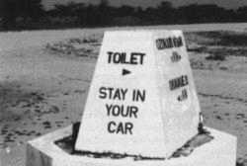
Just another way of saying no
Huge costs
Delay tactics
“Oh you silly little journalist”
Sending you the wrong thing
“Your request was unclear”
HIPAA
Privacy
Privatization

Slide 30

Negotiating: Some examples

Slide 31
Our database is on a mainframe and it’s very complicated, Missy

Slide 32
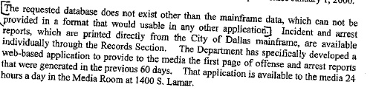

Slide 33
We don’t have the authority to do that

Slide 34
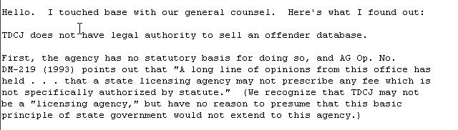

Slide 35
That will cost $25,000.

Slide 36
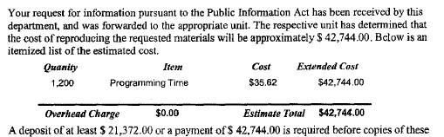

Slide 37
We have processed your request. The labor cost for the request is as follows.
Item # of hours
RESEARCH 20
CREATING FILES 6
CODING 24
TESTING 4
Total (54 X$72) = $3,888.00

Slide 38
111.67. Estimates and Waivers of Public Information Charges
(a) A governmental body is required to provide a requestor with an itemized statement of estimated charges if charges for copies of public information will exceed $40, or if a charge in accordance with §111.65 of this title (relating to Access to Information Where Copies Are Not Requested) will exceed $40 for making public information available for inspection. A governmental body that fails to provide the required statement may not collect more than $40. The itemized statement must be provided free of charge and must contain the following information:

Slide 39
We only keep the information for 7 days

Slide 40
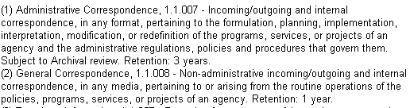

Slide 41
That uses proprietary software.

Slide 42
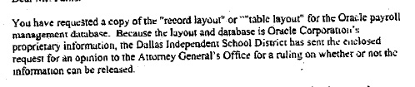

Slide 43
We don’t keep that on computer

Slide 44
Okay, we do, but it’s a lot of files

Slide 45
That information is protected by law

Slide 46
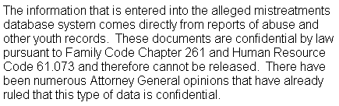

Slide 47
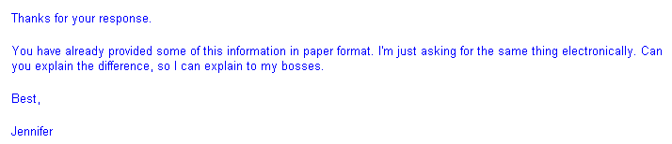

Slide 48
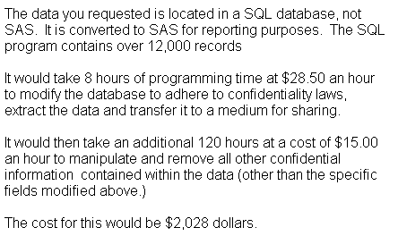

Slide 49
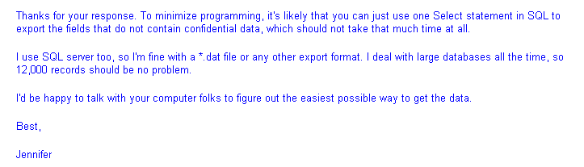

Slide 50


Slide 51
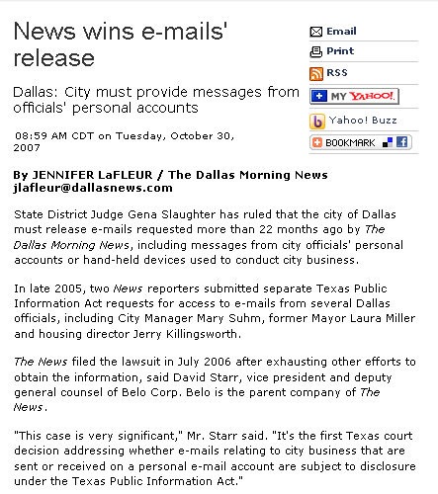
We’ve had some good outcomes…

Slide 52


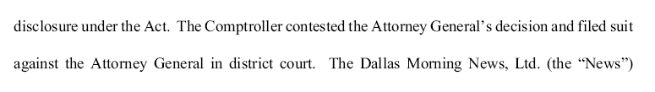

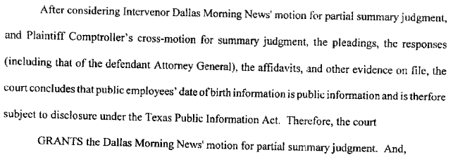
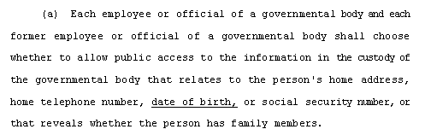
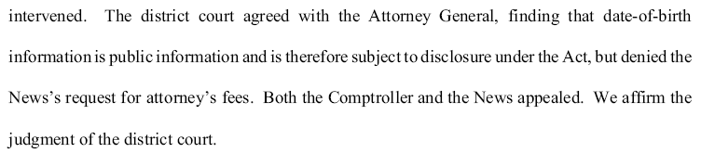
And some never end…
Nov. 2005 – update of state personnel database

Slide 53
Resources:
Investigative Reporters and Editors – www.ire.org/foia
The Reporters Committee for Freedom of the Press: www.rcfp.org
Justice Department’s FOIA page (includes links to FOIA officials and annual reports) -- http://www.usdoj.gov/04foia/index.html
A copy of this presentation will be available at www.jenster.com/nicar2012

