Slide 1
Building a document (and data) state of mind
IRE Better Watchdog Workshop, St. Louis
Jennifer LaFleur, ProPublica
(with materials from Jaimi Dowdell)

Slide 2
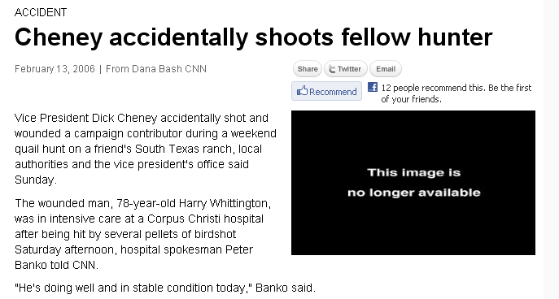
Behind many stories

Slide 3
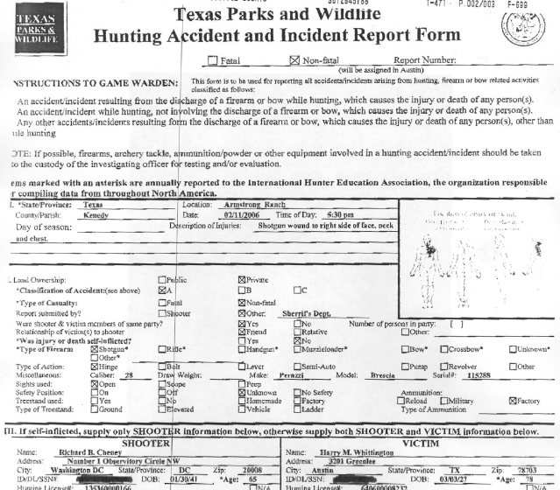
Are documents

Slide 4
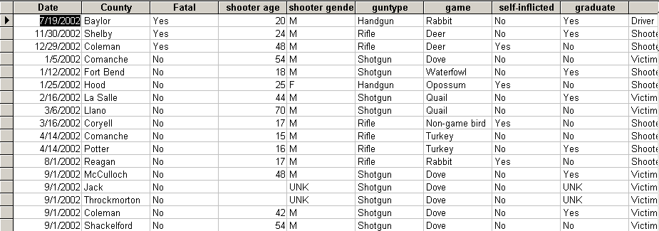
And data

Slide 5
Documents let you…
Truth-squad what officials are telling you
Check assumptions
Go deeper
Do stories no one else is doing

Slide 6
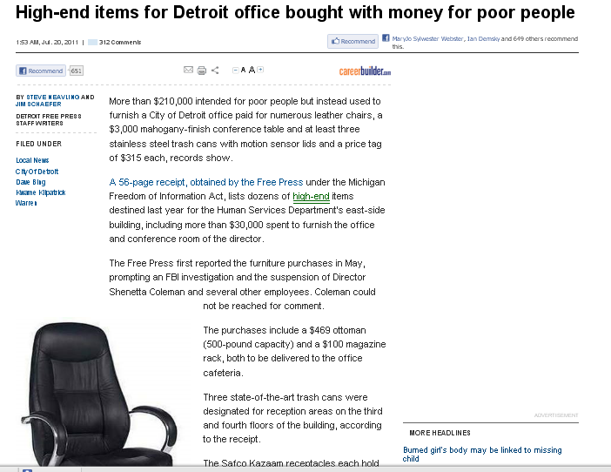
Detroit Free Press earlier this week

Slide 7
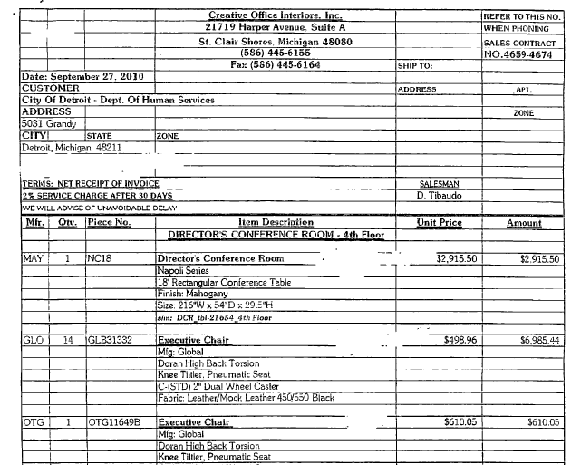
Detroit Free Press

Slide 8
What gets documented?
Anything that is licensed
Inspected
Counted
Paid or paid for

Slide 9
What gets documented?
Anything that is licensed –> dentists, contractors
Inspected –> bridges, schools
Counted –> census, school children
Paid or paid for –> contractors, supplies

Slide 10
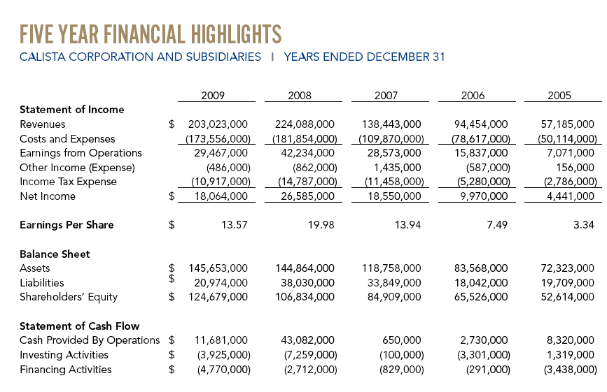
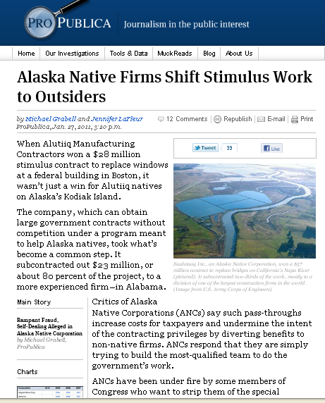

Slide 11
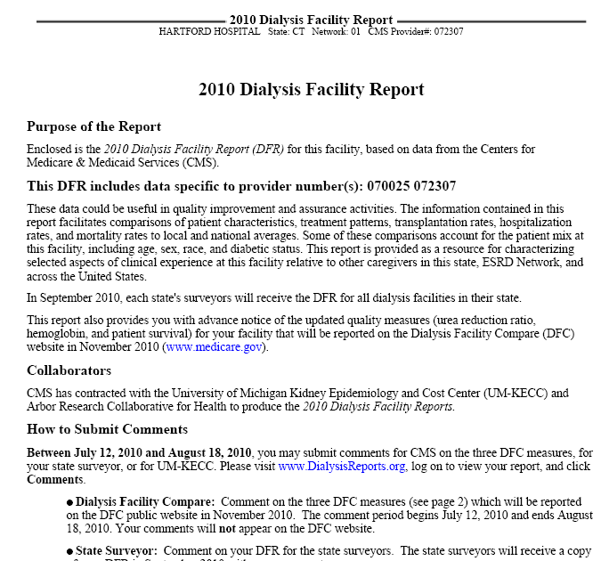

Slide 12
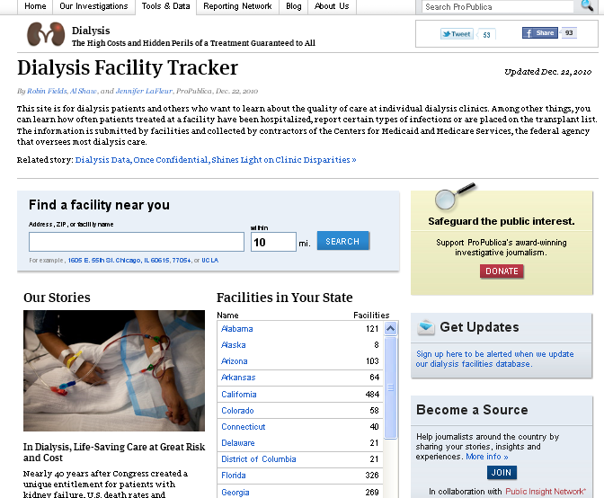
Source: Medicaid outcomes data for dialysis facilities
Findings: A CMS online tool did not tell the whole story about facilities. In some counties the gap in measures, such as survival rate were vast.

Slide 13
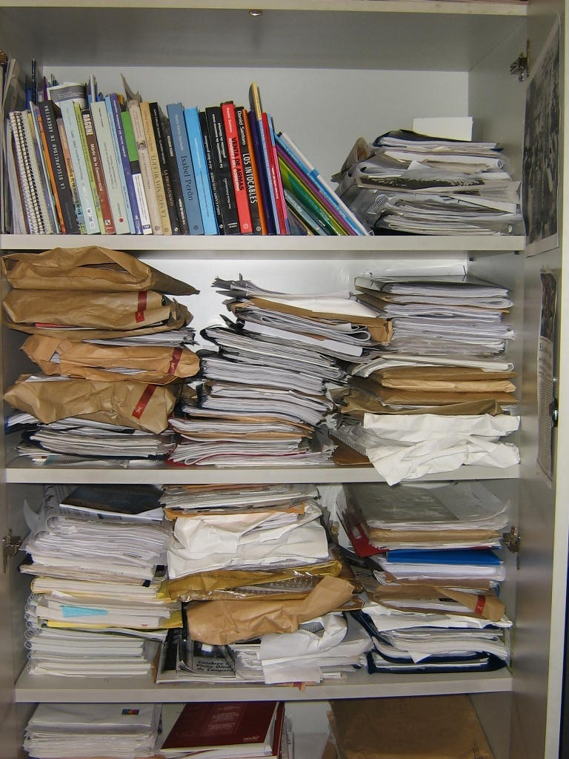
Documents also can be difficult to manage
(Tho’ I’ll give you some ways to deal with them later)

Slide 14
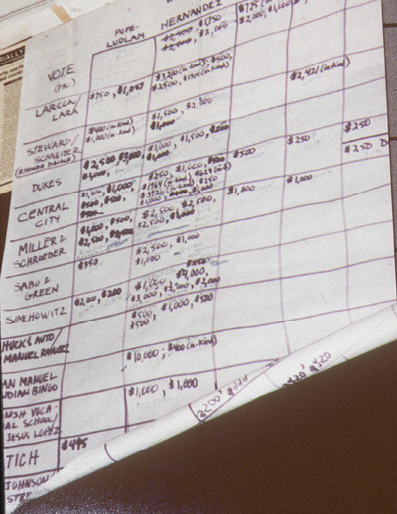
Even if you have to enter the information,
Dealing with it electronically will be easier…
Really.

Slide 15
Why data?
Doing stories based on data analysis
Involves using software such as Access, Excel, mapping and statistics
But it’s really just working with public records that are in a computer
And analyzing data on a computer is easier than counting thousands of sheets of paper

Slide 16
Why use data
Databases give you more to the story

Slide 17
Using data…
Databases give you more to the story
You can pick the best examples

Slide 19
How to tell a better story with data
Databases give you more to the story
Some of the best analogies are in the data
Contrasts are in the data

Slide 20
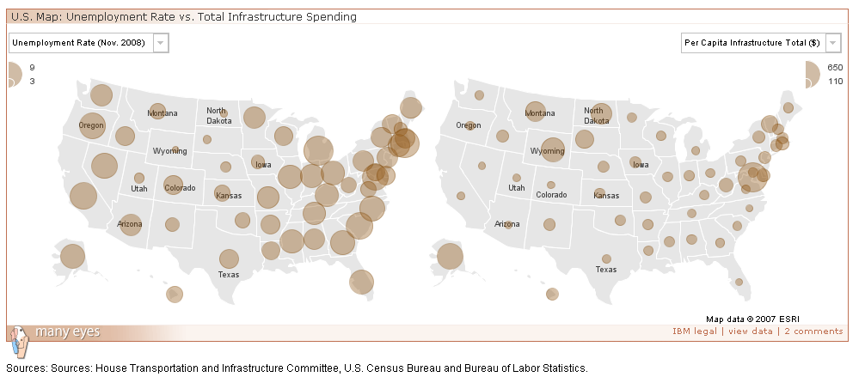

Slide 21
Caution: This slide contains extreme nerdiness

Slide 22
How to tell a better story with data
Databases give reporters more to the story
Some of the best analogies are in the data
Contrasts are in the data
Data can provide more powerful figures.

Slide 23
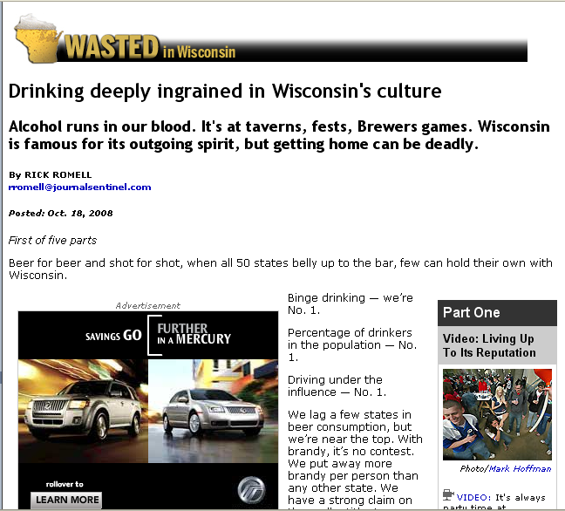

Slide 24
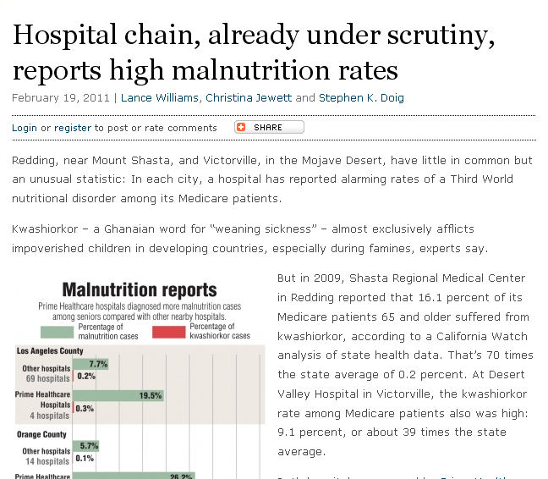
Source: California Health Dept. data, Medicare billing data
Findings: Some hospitals had “alarming rates of a Third World nutritional disorder among its Medicare patients.”

Slide 25
How to tell a better story with data
Databases give reporters more to the story
Some of the best analogies are in the data
Contrasts are in the data
Data can provide more powerful figures
Connections

Slide 26
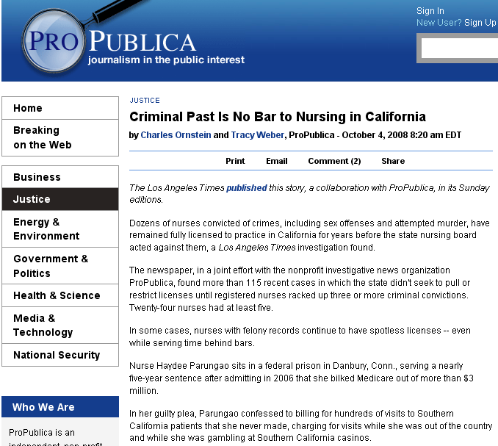

Slide 27
How to tell a better story with data
Contrasts are in the data
Data can provide more powerful figures
Connections
You have authority (and you can be more certain of your results)

Slide 28
Using data gives your readers and viewers…
More information and tools

Slide 29
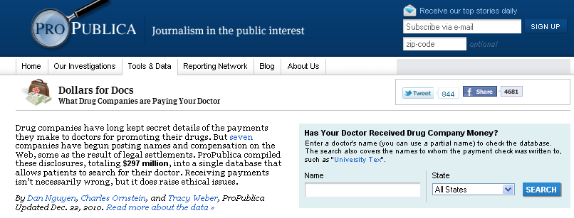
Source: Physician payment data scraped from pharmaceutical company Web sites
Findings: The data lead to several stories including how some paid doctors had blemished records and universities were not enforcing policies about physician payments

Slide 30
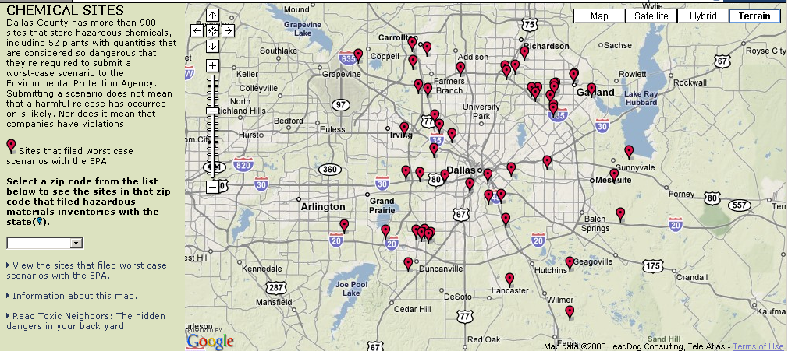

Slide 31
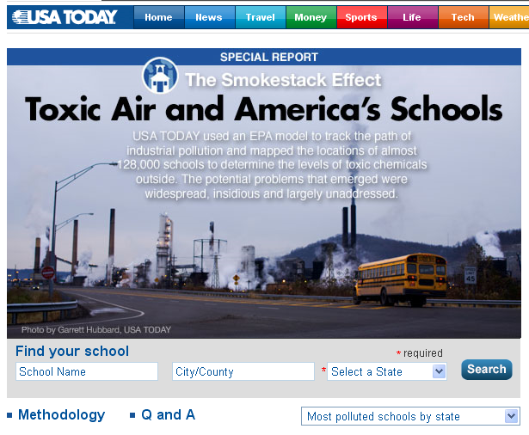
Source: EPA data and national education data
Findings: “The goal: To determine what sort of toxic chemicals children breathe when they go to school. ”

Slide 32
Federal information
Fedstats – A to Z list of statistical data from the government.
Data.gov – Searchable catalog of government data.
USAspending.gov – Federal spending data including grants, loans, contracts, etc.
Agencies themselves

Slide 33
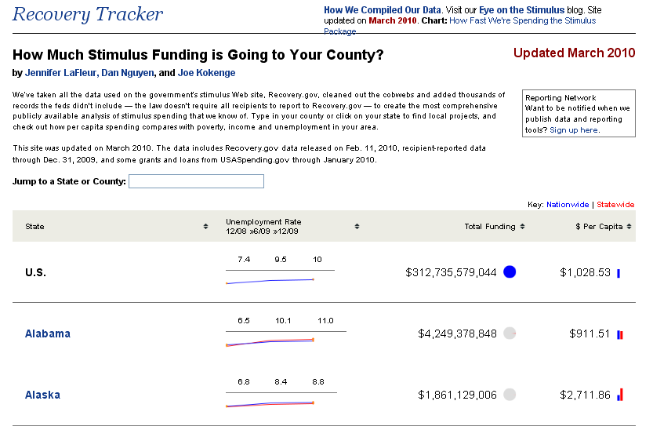

Slide 34
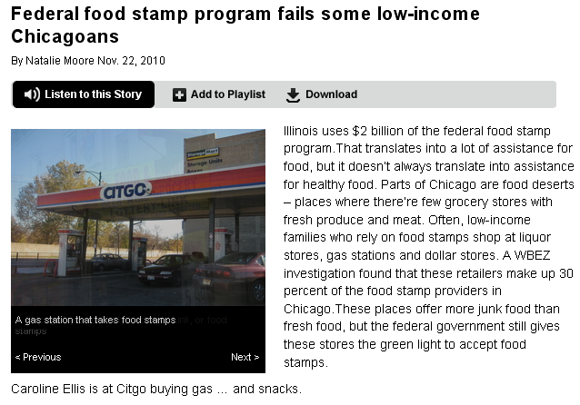
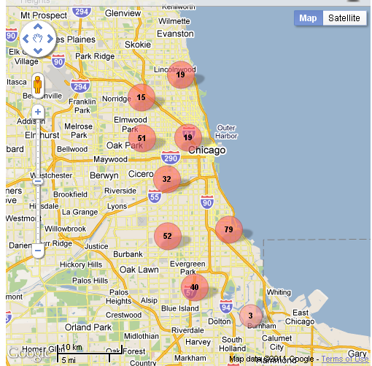
Source: Food stamp sales
Findings: Areas where people using food stamps have little or no access to full-service grocery stores…Liquor stores, gas stations and dollar stores make up 30 percent of food-stamp sales in Chicago

Slide 35
The Census
American FactFinder for quick data profiles. (Easiest to use.)
Datasets from the Census – download profiles, tables and more.
Download center – Download larger sets of data to compare states, counties, etc.
IRE and USA Today Census data

Slide 36
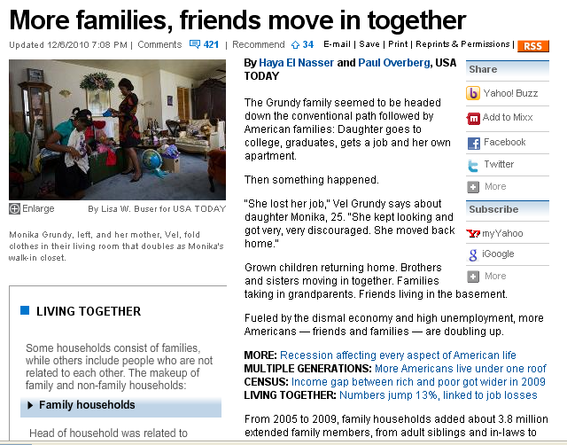
Source: Census
Findings: “Fueled by the dismal economy and high unemployment, more Americans…are doubling up”

Slide 37
Searchable databases
BRB Publications gateway to searchable records
OSHA workplace safety inspections
Fatality Analysis Reporting System data (FARS)
Federal Railroad Administration safety data
EPA environmental data searches
National sex offender registry (Department of Justice)
Bureau of Labor Statistics

Slide 38
Basic data/dox for any beat (Tip: get more than one year)
Annual reports
Audits
Budgets
Salaries
Phone directories
Organizational charts
Vendors
Calendars for officials
Travel records

Slide 39
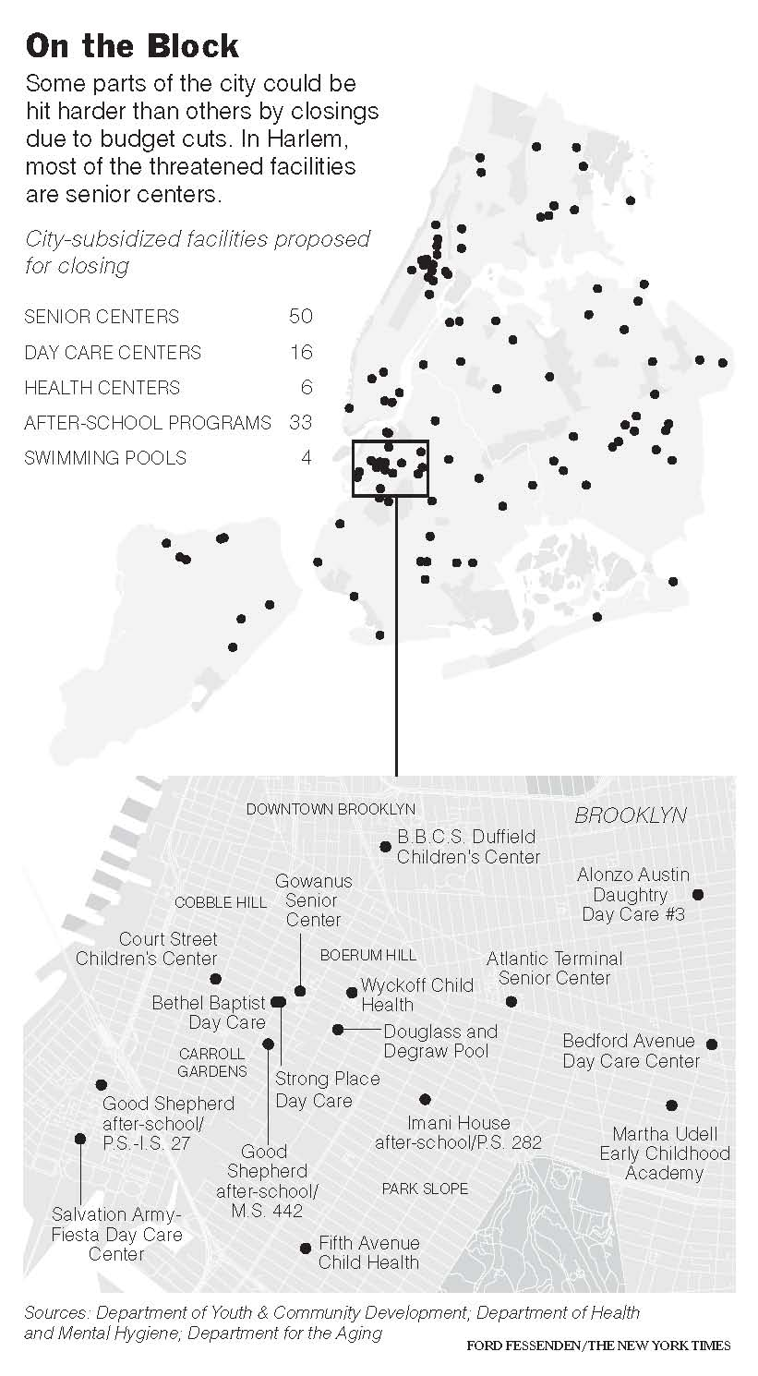
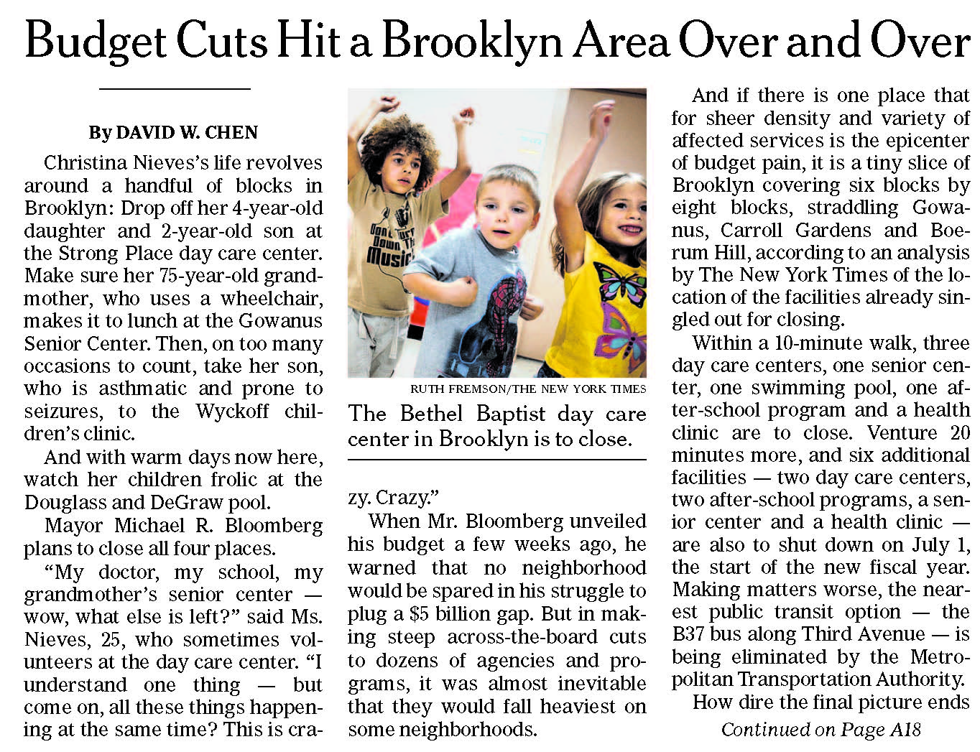
Source: City Budget
Findings: Some neighborhoods suffer more than others as mayor cuts budgets

Slide 40
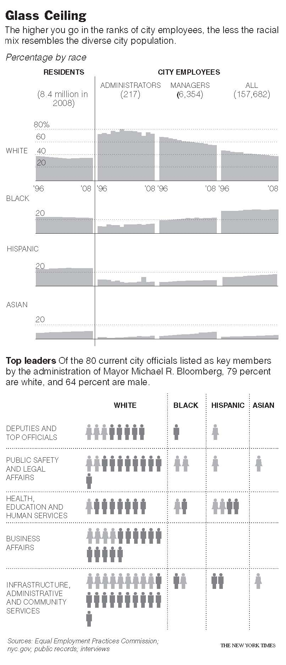
Source: EEOC reports, hand-built data
Findings: City workers overall and top officials in particular are less diverse than the city

Slide 41
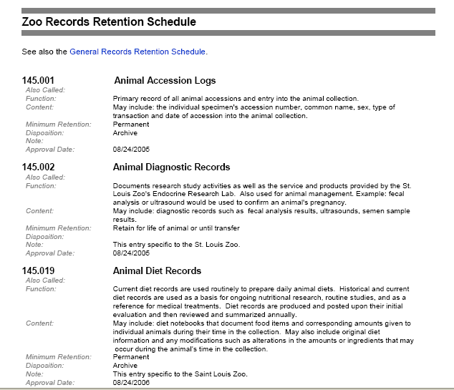
Retention schedules
Notes:
Example for retention sked: disaster preparedness drills:
259 Disaster Preparedness Drill Records This record series consists of the results of disaster preparedness exercises and supporting documents including scenarios, location of safety related drills, timetables, response times, probable outcomes, areas of difficulty, descriptions of how difficulties were resolved, and areas for improvement. The types of drills include, but are not limited to, fire, tornado, safety, hurricane, and SARA (Superfund Amendments and Reauthorization Act) chemical spills. Section 252.365(3)(b), F.S., requires state agencies to include in their disaster preparedness plans “schedules and procedures for periodic tests, training, and exercises.” Section 252.38, F.S., authorizes counties and municipalities to “develop an emergency management plan and program that is coordinated and consistent with the state comprehensive emergency management plan and program.” See also “DISASTER PREPAREDNESS PLANS,” “DIRECTIVES/POLICIES/PROCEDURES,” and “INSPECTION RECORDS: FIRE/SECURITY/SAFETY.” 2 calendar years provided reviews have been conducted.

Slide 42
Retention schedules
Missouri retention schedules
Illinois retention schedules
List from the Council of State Archivists
Notes:
Example for retention sked: disaster preparedness drills:
259 Disaster Preparedness Drill Records This record series consists of the results of disaster preparedness exercises and supporting documents including scenarios, location of safety related drills, timetables, response times, probable outcomes, areas of difficulty, descriptions of how difficulties were resolved, and areas for improvement. The types of drills include, but are not limited to, fire, tornado, safety, hurricane, and SARA (Superfund Amendments and Reauthorization Act) chemical spills. Section 252.365(3)(b), F.S., requires state agencies to include in their disaster preparedness plans “schedules and procedures for periodic tests, training, and exercises.” Section 252.38, F.S., authorizes counties and municipalities to “develop an emergency management plan and program that is coordinated and consistent with the state comprehensive emergency management plan and program.” See also “DISASTER PREPAREDNESS PLANS,” “DIRECTIVES/POLICIES/PROCEDURES,” and “INSPECTION RECORDS: FIRE/SECURITY/SAFETY.” 2 calendar years provided reviews have been conducted.

Slide 43
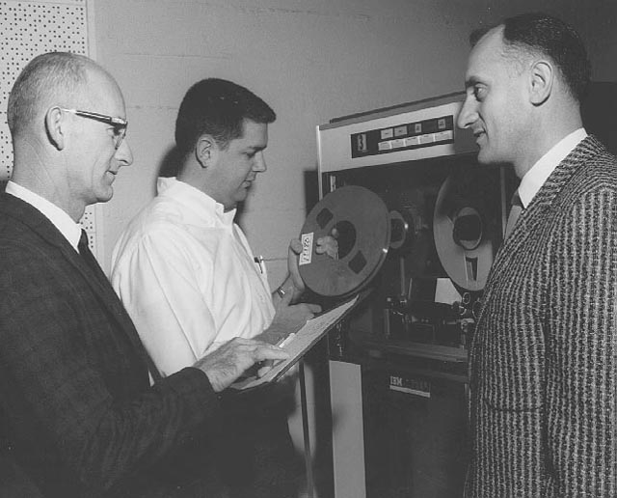
Nerd bonding
Visit the agency
Grab blank forms
Ask about records kept.
Ask how they do their jobs.

Slide 44
Other ways to find what they keep…
FOIA the FOIAs, Open records logs
State and federal statutes
State Audit reports, IG reports, GAO
Agency annual reports
Open Missouri

Slide 45
Other ways to find what they keep…
Online forms to submit information – examples:
Missouri AG consumer complaints
MO Division of Professional Registration complaints
Think creatively – beyond paper documents (calendars, phone call logs, expenses, budgets, etc.)
Notes:
For New York State Education Department – Search for “spreadsheet” also search for “2010”

Slide 46
Use Google’s advanced search
Use advanced searches to find records and data.
Domain or site restriction - url:gov
File type - filetype:xls
URL search - site:epa.gov

Slide 47
Nonprofits
990s –What all 501(c)3 that have more than $25,000 in annual revenue must file with the IRS.
Donors
Board members
Income sources
Federal Audit Clearinghouse

Slide 48
Downloading data
In Excel format – example Illinois Sex Offender Registry here.
From the web – example California West Nile Virus here.
In text format – example from data.gov search on “inspection” here.

Slide 49
Downloading data
If you can search for one item, you should be able to get a database of everything.
And remember that not all data is on the Web

Slide 50
And sometimes you have to build your own database

Slide 51
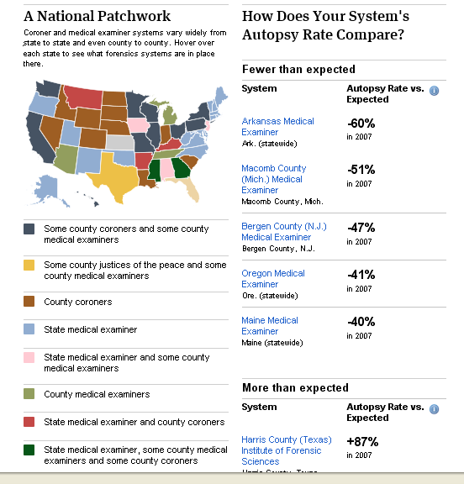

Slide 52
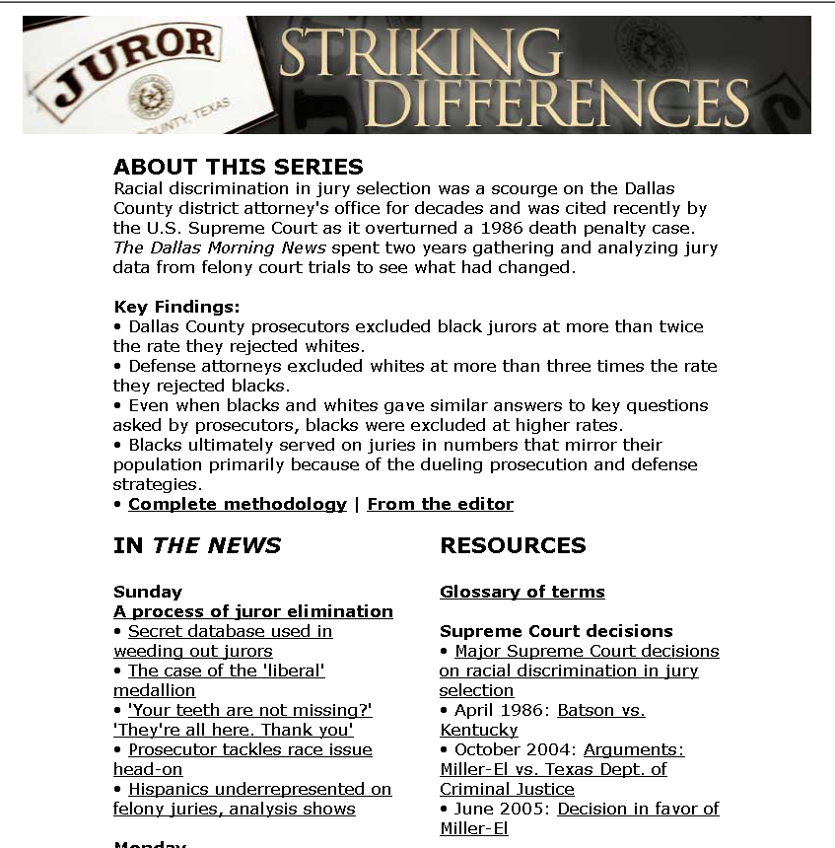

Slide 53
Getting started
Get hands on training
Keep practicing
Build a list of data/documents for your beat
Set a goal for short, medium and long-term stories

Slide 54
Stay organized
Keep track of requests and follow up on them
DocumentCloud for hard-copy reports
Mechanical Turk when the data is not readily available
Keep notes on your data

