Slide 1
The Data-Driven Story (Pt 1)
Conceiving and Launching
Jennifer LaFleur, ProPublica
David Donald, The Center for Public Integrity
NICAR 2013
Louisville

Slide 2
The Data-Driven Story
Data/story research
Getting the data
Interviewing the data
The methodology
The analysis
The pitch

Slide 3
Research
IRE Resource Center: tips sheets and previous stories
Chat with experts in your own newsroom
Nexis
Academic/government studies
OIG, GAO reports

Slide 4
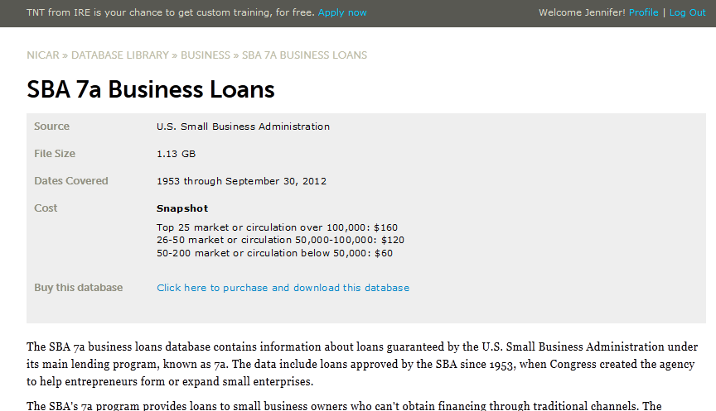
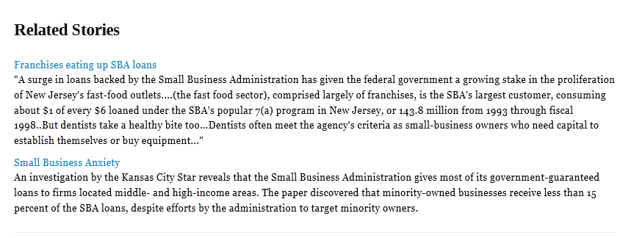

Slide 5
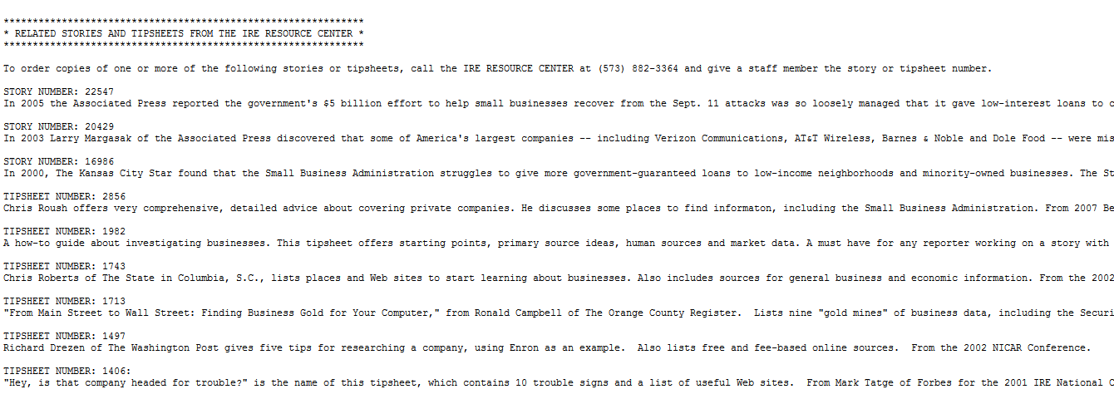
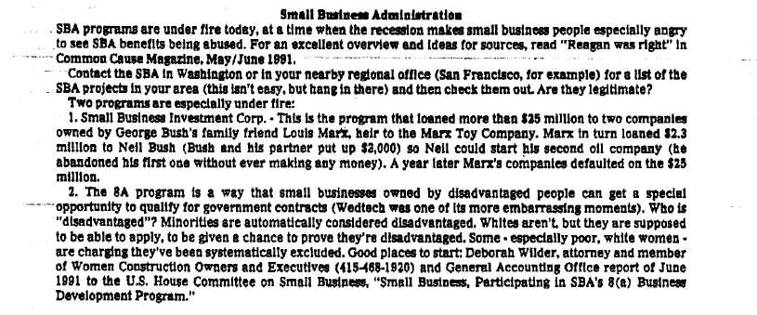

Slide 6
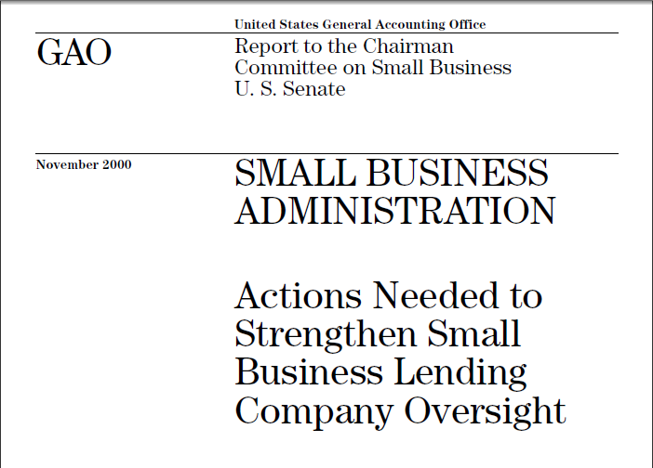
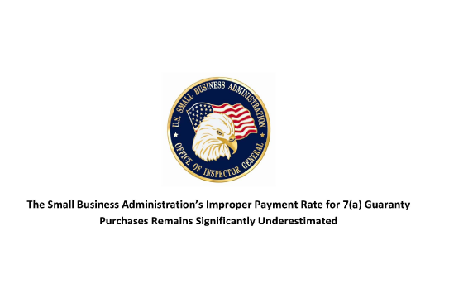

Slide 7
Getting the data
NICAR data library
Check the agency Website
Request from agency
Create data

Slide 8
Getting the data from an agency
Know the law
Do you homework
Know what the appropriate costs should be
Make your request clear
Get to know Leon
Follow up on your request

Slide 9
When there is no data
Use your sources
Sampling
Building data from documents
Physical surveys
Testing
Questionnaires, polls and surveys

Slide 10
Interview the data
Assume there are problems in the data

Slide 11
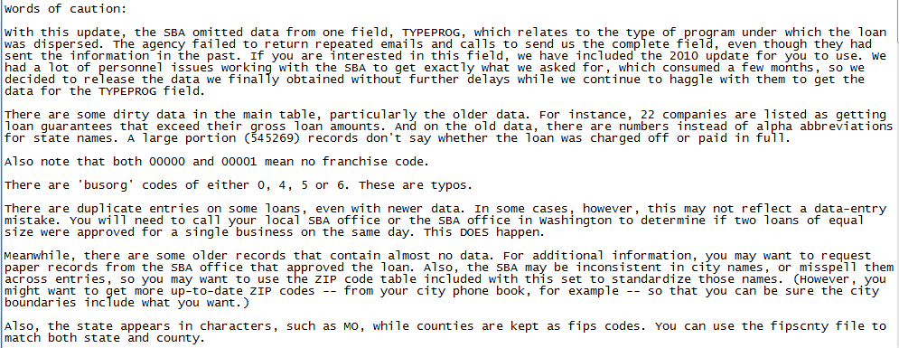

Slide 13
Interview the data
Assume there are problems in the data
How many records should you have? Are there other counts to check: counties, states, etc…

Slide 14
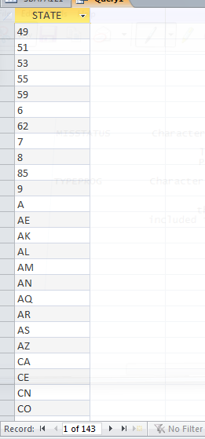
Select state
Group by state
From SBA7A121

Slide 15
Interview the data
Assume there are problems in the data
How many records should you have? Are there other counts to check: counties, states, etc…
Double-check totals or counts against summary reports
Check for duplicates in multiple ways
Consistency-check all fields

Slide 16
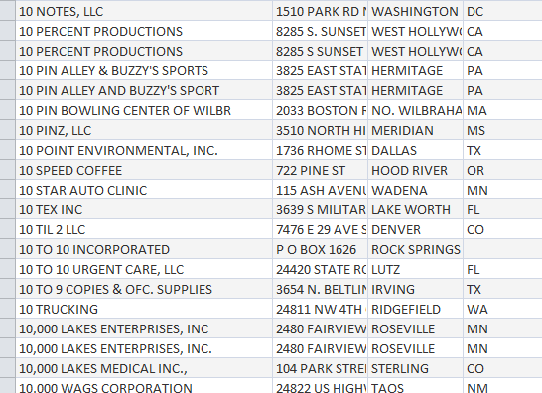

Slide 17
Interview the data
Internal consistency checks

Slide 18
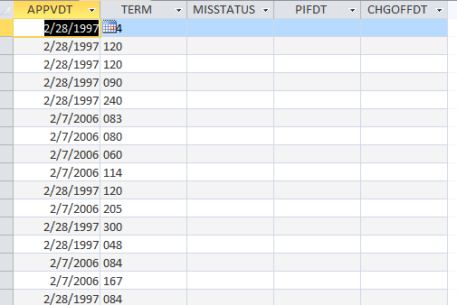

Slide 20
Interview the data
Internal consistency checks
Check the ranges of fields.
Check for missing data or blank fields. Are they real values, or did something happen with an import or append query?

Slide 21
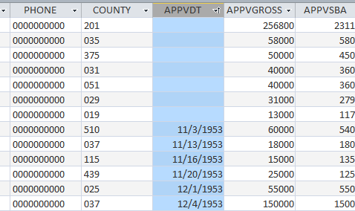

Slide 22
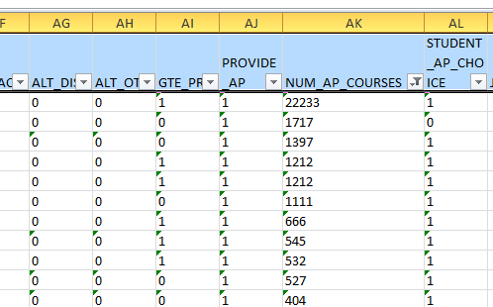

Slide 23
Interview the data
Internal consistency checks
Check the ranges of fields.
Check for missing data or blank fields. Are they real values, or did something happen with an import or append query?
Do you know what every field in the database means? Are there special codes?

Slide 24
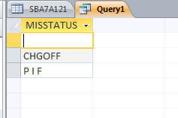
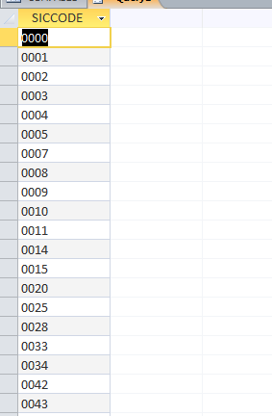
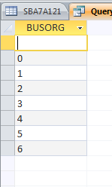

Slide 25
Interview the data
Internal consistency checks
Check the ranges of fields.
Check for missing data or blank fields. Are they real values, or did something happen with an import or append query?
Do you know what every field in the database means? Are there special codes?
Have there been changes over time that would create problems?

Slide 26
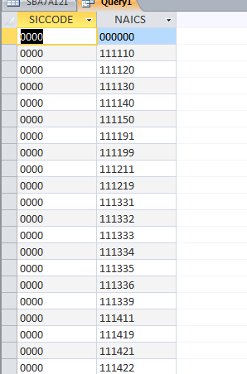

Slide 27
Truck accidents by year and agency

Slide 28
The Methodology
Don’t recreate the wheel
Use the IRE resource center and your experts
Keep notes as you interview and analyze your data
Use a standard naming convention for files and tables (I wouldn’t recommend “final”)
Are there certain records that should be excluded because of problems?

Slide 29
The Methodology
Borrow / steal from social scientists and other analysts
Review what they’ve already done and then interview them
Develop a hypothesis to test

Slide 30
The Methodology
Hone your analytical skills
Count, sort and filter for sure. Often, that’s all that you need
Learn to aggregate by grouping or using pivot tables if you using these techniques already
As you advance, build you skill with statistics

Slide 31
The analysis for story
So you’ve done all this, what are some approaches to analyzing data for stories?
They come from the groundwork you’ve already been laying
Think of the national, regional and local levels of reporting and their different requirements
So, some examples …

Slide 32
Resource Center example
IRE Resource Center story index
STORY NUMBER: 16986. In 2000, The Kansas City Star found that the Small Business Administration struggles to give more government-guaranteed loans to low-income neighborhoods and minority-owned businesses.

Slide 33
Approaches
Mashup data from other sources
Change over time

Slide 34
Analyze
Mashups: Use census data to create a socio-economic portrait based on the geography in your data
National: In which ZIP codes around the country is this pattern still the case?
Regional: How do amounts and successes of SBA loans compare in different low income areas?

Slide 35
Analyze
Local: Where are the deepest pockets of poverty in your city and how are SBA loans working there?
Change over time: Is this just as true today as it was in 2000? And at the national, regional and local levels?

Slide 36
Government and academic examples
Government Accountability Office reports and the Inspectors General investigations
Search engines such as Google Scholar and Microsoft Academic Search

Slide 37
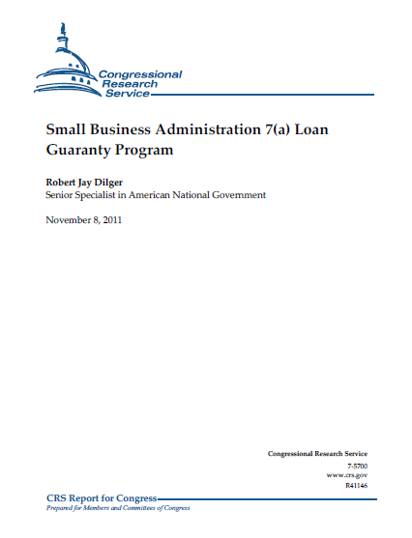
GAO example
In 2009, P.L. 111-5, the American Recovery and Reinvestment Act of 2009 (ARRA), provided additional funding to temporarily subsidize the 7(a) program’s fees and to increase the program’s maximum loan guaranty percentage to 90%.

Slide 38
Approaches
Compared to what? Find or create a measure that allows you to compare relative success or failure
For example, has the “charged off” to “paid in full” ratio increased since the guarantee increased from 75 percent to 90 percent?

Slide 39
Analyze
Which banks have done the most lending with increased guarantee compared to the banks lending before?
Which banks are the “leaders” in charged off loans?

Slide 40
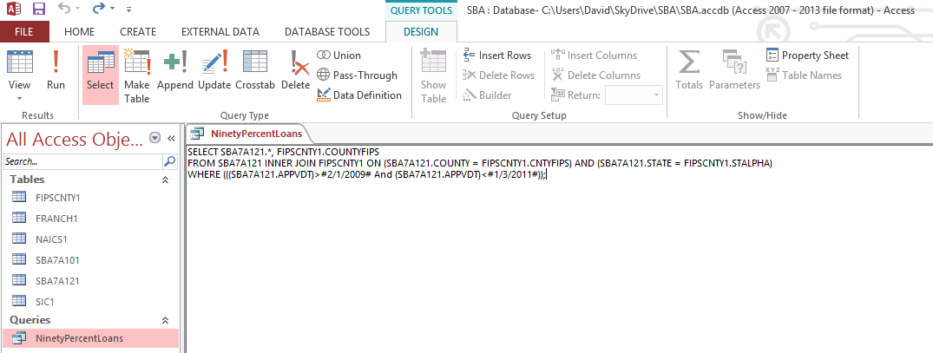

Slide 41
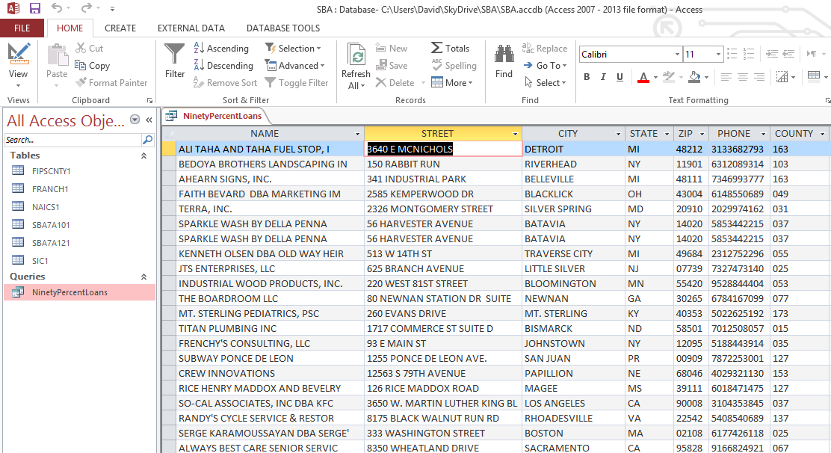

Slide 42
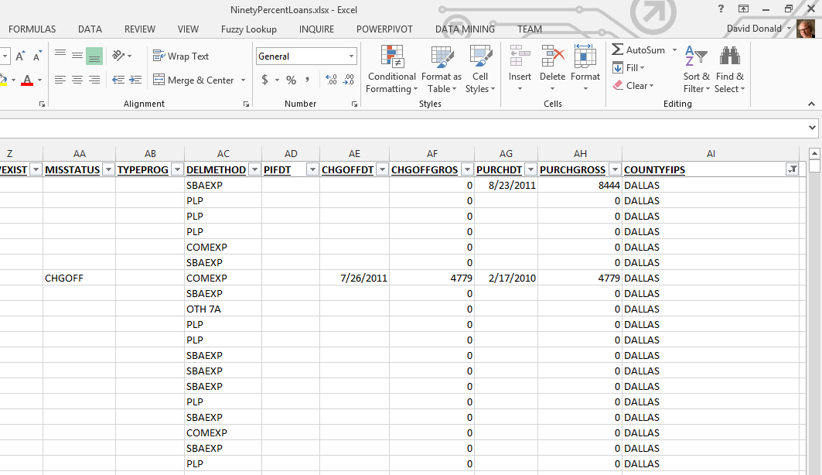

Slide 43
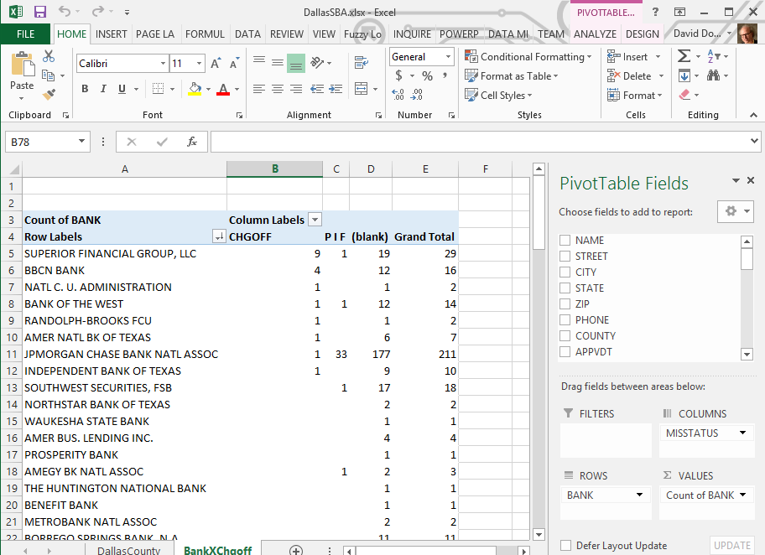

Slide 44
Reality check example
What does on the ground reporting show where the data and the SBA program are failing?

Slide 45
Approaches
Data is a reduced view of the world
Leave the newsroom, and look at the world in a lesser reduced version. In other words, report

Slide 46
Analyze
Local: Find examples of businesses that failed after receiving SBA loans
Compare what you’ve found about them in the court house and through interviews to what data – or lack of data – in the database

Slide 47
Analyze
For example, in Champaign, IL, a restaurant got one loan that was getting paid back. Then it upped it with a $550,000 SBA backed loan and went belly up in a year. That was two years ago. Still not in the SBA database.
(Thanks, Brant.)

Slide 48
From one of my smarty-pants colleagues:
One idea would be to see how many banks that have failed (http://www.fdic.gov/bank/individual/failed/banklist.html) issued SBA loans…
The FDIC is currently suing Innovative Bank, which failed on April 16, 2010. “In its lawsuit, the FDIC seeks to recover “not less than $7.1 million” the FDIC alleges the bank lost in connection with lending activities on eleven commercial loans and forty-three Small Business Administration loans. The complaint asserts claims for negligence, gross negligence and breach of fiduciary duty against the individual defendants, and also asserts fraud against one officer defendant, as discussed below.”

Slide 49
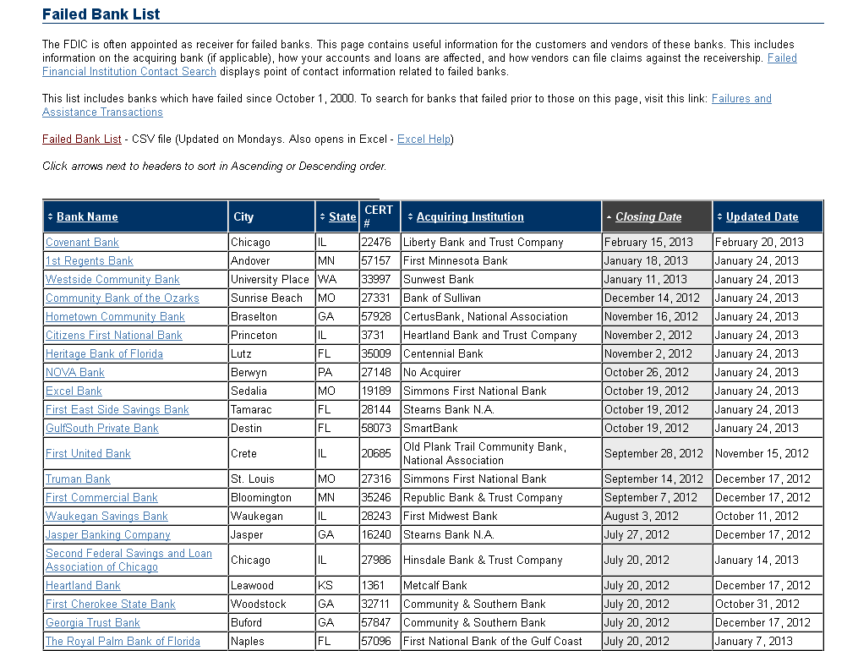
Truck accidents by year and agency

Slide 50
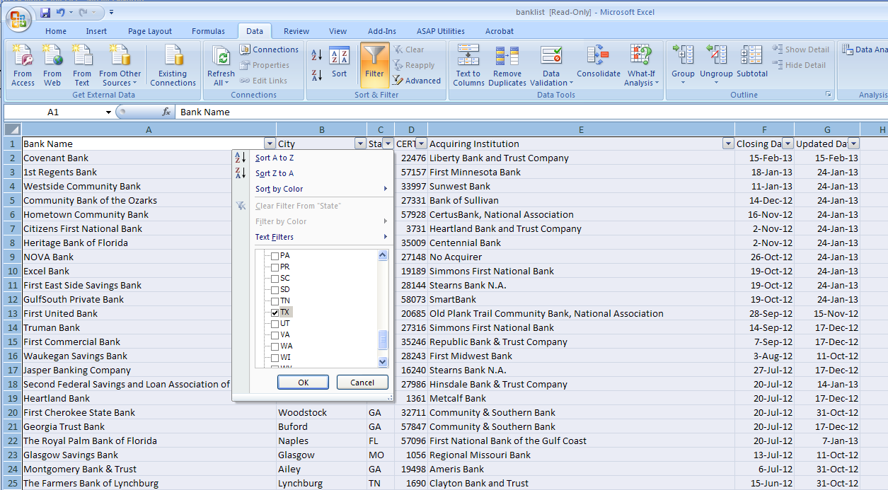

Slide 52
Failed banks
No common ID between the databases
Small enough number to do locally/statewide
Verify that it is indeed the same bank
Because there is a lawsuit, you know a relationship does exist

Slide 53
Closed banks in Texas

Slide 54
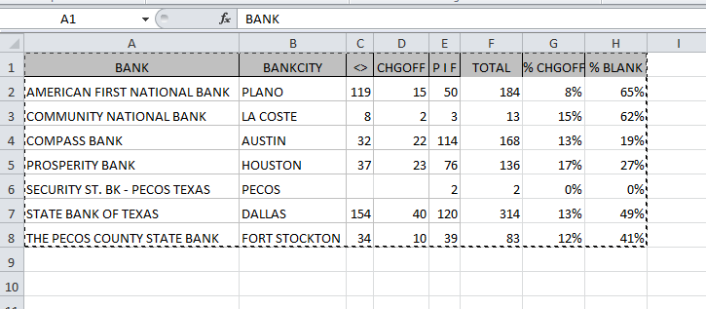
Loans made by potentially failed banks

Slide 55
Loans to lenders
In the real world, you would spend more time with this…
34 banks with “loan” or “lending” in their names in TX got SBA loans
20 of them are blank or were charged off

Slide 56
The Pitch
It’s all about timing, but a lot affects timing
For example, the editor or producers’ expectations
The level of understanding that your editor or producer has for CAR
Anticipating what will come out of your editor or producer’s mouth

Slide 57
Make sure
Your findings (including your math) are solid
You have a simple and easy way to explain your evidence
You have a minimum story
You have some idea of the time and effort needed to go forward
You discuss priorities
You get a specific go/no go decision or at least next steps

Slide 58
Beyond the data
How can you get real people into this story?
Why should the reader care?
What possible solutions are there?

Slide 59
The Pitch
Explain your findings in one or two sentences.
Provide an outline with a summary of your findings
Provide a timeline/potential costs

Slide 60
More questions?
Jennifer LaFleur
Jennifer.LaFleur@propublica.org
David Donald
ddonald@publicintegrity.org

