Slide 1
Cats
and
Stats
Jennifer LaFleur, CIR | Reveal

Slide 2
Cats
and
Stats
Jennifer LaFleur, CIR | Reveal

Slide 3
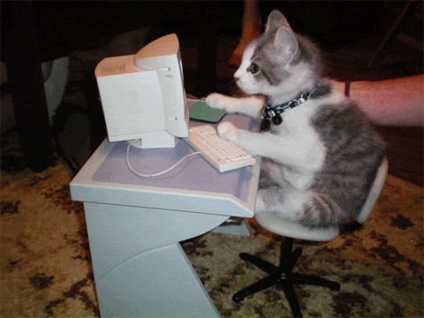
On
Why stats with cats
Cats are savvy computer users

Slide 4
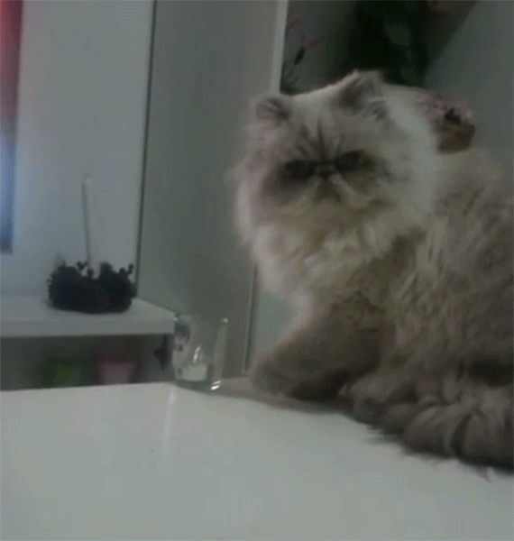
On
Why stats with cats
Cats are independent thinkers.

Slide 5
On
Why stats with cats
Cats can examine things critically.

Slide 6
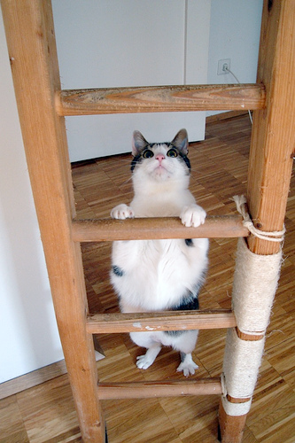
The data ladder
←continuous
←CATegorical

Slide 7
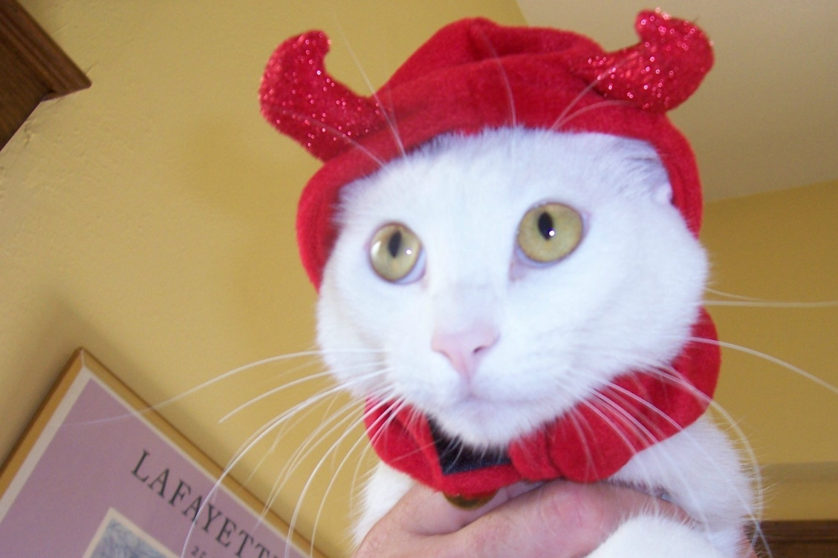
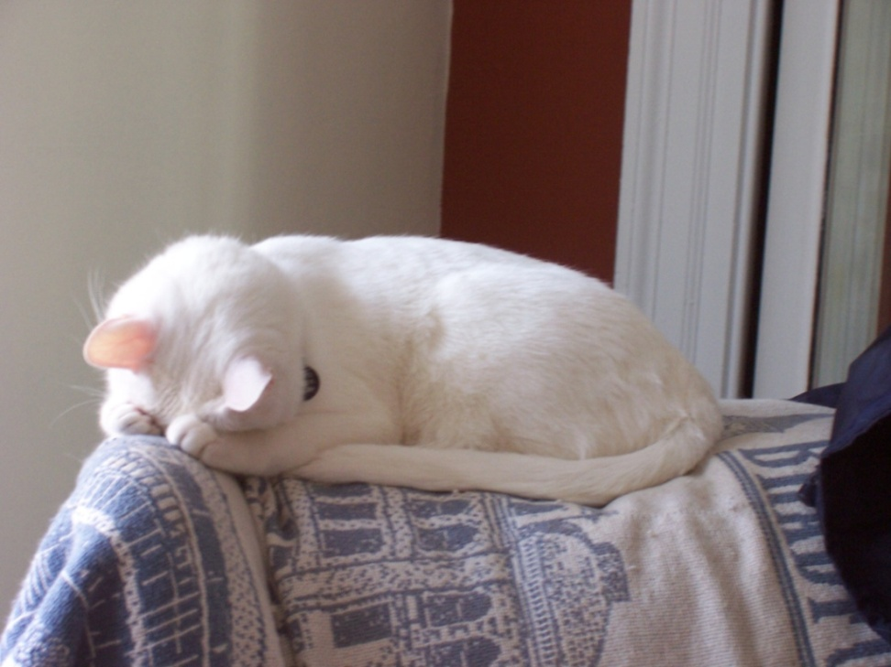
On
Dichotomous variables
1 0
Off

Slide 8
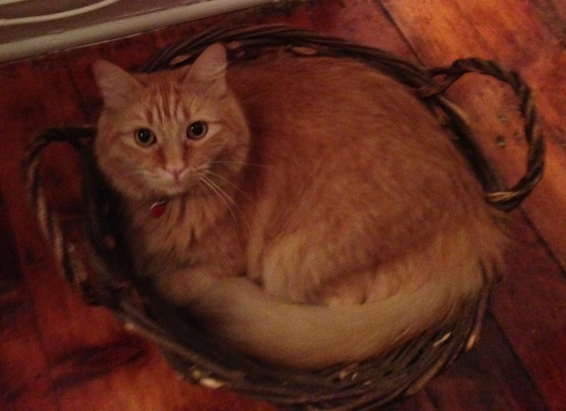
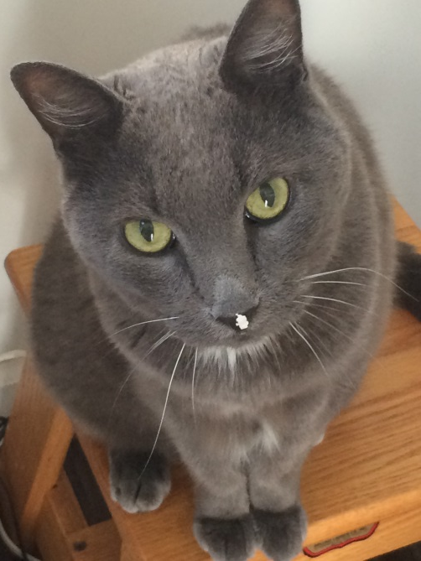
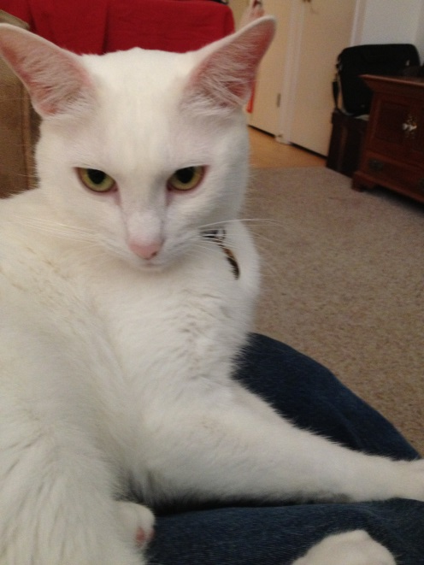
CATegorical variables
Gray
White
Orange

Slide 9
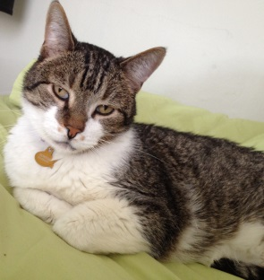
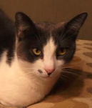
CATegorical variables
Male
Female

Slide 10
Observed versus expected values
Male
Female

Slide 11
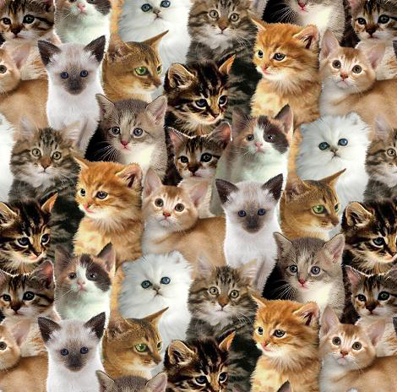
Continuous

Slide 12
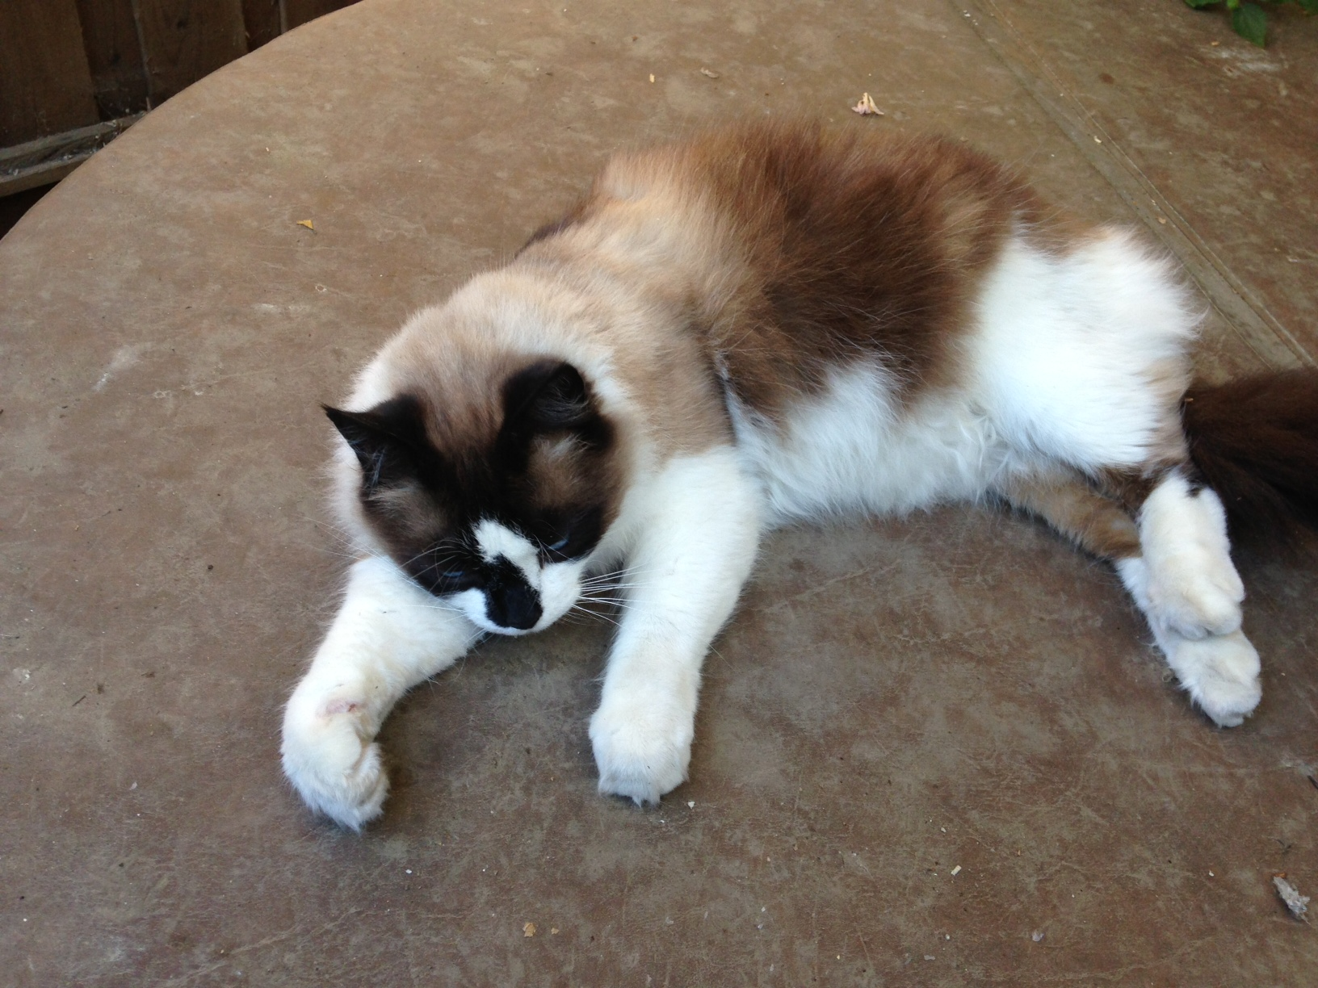
Distribution

Slide 13
Distribution

Slide 14
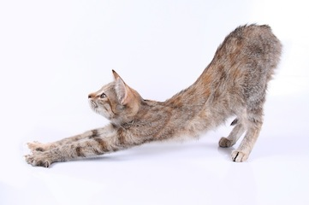
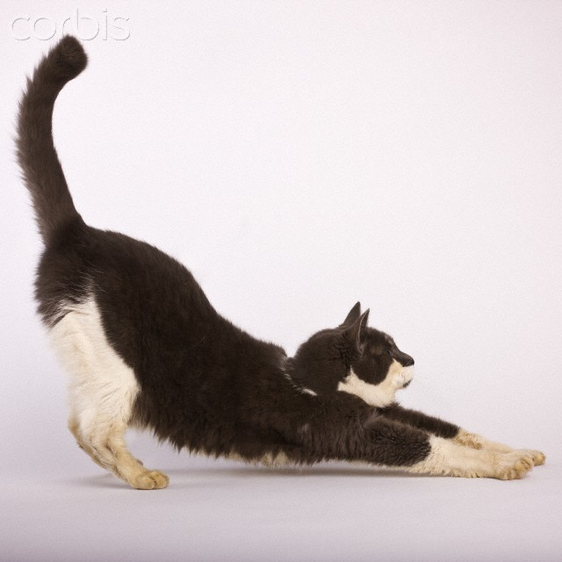
Skewness
Negative skew
Positive skew

Slide 15
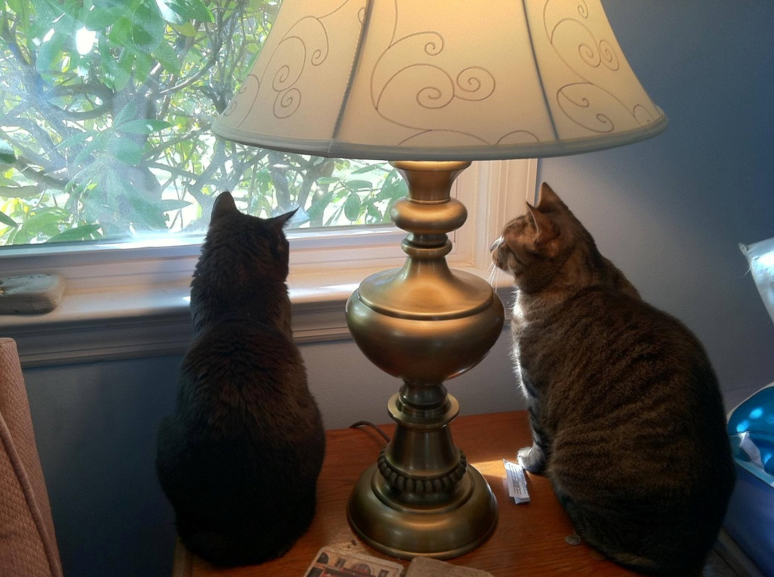
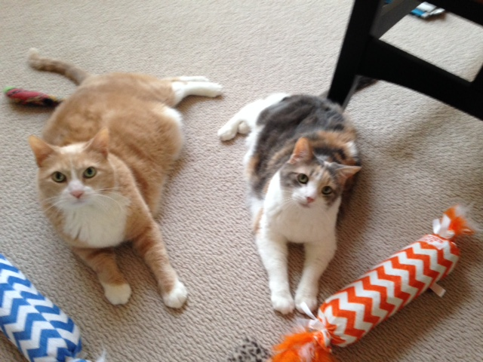
Paired tests

Slide 16
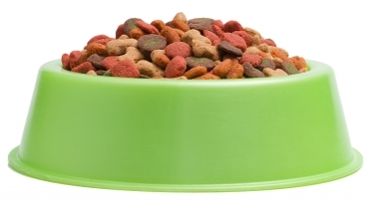
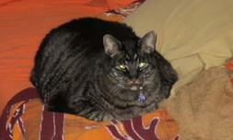
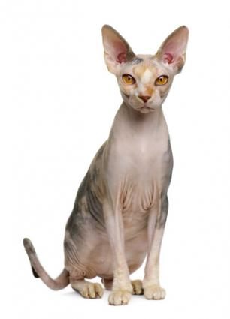
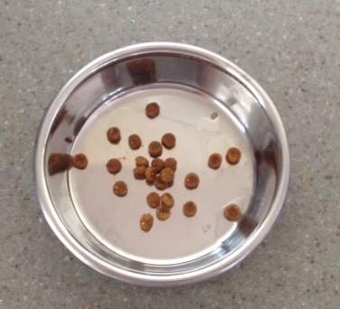
Correlation

Slide 17
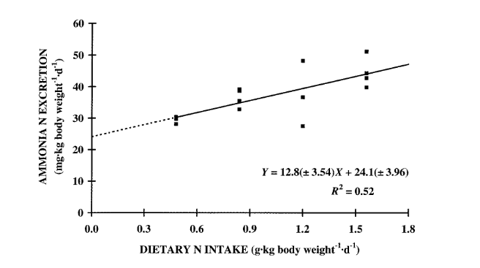
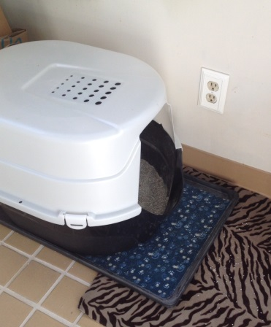
Regression: Dietary intake versus ammonia excretion

Slide 18
52 percent of change in “output” can be explained by input

Slide 19
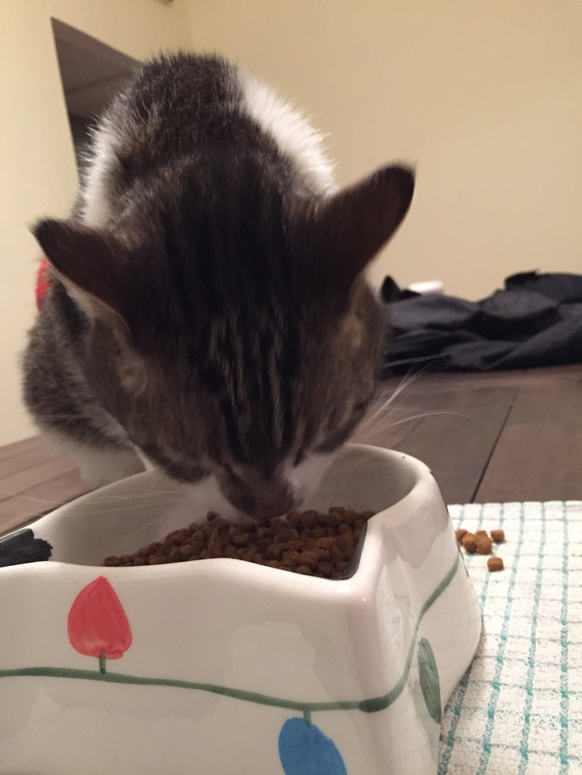
Sampling
When you can’t get an entire database or when you want to test your data – use a statistical sample
Sampling error

Slide 20
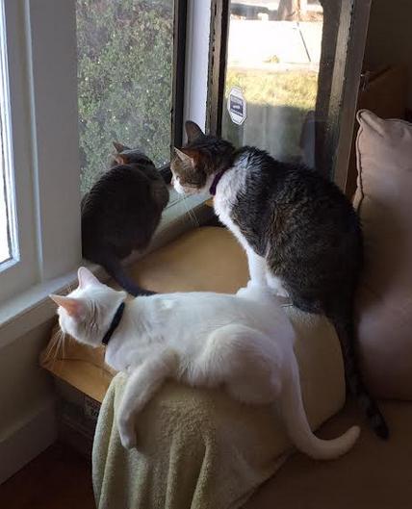
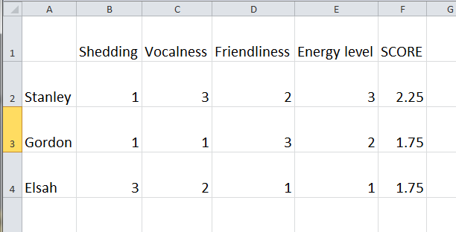
Index
Combines several factors into one number for comparisons

Slide 21
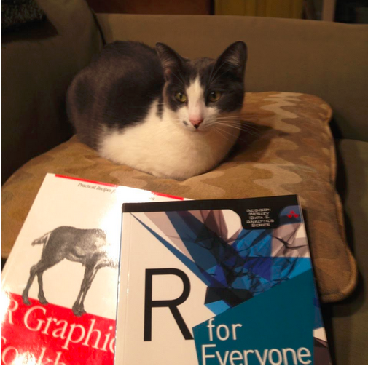
Tips: Study

Slide 22
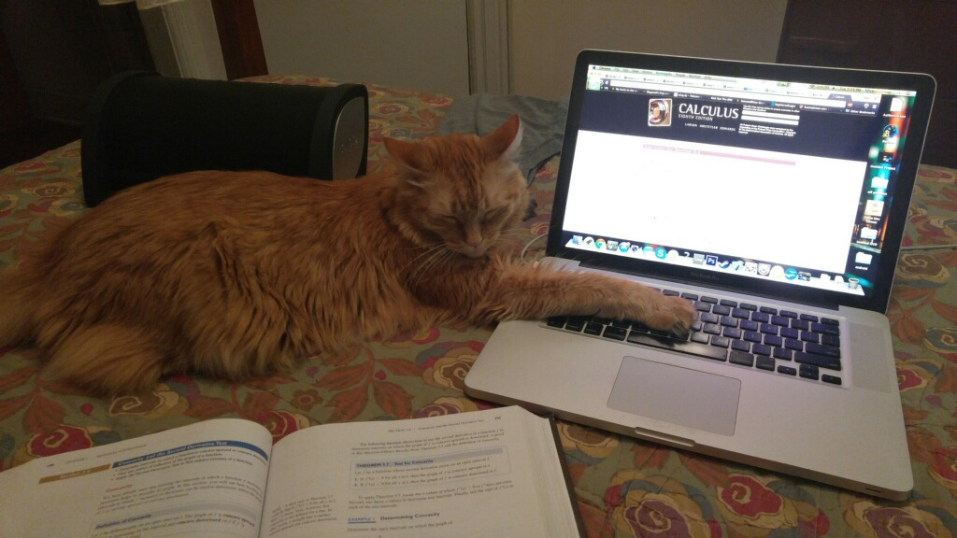
Tips: Do your homework

Slide 23
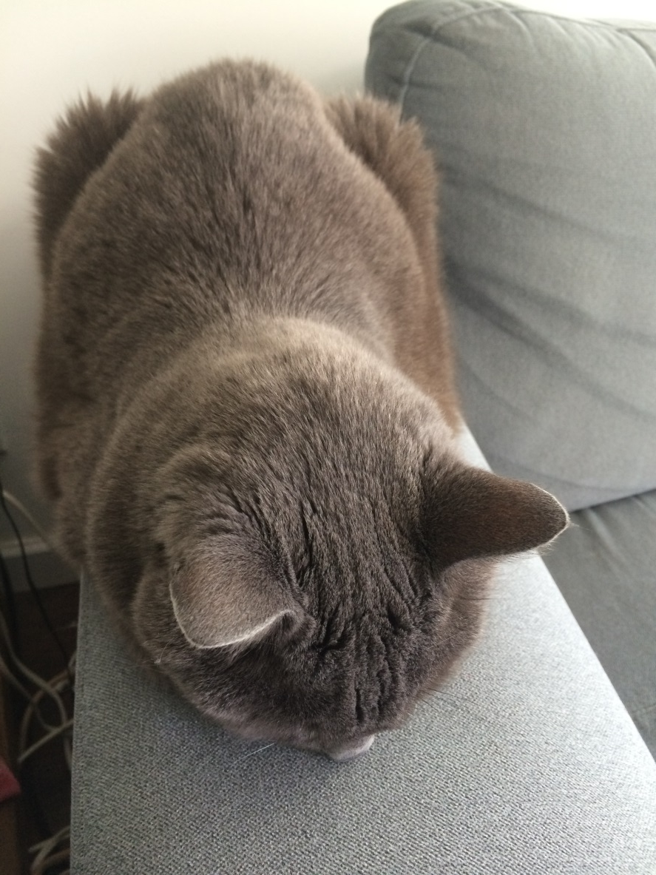
Tips: Examine your work closely

Slide 24
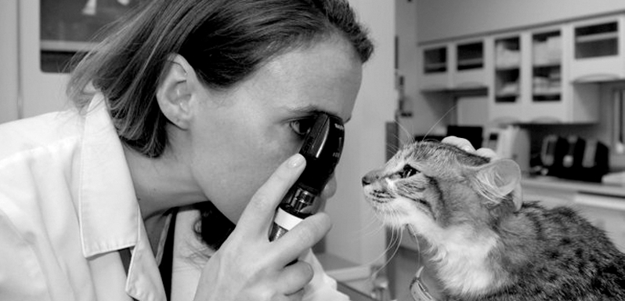
Tips: Talk to experts

Slide 25
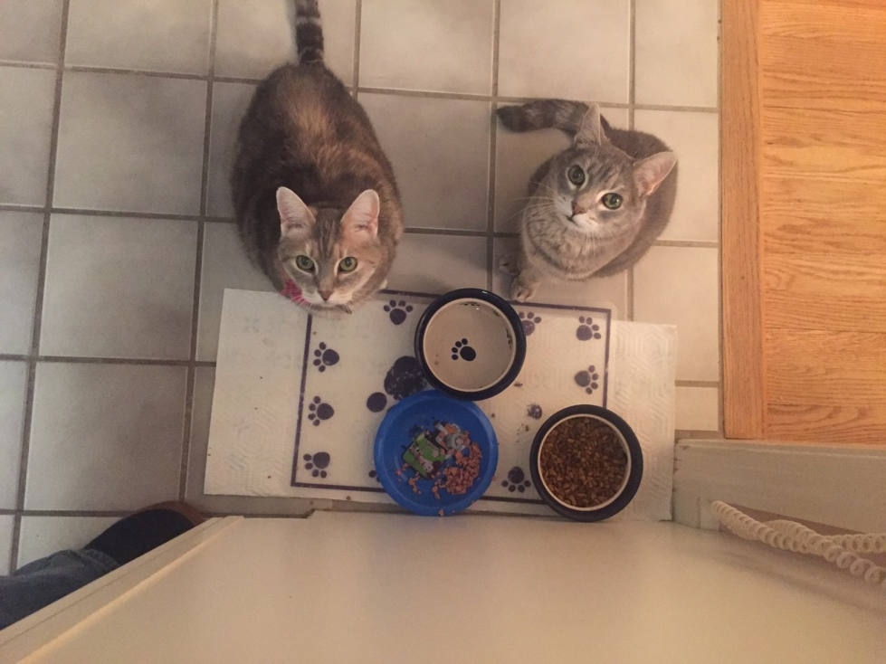
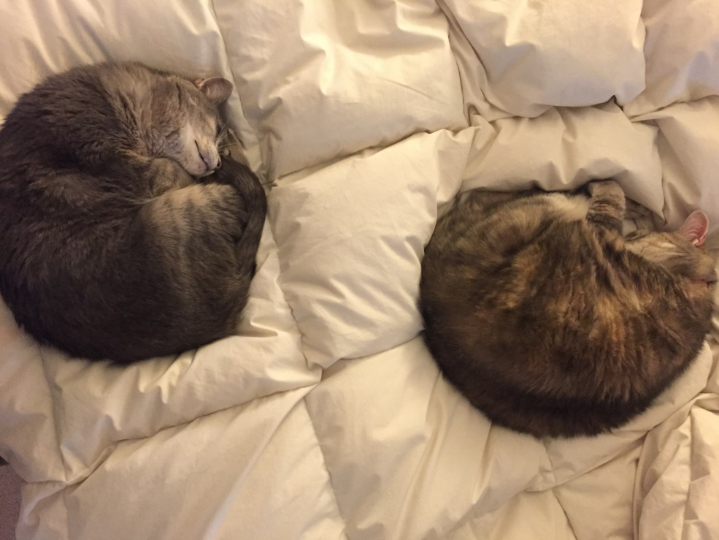
Tips: Get plenty of food and rest

Slide 26
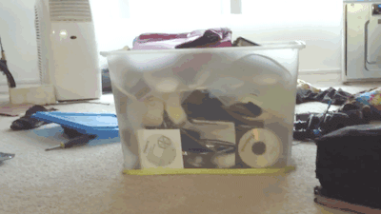
Tips: Repeat your work

Slide 27
But remember: You can do it

Slide 28
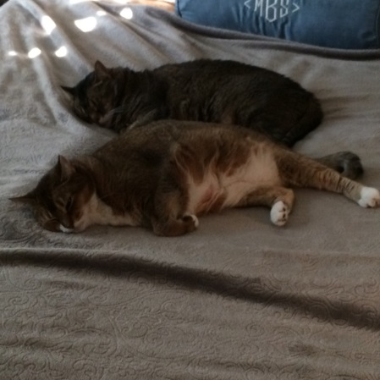
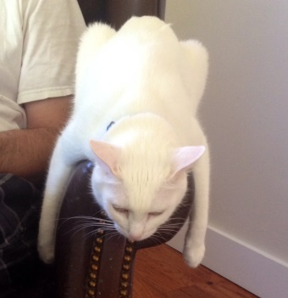
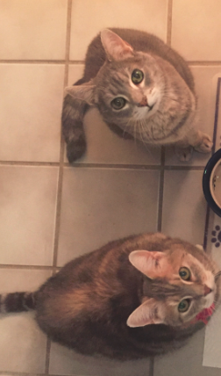
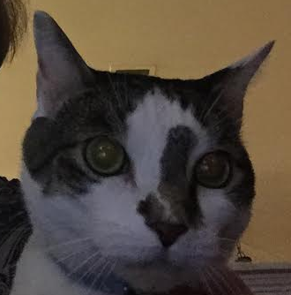
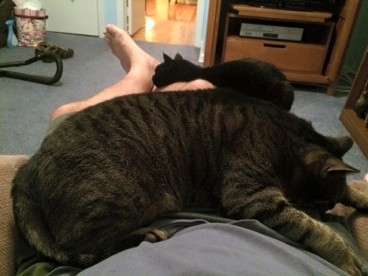
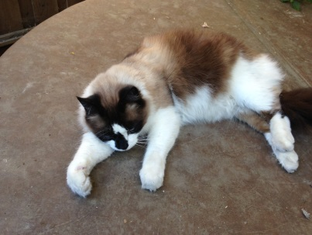
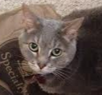
Meow!
Stanley
Basie
Gordon
Roux & Jazzy
Harley
Boris
Simon & Simone
Ben
Luna
Mocha
Tia & Belle
Elsah
Tuna & Pearl

