Slide 1
50 Ideas in 50 minutes
NICAR 2011
Jo Craven McGinty, The New York Times
Jennifer LaFleur, ProPublica
10:18 PM

Slide 2
This is in no way a comprehensive list.
The presenters you are about to see chose examples to give you a variety of media outlets, outlet size and subject matter.

Slide 3
Meyer winner
Source: Dept. of Ed data and surveys of campus crisis clinics
Findings: Many campuses had lax enforcement and reporting loop holes mean problems go unchecked.

Slide 4
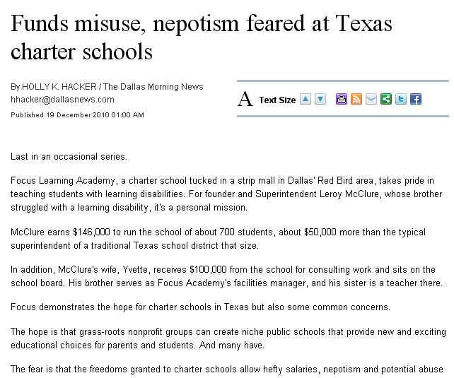
Source: Salary data and other charter school records
Findings: Reporters Found nepotism in charter schools and administrators earning six-figure salaries to run schools with only a few hundred or a couple of thousand students

Slide 5
Source: Voting and teacher data
Findings: “…they gave this promise to school board members: Support us or we'll remember you on election day.
But election day came, and the vast majority of teachers didn't show up.”

Slide 6
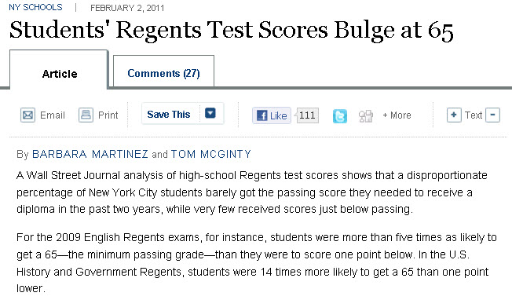
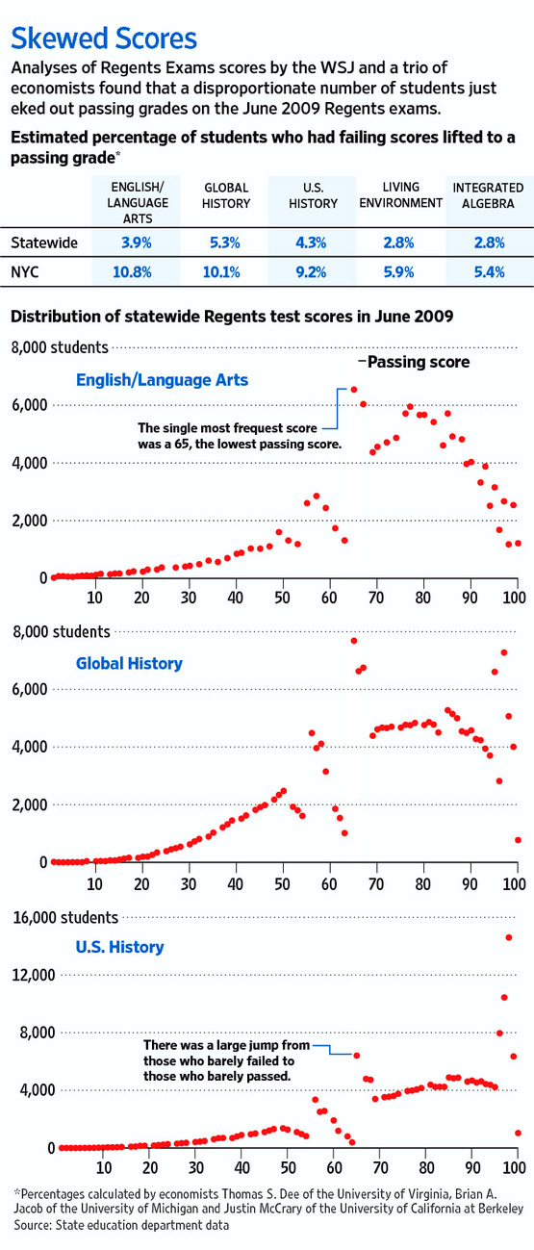
Source: Individual student test scores for Regents Exams
Findings: Graders were “scrubbing” tests to push failing students into the passing range

Slide 7
Source: School district credit card purchases
Findings: District card holders made questionable purchases with their cards.
10:18 PM

Slide 8
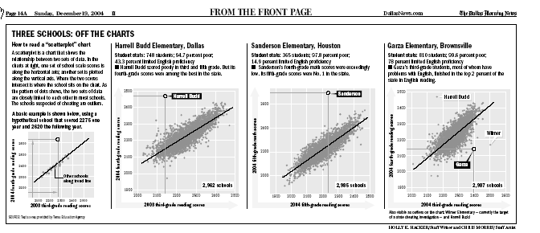
Source: Texas standardized test score data
Findings: Some schools showed improvement in scores that were much higher than normal

Slide 9
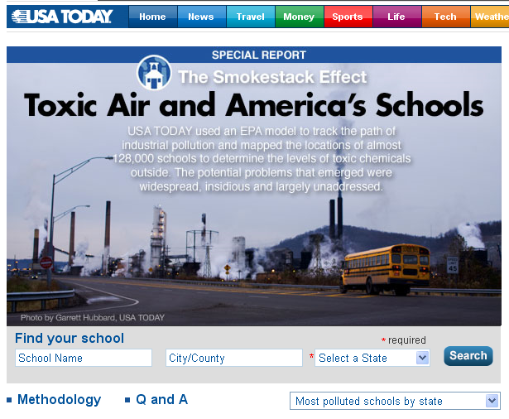
Meyer winner
Source: EPA data and national education data
Findings: “The goal: To determine what sort of toxic chemicals children breathe when they go to school. ”

Slide 10
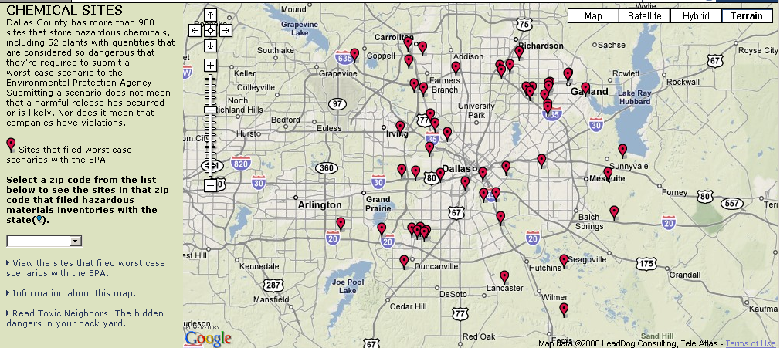
Source: EPA and state data on hazardous chemical locations
Findings: Dallas County has 900+ sites that store hazardous chemicals

Slide 11
Meyer winner
Source: Four decades of census data
Findings: “Over the past four decades, the state has come to depend on immigrant brains and brawn to an extent unmatched by any other state and almost any developed country.”

Slide 12
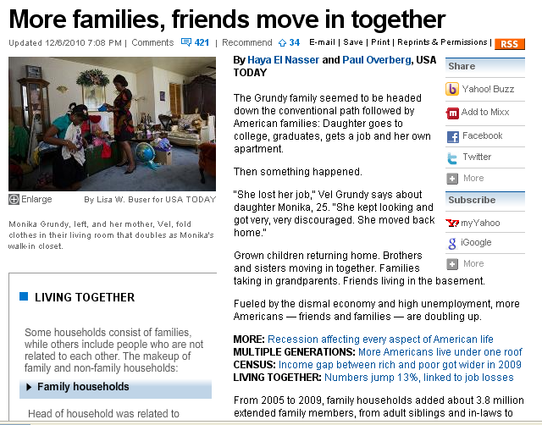
Source: Census
Findings: “Fueled by the dismal economy and high unemployment, more Americans…are doubling up”
10:18 PM

Slide 13
Source: In-house survey for Best Places led to this
Findings: Safe neighborhoods, quality public schools, living close to downtown and having a variety of municipal recreation facilities are more important to residents than low taxes

Slide 14
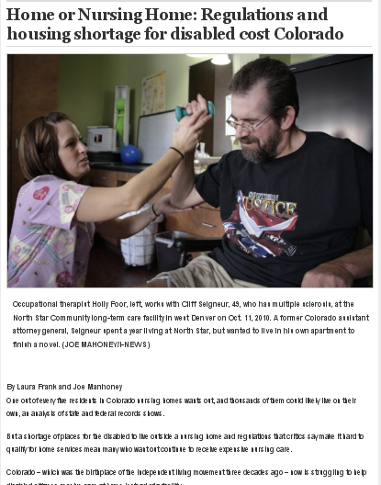
Source: Medicaid nursing home survey data and finance data, housing data
Findings: “…a shortage of places for the disabled to live outside a nursing home and regulations that critics say make it hard to qualify for home services mean many who want out continue to receive expensive nursing care.”

Slide 15
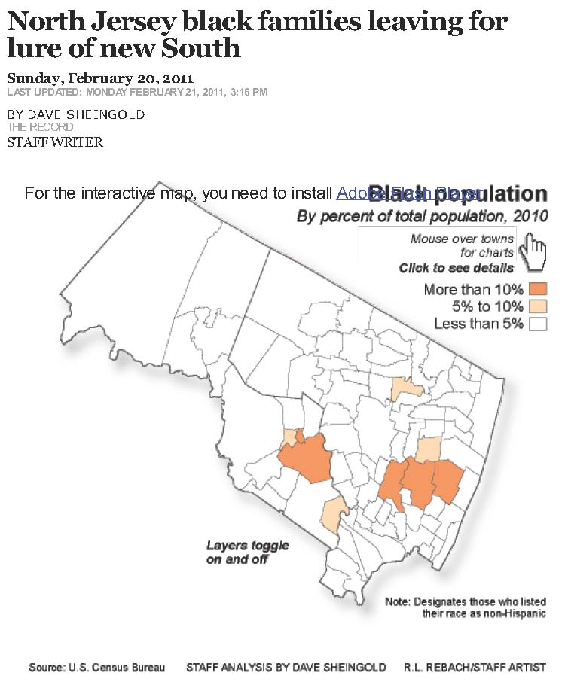
Source: Census Data
Findings: African-Americans are leaving black enclaves in the Northeast to move South to places that generations before them had fled.

Slide 16
Source: 18 custom-created categories
Findings: Tired of lists telling us which places rank as the best, based on someone else’s criteria, Rich Exner of the P-D came up with individualized rankings: Readers could go online to pick what's important to them among 18 categories he created to get a customized ranking from 1 to 100.

Slide 17
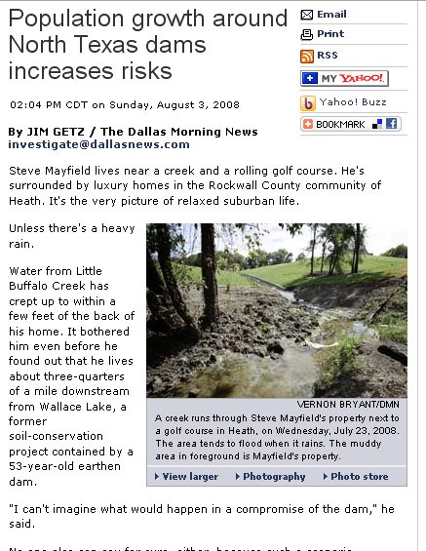
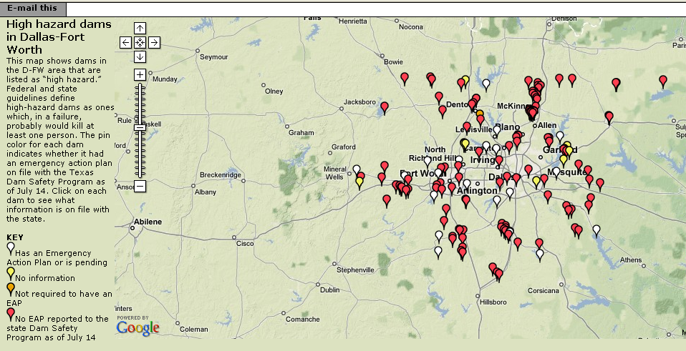
Source: Dam inspection data from Texas and federal government
Findings: Dam records had not been updated to account for population growth
10:18 PM

Slide 18
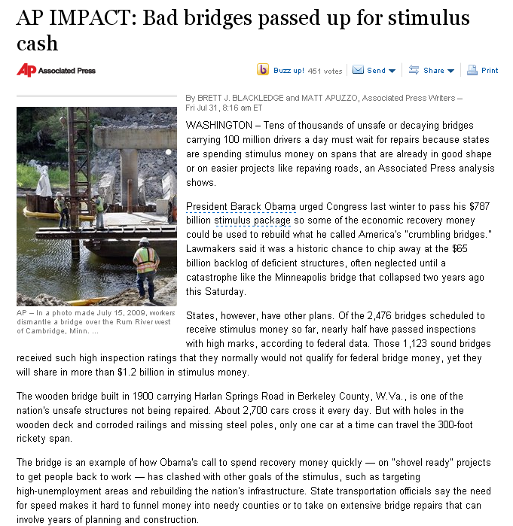
Source: Federal stimulus spending data and bridge inspection data
Findings: Stimulus money was going to fix bridges that were already in good shape and leaving out many that needed repair.

Slide 20
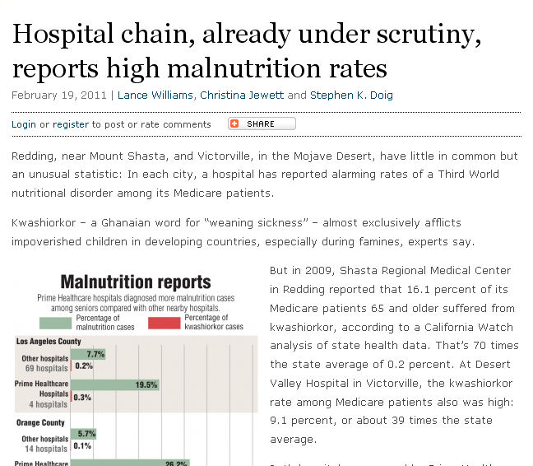
Source: California Health Dept. data, Medicare billing data
Findings: Some hospitals had “alarming rates of a Third World nutritional disorder among its Medicare patients.”

Slide 21
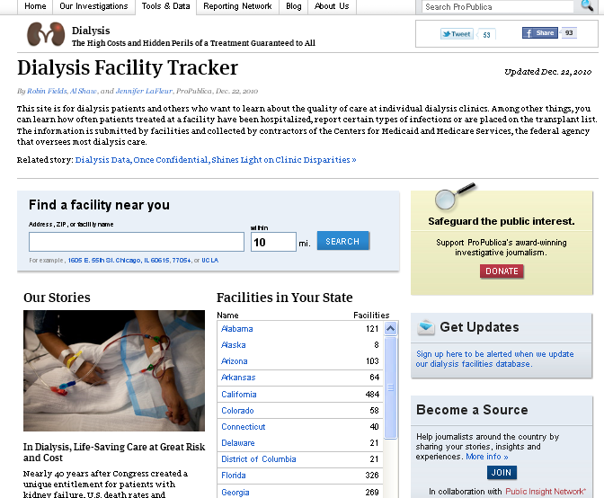
Source: Medicaid outcomes data for dialysis facilities
Findings: A CMS online tool did not tell the whole story about facilities. In some counties the gap in measures, such as survival rate were vast.

Slide 22
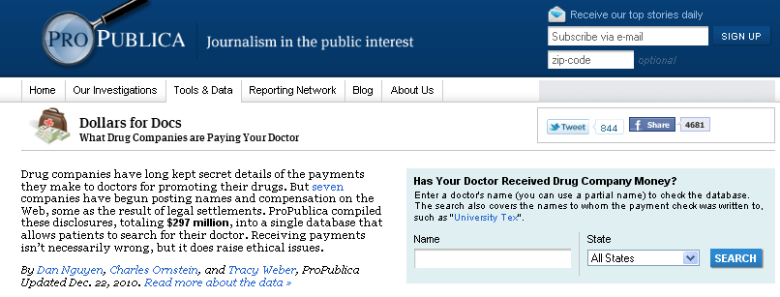
Source: Physician payment data scraped from pharmaceutical company Web sites
Findings: The data lead to several stories including how some paid doctors had blemished records and universities were not enforcing policies about physician payments

Slide 23
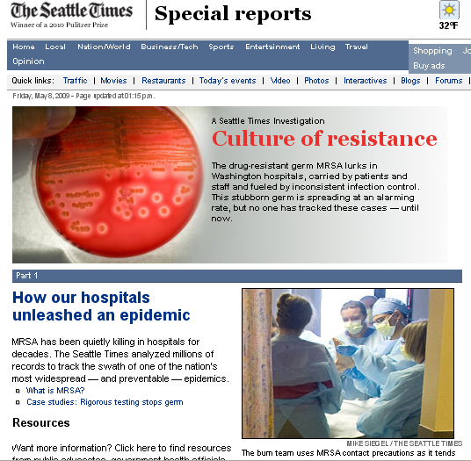
Meyer winner
Source: Washington Health Department data
Findings: “MRSA has been quietly killing in hospitals for decades.” But no one had tracked it until this story.

Slide 24
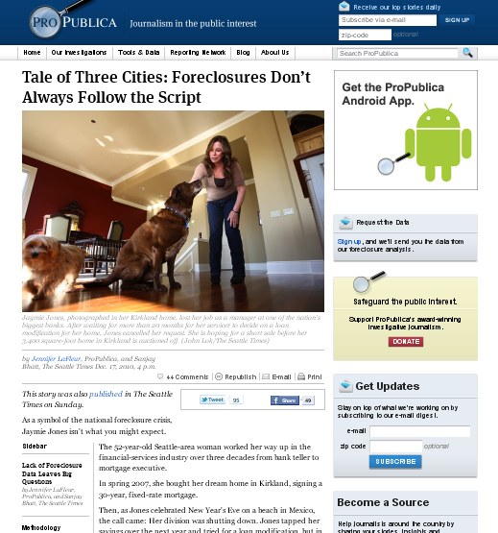
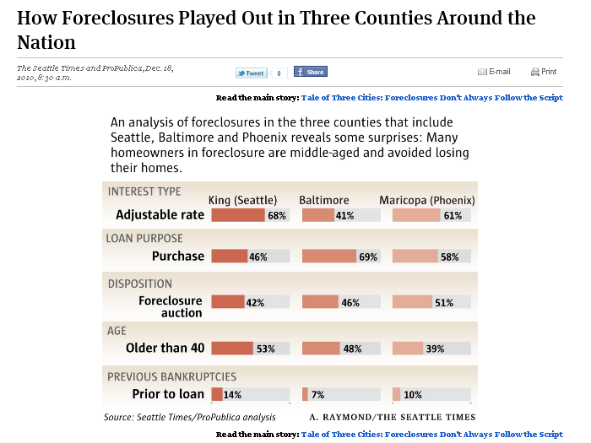
Source: Loan details, foreclosure information and bankruptcy filings
Findings: Loans leading to foreclosure didn’t always follow conventional wisdom

Slide 25
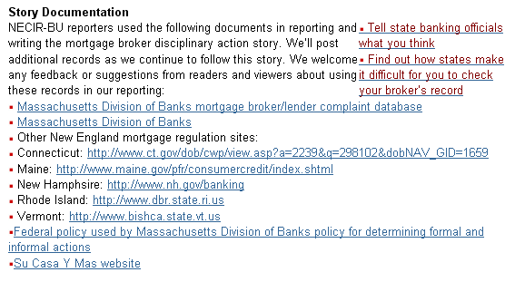

Slide 26
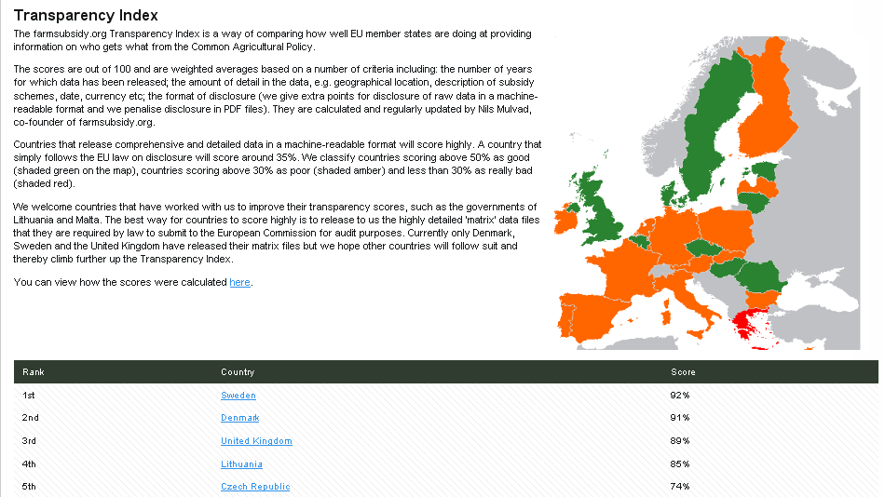

Slide 27
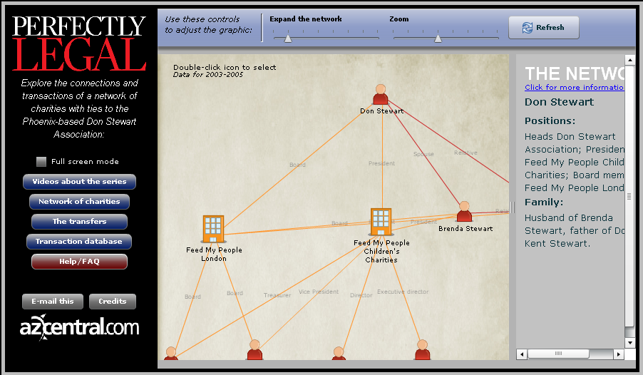
Source: Databases built from documents showing information about charities

Slide 28
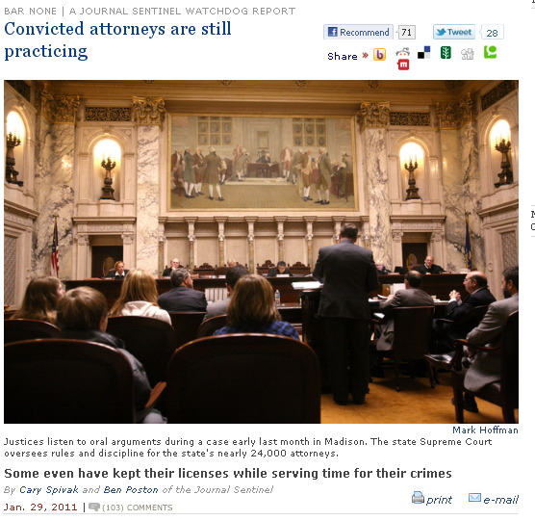
Source: Analysis of nearly 24,000 Wisconsin lawyers against state and federal court records
Findings: “…lawyers who are convicted of crimes are then subjected to a slow-moving disciplinary system that operates largely behind closed doors.”
10:18 PM

Slide 29
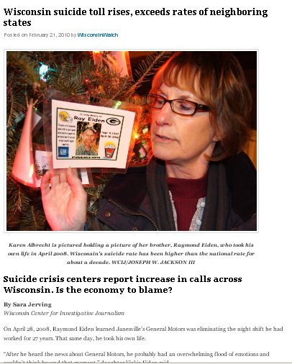
Source: Wisconsin State Department of Health Data
Findings: The state’s suicide rate continues to rise, exceeds those of neighboring states and has remained higher than the national rate for about a decade.

Slide 30
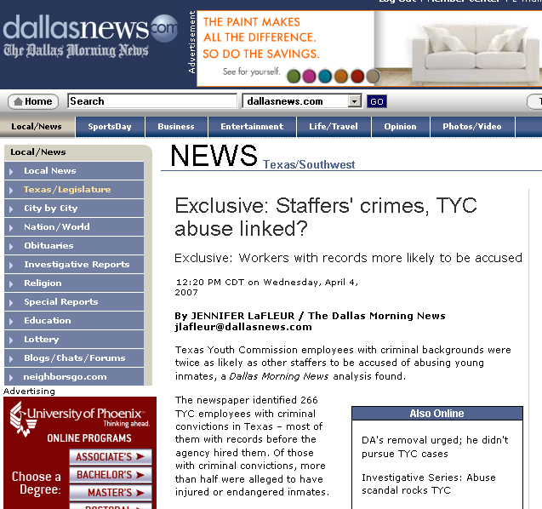
Source: Youth prison workers, criminal convictions and grievance data
Findings: Employees with criminal backgrounds were more likely to be accused of abusing inmates.
10:18 PM

Slide 31
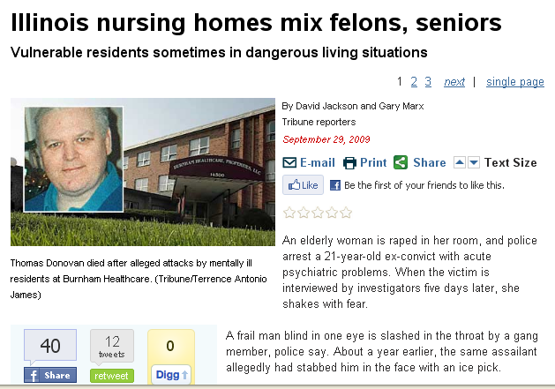
Meyer winner
Source: Illinois health data, police data
Findings: Dangerous systemic failed to protect elderly patients in Illinois nursing homes that also house mentally ill younger residents, including murderers, sex offenders, and armed robbers.

Slide 32
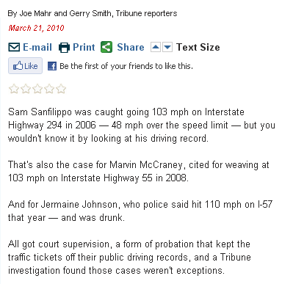
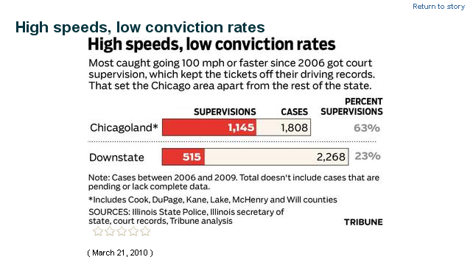
Source: State police data, court records
Findings: Special rules allow speeders to keep tickets off their records

Slide 33
Source: ICE referrals
Findings: Somerville police referred nine individuals to federal immigration officials between January 2009 and April 2010 for offenses ranging from prostitution to narcotics trafficking to possession of stolen property.

Slide 34
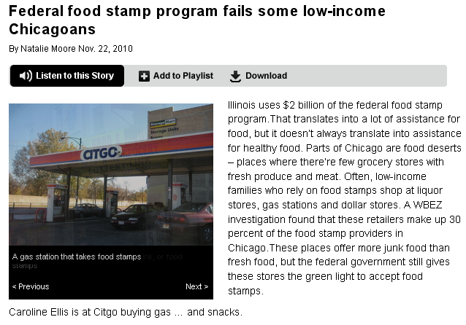
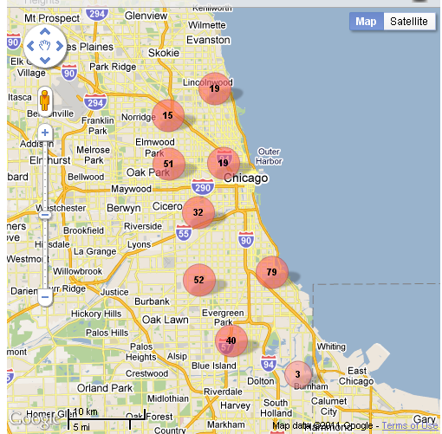
Source: Food stamp sales
Findings: Areas where people using food stamps have little or no access to full-service grocery stores…Liquor stores, gas stations and dollar stores make up 30 percent of food-stamp sales in Chicago

Slide 35
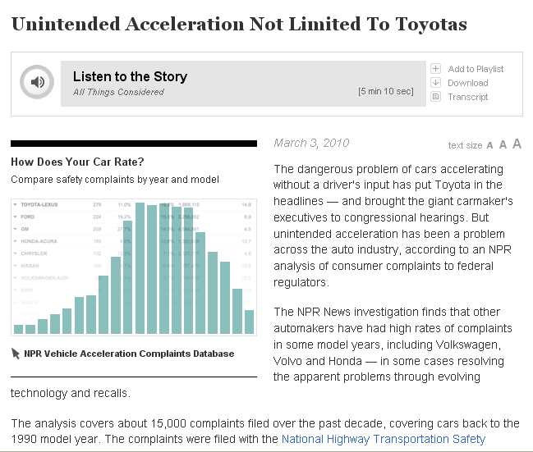
Source: NHTSA complaint dataa
Findings: “…unintended acceleration has been a problem across the auto industry.”

Slide 36
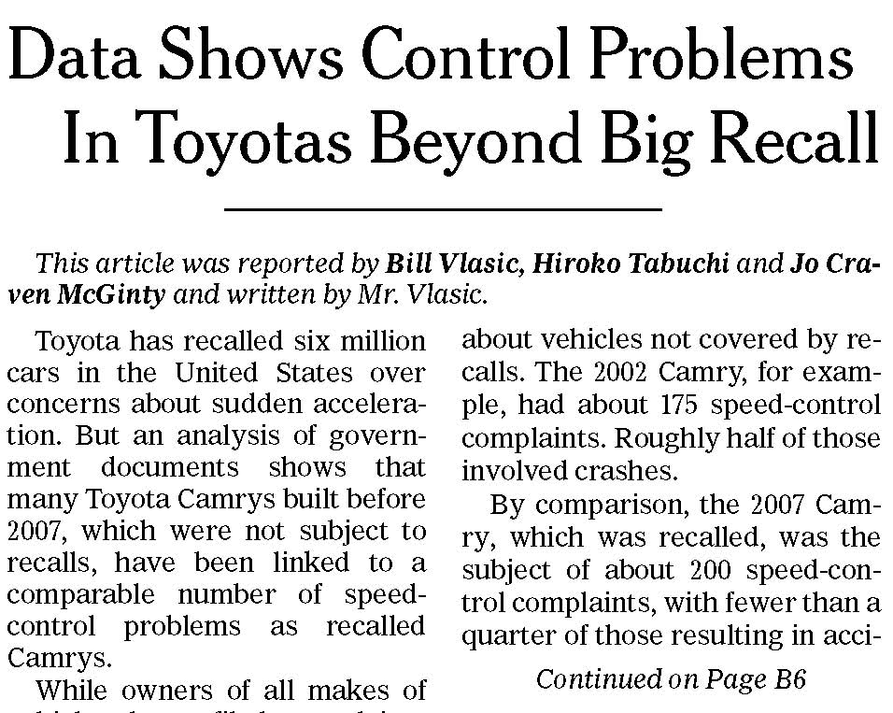
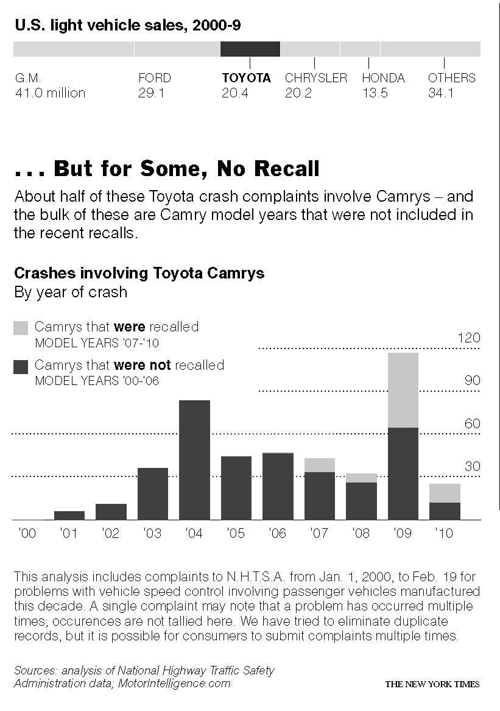
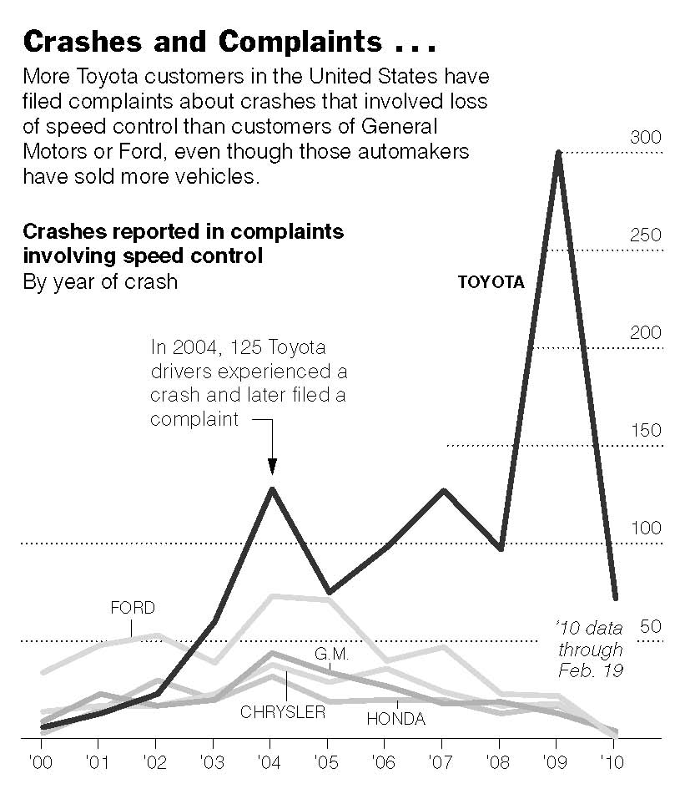
Source: NHTSA consumer complaints
Findings: Model years that were not recalled also had complaints

Slide 37
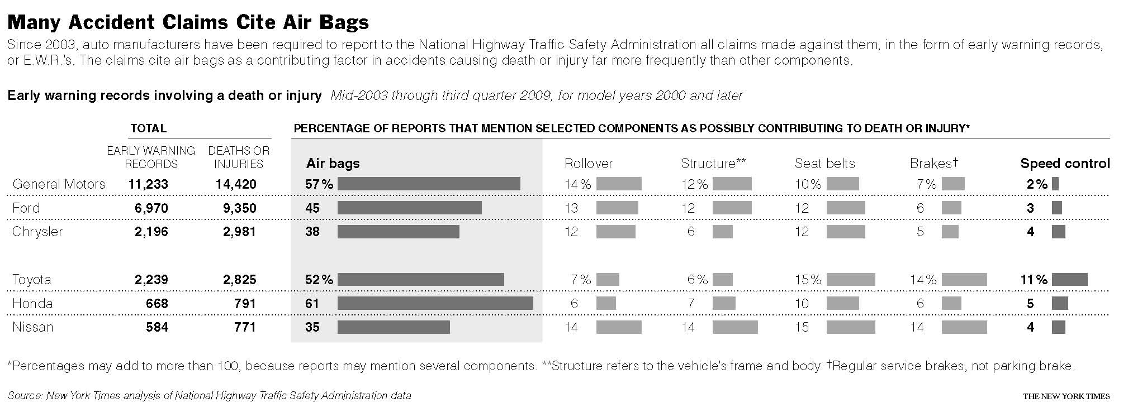
Source: NHTSA Early Warning Reports
Findings: Most claims involve air bags – not speed control

Slide 38
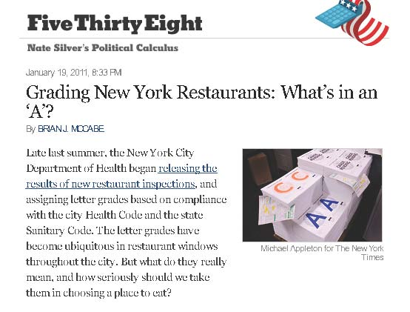
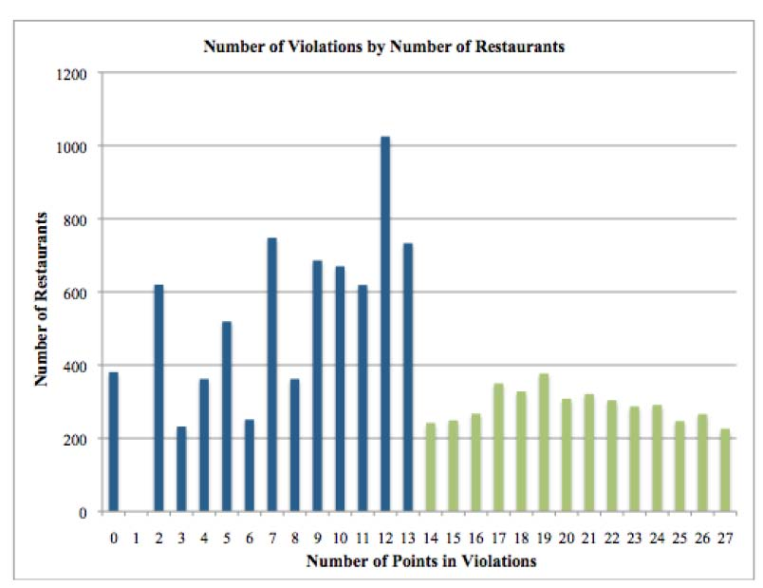
Source: Health Department points deducted during restaurant inspections
Findings: Four times as many restaurants scored 11, 12 or 13 than scored 14, 15, or 16. Chances are the difference between and “A” and a “B” rating are slight.
10:18 PM

Slide 39
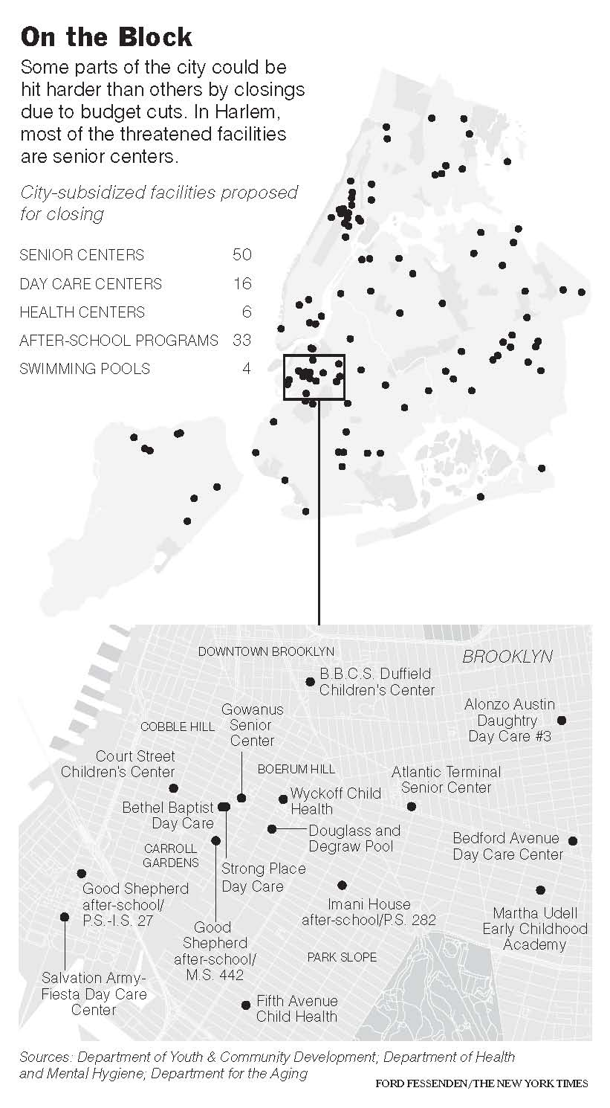
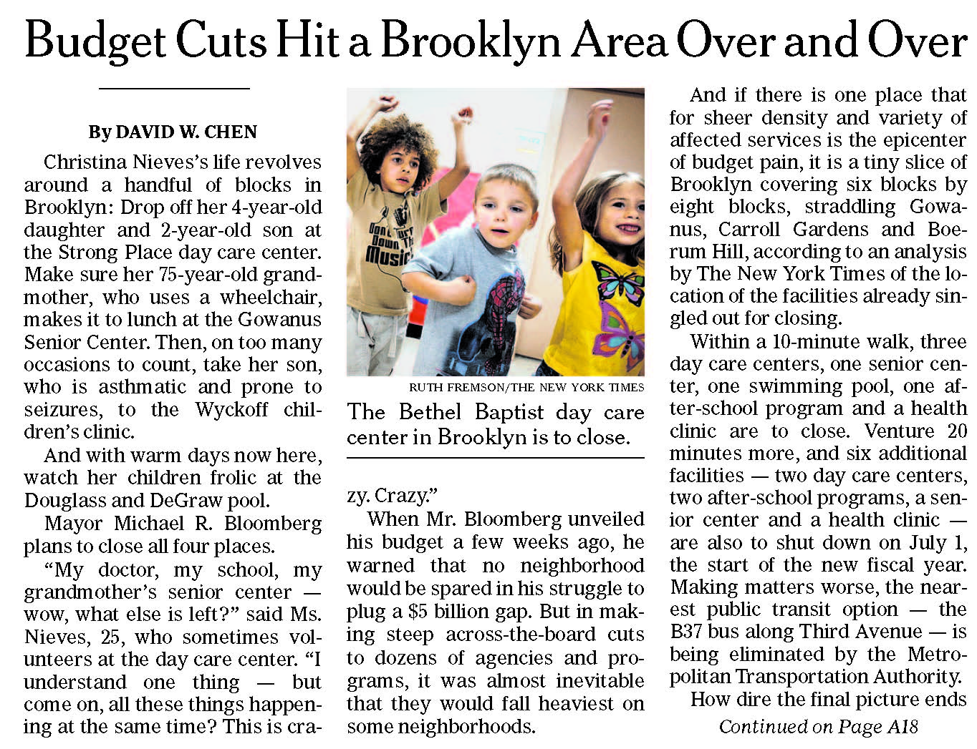
Source: City Budget
Findings: Some neighborhoods suffer more than others as mayor cuts budgets

Slide 40
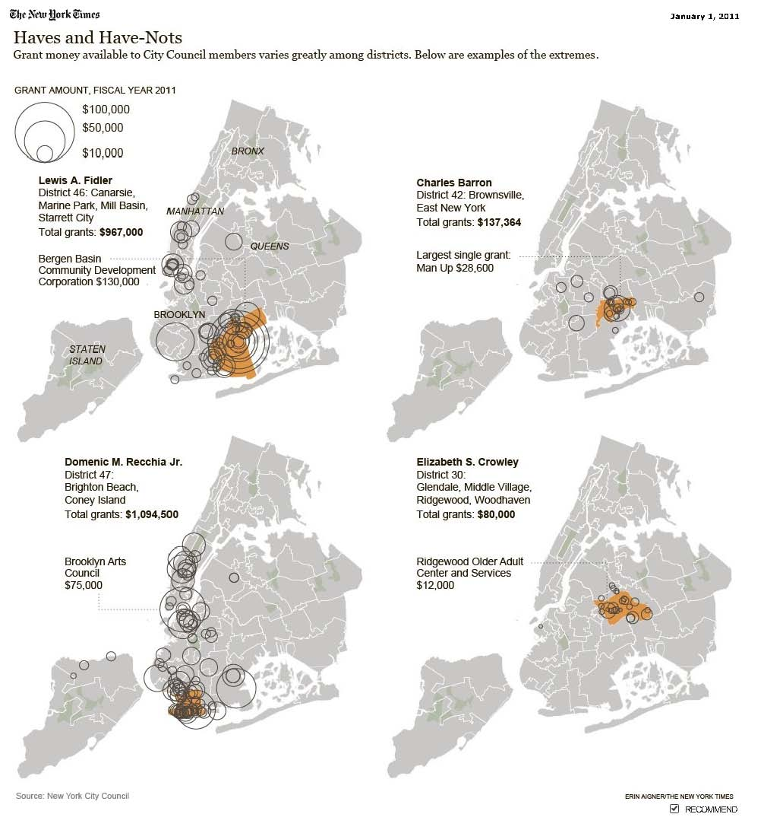
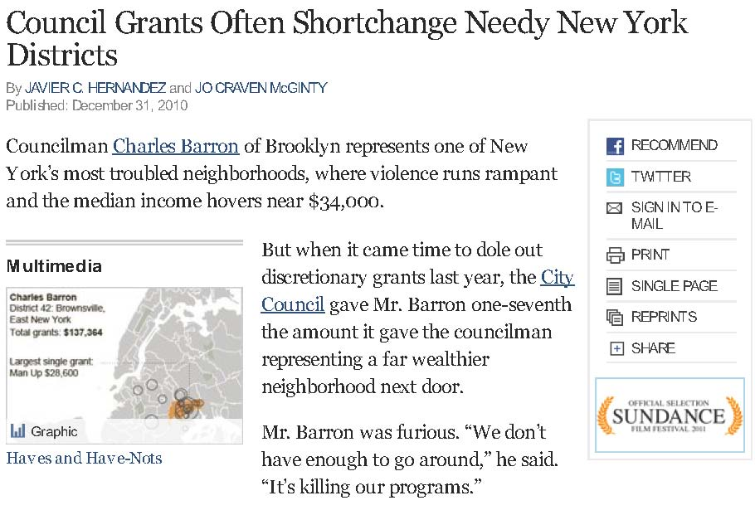
Source: City Council discretionary spending (earmarks)
Findings: Allies of the speaker seem to get more money to spend in their districts

Slide 41
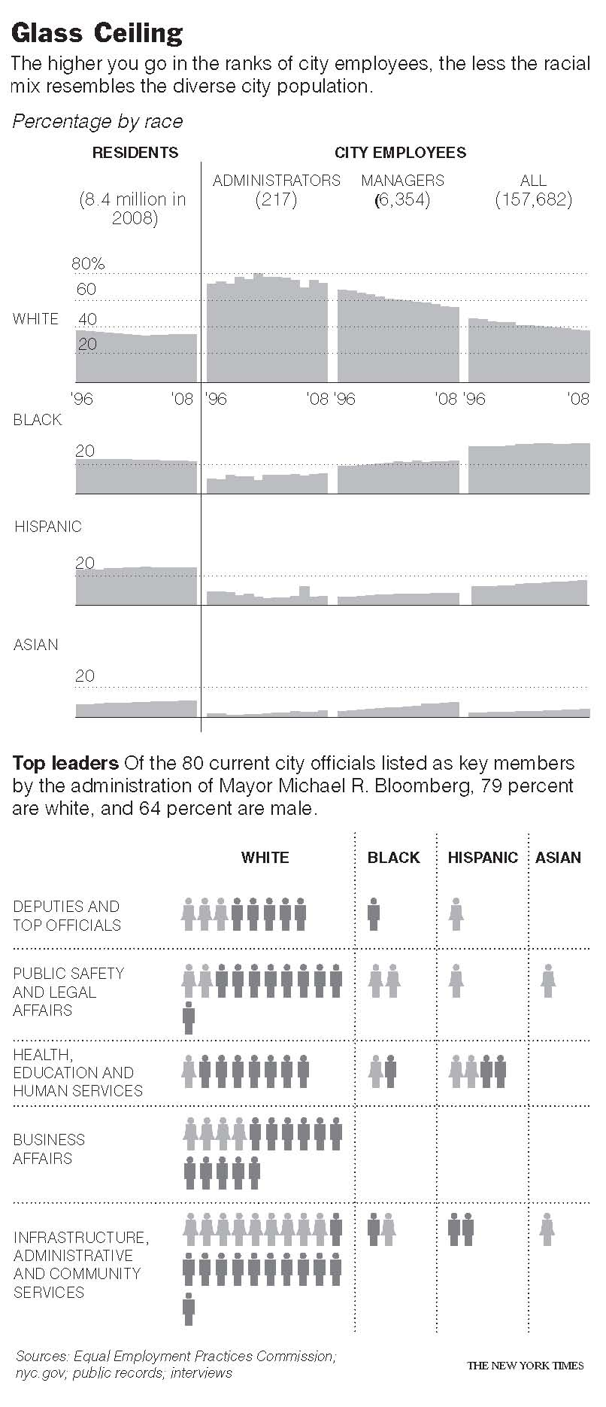
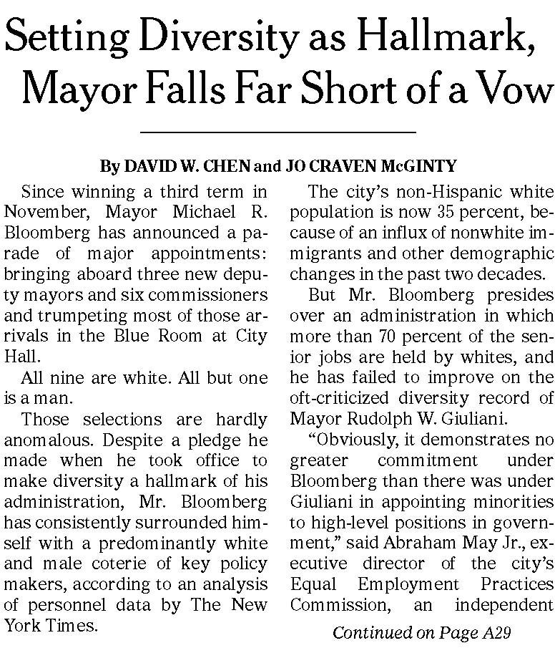
Source: EEOC reports, hand-built data
Findings: City workers overall and top officials in particular are less diverse than the city

Slide 42
Source: Federal jobs data
Findings: When Tories took power, the percentage of females began to drop.

Slide 43
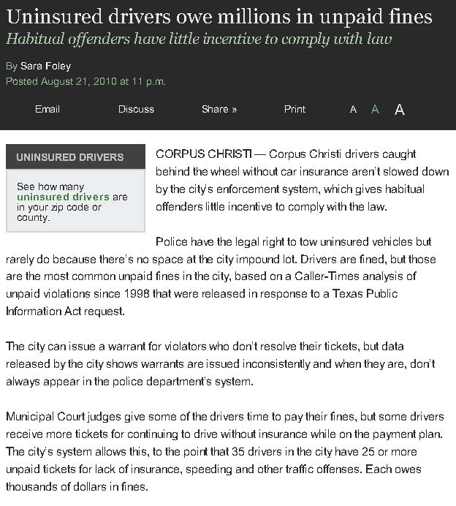
Source: Outstanding municipal court fines
Findings: The impound lot is full, so police seldom tow uninsured drivers – who, as a result, often don’t pay their fines.

Slide 44
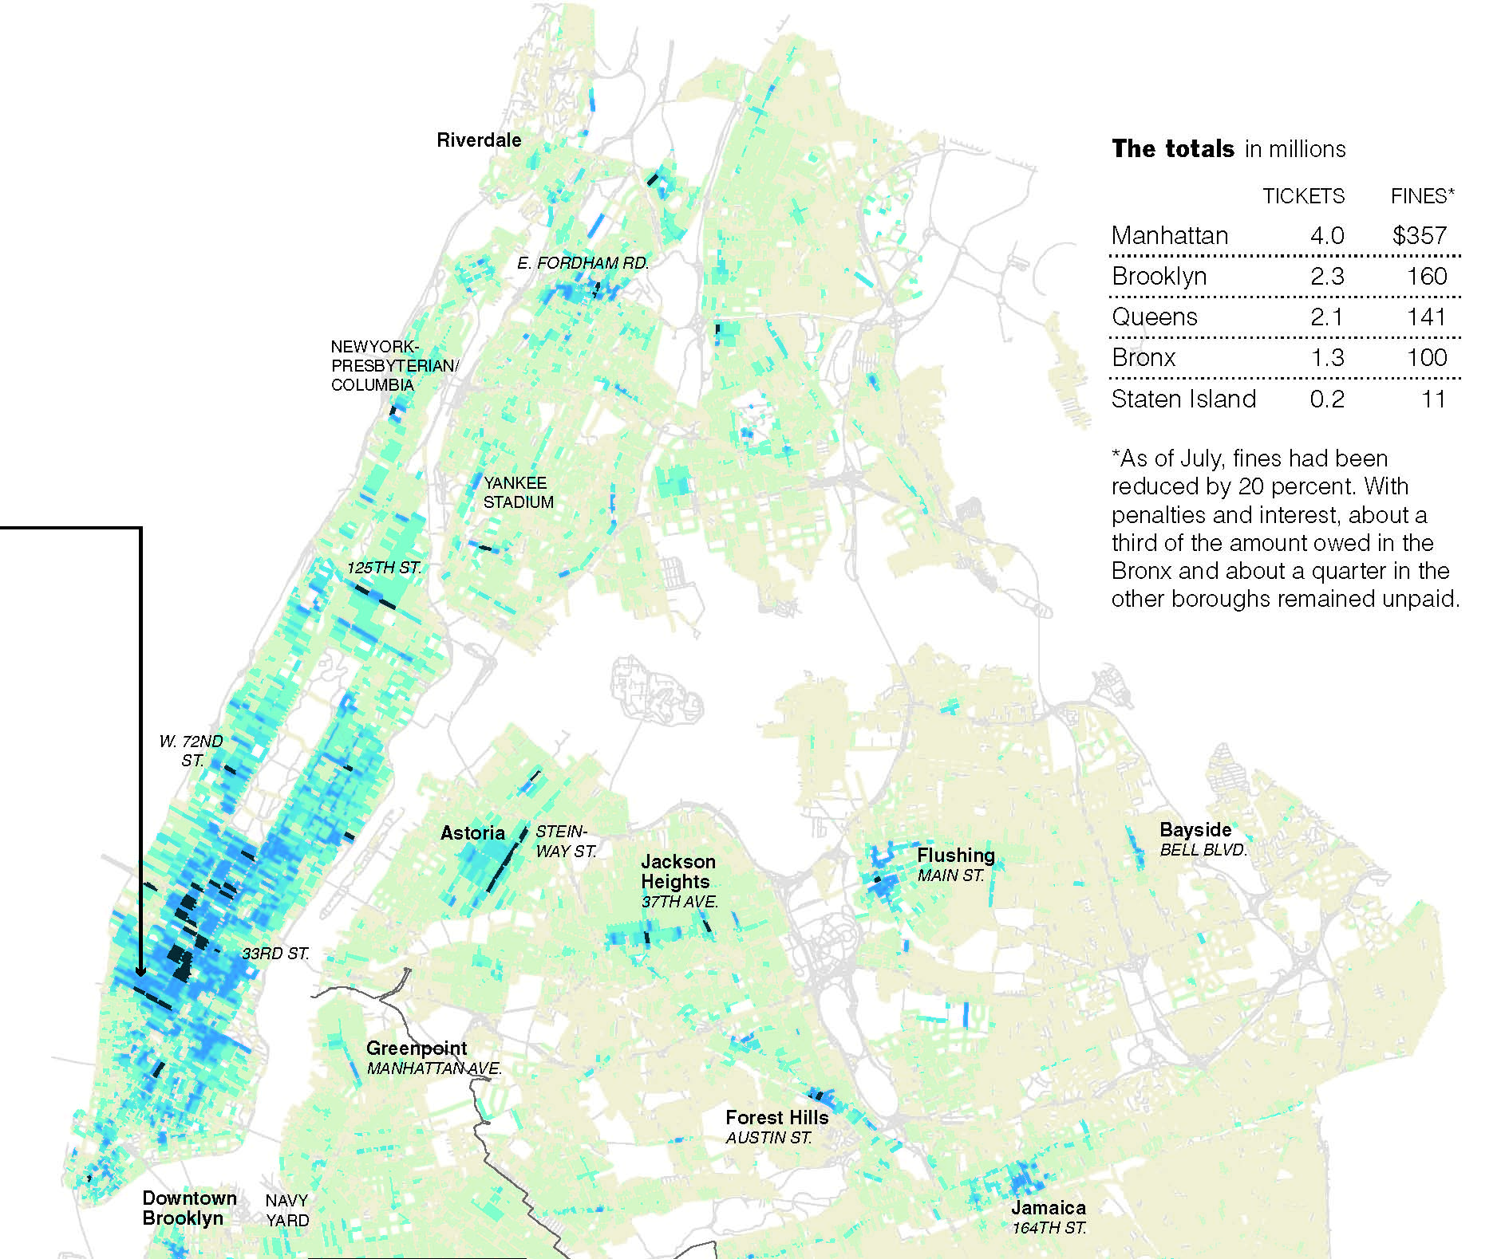
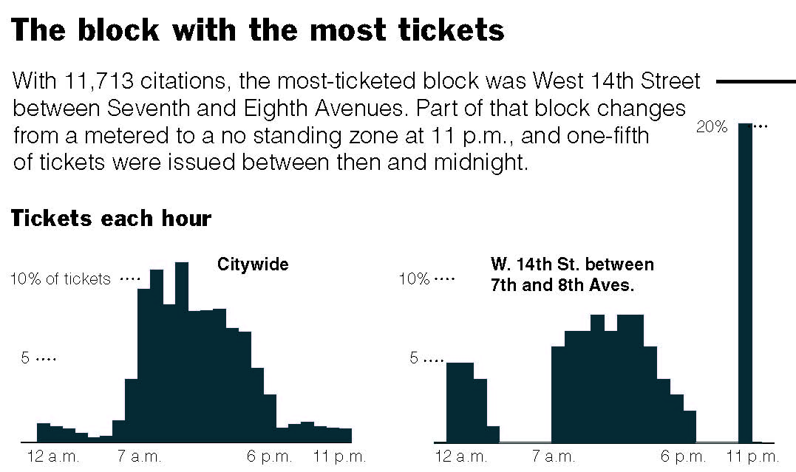
Source: Parking tickets
Findings: Ticket “dumping,” “disco” towing, day with most tickets, block with most tickets

Slide 45
Source: Municipal citiations
Findings: People love to gripe about how no one in Corpus Christi maintains their property. Among other things, the story dispelled the myth that code enforcement was a problem only in certain areas.

Slide 46
Source: Kent State journalism students collected the number of full scholarships (tuition, room and board) given to athletes and the number of full scholarships given to academic students.
Findings: Kent State’s largest college is Arts and Sciences. None of those students received a full scholarship. Meanwhile, 207 athletes received a full ride.

Slide 47
Source: Kent State journalism students surveyed NFL teams
to ask how much money they donate to colleges.
Findings: NFL rosters are filled with players trained at America's colleges and universities at no cost to the NFL. But franchises that answered the question – most refused – said they do not donate to colleges.

Slide 48
Source: Kent State journalism students asked members of the Ohio Congressional what programs they thought should be cut.
Findings: 13 of 20 of the Ohio Congressional Delegation refused to answer.
10:18 PM

Slide 49
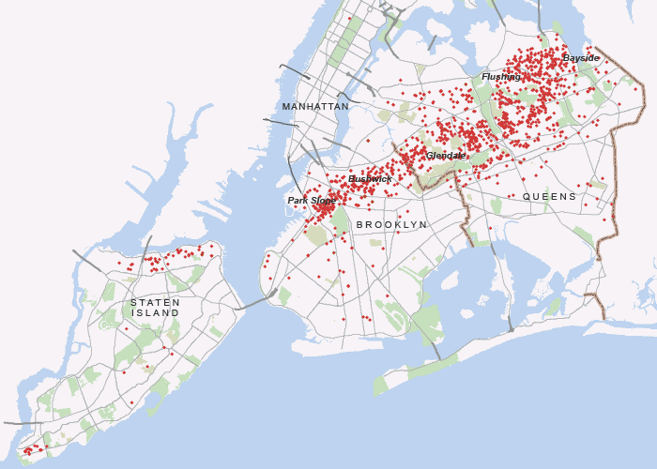
Source: 311 calls for downed trees
Findings: After a tornado swept across New York City, 311 calls for downed trees helps trace its path

Slide 50
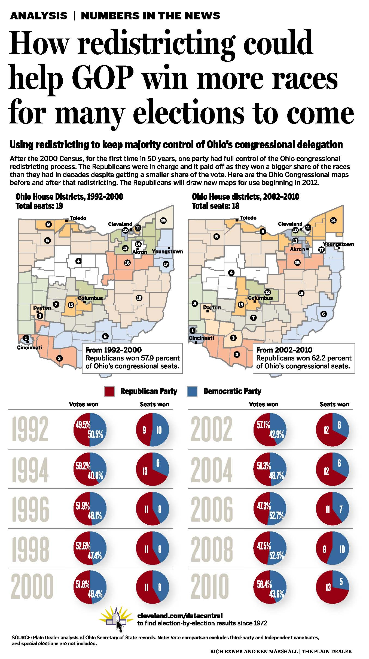
Source: 40 years of election results
Findings: When Republicans had full control, this is how new redistricting lines were drawn in.

Slide 51
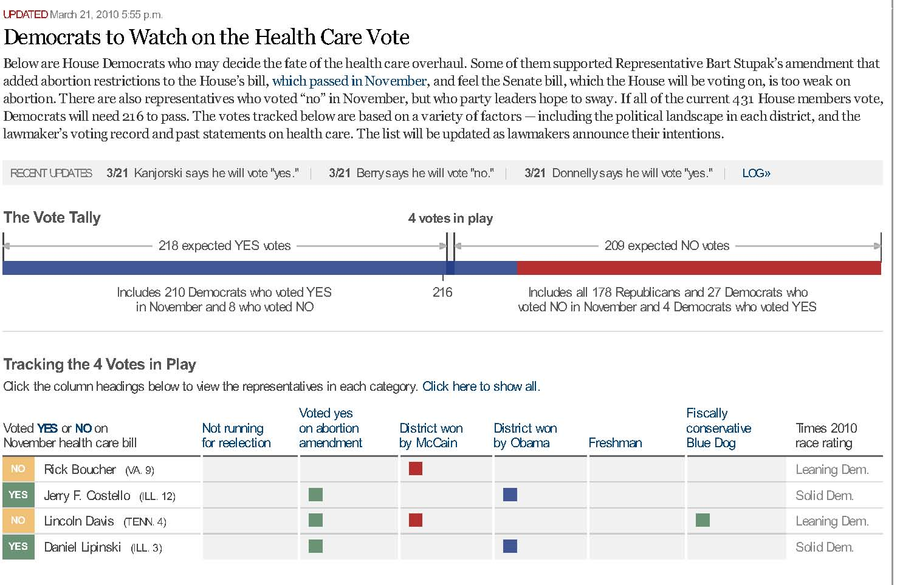
Source: Lawmakers’ voting records and past statements
Findings: These House Democrats could have decided the fate of the health care overhaul.

Slide 52
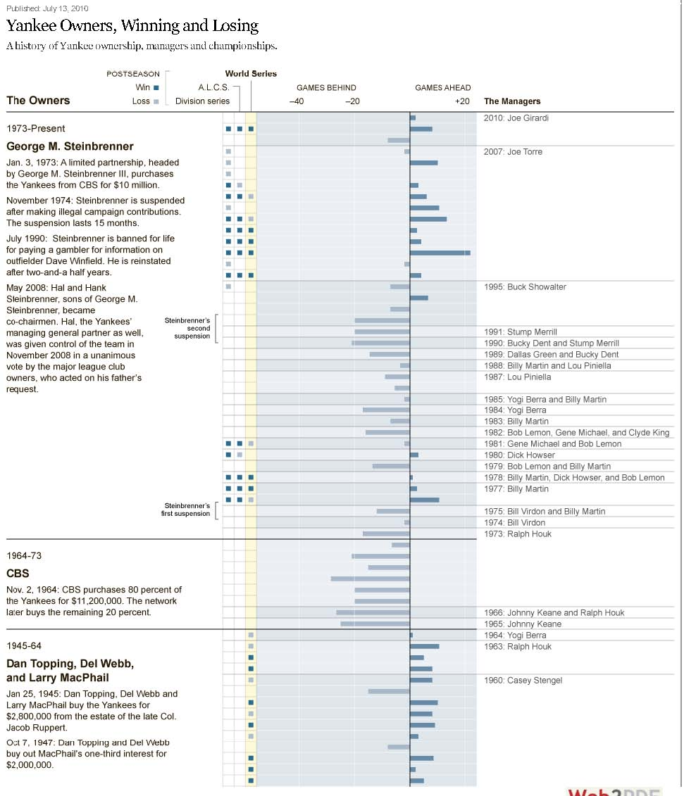
Source: baseball-reference.com
Findings: (speaks for itself)

Slide 53
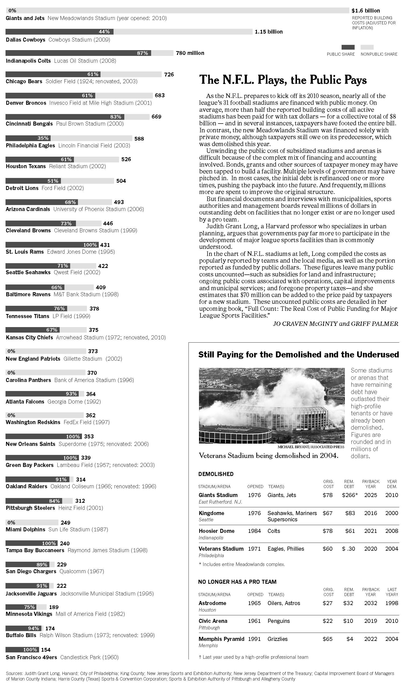
Source: Data constructed from paper records plus research by Harvard Professor Judith Grant Long
Findings: Millions of dollars in outstanding public debt remains on pro sports facilities that no longer exist or are no longer used by a pro team.

Slide 56
Databases to have in your newsroom – and to keep getting
Public payroll data --- over time, you’ll have former employees
Crime incident data
City/county check registers
Complaints from lots of sources: state AG, 311, etc…
Voter registration
Contracts and vendors
State and local campaign contributions
State and local lobbyists
10:18 PM

Slide 57
Okay, so maybe we went over our 50 count, but there were too many good stories to keep it to 50.
For more examples, go to www.ire.org/extraextra
Get a copy of this presentation at www.jenster.com/nicar2011
10:18 PM

